Slide 1
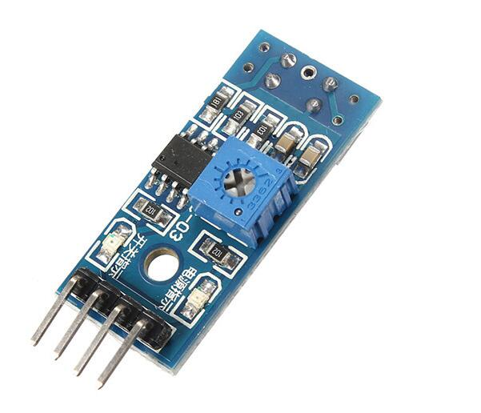
IR Tracking Sensor Module
The main idea behind it
An IR led shines on a reflective/absorbing surface. A photoresistor then changes its resistance depending on the received IR radiation and the resulting voltage is then compared by an LM393 dual comparator chip.
Interface A standard IR Tracking Sensor has a 3 Pin interface. VCC and GND for power suppling and a SIG pin for checking if the reflectance is beyond the threshold.
Our IR Tracking Sensor Module has also a fourth pin that allows the user to read the actual voltage signal of the sensor. However, we do not use that pin in our project.

Slide 2
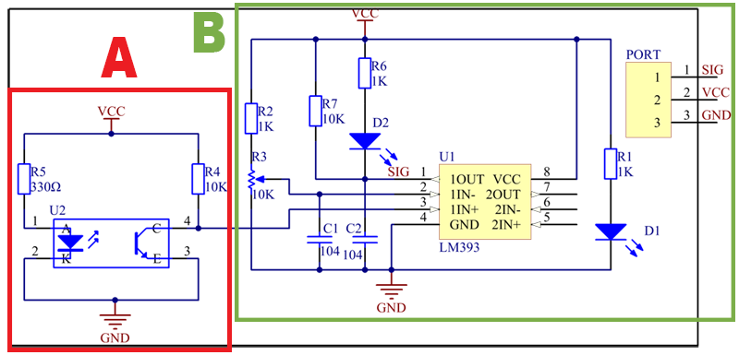
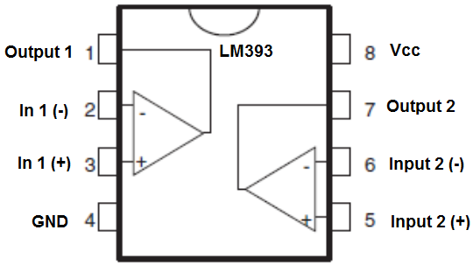
The Schematics:
IR Tracking Sensor Module
Block A contains the U2 module that has the IR led and the Photoresistor.
Block B contains a simple comparing circuit with two status led (D1 and D2) and one potentiometer R3 for manual regulating the threshold of the entire sensor.
D1 indicates whether the sensor is powered up or not. D2 indicates if the signal is positive (SIG=VCC).
LM393 is constituted by 2 standard low offset voltage comparators (only one is used) that returns VCC as +VCC and GND as -VCC, working indeed as a sort of Boolean operator. Capacitors C1 and C2 are placed in order to maintain SIG and 1IN- stable in case of power supplying problems.

Slide 3
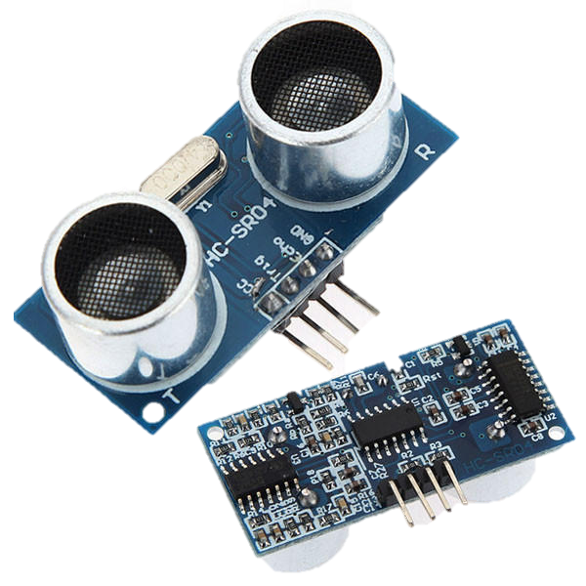
HC-SR04 Echo Locator
Main idea behind it
The sensor emits ultrasonic soundwaves to determine the distance of an object from 2cm to 400cm with a resolution of 0.3cm and a measuring angle of 30 degrees.
Main notes on interface and functionality
The sensor has an interface of 4 pins (VCC, Trig, Echo, GND). Whenever the Trig pin is set on HIGH, the transmitter (left piezo) sends the high-frequency soundwave. Whenever the receiver (right piezo) detects the echo of the soundwave, the Echo pin sets on HIGH.
You can send and read signals to the sensor manually setting up triggers and delays of 5-10μs with a standard Arduino Board.

Slide 4
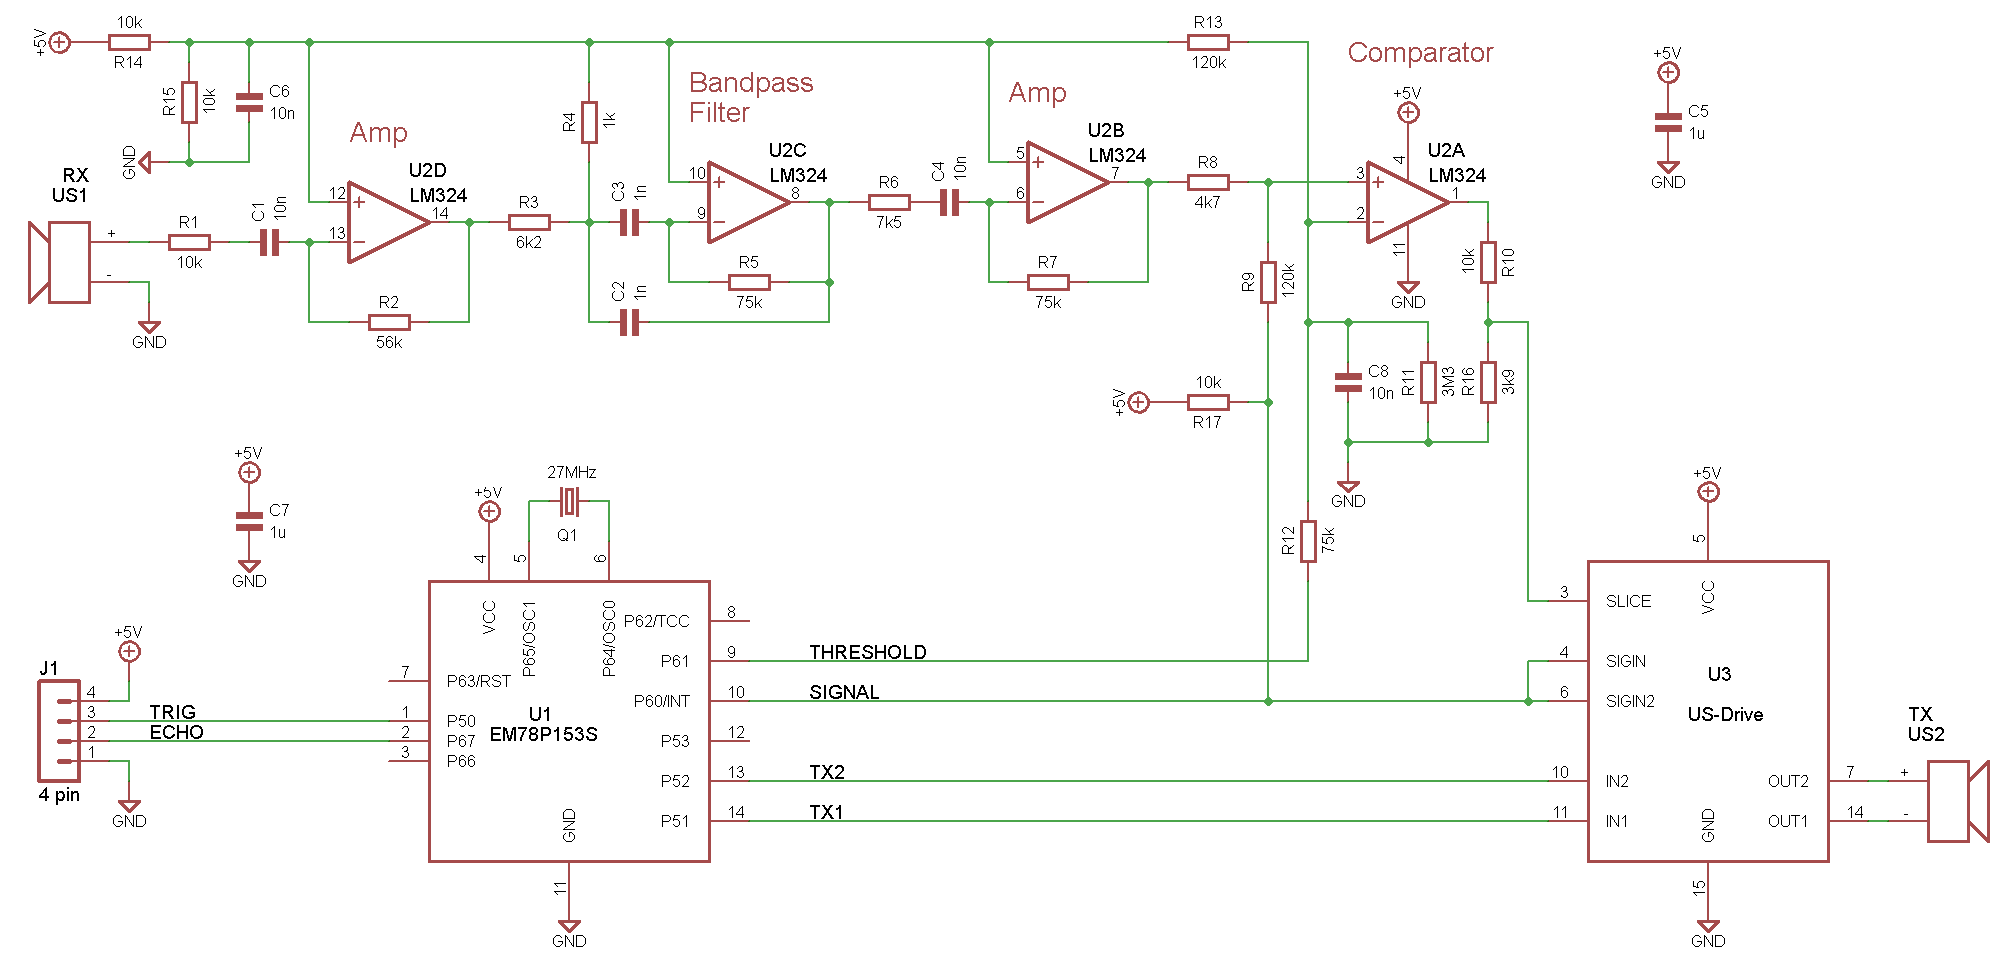
The Schematics:
HC-SR04 Echo Locator

Slide 5
The Schematics:
HC-SR04 Echo Locator
The HC-SR04 unit consists of three main parts: microcontroller, Transmitter and Receiver with associated amplifiers.
Microcontroller U1 (EM78P153):
Interface with Trig an Echo pins
Timing and sending antiphase burst
Squelch control (i.e. cutting receiver during transmission in order to avoid bogus echoes)
Receiving processed signal as a Rising edge interrupt
Transmitter U3 (MAX232):
Voltage drive to TX transducer from the antiphase TX signals from the micro (U1)
Receiver U2 (LM324):
Quad op-amp (low grade 1MHz unity gain bandwidth device)

Slide 6
More notes
HC-SR04 Echo Locator
The receiver is a chain of three op-amps as small signal stages, the final stage is a variable threshold hysteresis comparator with output switch.
Third stage (U2B, R6 and R7) is another amplifier with gain of approximately 10.
The last op-amp stage is a variable threshold hysteresis comparator with output switch, the output witch is formed by a transistor in U3 and pullup resistor R17.
First stage (U2D, R1 and R2) is an inverting amplifier of the RX transducer signal, with gain around 5.6 (allowing for tolerances). The output is attenuated with reference to mid-rail by R3 and R4.

Slide 7
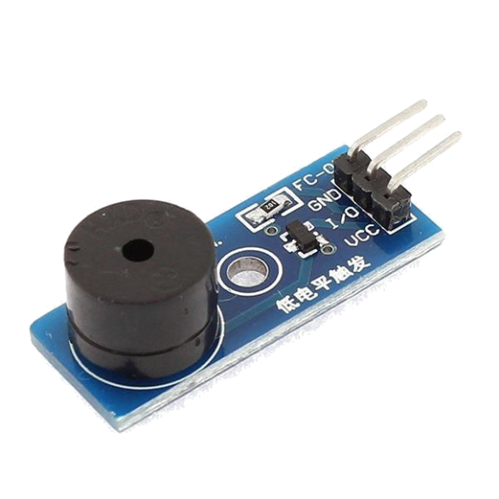
Piezo Active Buzzer
Main idea behind it
Whenever the module is powered and the trigger is set off, a membrane vibrates at a fixed frequency (Active Buzzer) generating a precise sound wave.
Interface
VCC and GND for power supply and I/O for triggering the sound.
If this were a Passive Buzzer, there would be no I/O pin, but we would had to give the precise sound frequency through the VCC and GND pins.

Slide 8
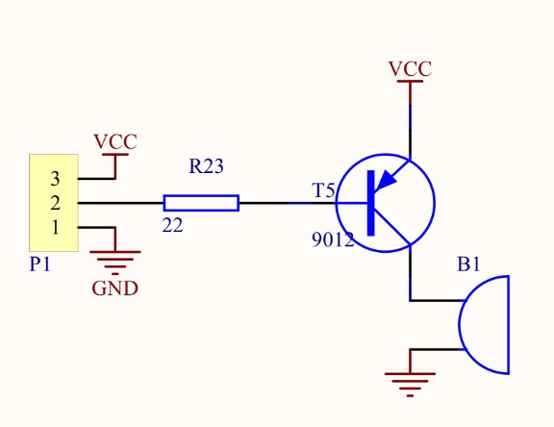
Piezo Active Buzzer – Schematic
Observations on the schematics
The circuit is simply constituted by a resistance and a transistor that acts as a switch on the I/O pin (nr. 2 connection).
The Active Buzzer B1 has a built-in oscillating source that will make a precise sound wave when electrified.

Slide 9
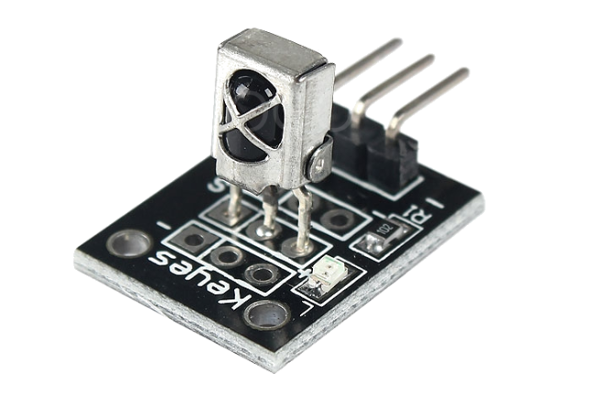
IR Receiver Module
Main idea behind it
A photodiode with integrated demodulator electronics is sealed on a simple PCB with 2 led status and a 3 pin interface.
The photodiode is a TL1838 that works on carrier frequencies of 35-40KHz
Interface
VCC and GND for power supply and SIG for measuring the IR signals recieved.

Slide 10
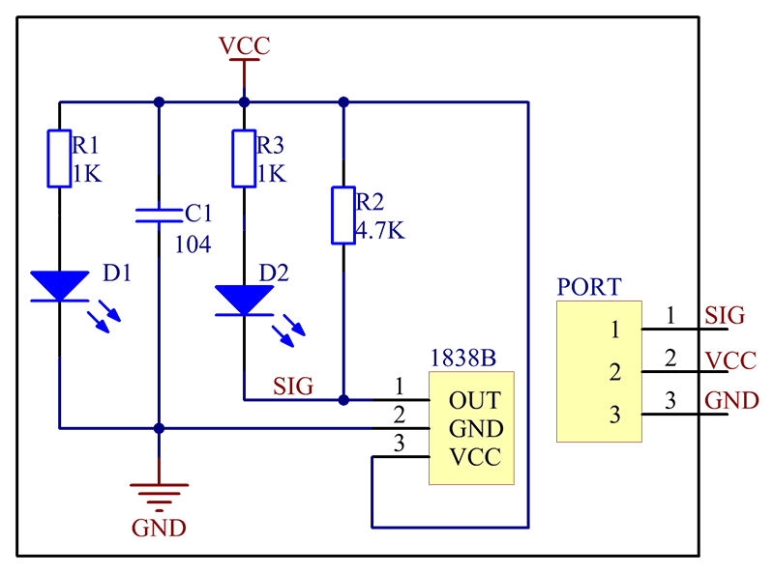
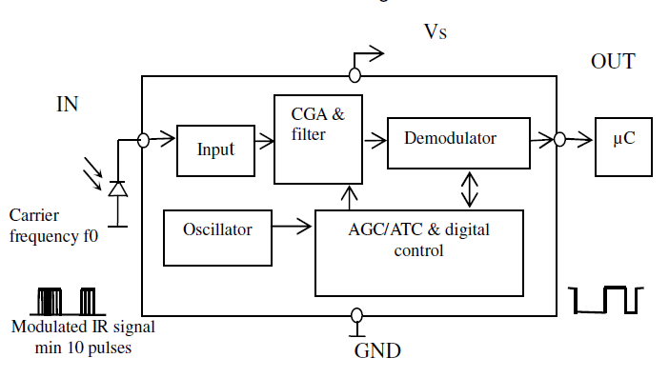
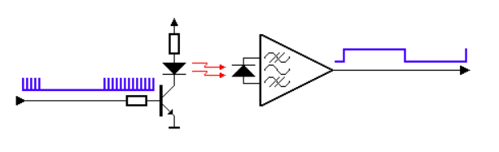
IR Receiver Module
The Schematics:
Observations on the schematics
The interface on the PCB is a simple wrapping circuit with a power status led (D1), a SIG status led (D2) and a capacitor for power stability (C1).
Remarks on the TL1838
The component has all the elements for receiving 35-40KHz modulated signals in intervals of 600μs. Unfortunately, we did not find the precise schematics of the component but only black-box schemes of its functioning.

Slide 11
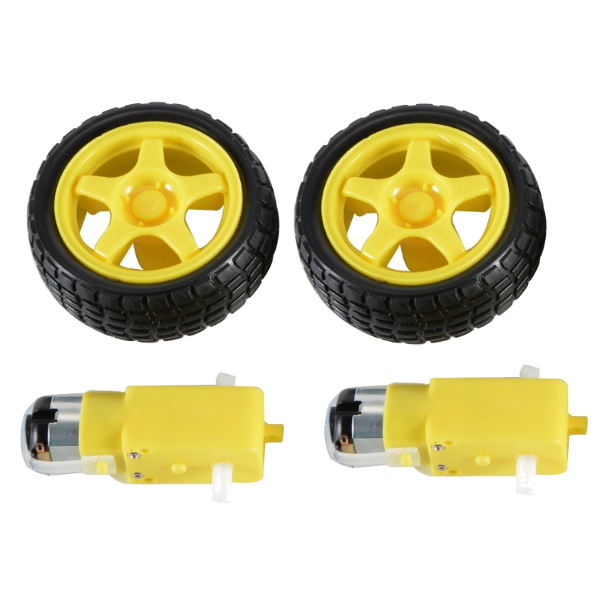
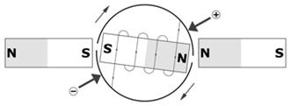
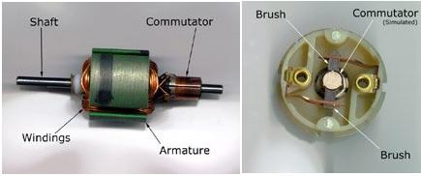
The (Simple) Physics of a DC Motor
From electrical to rotational energy
Two permanent magnets are placed next to an electromagnet whose inductor connectors (a pair of brushes) are placed in contact with a split-ring commutator.
With this simple configuration shown in these pictures (real DC motors may have more than 2 sectors), as the electromagnet is moving its polarity is changing and the shaft may keep rotating.

Slide 12
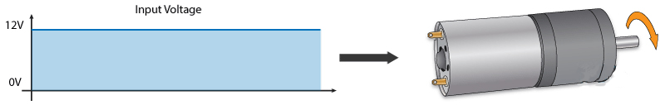
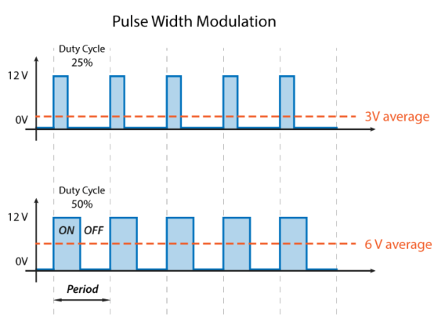
In order to have different speeds on a DC motor, it’s sufficent to provide different values of voltage. But how can we provide such values when or microcontrollers only support Digital Outputs (e.g. all or nothing)?
With Pulse Width Modulation (PWM)
PWM is a technique which permits to adjust the average value of the voltage that’s going to the electronic device by turning on and off the power at a fast rate. The average voltage depends on the duty cycle.
Almost every Arduino module and shield comes with at least one GPIO which supports PWM.
Controlling the Speed with PWM:

Slide 13
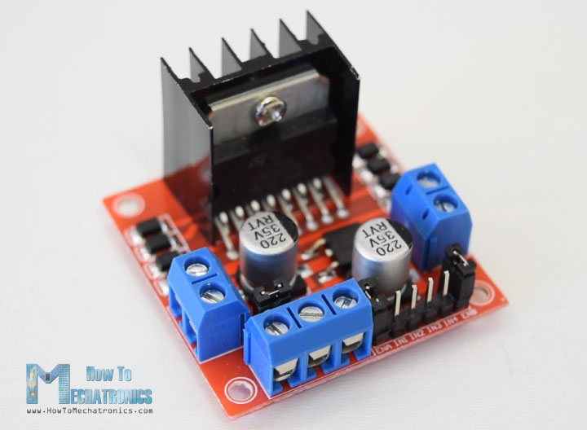
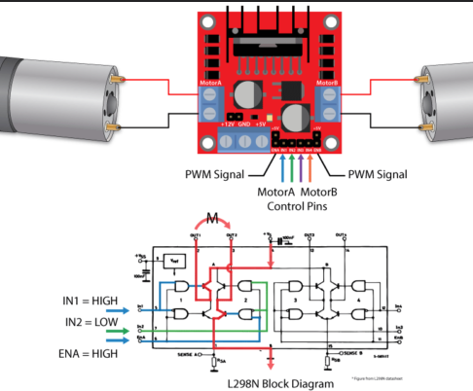
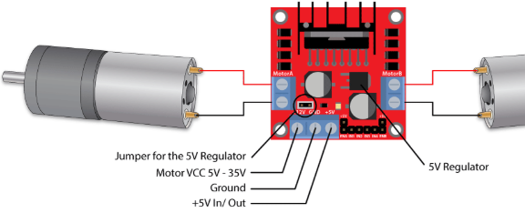
One module to control them all...
In order to control both the PWM ‘voltage’ and the wheels’ direction (inverting the voltage means inverting the rotation), the most common module in amateur projects is the L298N.
This module supports voltages between 5 and 35V, with a peak current up to 2A.
Here we show a single module capable of controlling two wheels at the same time, but we actually make use of a bigger module with 2xL298N and some support circuits for controlling also Servo Motors.

Slide 14
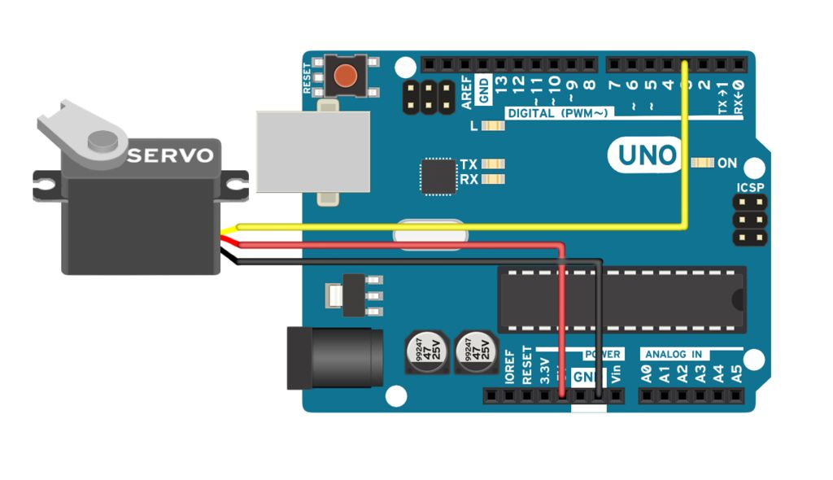
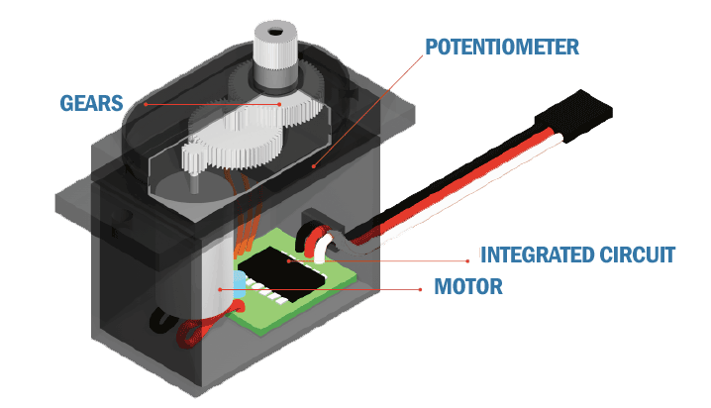
Servomotors
Perfect control over angular position
Servomotor is a term used to refer to motors suitable for use in a closed-loop control system (e.g. a system where the control action from the controller is dependent on feedback from the process).
In our contest, our servomotor is a rotary actuator whose orientation can be precisely controlled with a simple PWM signal.
This allows us to make the Echo Locator of the car ‘look around’ at precise degrees.

Slide 15
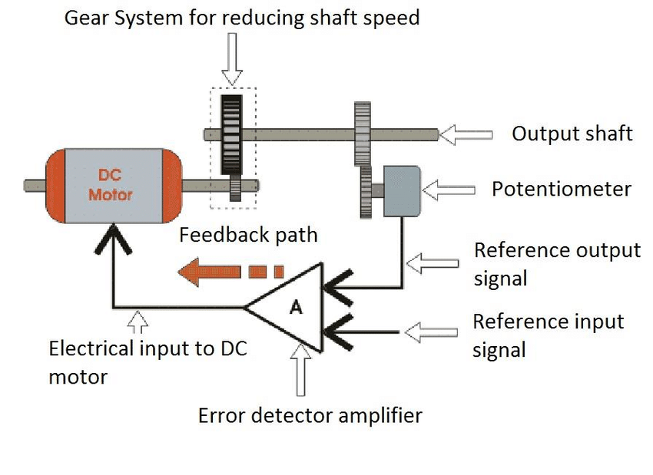
Servomotors
ServoMotors: how do they work?
Servomotors are a simple combination of a DC motor, a potentiometer and a closed-loop control circuit.
The DC motor is attached by gears to control the output shaft orientation. When the shaft of the motor is at the desired position, the power supplied to the motor is stopped by the op-amp in the closed-loop control circuit.
The motor's speed is proportional to the difference between its actual position and desired position. This is called proportional control.

