Slide 1
MASTER DEGREE THESIS
An Incremental Approach to
Automatic Firewall Configuration
Filippo Del Ministro
Supervisors
prof. Fulvio Valenza
prof. Daniele Bringhenti
prof. Francesco Pizzato
prof. Riccardo Sisto
Politecnico di Torino | Cybersecurity | Academic Year 2025-2026
Notes:
Good morning everyone, thank you for being here. My name is Filippo Del Ministro and today I'll present my thesis, "An Incremental Approach to Automatic Firewall Configuration," supervised by professors Fulvio Valenza, Daniele Bringhenti, Francesco Pizzato, and Riccardo Sisto.

Slide 2
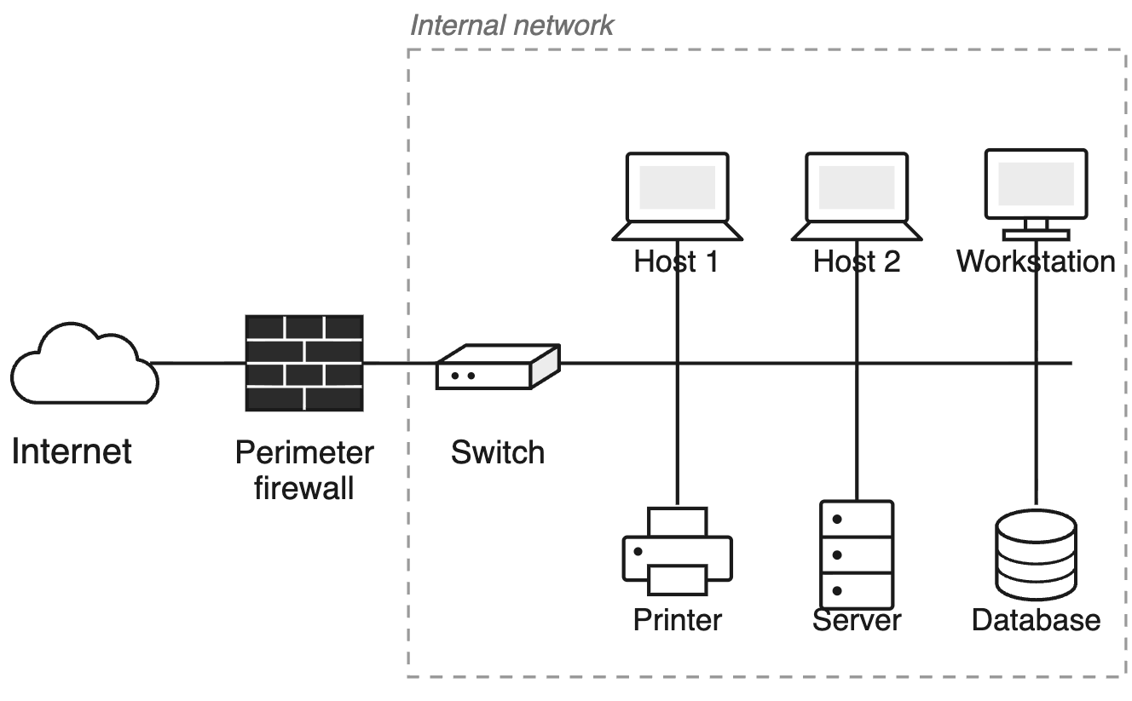
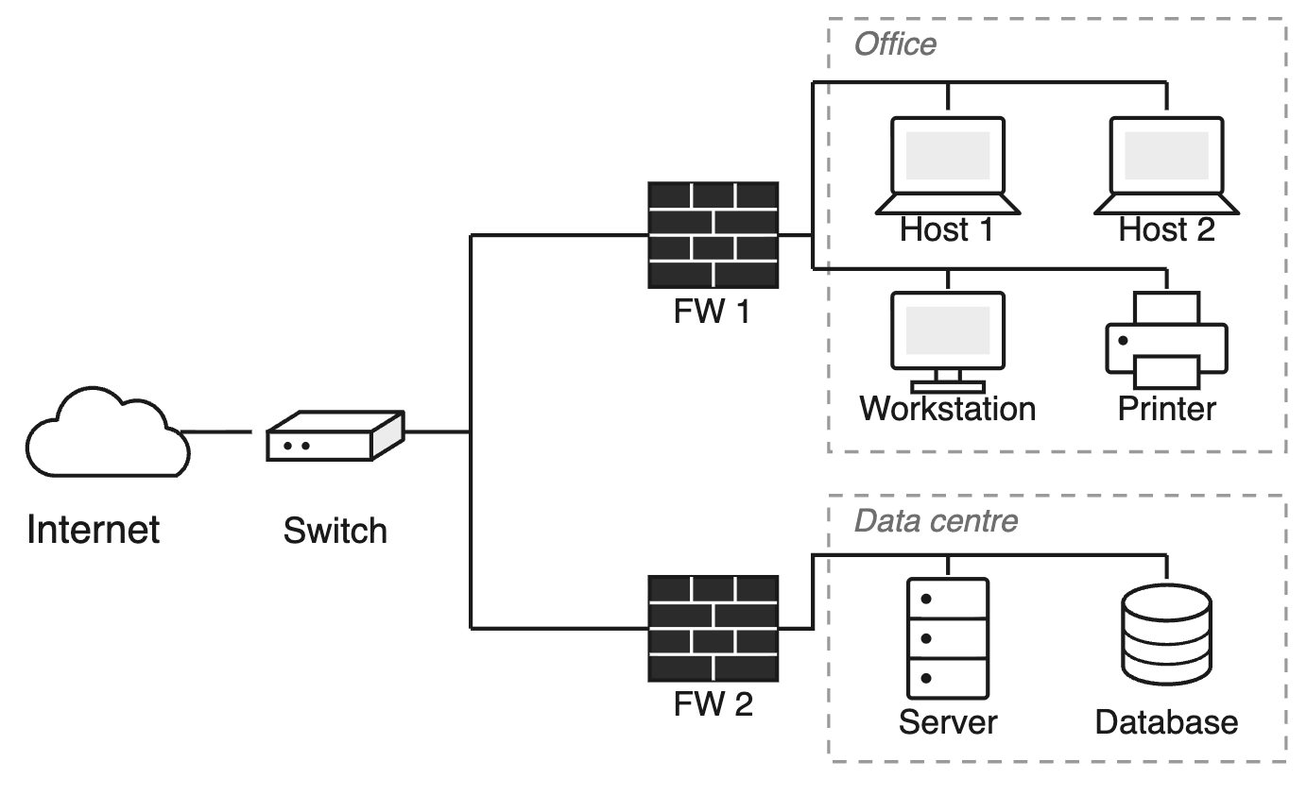

Background
Growing network complexity is driving a shift to distributed firewalls
Benefits: finer-grained control, containment of lateral movement, tailored policies across the network
Trade-off: more instances an rules to configure means more chances for conflicts; manual configuration is error-prone, with no guarantees of correctness
Traditional perimeter firewall
Distributed firewalls
2
Notes:
Let's start with the context. Modern networks are complex, and the growing complexity is the reason why security is shifting from a single perimeter firewall to a distributed approach, namely micro segmentation.
This shift brings well-known benefits: finer-grained control over traffic, containment of lateral movement if one segment is compromised, and policies tailored to each part of the network — for instance, a stricter policy for the data centre than for a general office segment. But it also complicates configuration: there are more firewall instances to manage, and if that configuration is kept manual, it becomes error-prone and offers no guarantee of correctness — a single mistake can silently violate a security requirement, or block legitimate traffic.
- Context; we are talking about securing IT network
Modern networks are complex → shift from perimeter firewall to microsegmentation
Distributed firewalls brings benefits (finer control, lateral-movement containment, per-segment policies)
Example: stricter policies for data centre or general office segment
but also new challenges => error in configuration can cause malfunctions such as blocking legitimate traffic or worse, allowing illegitimate traffic

Slide 3
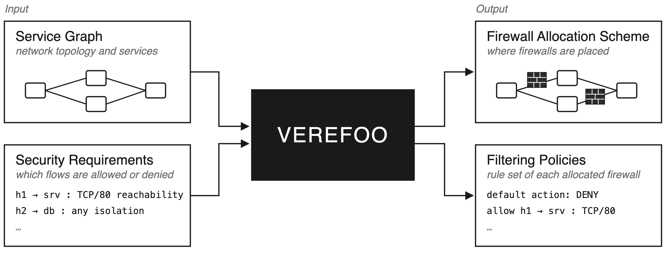
What is VEREFOO?
VEREFOO is an automatic tool to that allocates and configures firewalls for a given network, formally guaranteeing correctness and optimality
*
*Network Security Requirements (NSRs) — which traffic flows must be allowed or denied
3
Notes:
In this context, help network administrators manage their network without configuration errors. VEREFOO is an automated tools for firewall placement and configuration
VEREFOO takes two inputs: the network topology, formally described through a Service Graph — its nodes and links — and a set of Network Security Requirements, the NSRs, which describe which traffic flows must be allowed or denied
From these, it produces two outputs: a firewall allocation scheme, meaning where the firewalls are placed in the topology, and a filtering policy for each firewall, meaning how to configure it to properly enforce the security requirements.
VEREFOO guarantees optimality — minimizing the number of firewalls and configuration rules — and formal correctness: every requirement is guaranteed to be enforced.
The main limitation of a tool built this way is that it doesn't handle change well: modern networks are dynamic, with nodes added and removed and traffic requirements evolving continuously. The original version of VEREFOO does not address this probel at all, re-computing the new configuration from scratch every time a novel security requirement is added,
-----------------------------
In this context, automated tools for FW placement and configuration, such as VEREFOO, can help network admin to administrate their network without any configuration errors.
VEREFOO ipnut:
Netowrk topology => through a Service Graph which describe the topology of the network (nodes and links)
Security Requirements => called NSRs in the tool and in the following slides: which traffic flows must be allowed or denied
VEREFOOO Output:
Firewall allocation schema => meaning where Firewall are allocated in the topology
Filtering policies per FW => meaning how to configure those FW to properly enforce the security requirements
VEREFOO guarantee optimality (minimizing firewalls and rules) and formal correctness (every NSR will be enforced)
The main limitation of this tool built like this, is that it does not handle changes while modern networks are dynamic and continuously changing (nodes are added, removed and traffic requirements change over time)
It re-compute the configuration each time a novel security requirement is added.
-----------------------------
MORE:
Filtering rules are vendor independent => can be further specified to have in iptables

Slide 4
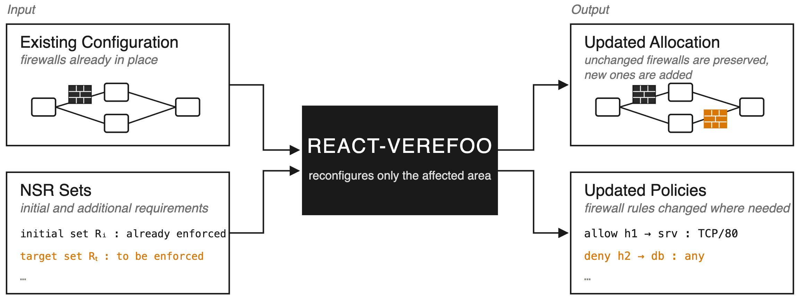
Solution for dynamism: React-VEREFOO
React-VEREFOO automatically reconfigures an existing firewall configuration when new requirements are introduced, avoiding a full re-computation from scratch
Input: existing configuration (firewalls already in place), initial requirements + additional requirements
Classifies NSRs as added, kept, or deleted and reconfigures only the affected area
Much faster than the monolithic version when only a small batch of requirements changes
3
Notes:
VEREFOO, as we just saw, guarantees correctness and optimality by construction, but it's monolithic: any change to the NSR set triggers a full recomputation from scratch.
To accommodate the dynamism of real networks, React-VEREFOO was developed: it takes an existing configuration already in place, the initial security requirements, plus a set of additional requirements, and reconfigures only the area of the network that actually needs to change.
To do this, React-VEREFOO classifies each NSR as to-be-added, to-be-removed, or kept, and only reconfigures the firewalls that fall within the affected area. Formal correctness is still guaranteed
What changes is performance. React is much faster compared to the monolithic version, which always compute the configuration from scratch.
Experimental tests, however, show that this benefit is not constant and depends on the number of additional requirements to be added. In particular, React it's much faster when only a small portion of the requirements changes, and it is comparable to the monolithic run, whenever the batch of new requirements is larger.
It's exactly on this last observation that the key intuition of this research is built — which brings us to the next slide.
-------------------------
- To accommodate the dynamism, React-VEREFOO has been implemented: this get an existing configuration already in place, additional requirements, and re-configure only the area that needs to be reconfigured
- To do so, React VEREFOO classifies NSRs in to be added, to be removed and kept, and then configure FW that fall in the affected area
Again, formal correctness is guaranteed, but performances are much faster compared to the monolithic version where all the configuration starts over from scratch.
Experimental test, however, shows that React-VEREFOO is much faster when only a small portion of requirements change, and in the contrary, execution time is comparable to the monolithic version whenever a large batch of new requirement is introduced.
On this very last assumption is build the key intuition of this research (next slide)

Slide 5
KEY IDEA
Replace the one-shot approach of VEREFOO with a sequence of calls to React-VEREFOO — each one adding one single requirement.
Vanilla VEREFOO
Iterative VEREFOO (this thesis)
large batch of N NSRs
1
2
3
…
N
▼ one expensive solver call
▼ many minimal solver calls
speedup degrades as the batch grows
advantage stays consistent, whatever the total
Notes:
The key idea of this research is then to exploit this very last observation, that React-VEREFOO’s performance are much faster when a small batches of new requirements is provided, to replace the one-shot approach of VEREFOO, with multiple simple calls to React-VEREFOO, with one single requirement each time.
-----------
Use this very last observation => that React is much faster when a small batch of new requirements is introduced
To replace the one-shot approach of VEREFOO
With multiple simple calls to React version => adding one single requirement each time

Slide 6
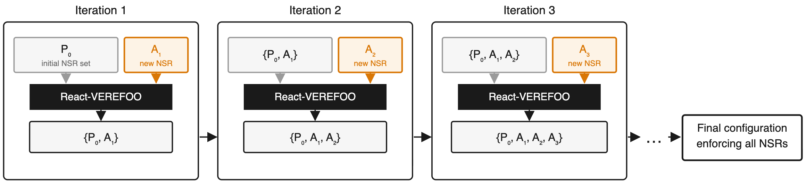
Thesis Contribution: Iterative VEREFOO
Pushes the incremental principle to its extreme: introduces exactly one new NSR at a time
Starts from the initial set P₀ and folds in one additional requirement at a time — A₁, A₂, A₃, etc.
At each step, React-VEREFOO is invoked with everything enforced so far plus the new requirement: {P₀} + A₁ then {P₀, A₁} + A₂, and so on
Correctness is always guaranteed by React-VEREFOO; all NSRs are satisfied by the final configuration.
6
Notes:
The idea behind this thesis is to push the incremental approach to its extreme: instead of feeding React-VEREFOO a batch of new requirements, we give it exactly one at a time. And to be clear, we're not reinventing the wheel here — we're reusing React-VEREFOO exactly as it is, just using specific input to it.
As a quick reminder, React-VEREFOO normally takes two batches: a set of requirements already enforced, and a set of new requirements to add. What the iterative approach does is manipulate exactly this interaction. We call P0 the initial set of requirements, and A1, A2, A3, and so on the additional requirements we want to introduce, one by one.
So at the first iteration, P0 is passed as the 'old' requirements and A1 as the 'new' one. At the second iteration, P0 plus A1 becomes the 'old' set, and A2 is the only 'new' requirement. And this continues for all the additional requirements (N).
As you can see, only one requirement at a time is introduced. Every iteration thus always receives the smallest possible incremental problem.
Correctness is always guaranteed by React-VEREFOO itself.
-------------------------
- So the idea of this thesis is to push the incremental approach to its extreme, just by introducing only one NSR at a time
Not reinventing the wheel, but just using React-VEREFOO with selected inputs
Reminder: apart from the topology, react-VEREFOO gets two batches of requirement: one of “old" requirements and one of "new" requirements
assuming P0 as the initial requirements, and A1, A2, A3 as the additional requirements that we would implement we are just passing different input to React-VEREFOO depending on the iteration:
Iteration1: P0 as the old and A1 as the new
Iteration 2: P0 + A1 as the old, and A2 as the new
And so on for all the requirements we want to enforce
- Additional note: correctness is guaranteed by React-VEREFOO itself because we are only manipulating the interation with it, not creating a brand new tool of it

Slide 7
Implementation
VerefooSerializer
Initial Requirements
Additional Requirements
1
All changes are confined to VerefooSerializer
P₀
A₁
A₂
A₁
…
A_{N}
The entry point to the VEREFOO tool
2
A new wrapper unpack the additional requirements
↻
Split A₁, … A_{N} into one call per requirement, instead of a single batch call
Solver
Solver
Repeat for each A_{i}
3
State updated every iteration
Current requirements and graphs are updated at each call to propagate the intermediate result into the next iteration
…
Solver
4
All other components remained untouched
NEW — iterative loop
MaxSMT encoding, VerefooProxy, VerefooTranslator unchanged
Final configuration
8
Notes:
The iterative variant was implemented entirely by modifing the Serializer, on of the main component of the tool — without touching anything on the caller side. Only one wrapper was added: its job is to intercept the call before it reaches the solver, and manipulate what gets passed to React-VEREFOO, feeding it one requirement at a time instead of the full batch. Across iterations, the intermediate results are propagated through two structures that get updated at every step: consideredProps, tracking what's already enforced, and currentGraph, the configuration as it evolves. Everything else — the MaxSMT encoding, VerefooProxy, the Translator — is left completely untouched, which guarantees retro-compatibility with the rest of the pipeline.
-----------
- Implemented inside VerefooSerializer — the shared entry point for all three variants
- No changes needed on the caller side
- Only one wrapper added: intercepts the call to the solver and manipulates the input to React-VEREFOO
- Intermediate results propagated via two structures updated at each iteration: consideredProps and currentGraph
- Everything else (MaxSMT encoding, VerefooProxy, Translator) untouched — guarantees retro-compatibility

Slide 8
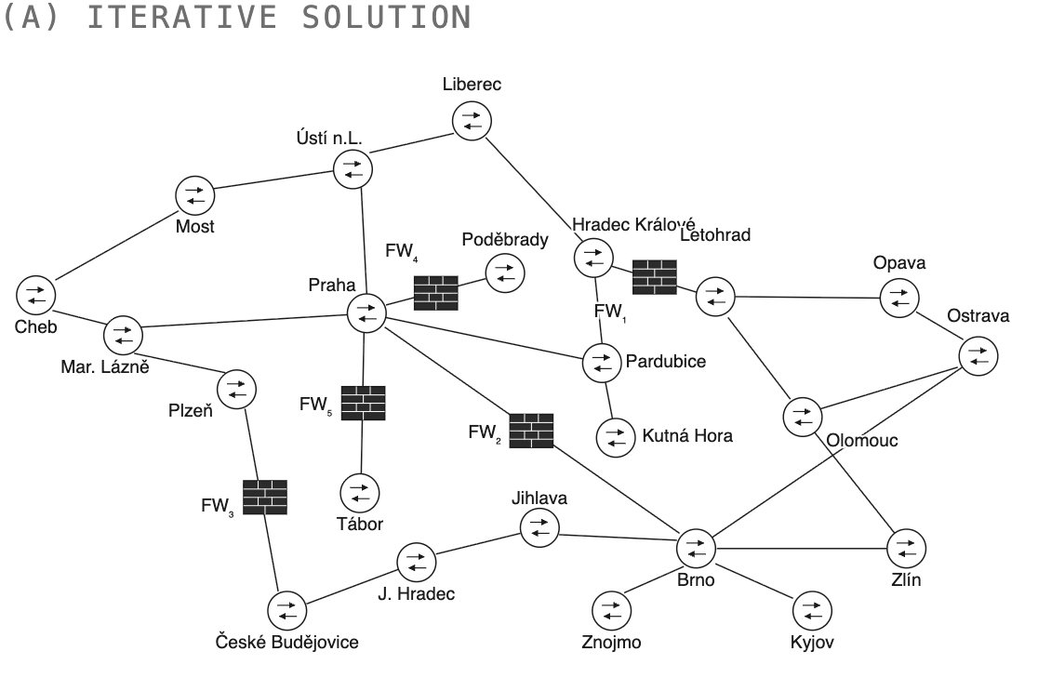
Qualitative validation
CESNET: 23 nodes, 28 links
P₀: 10 NSRs — enforced by 3 firewalls
5 additional NSRs introduced iteratively
Results:
Firewalls allocated
Configuration rules
5
4
No previously satisfied requirement ever broken
9
Notes:
The iterative version was validated qualitatively on the CESNET topology, a real academic network in the Czech Republic, with 23 nodes and 28 links. The initial configuration had ten requirements, already enforced by three firewalls. Starting from there, I introduced five additional requirements one at a time, tracing each iteration step by step to confirm that every new requirement was satisfied — and, just as important, that none of the previously satisfied ones were ever broken along the way.
The final configuration ends up with five firewalls in total, enforcing all fifteen requirements: the ten initial ones plus the five that were added incrementally.
- Validated qualitatively on CESNET, a real academic network in the Czech Republic (23 nodes, 28 links)
- Initial configuration: 10 requirements, enforced by 3 firewalls
- 5 additional requirements introduced one at a time, tracing each iteration step by step
Final result: 5 firewalls total configured by 4 rules, enforcing all 15 requirements
No previously satisfied requirement was ever broken at any stage

Slide 9
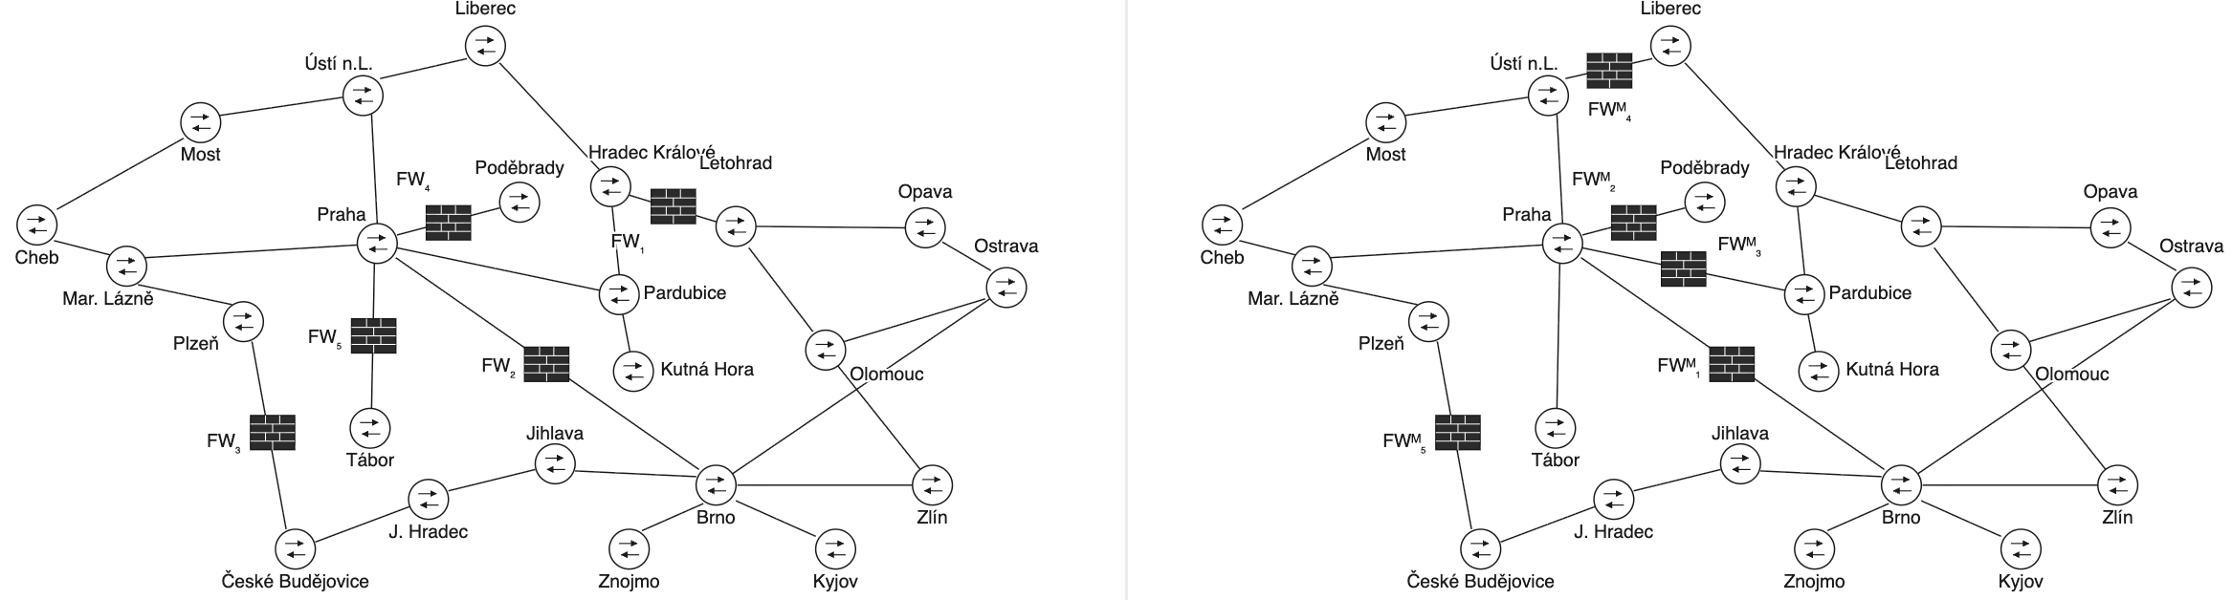
Iterative (left) and monolithic (right) firewall placement over the same 15 NSRs
Validation: Iterative vs. Monolithic
The two results are directly comparable: both reach 5 firewalls, 3 of them in the exact same positions.
Iterative solution
Monolithic solution
Iterative (left) and monolithic (right) firewall placement over the same 15 NSRs and topology
Comparison:
One extra rule in the iterative result; negligible cost
Iterative stays stable: already valid firewall are never reconfigured
10
Notes:
To put this result in context, I ran the same test with vanilla VEREFOO — the monolithic version — over the exact same topology and the same set of fifteen NSRs. The result is a very similar configuration: five firewalls, three of which serve the exact same purpose, in the exact same positions, as in the iterative solution.
The difference shows up on the other two firewalls, and it is due to visibility of requirement at each step. The iterative approach never sees beyond the single requirement it's currently processing, and needs to commits to a firewall allocation at every stage. The monolithic approach, on the other hand, sees all fifteen requirements at once and can optimize globally. In this specific case, the firewall allocation is the same, but the iterative version needs to configure one extra rule.
That said, the iterative approach has a compensating advantage: it never relocates a firewall that's already valid, avoiding both the operational cost and the transient insecure states that a full re-run would cause. This matches how requirements actually accumulate over time in real networks, and it's exactly what motivates using this approach in highly dynamic environments.
- Same test run with vanilla VEREFOO (monolithic) — same topology, same 15 NSRs
- Result: very similar configuration — 5 firewalls, 3 with the exact same purpose/position as the iterative solution
- Difference on the other 2 firewalls comes from visibility: iterative commits at each step, never seeing beyond the current requirement; monolithic optimizes globally
- Cost of this: one extra rule in the iterative result. In any case negligible.
- Benefit: iterative never relocates an already-valid firewall — avoids operational cost and transient insecure states
- Matches how requirements accumulate in real networks — motivates using the iterative approach in dynamic environments

Slide 10
Conclusions & Future Work
Conclusions
Future Work
Validated qualitatively on a realistic CESNET topology
Correctness is guaranteed, and the result is comparable to the monolithic baseline: 3 identical firewall allocations, only one extra rule
Particularly suited to highly dynamic environments, where reconfiguration can become a bottleneck or a massive operational cost
Quantitative benchmarking is still missing and needed: execution time against the monolithic baseline, across multiple topologies and configurations
Further optimizations could be explored: traffic-aware NSR ordering, and support for NSR removal
11
Notes:
[10:30-11:45] The iterative approach was validated qualitatively and reaches a result that almost matches the monolithic baseline in firewall count, with just one extra rule, despite never having visibility beyond the single requirement being processed. I expect scalability to be the main advantage as topologies and reconfigurations grow larger. Future work: quantitative time benchmark at larger scale, traffic-based requirement ordering to reduce tie-driven reconfigurations, support for NSR removal.
---
Finally, the iterative approach has been validated via a qualitative testing with a comparable result to the monolithic version
This approach could be particularly suited for high dynamic environment where topologies or requirements changes frequently
As future work I would like to propose
Quantitative test to benchmark the iterative solution, over multiple configuration and topologies
NSR removal which was not particularly considered in this thesis research
And finally one optimization proposal to order NSR keeping in mind their traffic awereness

Slide 11

Thank you
for your attention
Notes:
[11:45-12:00] Thank you for your attention, and I'm happy to take any questions.

