Slide 1
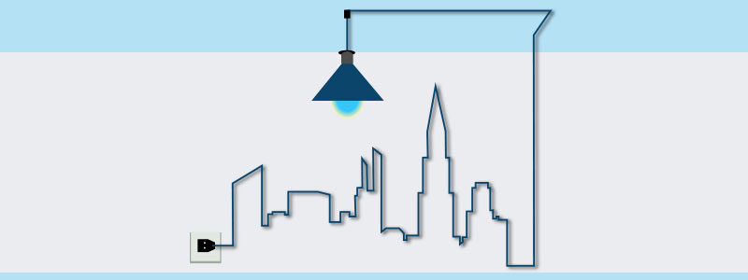
APPLIANCE STATE PREDICTION
Filippo Medri
Metis San Francisco
Spring 2018

Slide 2
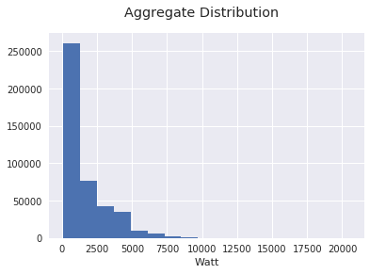
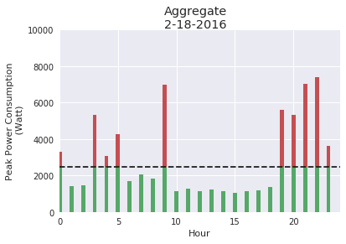

Energy Cost
Electric bill is made up by the sum of three component:
- Fixed contract (fixed by the provider)
- Total Consumption (what really you have consumed)
- Peak Demand Charges (max energy demand )
Bill item | Cost
Fixed | $ 12 Month
Hourly | $ 0.13 – 0.22 kWH
Peak | $ 18 * max kW
From 30% to 70% !!!

Slide 3
Setup
Dataport database:
  Aggregate and appliance data
  1 minute sampling
  699 Building from Texas (2013-Now)
  Remote Postgres SQL
Dataset
  1 Building
  1 January to 30 October 2016
  ~ 430000 record
  6 Appliance
Features
  Aggregate (Watt)
  Month
  Weekday
  Hour
  Minute
Classifiers
  SVC
  KNN
  Random Forest

Slide 4
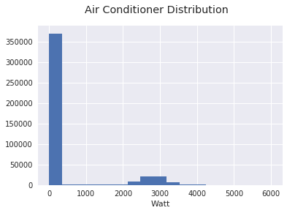
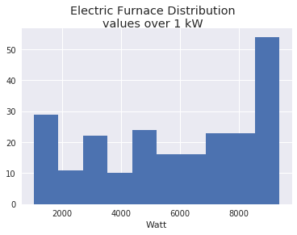
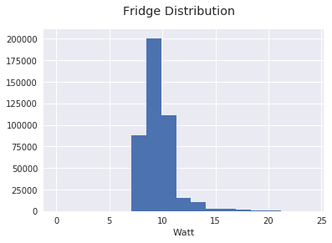
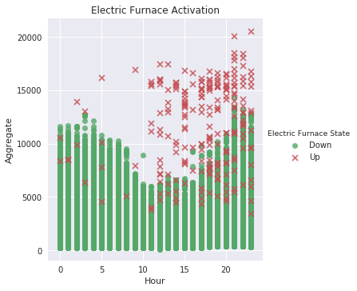
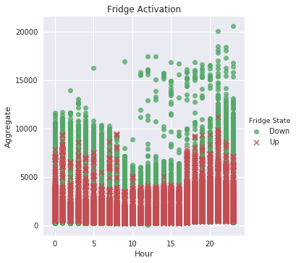
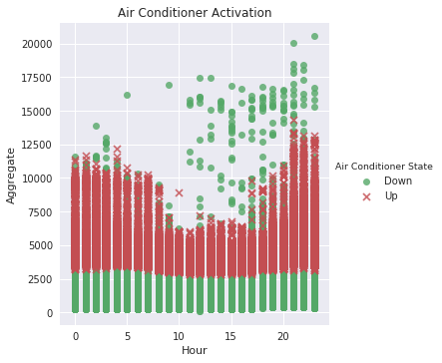
Appliance account on Aggregate

Slide 5
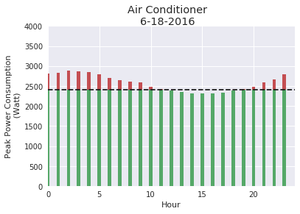
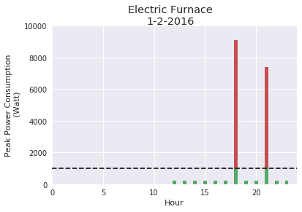
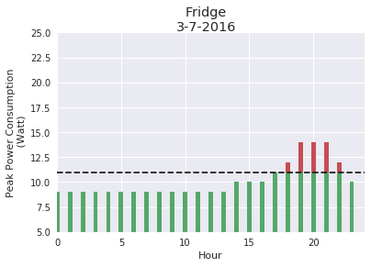
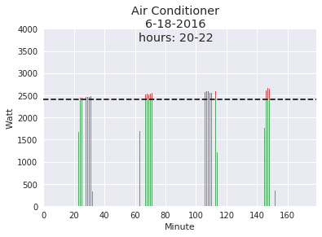
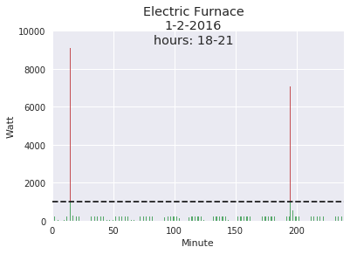
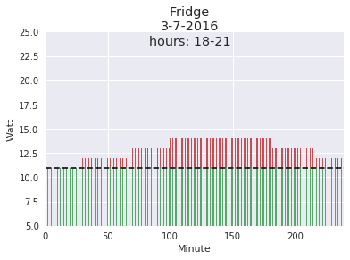
Appliance Signatures

Slide 6
Classification
Target Variable: Fridge Status
Class Imbalance: 90% Fridge Off, 10% Fridge On
Oversampling 35% via SMOTE
Cross fold Validation:
  n_estimators': 1000,
  'min_samples_split': 5,
  'min_samples_leaf': 2,
  'max_depth': 110

Slide 7
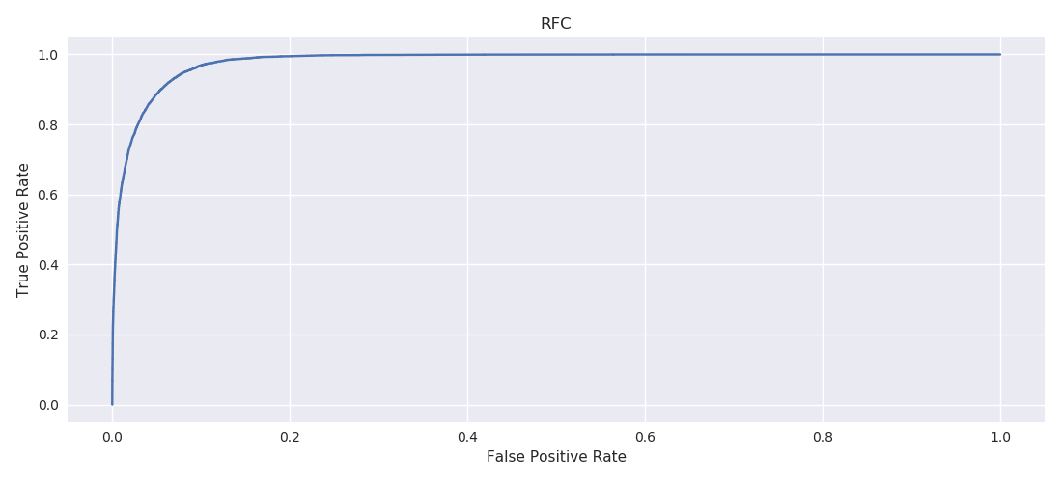
Random Forest Result
Index | Value
Accuracy | .96
Precision | .79
Recall | .70
F1 - Score | .74
Feature | Importance
Aggregate | .19
Month | .30
Day | .20
Hour | .22
Minute | .07
AUROC = .9801077

Slide 8
What’s next
Model different appliances
Cross validate appliances through buildings
Lower the sampling rate
Include meta-data about building usage (houses, offices, number of inhabitants)

Slide 9
Thank
You!!!

