Slide 1
Credit Card Churning Classification
Supervised Learning

Slide 2
Introduction
The Churning Customers are customers which sign-up and leave in a short period of time, possibly to gain some benefit from the subscription, in this case of a credit card service.
The aim of our analysis is to classify the individuals using Supervised Learning techniques in order to predict attrited and existing customers.

Slide 3
Methodology and Discussion
Classification Tree
Random Forest
SMOTE
Algorithm
Pruning
Model Selection

Slide 4
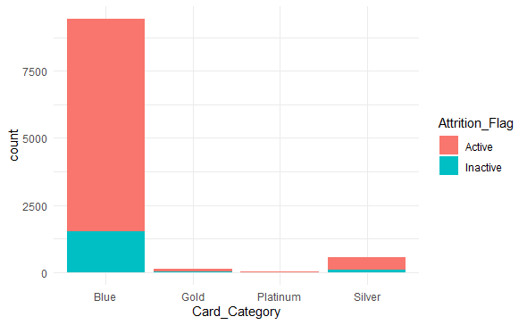
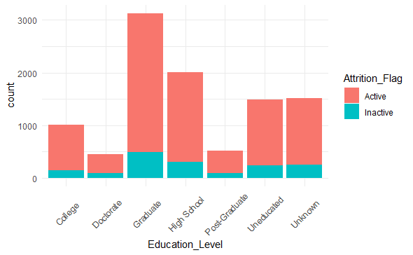
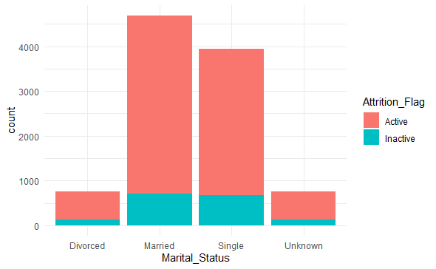
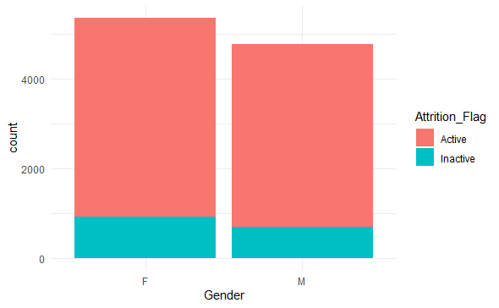
Categorical Variables Barplots

Slide 5
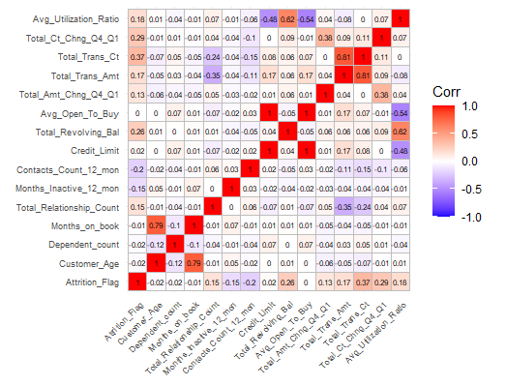
Spearman Correlation
To control the correlations, the target variable has been converted into a numerical with values 0 and 1.
We can see with which variable there is a monotonic relation.

Slide 6
Classification Tree
The Classification Tree is a supervised method which is formed by a root node, inner nodes and leaves. In our case each node has two splits and each leaf represents a label. A tree with an high number of nodes is likely to overfit the training set so we are going to prune it in order to limitate this issue.

Slide 7
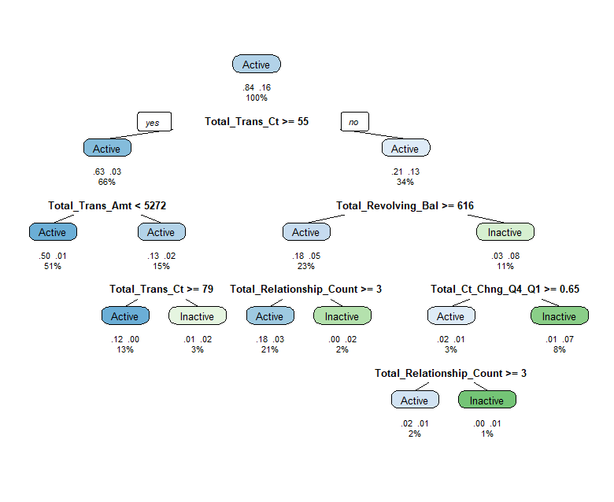
Classification Tree (cont’d)
The first resulting tree, pruned at a complexity parameter of 0.023
The Confusion Matrix obtained is the following:
Real\Pred | Active | Inactive
Active | 1637 | 52
Inactive | 94 | 243

Slide 8
Random Forest
The Random Forest is a method useful in order to reduce the variance of the model injecting a certain quantity of bias. It creates a number B of uncorrelated trees and then retrieves a label following the majority rule.
Without Hyperparameters Tuning:
With Hyperparameters tuning
Real\Pred | Active | Inactive
Active | 1671 | 18
Inactive | 48 | 289
Real\Pred | Active | Inactive
Active | 1673 | 16
Inactive | 35 | 302
Notes:
tuning resulting params: mtry = 10, ntree= 1000

Slide 9
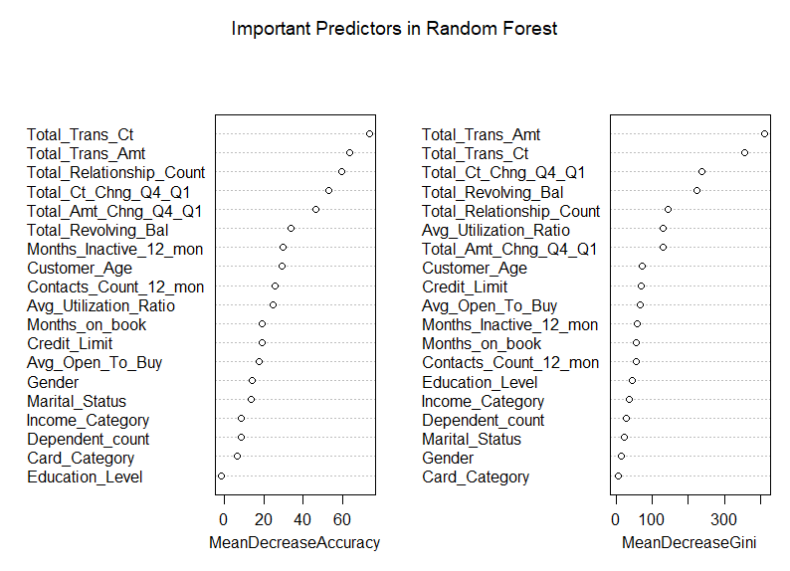
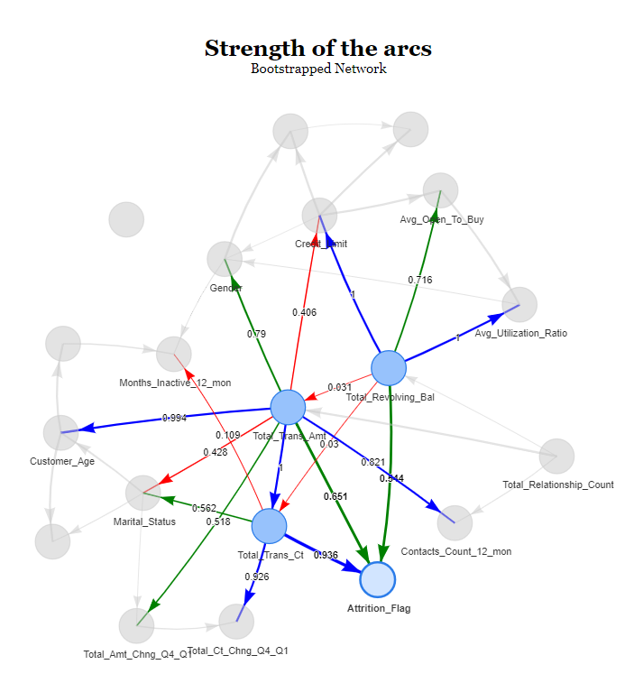
Random Forest - Model selection

Slide 10
Random Forest - Model selection (cont’d)
Using Model selection un create a subsample of the original dataset keeping only the “useful” variables found, so the top 5 variables for the two scores (this is an arbitrarily decision).
Decision Tree
Random Forest
Real\Pred | Active | Inactive
Active | 1631 | 58
Inactive | 74 | 263
Real\Pred | Active | Inactive
Active | 1664 | 25
Inactive | 36 | 298

Slide 11
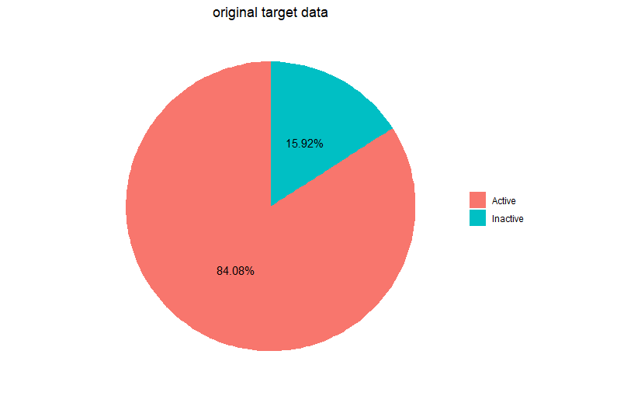
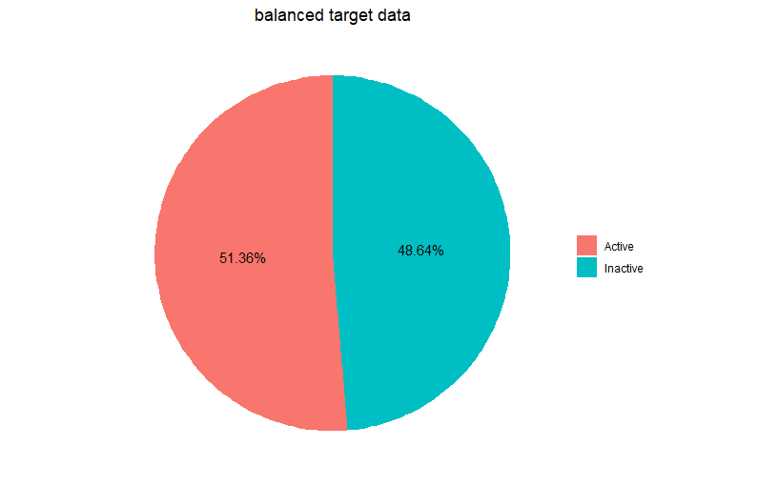
SMOTE Algorithm
The SMOTE Algorithm exploits the K-Means Clustering in order to balance the data in a classification problem, aiming to reduce the possible problems derived by the over-representation of a class with respect to the other.

Slide 12
SMOTE Algorithm (cont’d)
Decision Tree
Random Forest
Real\Pred | Active | Inactive
Active | 1556 | 133
Inactive | 32 | 305
Real\Pred | Active | Inactive
Active | 1649 | 40
Inactive | 26 | 311

Slide 13
Results
Model\Index | Precision | Recall | Accuracy | F1-Score
Tree | 0.9456961 | 0.9692126 | 0.9279368 | 0.9573099
RandomForest | 0.9720768 | 0.9893428 | 0.9674235 | 0.9806338
ModSel_Tree | 0.9565982 | 0.9656602 | 0.9348470 | 0.9611078
ModSel_RF | 0.9788235 | 0.9851983 | 0.9698914 | 0.9820006
Tuned_RF | 0.9795082 | 0.9905269 | 0.9748272 | 0.9849868
Smote_tree | 0.9791535) | 0.9177028 | 0.9151037 | 0.9474328
Smote_RF | 0.9844776 | 0.9763173 | 0.9674235 | 0.9803805

