Slide 1
OECD Better Life Index Clustering
Unsupervised Learning

Slide 2
Introduction
The Better Life Index Created by OECD is formed by 24 numerical variables which describe different aspects of each Country (39 including the OECD average) included on the analysis, such as the level of pollution, the employment rate, life expectancy, etc.
We want to use these characteristics in order to categorize countries and find their recurrent patterns and similarities using Unsupervised Learning methods.

Slide 3
Methodology and Discussion
Three different methods will be applied:
Principal Component Analysis
Hierarchical Clustering
K-Means Clustering

Slide 4
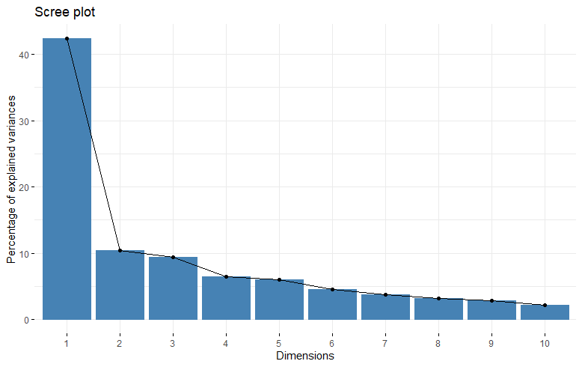
Principal Component Analysis
The Principal Component Analysis (PCA) is a statistical method very useful for our project in order to reduce the dimension of the feature space controlling the amount of information (variance explained by each Component) that you want to keep. In our case we will keep about 53% of it with two PCs.
Notes:
PCA is based on Euclidean distance and needs scaled variables

Slide 5
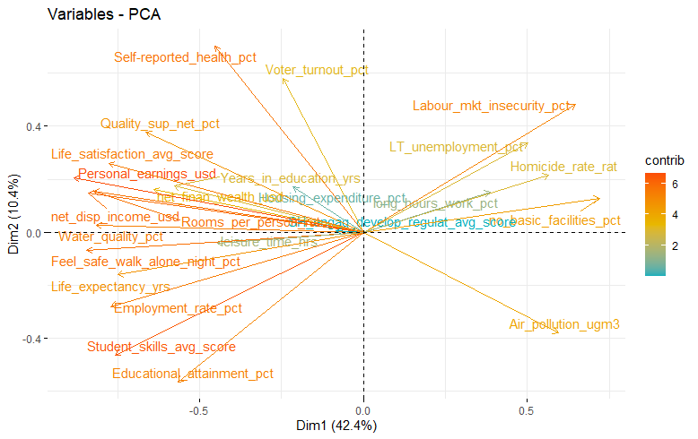
PCA (cont’d)
The graph indicates the direction and the magnitude of the contribution of each variable to the components.
The First PC captures the positive and negative relation on the citizens life.
The Second PC captures an higher variety of variables, and the relation is less clear.

Slide 6
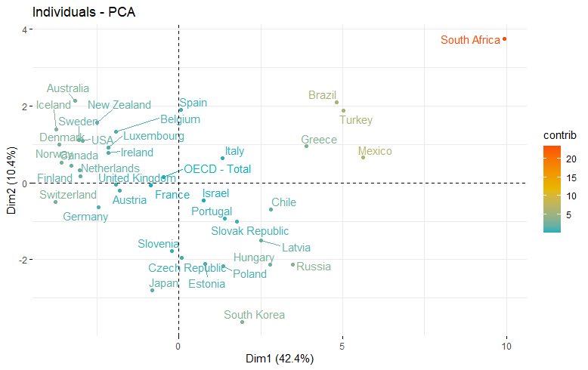
PCA (cont’d 2)
The graph with the individuals indicates how the countries are distributed with respect to the new set of coordinates.
We can already see possible candidate clusters between them.

Slide 7
Hierarchical Clustering
Hierarchical Clustering treats all the N observations of a dataset as single clusters, then using a dissimilarity method (Euclidean Distance) and a specific linkage strategy it reduces their number until the reach of some threshold.
We are going to use the Average Linkage Method, where the distance between two clusters is defined as the average of distances between all pairs of objects. The algorithm used on R permits us to automatically define the optimal number of clusters.

Slide 8
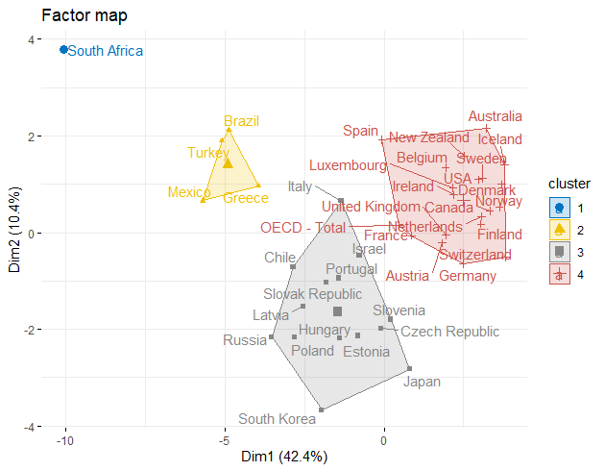
Hierarchical Clustering (cont’d)
The graph is reversed with respect to the PCA one. But it permits to easily identify the 4 clusters chosen from the algorithm.
The first cluster is identified only by South Africa; the second comprehends just four countries; the last two are big and contains the majority of OECD countries, with, in a sense, more advanced places moving to the right part.

Slide 9
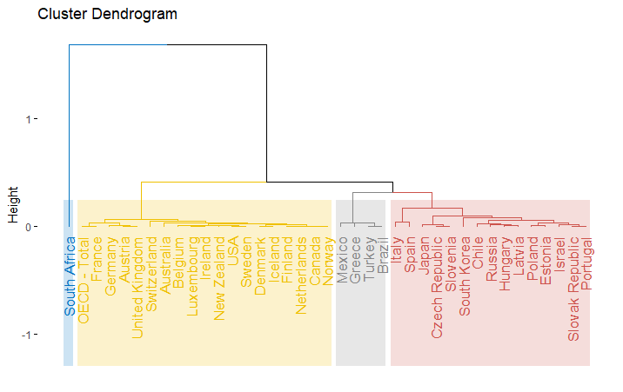
Hierarchical Clustering (cont’d)
It is also available a tree-like representation of the clusters called dendrogram which permits to chose the height at which cut our tree, in order to arbitrarily define the number of clusters.

Slide 10
K-Means Clustering
The K-Means Clustering is another unsupervised method, differently from the HC it is based on the choice of the number of clusters, which are going to be randomly positioned at first and then optimized.
We are going to use an R function which permits us to compare 30 indexes in order to chose the number of clusters represented by the majority of them, which in our case is 3.

Slide 11
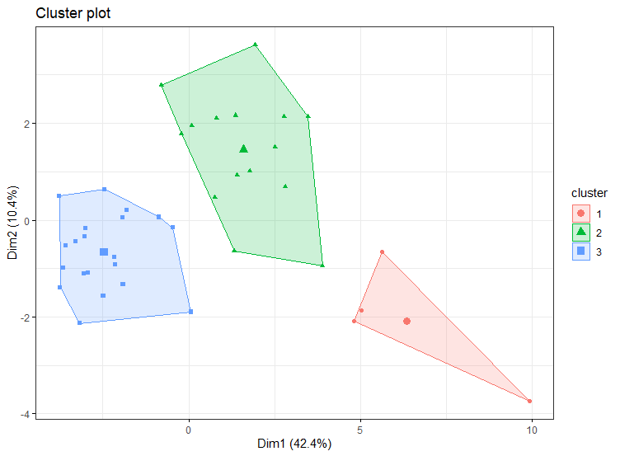
K-Means Clustering (cont’d)
The resulting graph (which is another time reversed wrt the previous one) represents again two big clusters containing the majority of the data and a smaller one, which in this case contains also the “extreme” South Africa.

Slide 12
Results
The analysis permitted us to represent our data in a more meaningful way, isolating the characteristics of each cluster and consequently of the countries contained into it. Getting rid of almost 50% of the variance explained did not limited us and we may also be able to double check our result comparing with the real ranking made by OECD.

