Slide 1
Driving Style Clustering
Data Mining and Text Mining Project Spring 2009

Slide 2
Exploration
Find meaningful attributes
Speed
Engine speed
Vehicle information
GPS information (latitude, longitude, and date)
Discard non meaningful attributes
Acceleration
Torque
Fuel consumption
Engine temperature
GSM information

Slide 3
Clean and Preprocess
Get rid of:
Duplicates examples
Non meaningful attributes
Non meaningful values
Smooth peak values
Eliminate dependence from time
Normalize attributes to set equal weights before the clustering process

Slide 4
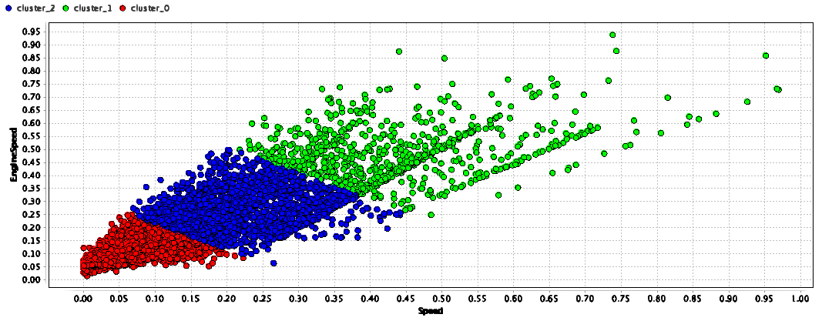
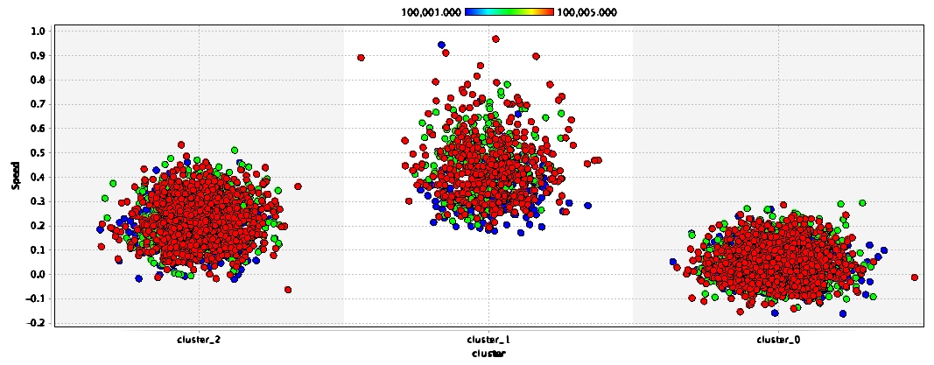
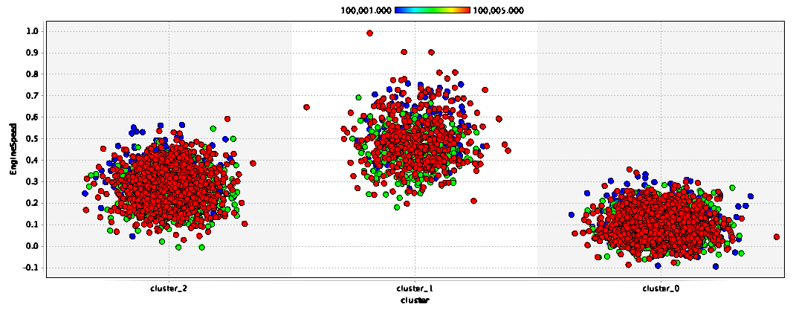
Mine (1/2)
Apply K-Mean (unsupervised learning) to find clusters

Slide 5
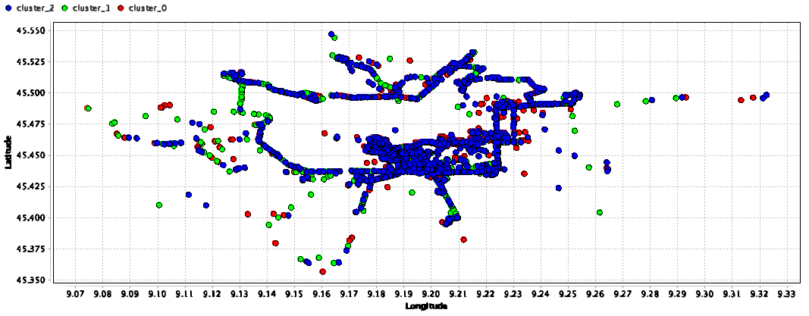
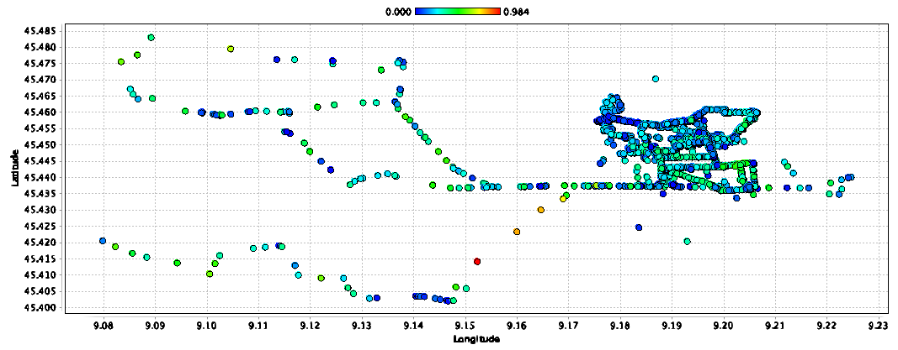
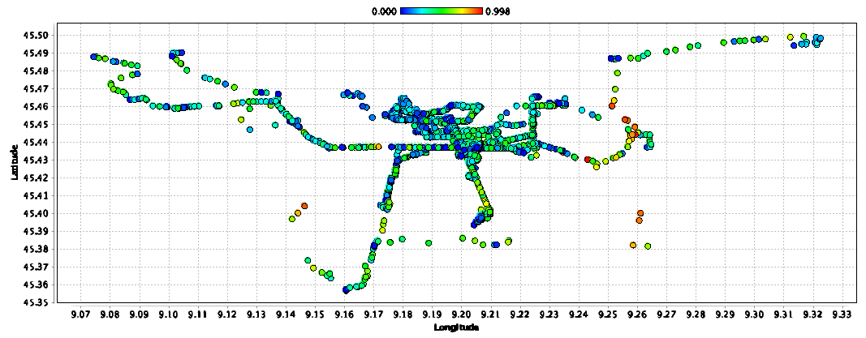
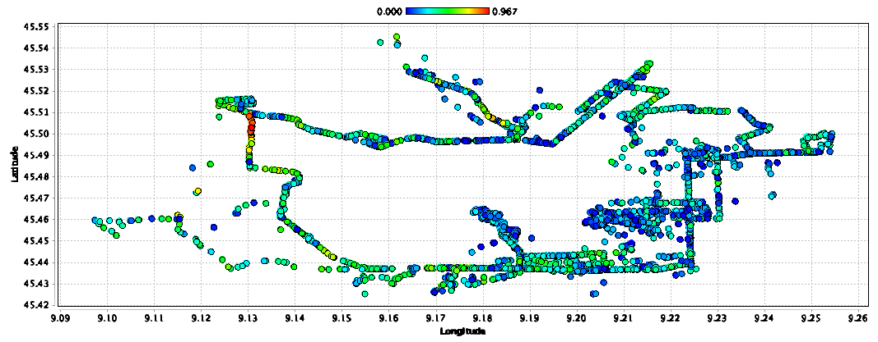
Mine (2/2)

Slide 6
Conclusions
Three clusters representing a logical subdivision considering the real life driving style
Speed and Engine speed are obviously correlated hence diagrams showing clusters distribution over these attributes are very similar in shape and density
Every vehicle has an equal distribution over all three clusters
Driving style is not affected by the position of the vehicle since all clusters are equally spread over GPS coordinates

