Slide 1
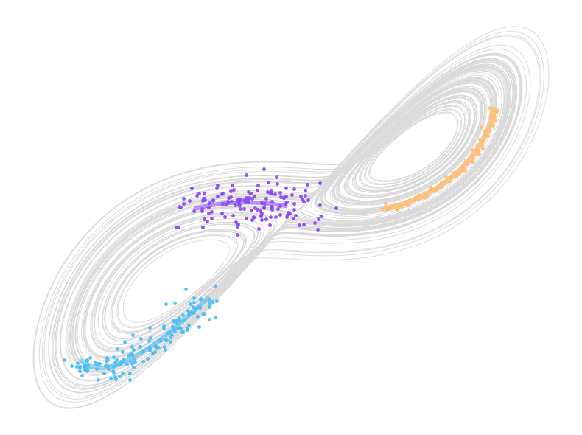
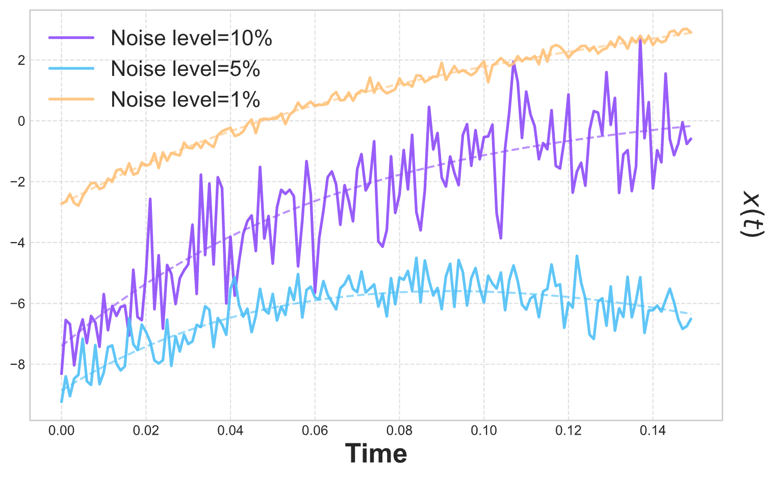
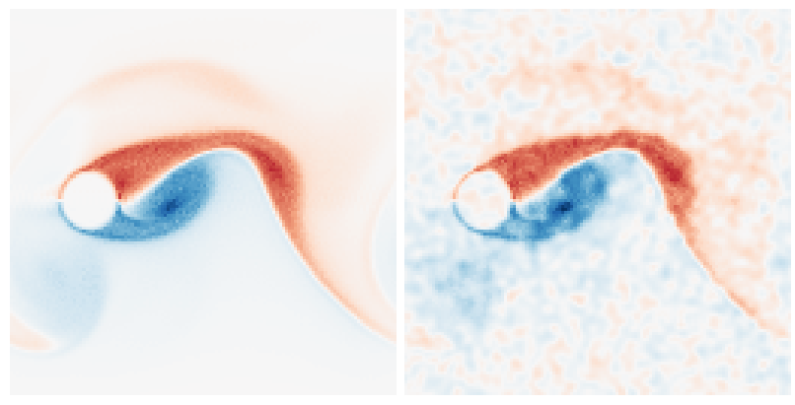
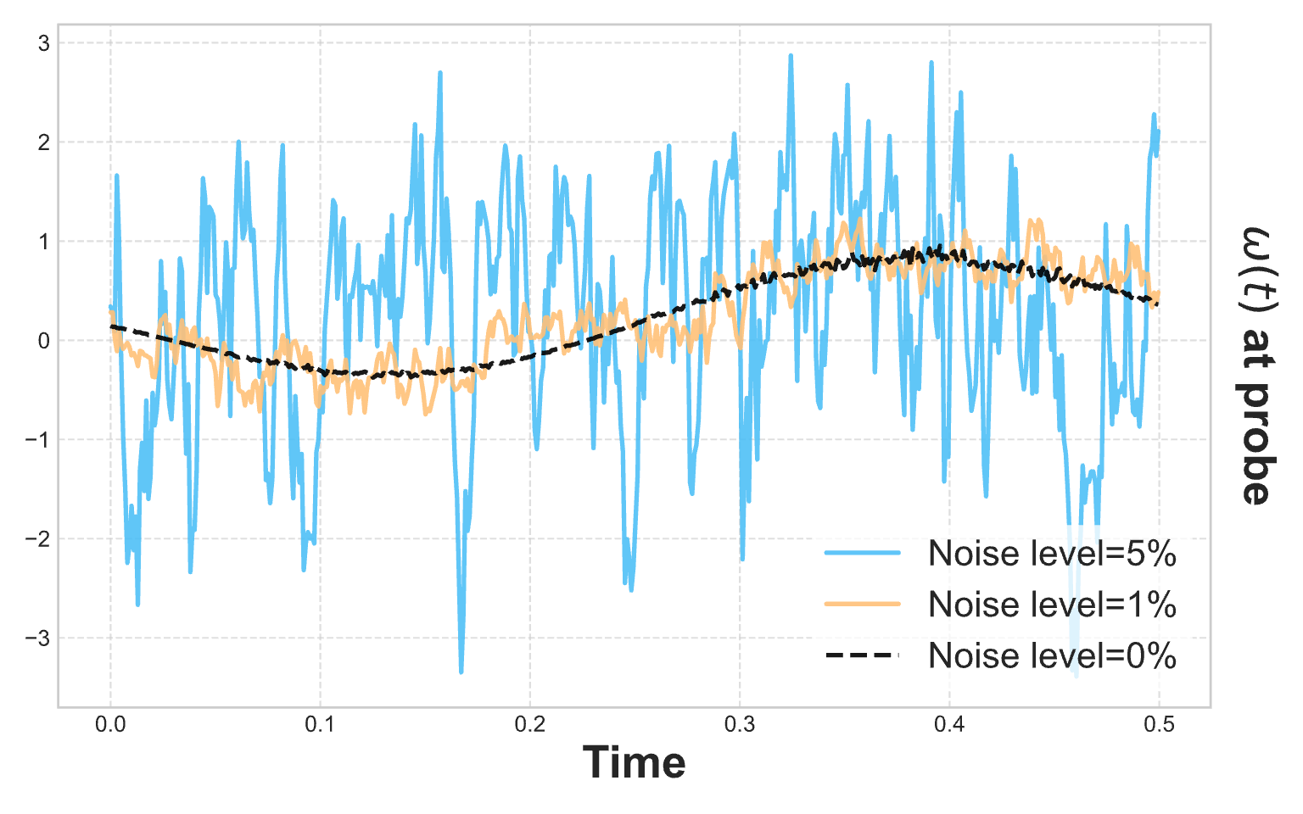
Acquire Data
Measure Noise Impact
ODE
PDE
Notes:
Dots are very small: everything should be made much bigger
Reduce the tiks to much less
Try to put the trajectory dshed below
Write the name of the two cases in the box
draw onw box for ODE and ONE for PDE
First column
1. Collect Data ______
2. Estimate Noise
Add label for the noise of the PDE
Put on the same line and try to align arrows
Reduce time points in the PDE trajectories
Try to simplify the legedns by using 1x noise, 2x noise, 5x noise
Estimate Fidelity

Slide 2
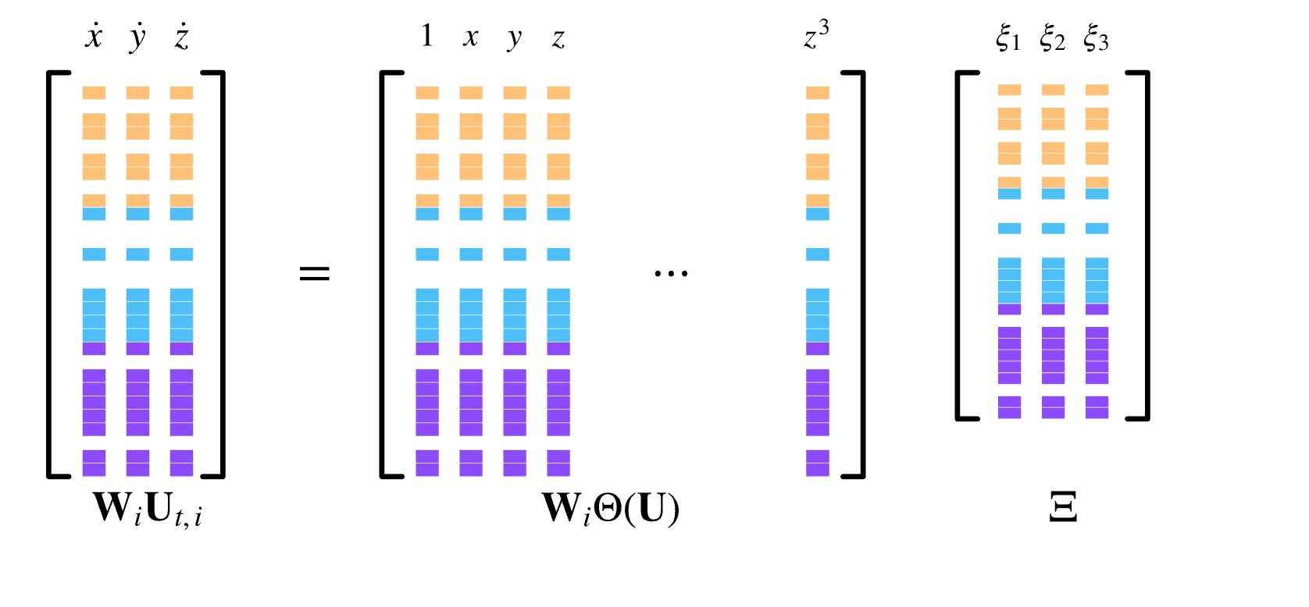
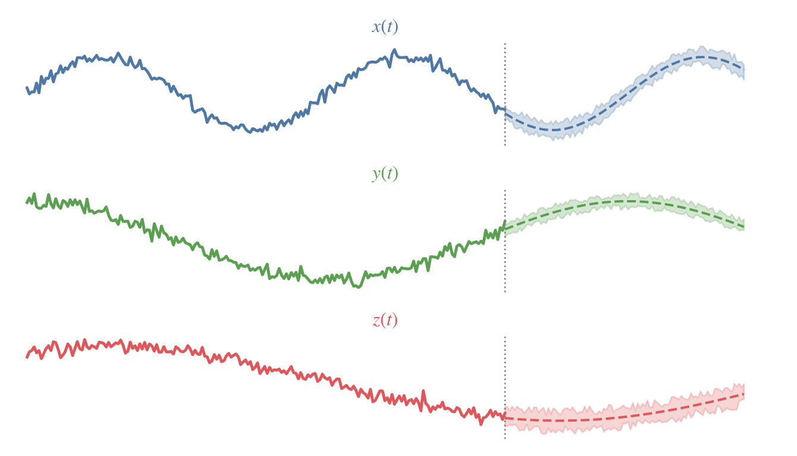
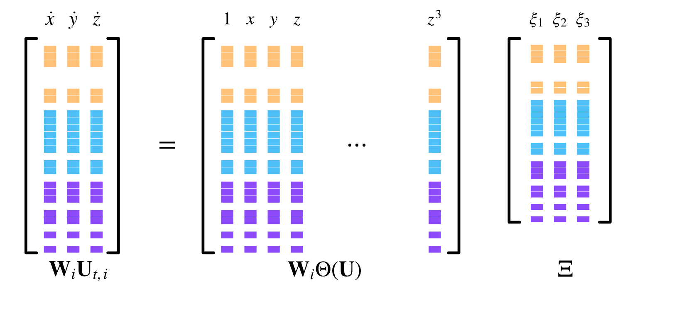
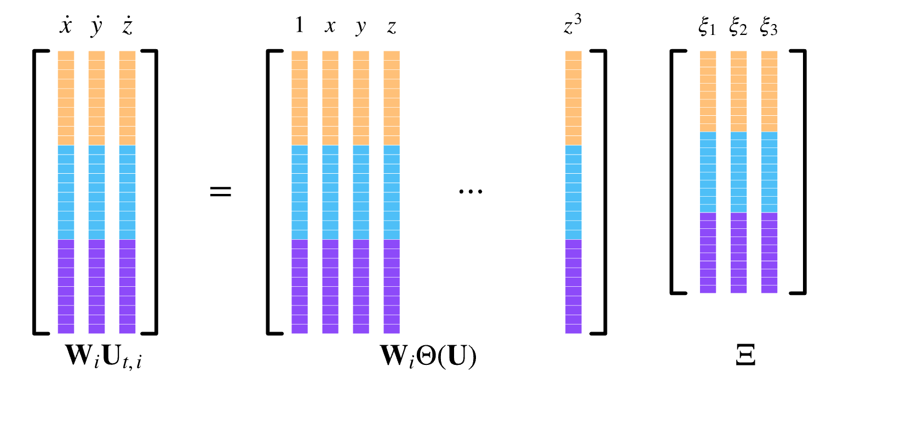
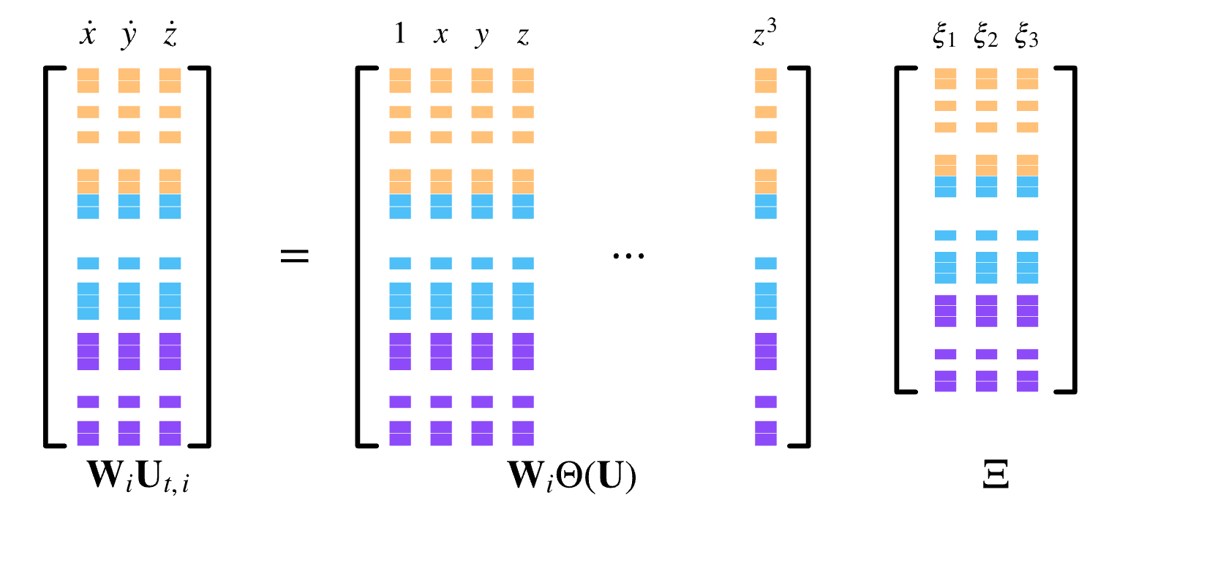
Ensembling
Assemble Library
Modelling and Forecasting
…
Weight Samples by Importance
Notes:
show taht it is the blue
threee ensemble sindy
remove standard Sindy

