Slide 1
Instructions
Proyek PRAUAS
IEE3032 - PBW
_{Filipus Dani - 202000135}

Slide 2
NODE -RED
NODE-RED
_{27 Sensor Random dan Dashboard}

Slide 3
27 Sensor
Node-RED
SPESIFIKASI SENSOR
Pabrik Smart Farm
Subsistem susu hewani dan telur
Subsistem daging merah
a. Sensor Temperature Infrared (-50-380OC)
b. Sensor Conductivity (0-200 mS/cm)
c. Sensor Flow Susu (0-10 L/min)
Aktuator Milking machine (0-100 mm/s)
a. Sensor CO (0-500 ppm)
b. Sensor Amonia (0-100 ppm)
c. Sensor Pressure (0-500kPa)
Aktuator Slaughter machine (0-200 rad/s)
Aktuator smart farm:
Output produk (0-1000 kg/hari)
Subsistem daging putih
a. Sensor O2 (0-25%)
b. Sensor CO2 (0-5000 ppm)
c. Sensor Water Level (0-10 m)
Aktuator Feeding machine (0-300 cm2/s)

Slide 4
27 Sensor
Node-RED
SPESIFIKASI SENSOR
Pabrik Smart Plantation
Subsistem sumber karbohidrat
Subsistem sayuran
a. Sensor Soil Moisture (0-100%)
b. Sensor pH (0-14 unit)
c. Sensor Sunlight (0-1000 lux)
Aktuator Output gramasi karbohidrat (0-1000 gr/s)
a. Sensor Humidity (0-100%)
b. Sensor Anemometer (0-50 m/s)
c. Sensor UV (0-1000 mW/cm2)
Aktuator Sprayer (0-200 cm3/s)
Aktuator smart plantation:
Hasil tanam (0-100 ton/bulan)
Subsistem buah-buahan
a. Sensor Solar Radiation (0-2000 W/m2)
b. Sensor Berat Buah (0-10 kg)
c. Sensor Color Hue (0-360O)
Aktuator Pemberi pupuk (0-5 kg)

Slide 5
27 Sensor
Node-RED
SPESIFIKASI SENSOR
Pabrik Smart Restaurant
Subsistem deteksi musim
Subsistem deteksi hasil penjualan
a. Sensor Barometer (0-200 kPa)
b. Sensor Wind Vane (0-360O)
c. Sensor Visibility (0-10 km)
Aktuator AC (16-32 OC)
a. Sensor Inventory Stock (0-100%)
b. Sensor Selling Rate (0-5000 item/day)
c. Sensor Customer Satisfaction (0-10)
Aktuator Diskon (0-20%)
Aktuator smart restaurant:
Proyeksi Keuntungan (-10-200 jt/bulan)
Aktuator Seluruh Pabrik:
Output nilai pabrik (0-100)
Subsistem deteksi jumlah pengunjung restoran
a. Sensor Occupancy (0-100%)
b. Sensor Audio (0-90 dB)
c. Sensor Sentimen (0-100%)
Aktuator Petunjuk Jumlah Kursi (0-100)

Slide 6
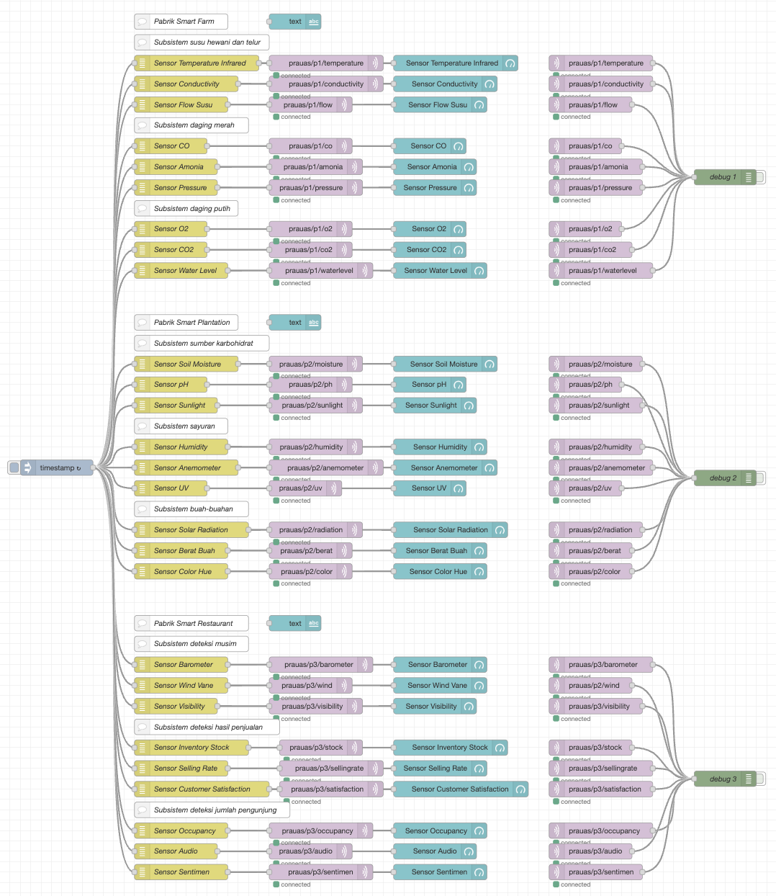
Flow Nod
9 Sensor
Flow NODE-RED
3 pabrik masing-masing dengan 3 subsistem masing-masing dengan 3 sensor. Total 27 sensor dengan jangkauan nilai tersendiri dan topik MQTT tersendiri
Notes:
To change the image behind the Mock up.
Select the layer - > Right Click -> Send to Back -> Delete the image -> Drag & Drop your Own Picture -> Send to Back (again)

Slide 7
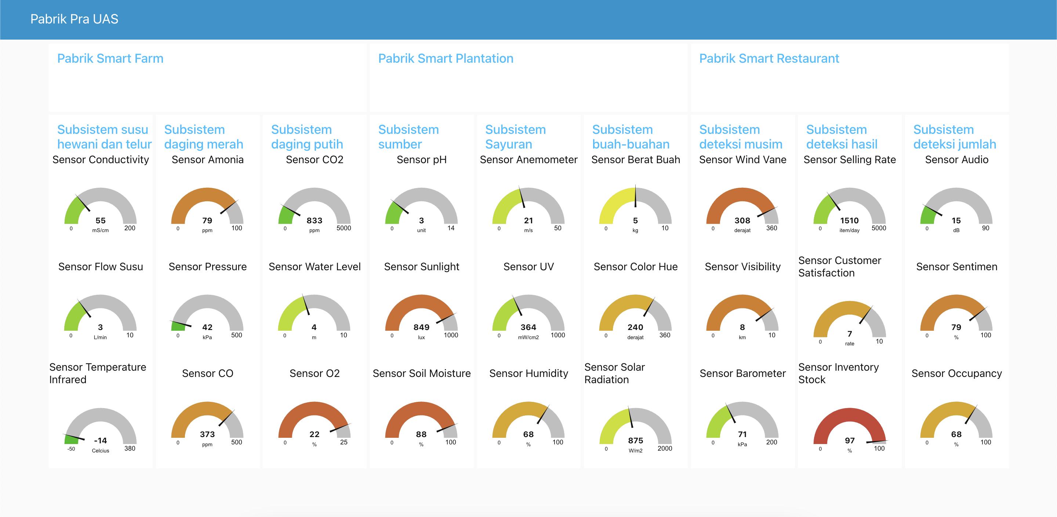
Dashboard Nod
9 Sensor
Dashboard NODE-RED
Notes:
To change the image behind the Mock up.
Select the layer - > Right Click -> Send to Back -> Delete the image -> Drag & Drop your Own Picture -> Send to Back (again)

Slide 8
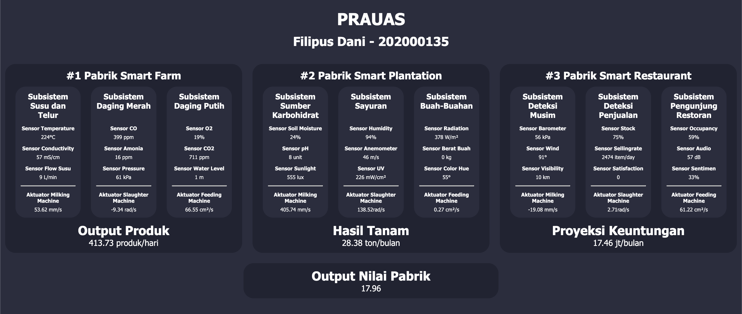
Komunikasi MQTT
Dashboard Django
Notes:
To change the image behind the Mock up.
Select the layer - > Right Click -> Send to Back -> Delete the image -> Drag & Drop your Own Picture -> Send to Back (again)

Slide 9
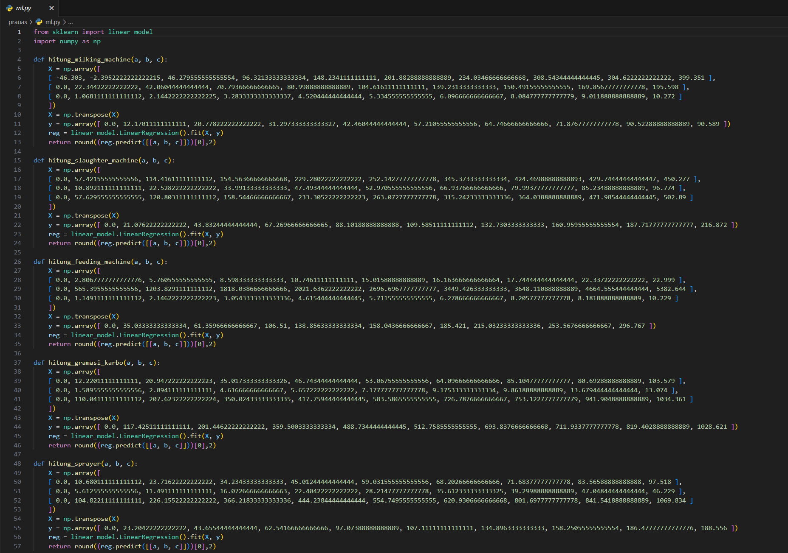
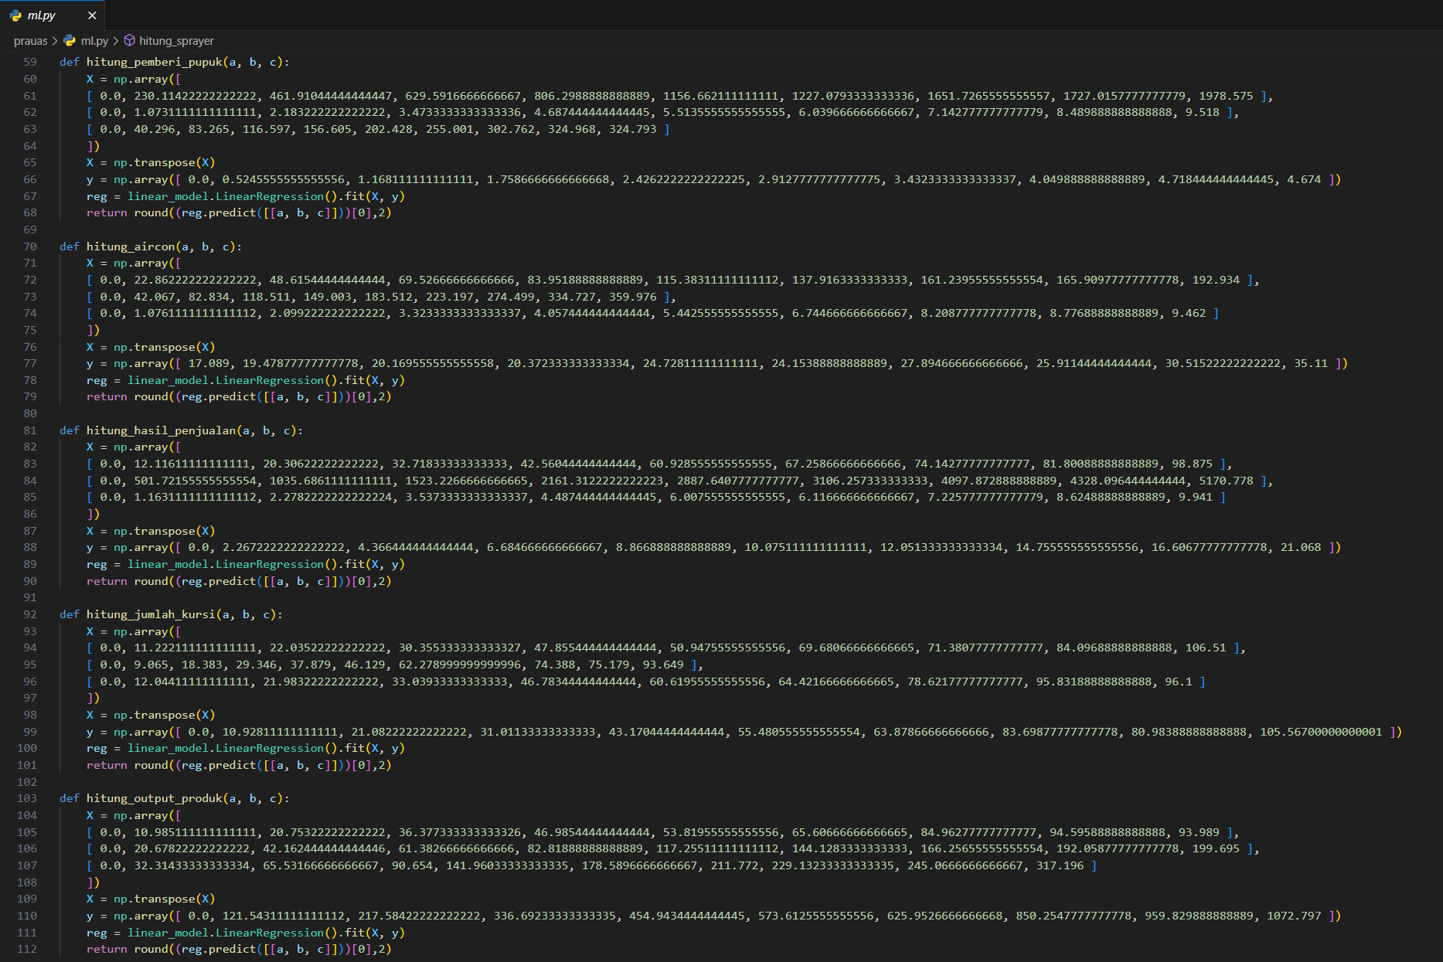
Django
Machine Learning
Notes:
To change the image behind the Mock up.
Select the layer - > Right Click -> Send to Back -> Delete the image -> Drag & Drop your Own Picture -> Send to Back (again)

Slide 10
Terima Kasih

