Slide 1
The Mission
Stand up an OpenShift environment not prod ready
Deploy an app in OpenShift
Document process so others can reference
Not become an OpenShift master overnight
Notes:
-My feel for the objectives after reading the mission and talking to shea
-Short period of time to explore OpenShift there are going to be things in OpenShift that don’t make sense right away. Not going to spend all the time digging into the details, but document those challenges and come back and explore in more detail

Slide 2
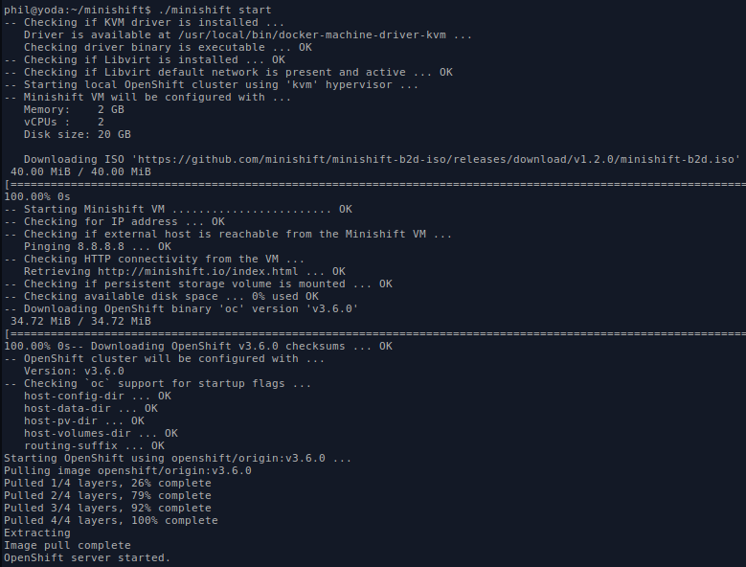
OpenShift Deployment
The easy way, minishift
Notes:
-Wanted to get right into OpenShift to explorer and not spent time figuring out how to an install from scratch
-Have tab open:
https://www.openshift.org/minishift/
-Demo starting up of minishift and into the web site
-Handy to have a local copy running for testing without having to connect to a remote instance

Slide 3
Exploring OpenShift
Getting familiar with oc tool
Docker machine & boot2docker
SSH to minishift VM
http://xip.io is pretty neat
Notes:
-logging into the gui
-some built in help and documentation oc types is handy
-added user to cluster admin test
-can ssh to minishift VM and look at docker config, push images to internal docker registry
-didn’t know about docker machine (lightweight vm that runs docker engine) and boot2docker (light vm designed to run docker)
-xip.io that is used for routes is pretty neat for doing testing

Slide 4
The App
Pretty simple web js app on git hub
deploy app with httpd image and git repo
deploy docker hub image - root issue & workaround
add image to catalog - works but errors out
does not contain a value for the io.openshift.s2i.scripts-url label
Notes:
-first was deploying the web app with the built in httpd image and selecting git repo
-Then try deploying using the docker hub image that has code in. Used web gui, ran into permission issue as image wanted to run as root. Found a work around, not the best
-Found guide to get image to catalog with just editing. Shows up but doesn’t deploy. Need to read up more on how that whole process works in detail

Slide 5
Challenges
Admin settings of OpenShift seem complex
User and permissions inside of OpenShift
Getting image to not run as root
Adding Image to catalog
Notes:
-Lots of buttons and knobs to set on the admin side of things
-Seems like a service account gets created for every project & each project is very isolated from each other
-Allowing users to see each other’s projects didn’t seem straight forward
-Deploy image from web gui to pull from docker hub

Slide 6
Resources
Free ebook from RedHat – OpenShift for Dev’s
https://www.openshift.com/promotions/for-developers.html
Video walk through showing OpenShift by using minishift
https://blog.openshift.com/openshift-3-walkthrough/
OpenShift docs
https://docs.openshift.org/
MiniShift
https://github.com/minishift/minishift
Notes:
-openshift docs has section about minishift

Slide 7
Resources - Detailed
Getting image to run as root
Command: ./oc adm policy add-scc-to-user anyuid -z default
Link: blog.openshift.com/getting-any-docker-image-running-in-your-own-openshift-cluster/
Setting user as cluser admin
Command: ./oc adm policy add-cluster-role-to-user cluster-admin admin
Link: docs.openshift.com/container-platform/3.3/admin_solutions/user_role_mgmt.html
Adding image to catalog
Link: blog.openshift.com/jupyter-on-openshift-part-7-adding-the-image-to-the-catalog/
Command: ./oc import-image tomaskral/nonroot-nginx –confirm
./oc get imagestreams/nginx -o json (to look at image stream definition)
./oc patch imagestreams/nonroot-nginx --type json --patch '[{"op": "replace", "path": "/spec/tags/0/annotations", "value": { "tags": "builder" }}]'
Can ssh to minishift vm: IP of minishift with docker/tcuser
Push images to internal docker registry: docs.openshift.org/latest/minishift/openshift/openshift-docker-registry.html
OC client tool: github.com/openshift/origin/releases/tag/v3.6.0

Slide 8
Impressions
Really powerful for dev teams
Making life easier for ops team
Interface not overly complicated
Service providers using metered OpenShift ?
OpenShift used for production?
Notes:
-devs don’t need to mess around with local docker containers. Can just log in hit some buttons have a test environment ready
-Once set up and running I can see things being easier for ops team. Don’t have to maintain and admin test and lab environments for devs
-Web interface is pretty straight forward for a lot of complex things happening under the hood. There isn’t a lot of knobs and buttons to mess around with

