Slide 1
Views v0.4.0 / pi v0.4.0
The basic advice regarding response times has been about the same for thirty years [Miller 1968; Card et al. 1991]:
0.1 second is about the limit for having the user feel that the system is reacting instantaneously, meaning that no special feedback is necessary except to display the result.
1.0 second is about the limit for the user's flow of thought to stay uninterrupted, even though the user will notice the delay. Normally, no special feedback is necessary during delays of more than 0.1 but less than 1.0 second, but the user does lose the feeling of operating directly on the data.
10 seconds is about the limit for keeping the user's attention focused on the dialogue. For longer delays, users will want to perform other tasks while waiting for the computer to finish, so they should be given feedback indicating when the computer expects to be done. Feedback during the delay is especially important if the response time is likely to be highly variable, since users will then not know what to expect.

Slide 2
Need for Speed
Too slow:
Node.js
MongoDB/NoSQL
qPid, AMQP
HighCharts.js
jQuery

Slide 3
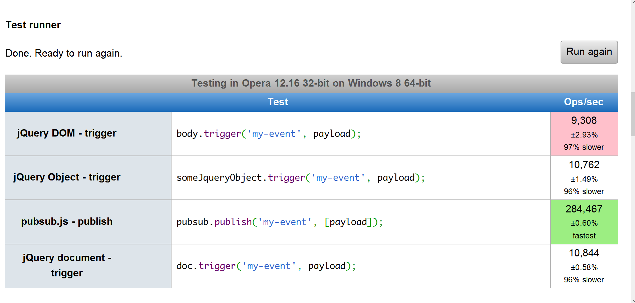
The Problem with jQuery

Slide 4
Need for Speed
Fast enough:
Varnish
Redis
MySQL
ZeroMQ
raphaël.js
GreenSock Animation Platform
HTML5 native functions
CSS3 transformations

Slide 5
Need for Speed
Aggregér på øverste nivå allerede under innsamling av data, sortér i time buckets
Gjør batch-inserts i MySQL
Bruk Redis som sentralt applikasjonsminne, unix sockets til kommunikasjon, og igbinary som serializer
Bruk Redis til PHP-sesjoner
Best-practice GIF beacon

Slide 6
GIF Beacon Done Right
Method works in any browser
Encode event object in GIF url
Request the url with a new Image() object, do not touch the DOM
Catch encoded events in varnish VCL
Return HTTP 204 No-Content
Saves one HTTP packet
Only 204 means success
Pipe 204 events from Shared Memory with varnishlog into an aggregator script or program
Publish live aggregates on Redis pubsub channels
Batch-insert collected data into MySQL at set intervals
Keep all application data in Redis
Good for collecting big amounts of data from a big number of clients
No return channel*

Slide 7
Need for Speed
AJAX: PING + HTTP-overhead (ca. 120 ms)
WebSocket: PING + TCP-overhead (<40 ms)
PING-tid innenlands i Norge ligger på 20-100ms
Modulær innlasting over WebSocket
Caching av js-/css-moduler i LocalStorage
Bakgrunnsprosessering i WebWorker

Slide 8
Need for Speed
MySQL v Redis
MySQL query: a few milliseconds
Redis cache check: a few microseconds

Slide 9
Out with The Old, in with The New
OUT
AJAX
XML
MVC/MVV
data binding
callback pasta
Node.js
NoSQL
Jquery
IN
WebSockets
JSON
Flow-Based Programming
Self-contained components
WebWorkers & messaging
Redis pubsub
MySQL with table templates
HTML5 native functions

Slide 10
A Brand Spanking New Idea: π
Use message passing across a namespace to tie any number of clients and server services together.
Open a bridge between the client and server messaging hubs, creating a namespace across the entire ecosystem, each with a single point of entry, making User Access Control a breeze.
Add services to the namespace by writing scripts and programs that listen for commands and publish their progress and status within their own namespaces.
Server scripts written in PHP have access to the current PHP session even when running as CLI.

Slide 11
A Brand Spanking New Idea: π
pi is a simple, lightweight, flexible and fast application platform for HTML5 compatible browsers.
It features:
- modular loading and dependency injection of JS and CSS
- session support
- utility libraries
- a set of conventions for how to implement an interface
- a visual component library called pcl
- a pcl charting library using SVG and raphaël.js
- streaming live JSON data packets over SSE (Server-Sent Events) / EventSource

Slide 12
  <head>
  <script>
  var
  π = π || {}, pi = pi || π;
  // activate the debugger
  π.DEBUG = true;
  //make a note of when we started up.
  pi.__sessionstart = (new Date()).getTime();
  </script>
  ...
  <!-- bootstrap -->
  <script src="../../assets/js/pi.js"></script>
  </body>

Slide 13
  var
  π = π || {},
  pi = pi || π;
  /* ---- Our top level namespaces ---- */
  π.events = π.events || { _loaded: false, _ns: 'events' };
  π.srv = π.srv || { _loaded: false, _ns: 'srv' };
  π.app = π.app || { _loaded: false, _ns: 'app' };
  π.pcl = π.pcl || { _loaded: false, _ns: 'pcl' };
  π.session = π.session || { _loaded: false, _ns: 'session' };
  π.system = π.system || { _loaded: false, _ns: 'system' };
  π.debug = π.debug || { _loaded: false, _ns: 'debug' };
  π.io = π.io || { _loaded: false, _ns: 'io' };
  π.util = π.util || { _loaded: false, _ns: 'util' };
  π.math = π.math || { _loaded: false, _ns: 'math' };
  π.statistics = π.statistics || { _loaded: false, _ns: 'statistics' };
  // your plugins here, like so: pi.plugins.yourcompany.yourplugin.[whatever] = { # your plugin object };
  π.plugins = π.plugins || { _loaded: false, _ns: 'plugins' };
  // for all you crazy cowboys, your own playground
  π.maverick = π.maverick || { _loaded: false, _ns: 'maverick' };
  π.PI_ROOT = "assets/js/";
  π.LIB_ROOT = "../../assets/js/";
  π.SRV_ROOT = "../../../srv/";

Slide 14
  π.inject = function (src, elem) {
  var
  element = elem || document.body,
  fragment = document.createDocumentFragment(),
  container = document.createElement("div");
  container.innerHTML = src;
  fragment.appendChild(container);
  element.appendChild(fragment);
  };
  π.require = function(module, async, defer, callback){
  if (π.loaded[module.replace(/\./g,'_')]) {
  if(callback) {
  this.callback.call("loaded");
  }
  return true;
  }
  var
  cursor = document.getElementsByTagName ("head")[0] || document.documentElement,
  path = '../../assets/js/pi.',
  script = document.createElement('script');

Slide 15
WebService API
JSON WebService
With PHP session
Good for collecting data from a large number of individual user sessions
Too slow for application use

Slide 16
WebSocket API
JSON messaging
Full duplex connection
With PHP session
Extremely low latency (PING + milliseconds)
No gzip
The only connection fast enough for application use, when target is <100ms response times

Slide 17
SSE/EventSource API
JSON packet stream
With PHP session
Low latency (PING + milliseconds)
No gzip
No return channel
Good for streaming events to multiple clients

Slide 18
Bottlenecks
Incoming: Probably varnish and/or NIC, but needs verification
Outgoing: Each WebSocket session uses a separate port, limiting the maximum number of concurrent sessions to tens of thousands. Each session will also run as a separate thread on the server, which may end up being the performance roof first hit on servers with CPU constraints.
Intra-process communication: Some services have the potential to overload a single redis instance with pubsub messages if programmers make mistakes, or we hit an Ariane 5-type situation where one type of message occurs much more frequently than anticipated.

Slide 19
Scalability
Incoming: Put HAProxy in front of several Varnish servers
Incoming / Intra-process: Use Redis version with clustering support
Outgoing: Implement a generic server that is able to handle multiple concurrent sessions in a single-thread event loop. Make the generic server transparent to the namespace, so multiple instances can run on the same server
Application data sharing: Use multiple instances of single-threaded Redis servers, or the clustered version of Redis
Inherent: Use a separate (or virtual) server for each application

Slide 20
Reliability
Increase reliability: Exchange AMQP or similar for Redis pubsub => guaranteed message delivery, but at greater cost
Varnish + LAMP = The Gold Standard of reliable, high-speed performance

Slide 21
What's unique?
Combining namespaces and scopes across the client and server
Addressable JSON data packets
Addressable events
System-wide event subscriptions with wildcards
Callbacks implemented system-wide (cli/srv roundtrip ~= 30-60 ms)
Bridging subnets
Dynamic mapping of client-side namespaces to different server-side scopes
Class/instance data storage in separate scopes on server
Fine-grained access control can be implemented using a standard method like the unix file system or htaccess, and that single access control class can be shared by all server-side scripts.
The Flow-based approach: A forgotten seventies' programming paradigm uniquely suited for asynchronous systems, highly efficient in both real-time and batch-processing systems

Slide 22
Namespacing
Use namespaces throughout the system for organization of files, classes, objects and session data:
Pi installation
App
Component
User
Connect any two points throughout the system.
Broadcast using wildcards
Use point-to-point delivery

Slide 23
Scoping
Connect namespaces through routing across client/server bridge, in order to create four scopes:
System (installation of pi)
App (running on system)
Component (running within app)
User
Rewrite addresses at bridge to create «subnets»
Single point of access => easy access control
Connect any two points throughout the system.

Slide 24
From Rewrite to Rewiring
Use rule-based routing to connect to server-side services and storage:
Rewrite addresses at bridge to create «subnets»
Rewrite addresses to store data at correct level of specificity: company, application, user, session, component, instance

Slide 25
Take pcl
Component config and data is stored under:
pi.pcl.[company].[component]
Component config and data within app is stored at:
pi.pcl.[app].[company].[component] (for all app users).
Component data storage at instance level:
pi.pcl.[app].[company].[component].[id]
Connect pi.sessions.[app.company.user] server-side to pi.app.session client-side, and create «data spaces» transparent to client app code through a router at the client/server bridge

Slide 26
Go Global
π lives in the global scope of the browser's JavaScript VM. A global app object is an inoculation against scope confusion and the Pyramid of Doom.
Any part of pi can always create a pointer to itself, and can find it's own local and systemic address.
Our client session maps directly to the server session.

Slide 27
The Power of Conventional Thinking
Use conventions to overcome structural problems arising from loose typing and anonymous scopes
Don't (just don't) try to create a verbose, self-describing data interchange format (looking at you, XML)
Use standard, light-weight data encoding, and pre-defined data structures for best performance. (Binary, where possible)
Trusted code always obeys conventions
Some words are reserved by convention
Examples:
π. is for sysdevs only, everybody else uses pi.
Any code starting with π. is part of the platform
Any code starting with pi. is using or extending the platform

Slide 28
Protect Your Privacy
Objects whose name starts with a single underscore, are considered _protected.
Objects whose name starts with a double underscore, are considered __private.
_protected functions/variables should only be accessed by trusted code.
__private functions/variables should only be accessed by the object itself

Slide 29
Principles / Philosophy
Just-in-time (JIT)
Batch processing
Background workers
Speculative execution
Self-contained units
Pass-through
Keep moving forward
Follow conventions
Use best practices

Slide 30
The Future
Client
Go binary (JS typed arrays)
WebRTC
Server
Go compiled or LLVM (C / Pascal / Python)

Slide 31
The End Station
Go point-to-point binary messaging with
ZeroMQ*
* just add namespaces

