Slide 1
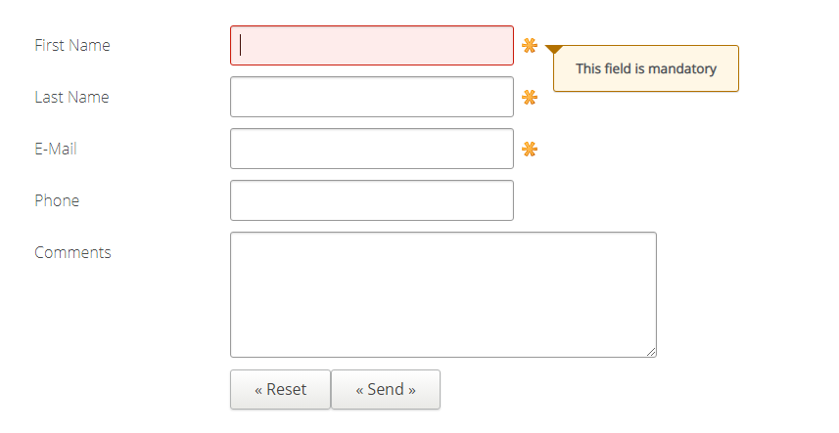

Slide 2

First Name
Last Name
E-Mail
Phone
Comments

Slide 3


