Slide 1
Diabetic patients readmission prediction
Filippo Colella [03344], Camilla Marvaldi [03548], Lorenzo Licini [03884], Riccardo Leonetti [03515], Parik Lanke [03536], Jahnavi Minocha [04497]

Slide 2
Task overview
Goal:
: Predicting early (<30 days) readmission [binary classification task]
: Predicting early (<30 days), late (>30 days) and No readmission [multi level classification task]
Process:
Data Import Encoding and Initial Cleaning
Exploratory Data Analysis (EDA)
Modeling and and Sensitivity analysis on:
- Model choice, ensembling and tuning
- Explainability
- Evaluation

Slide 3
Data overview
Data: 79,183 patient encounters, 49 features.
Targets :
“Early_readm” (binary) : has “1” if readmitted within 30 days, “0” otherwise
“Readmitted” (multiclass) : has 3 levels (readmitted within 30 days , after 30 days , not readmitted)
In general we verified that apart from a very few amount of times (<1%) if a patient had “readmitted” = No then its NBR doesn’t show up anymore in the dataset.

Slide 4
NaN analysis and Feature reduction
Replaced placeholders into NaNs
Missing values summary :
max_glu_serum: 94.7% missing -> dropped as too many missing values
A1Cresult: 83.1% missing -> dropped as too many missing values
medical_specialty: 48.7% missing -> dropped cause of assumption
payer_code: 40.1% missing -> dropped cause irrelevant
Other columns like race, also had missing values (2-10%).-> imputed differently
10 Drugs columns dropping due to low relevance
A1C results and max glucose serum were temporarily retained in EDA

Slide 5
Features Encoding
Categorical features encoded as different levels (Ordinal features like age were encoded giving an increasing order to the categories)
Diagnosis encoding following top 60 levels + disease taxonomy
Target encoding
Features type map

Slide 6
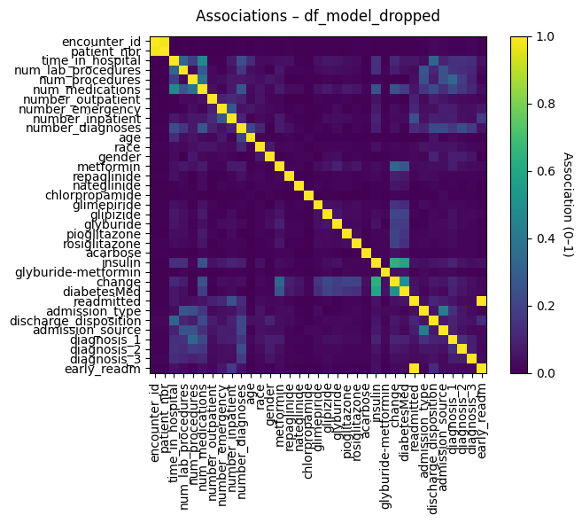
EDA - Correlation Heatmap
A function choses the right metric accordion to feature type
Metrics are plotted and stored in a df
Performed also for the df with A1C and max_glu_serum
Not meaningful on subslice of the data

Slide 7
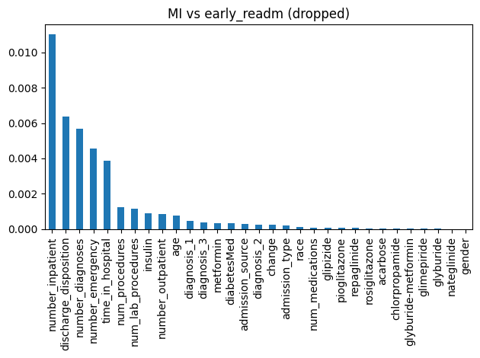
EDA - Mutual Information - Early readm

Slide 8
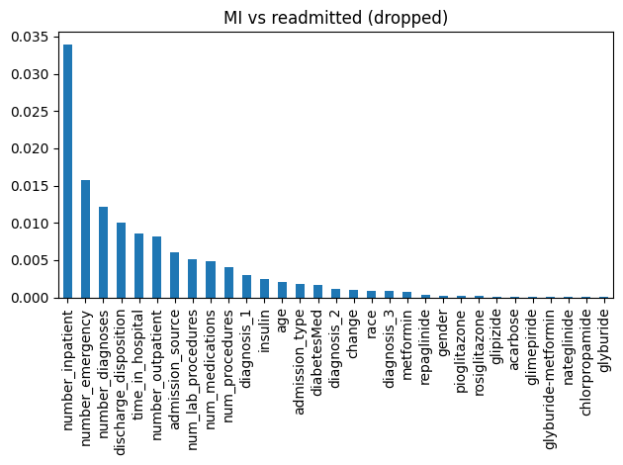
EDA - Mutual Information - readmitted

Slide 9
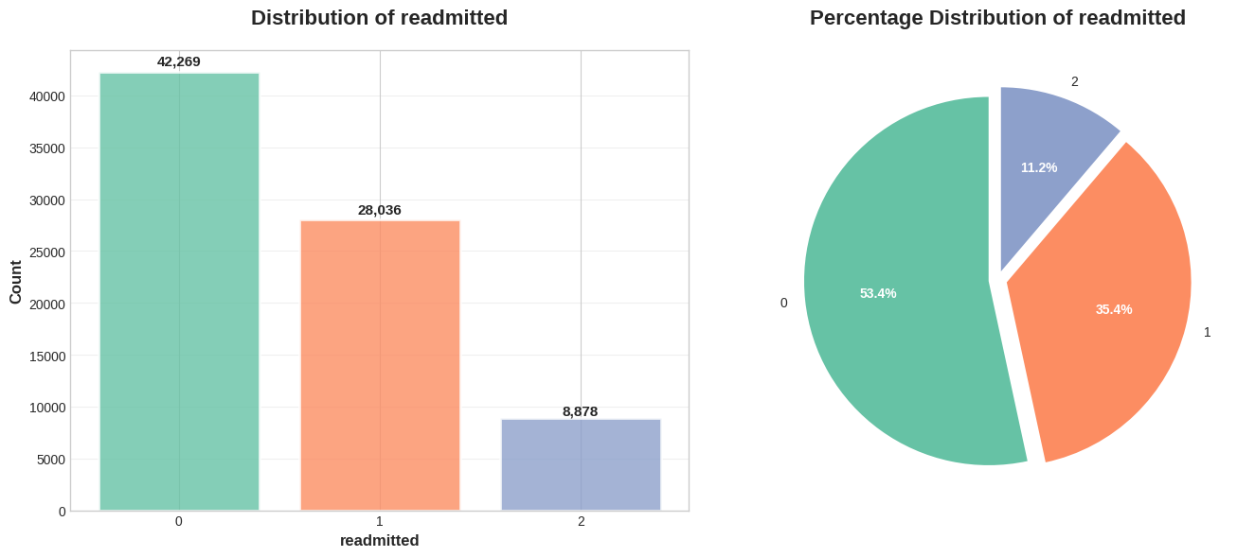
EDA - Target distribution - Multiclass

Slide 10
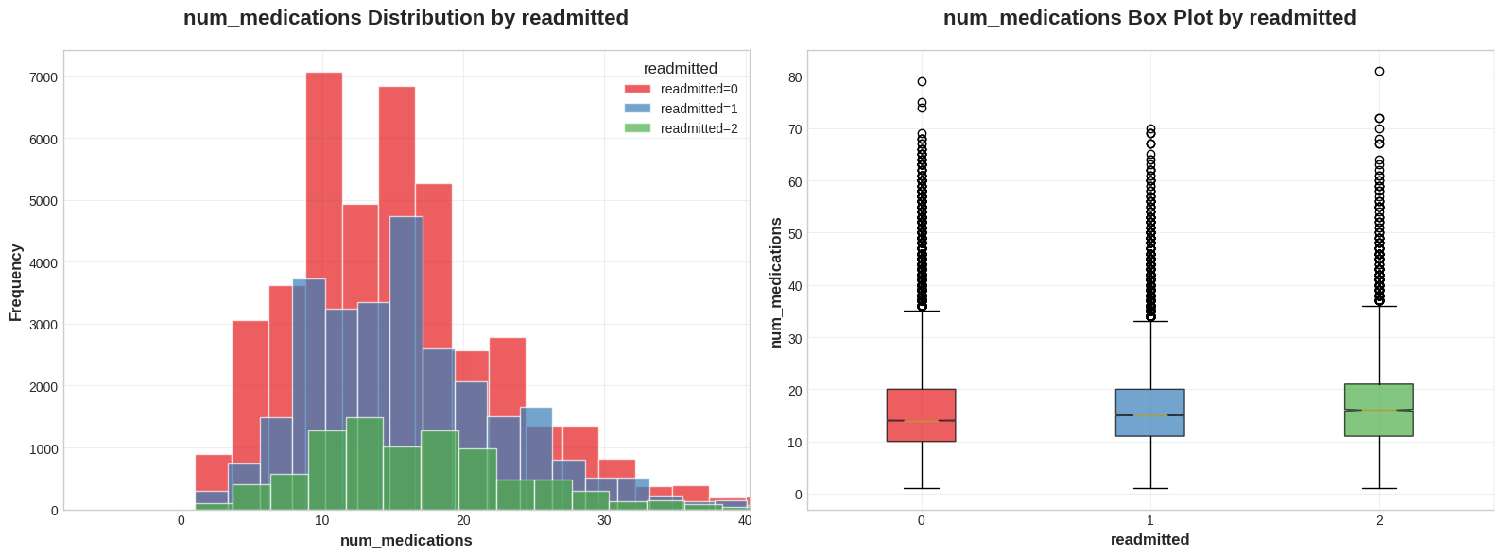
EDA - Target stratification - Multiclass

Slide 11
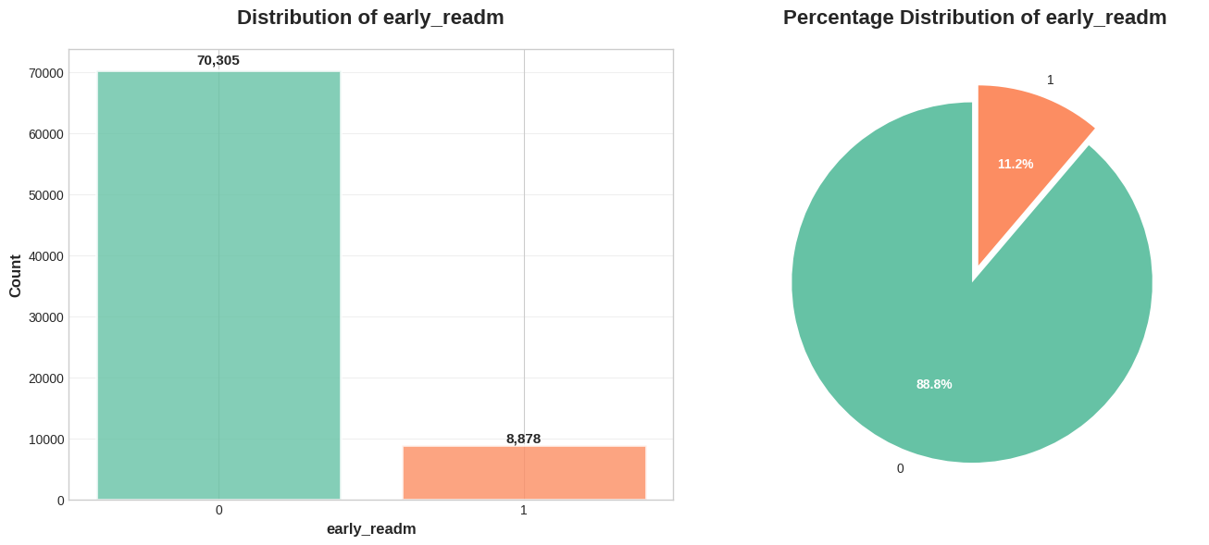
EDA - Target distribution - Binary

Slide 12
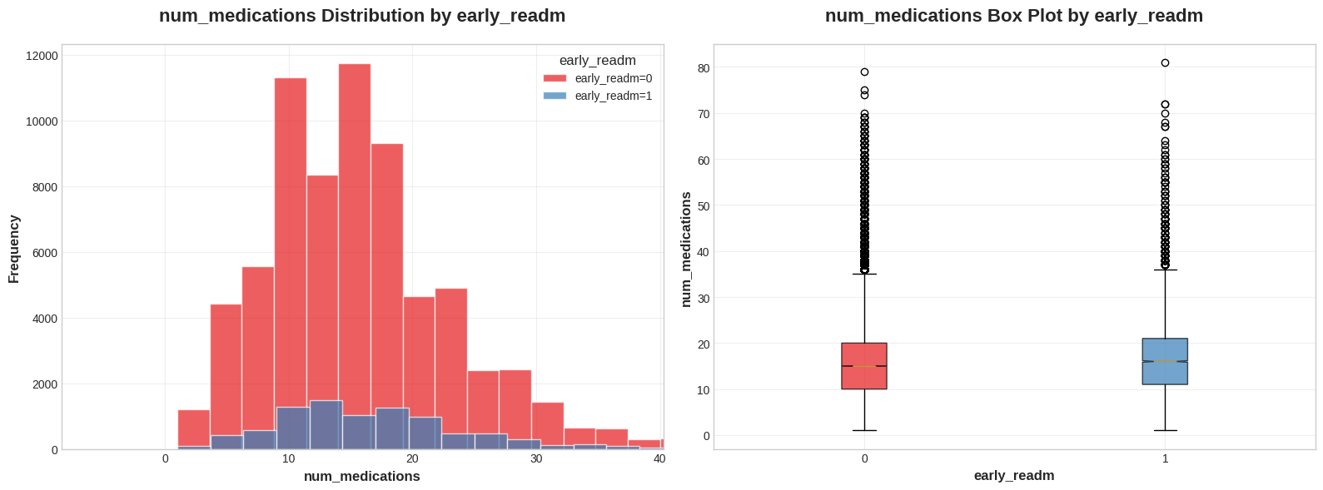
EDA - Target stratification - Binary

Slide 13
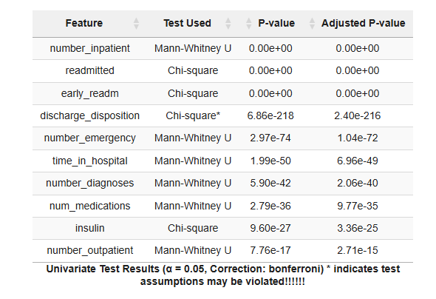
EDA - Univariate test function (both targets)

Slide 14
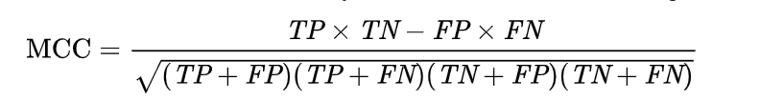
Evaluation Metric choice - MCC [1]
Computed directly on CM
More reliable for imbalance datasets
the ROC AUC does not say anything about precision and negative predictive value.
its high value always corresponds to high values for each of the four confusion matrix basic rates
[1] Chicco, D., Jurman, G. The Matthews correlation coefficient (MCC) should replace the ROC AUC as the standard metric for assessing binary classification. BioData Mining 16, 4 (2023). https://doi.org/10.1186/s13040-023-00322-4

Slide 15
Pre processing pipelines - Missing Value Imputation:
Threshold = 10%
KNN if > 10 %
Simple imputation (Mode, Median) if < Threshold

Slide 16
Continuous (Integers) Columns Pre-processing
Imputation
Yeo-Johnson power transform due to skewness
Isolation Forest outliers clipping (1st-99th percentile)
Standardization

Slide 17
Ordinal and Nominal Columns:
Already encoded
Imputing only
No other transformations

Slide 18
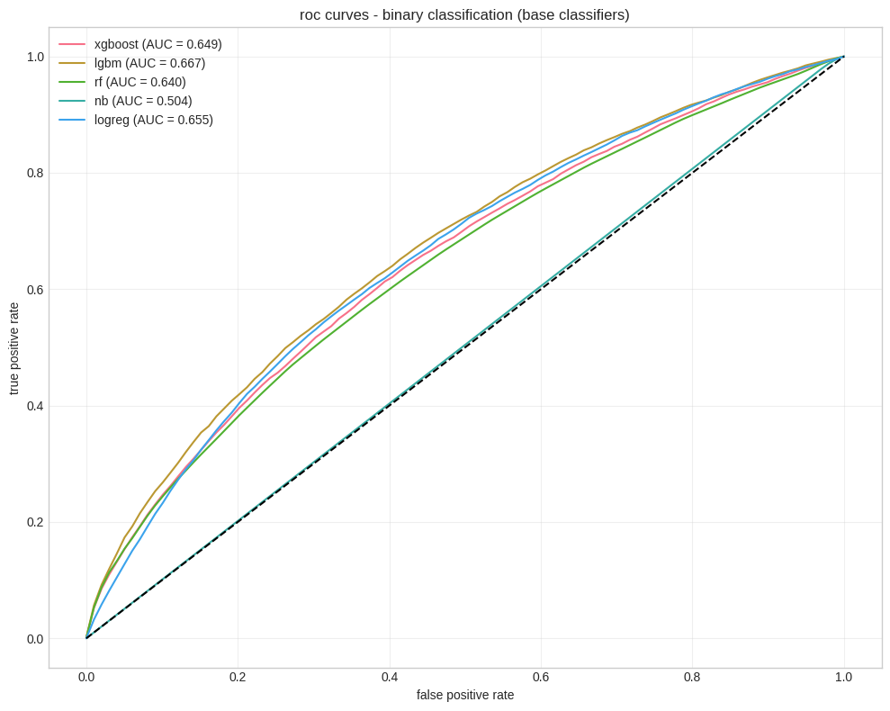
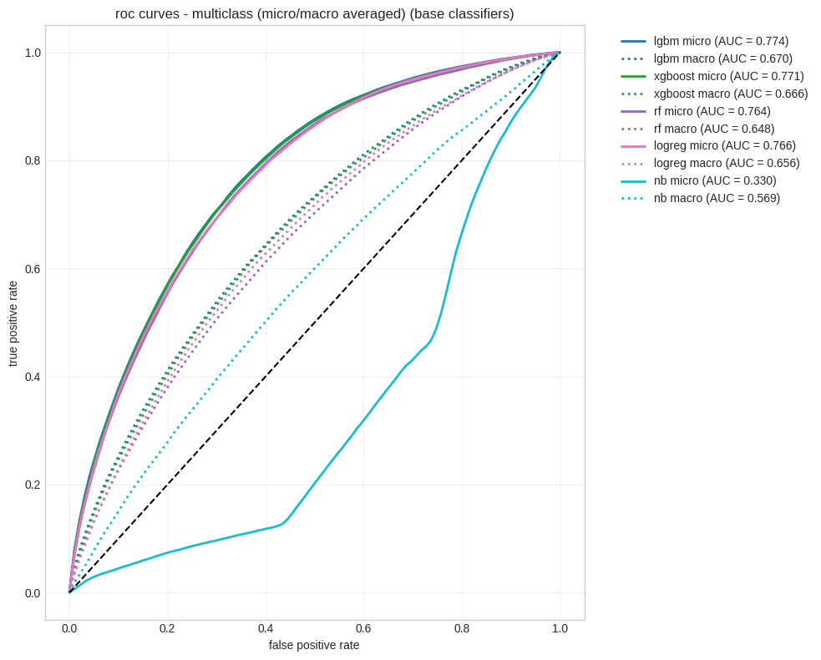
Baseline classifier evaluation

Slide 19
Ensemble size evaluation
Top 2 vs Top 3 performers comparison on 5 fold CV ranked by MCC

Slide 20
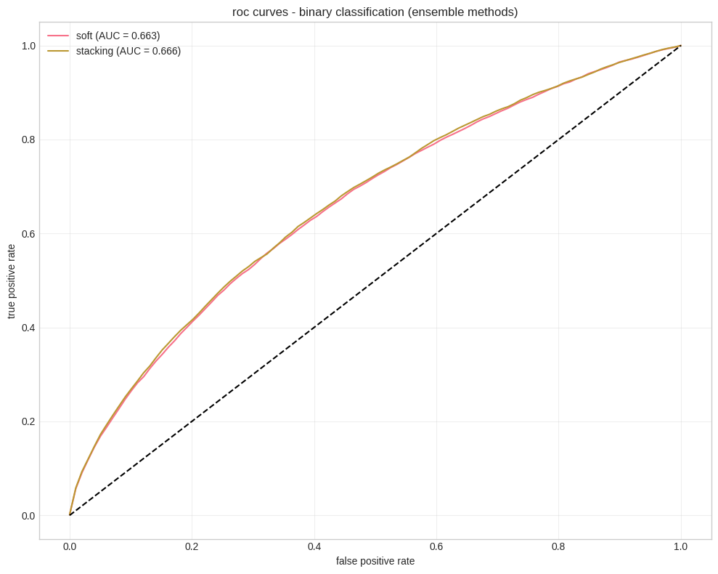
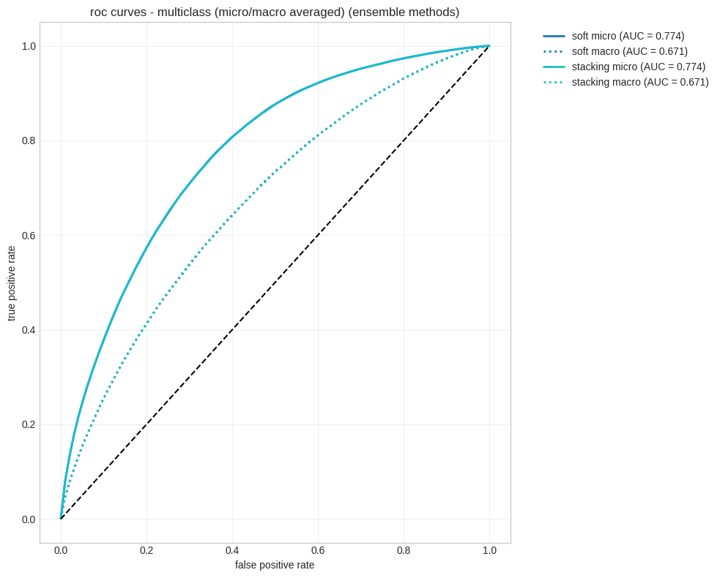
Ensemble method comparison

Slide 21
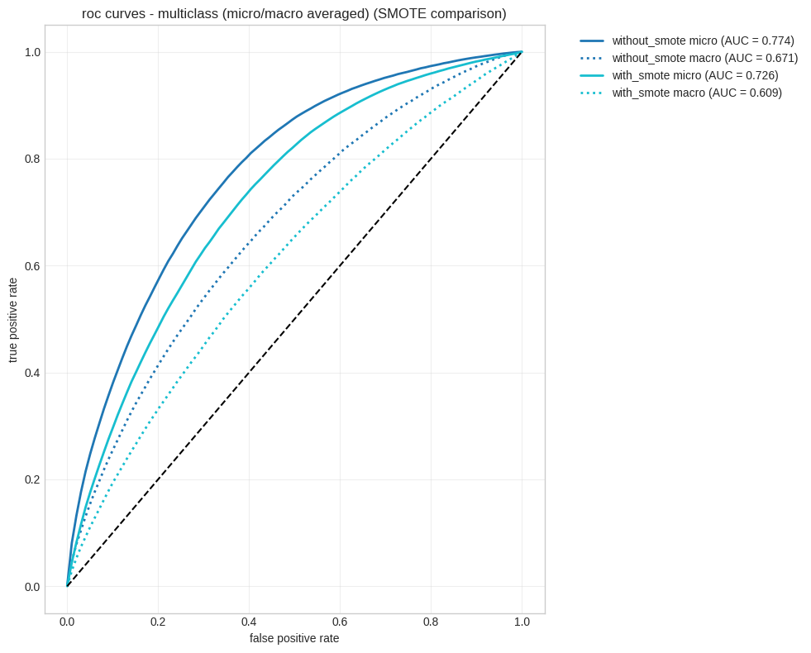
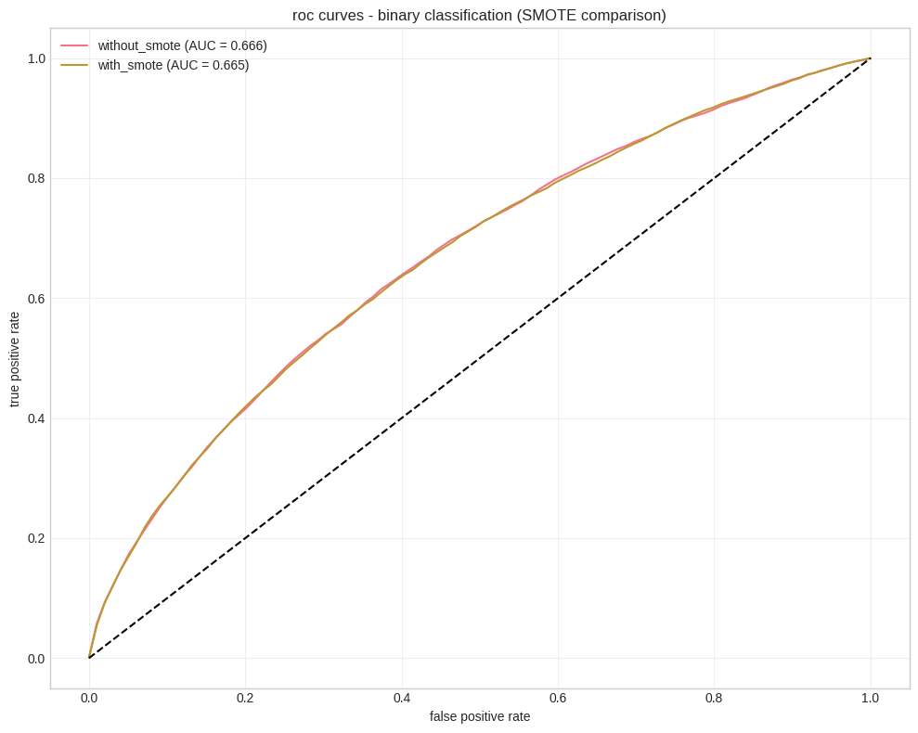
Oversampling choice (given imbalance)
+50% of minority(ies) class(es)

Slide 22
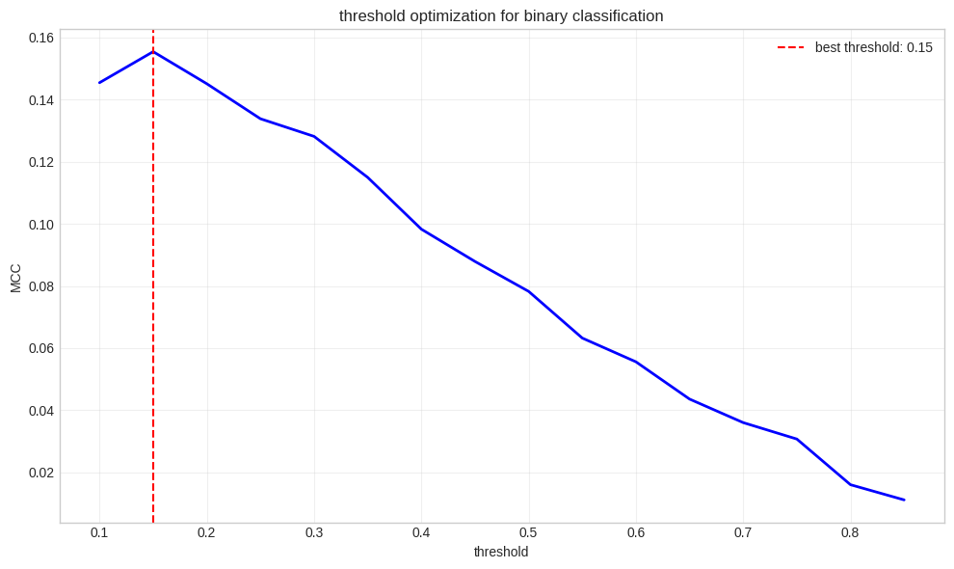
Binary Threshold optimization

Slide 23
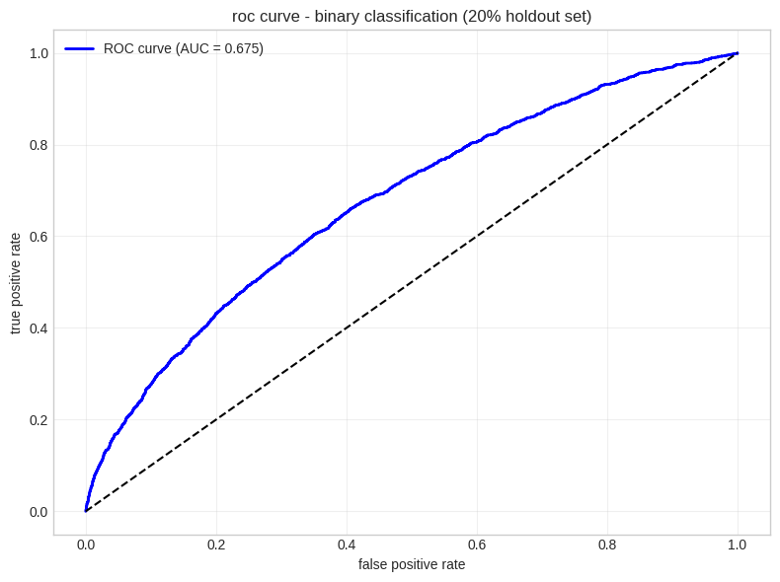
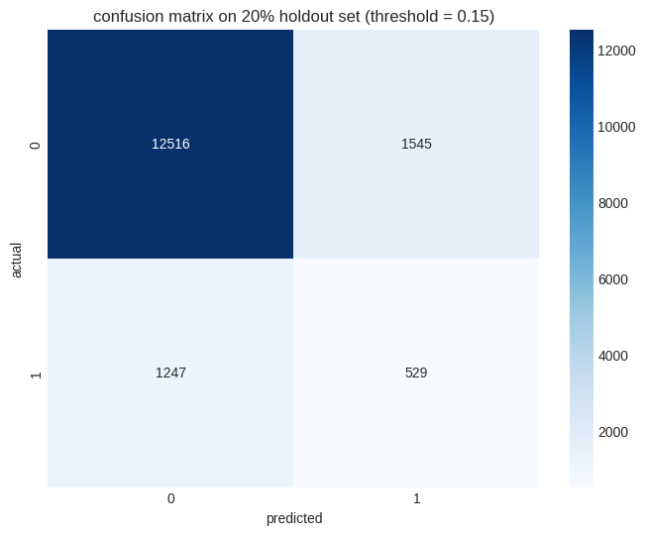
Binary model (threshold tuned) performance

Slide 24
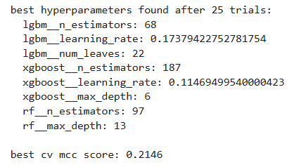
Hyperparameters tuning (Optuna) Multiclass only
Summary :

Slide 25
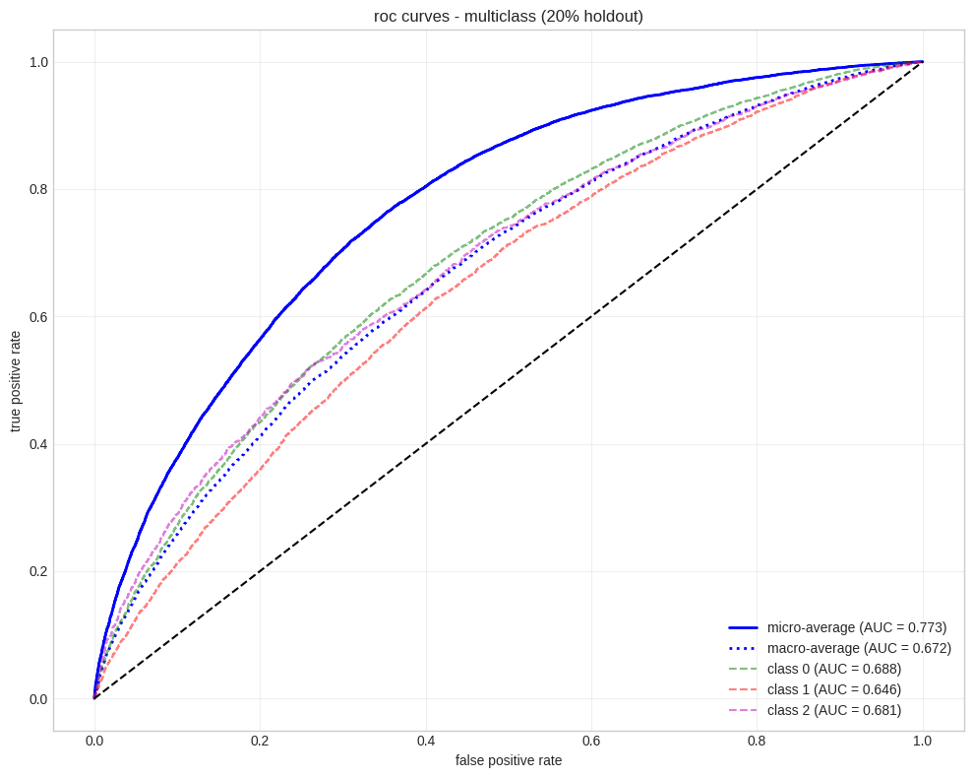
Tuned multiclass ensemble model performance summary
MCC: 0.2036

Slide 26
GNN Approach
Model each patient as a network
Nodes: Individual patient encounters
Edges: Built using patient number to link encounters from the same patient
Target: Multiclass readmission only

Slide 27
Training strategy
Patient-wise split:
Train: 60%, Validation: 10%, Test: 15%
Prevents leakage across patient encounters

Slide 28
Workflow
New feature creation : sequence encounter (the model is aware of previous encounters)
Very brief EDA
Base model comparison on evaluation set
Model choice based on MCC and plotting micro and macro AUC
Re training of best model and evaluation on Hold out set
Attempted explainability with node weights inspections
Final model training and prediction file generation

Slide 29
Pre-processing
Feature Handling:
Continuous features:
KNN imputation if threshold is met -> Standardization
Categorical features:
OHE and mostar frequent imputation

Slide 30
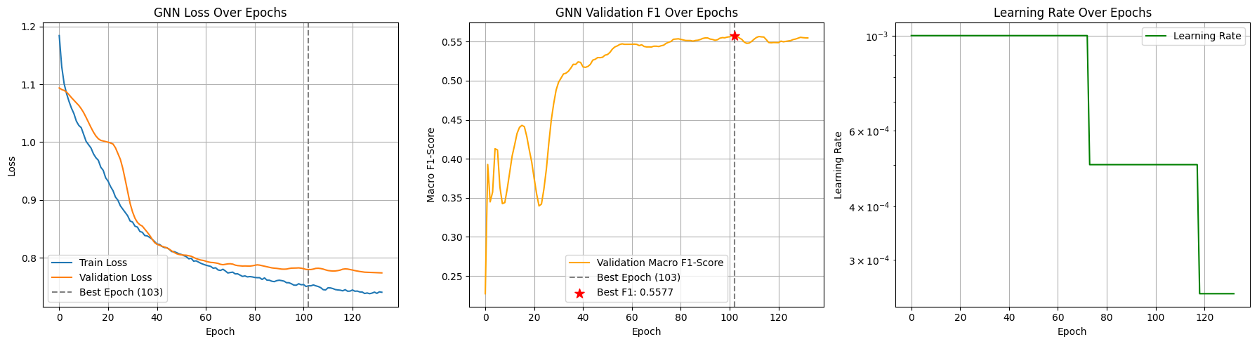
GNN Training report

Slide 31
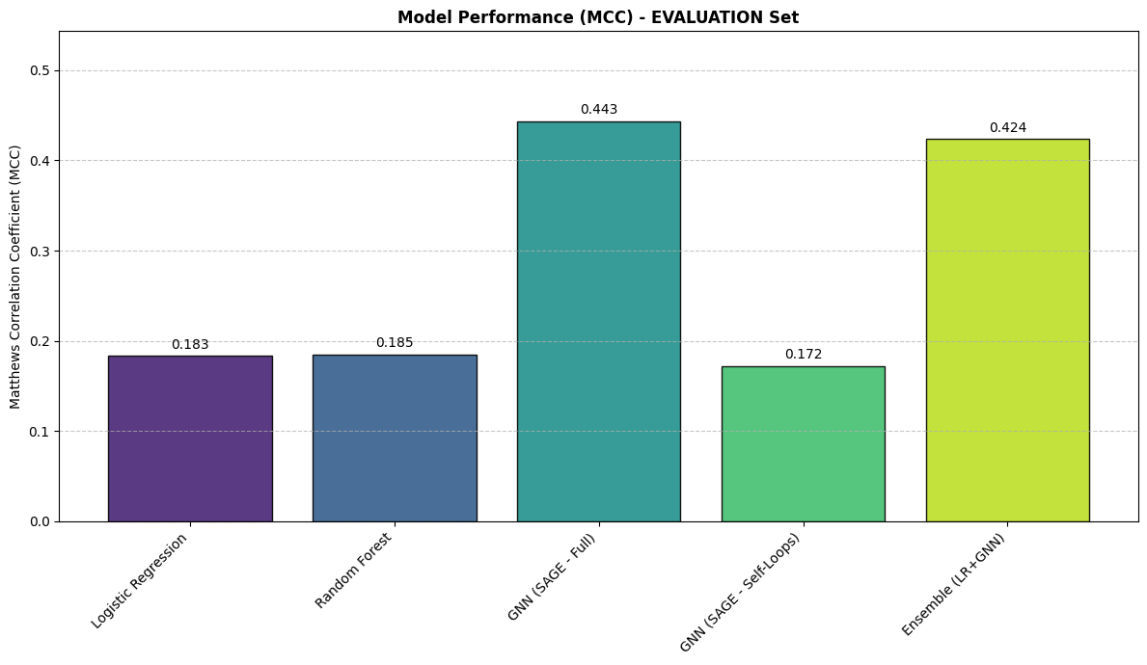
MCC Comparison - Eval set

Slide 32
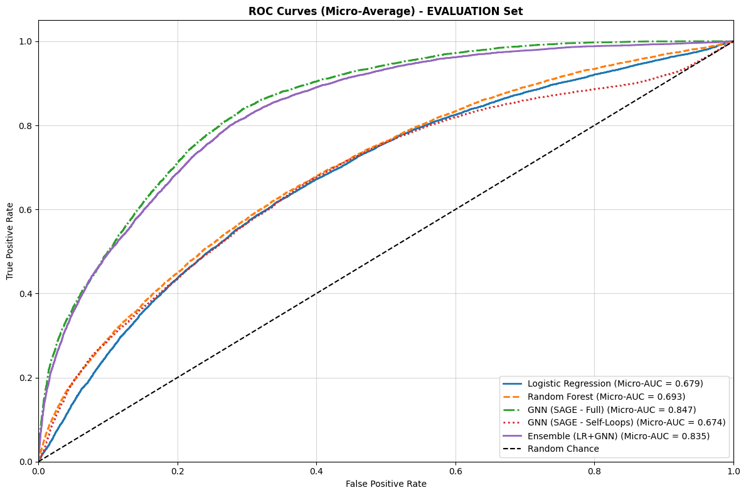

Slide 33
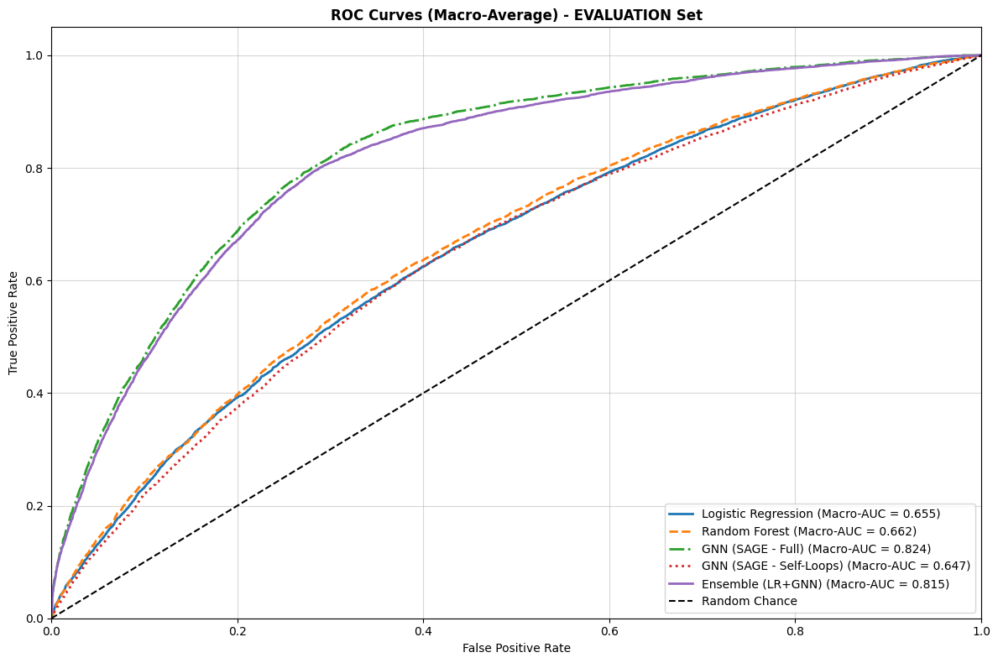

Slide 34
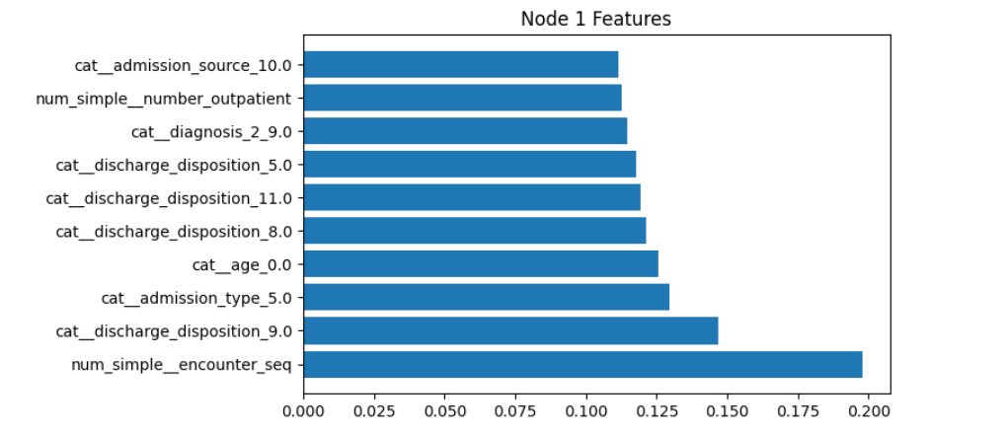
Nodes FI

Slide 35
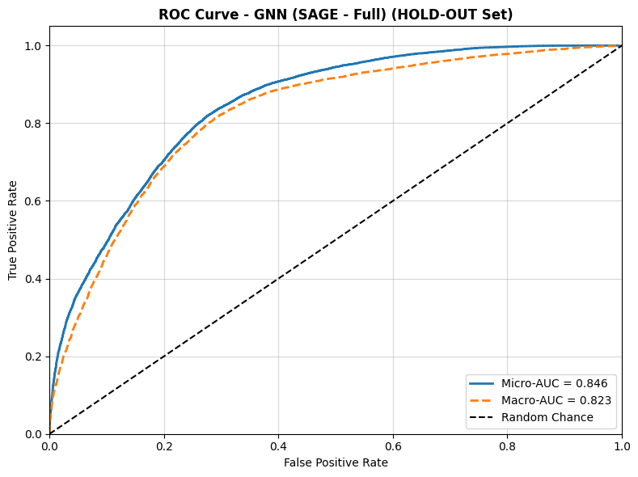
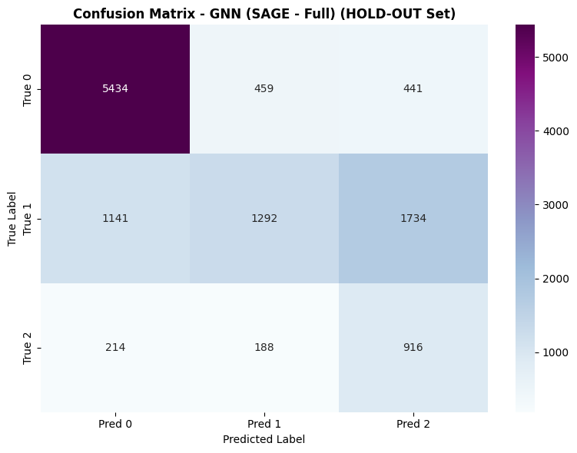
Hold out set performance

