Slide 1

NetZero Commitment & Company Carbon Emissions:
A Climate Action Check In The MSCI ACWI World index
Filippo Radice Fossati
Notes:
Hi Everybody, thanks for being here today. my name is Filippo Radice, currently serving as a data scientist fellow at Entelligent, a firm that helps financial institutions managing climate transition risk.
I am here today to present my latest research project where I was interested to assess potential relationship between company carbon emissions level and their commitment to netzero

Slide 2

Introduction
Entelligent
Helping financial institutions identifying and managing climate transition risk
Scenario Analysis Top-down and Bottom-up technology
Top-down model uses scenarios to capture policies, technologies and market preferences changing under different climate scenarios
The Bottom-up includes data on company emissions
Notes:
First off, What is transition risk?
As everybody might know to mitigate the impact of climate change, we need to decarbonize our economy, moving away from fossil fuels to rely more on renewable. transformation at all levels.. Policies, technologies market preferences.. And so investors need to understand how adaptable companies are to adjust to this transformation.. Thee higher the adaptability the lower the risk and the better the investment ..
To answer to this need Entelligent invented a technology that could use scenarios built by financial expert, economist and climate scientist that describes how the world could change to become carbon neutral.. Together with company level information such as carbon emission.. Why emission? It is going to be hard for a company to adapt if its business model relies a lot from fossil fuels and all the sudden biden administration introduces a very high carbon tax right.. And so by using again scenarios and company information Entelligent can estimate company adaptability.. Their exposure to transition risk

Slide 3
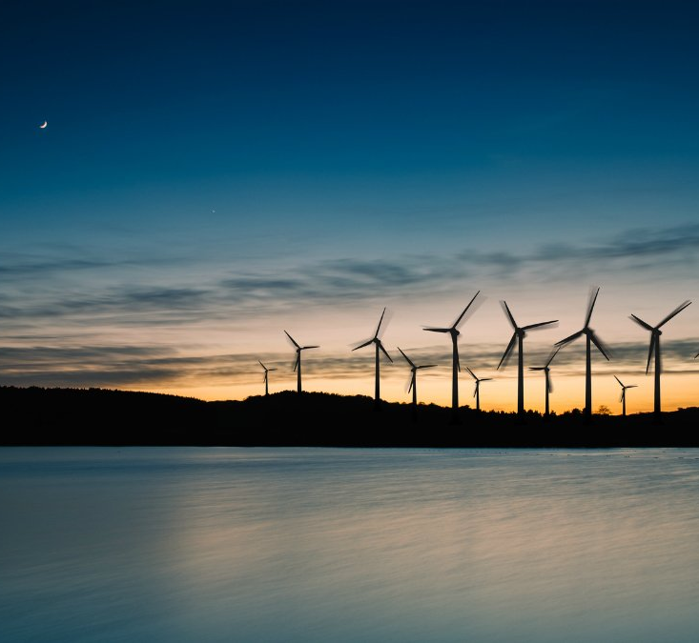
Problem Statement
Does a NetZero commitment have a relationship with company current emission level?
Are companies with a lower level of carbon emissions more likely to commit to NetZero?
Notes:
Company Emissions are very important for Entelligent. But not always available. Soetimes there is a need to impute those values.
To improve the accuracy of a potential imputation, for my project I decided to look for more predictors.
The one that I will be presenting today relates with company climate action commitment. First off, if there is a relationship between the level of emission and the fact that companies were deciding to commit to netzero.. Go carbon neutral.. And more precisely if companies with lower level of emission were more likely to commit to netzero

Slide 4

Data & Methodology
Data Import
& Cleaning
T-Test
Analysis
Regression
Model
Classification
Model
Streamlit
App
Notes:
To take a look at these relationships,
1. I developed first a Ttest analysis on all additional predictors;
2. then I developed a multiple linear regression model that was using only the predictors that passed Ttest.
3. Lastly, to further investigate the relationship between company carbon emissions and NetZero commitment, I developed a classification model to predict whether or not a company committed to NetZero based on a series of predictors.
4. The model has been deployed over a streamlit app with the idea of developing a user-friendly tool that could help a non-technical audience understanding which key company characteristics could increase the likelihood of NetZero commitments.
For this presentation my focus will be, after a brief description of my dataset, on the classification model and streamlit app

Slide 5
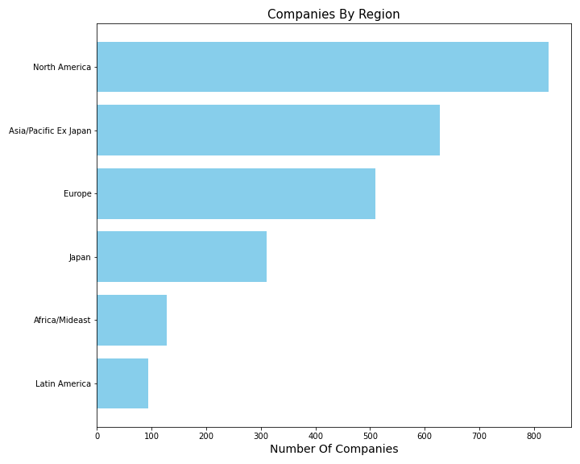

Data Import & Cleaning – Dataset Description
MSCI ACWI World Index
~2500 companies
Across Multiple Region
Notes:
Region: Europe, North America, Japan, Asia/Pacific, Latin America and Africa/Mideas.. As you can see the majority of companies are located in North America (Us and Canada), Asia /Pacific (india, china, Australia) and Europe

Slide 6
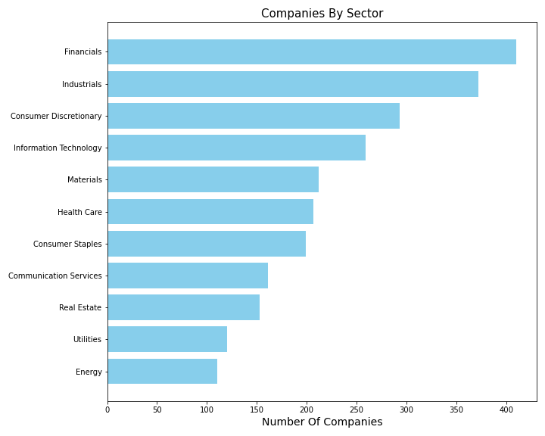
Data Import & Cleaning – Dataset Description
MSCI ACWI Benchmark
~2500 companies
Across Multiple Region
Across Multiple Sector
Notes:
This is the distribution of companies across different sectors, This is global industry classification standard (GICS), which is an industry taxonomy developed by MSCI and Standard&Poor for use by the globl financial community.
Sectors: Industrials, Consumer Discretionary, Consumer Staples, Information Technology, Financials, Communication Services, Health Care, Real Estate, Materials, Utilities and Energy
Industrials,
Consumer Discretionary - non essential by consumers but desirable if their available income is sufficient to purchase them (automobiles & Components, )
Consumer Staples – goods and services that people use on a daily basis, like food, clothing or other personal products (food & beverage & tobacco)
Information Technology (software and services/ technology hardware & equipment)
Financials (banks insurance)
Communication Services (media & entertainment)
Health Care (pharmaceuticals biotechnology & life sciences
Real Estate,
Materials,
Utilities
Energy

Slide 7
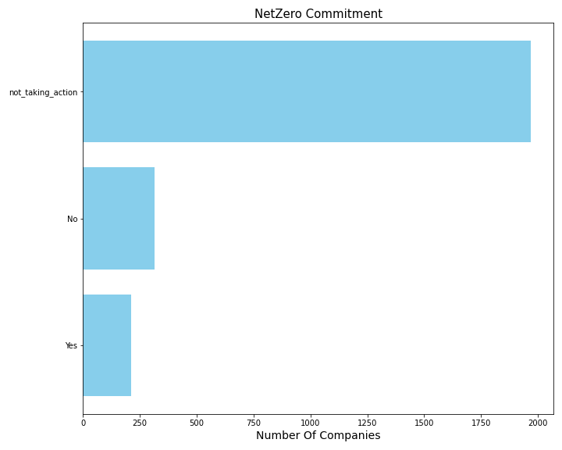

Data Import & Cleaning – Dataset Description
MSCI ACWI Benchmark
~2500 companies
Across Multiple Region
Across Multiple Sector
~1000 company climate commitments
~600 explicitly declared if they committed to NetZero
Notes:
This instead represent the total number of companies that did or did not commit to netzero.
Not taking action are companies that did not even communicate other type of targets.
I decided to remove this class form classification problem as I was interested to take a look at whom explicitly declared whether or not committed ot netzero.
Out of ~2500 companies I could only find climate actions commitment for roughly ~1000 firms. For the remaining ~2000 companies I assumed that they did not make any climate commitments yet.

Slide 8
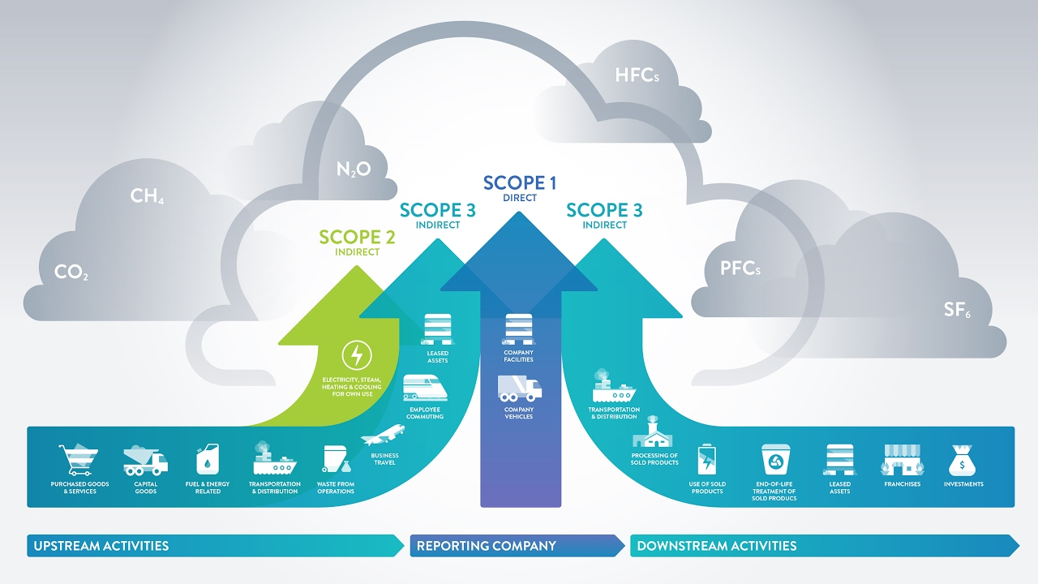
Introduction
Company Emissions
Scope 1: Emissions produced directly (Operation)
Scope 2:Emissions produced indirectly by purchasing Electricity/Heat (Operation)
Scope 3: Emissions produced indirectly through the Value Chain
Notes:
Scope 1 emissions refers to the greenhouse gases that a company emits directly, as produced from sources that are controlled or owned by the company itself (e.g. vehicle, boilers, furnaces). Companies also produce emissions indirectly by for example purchasing the electricity or energy for heating and cooling its own buildings. The energy carriers produced for company operations generates Scope 2 emissions. Scope 3 emissions instead, are the ones generated in a company value chain (suppliers and customers.
Another important distinction to make.. And we will see later why.. Is how easily for a company might be to reduce either one of these scopes..
Clearly for scope 1 and 2 is relatively easier.. They can invest in energy efficiency of their buildings change their boilers and buying electricity from utilities that producing energy mainly through energy sources.. It is harder with scope 3 emissions as those really depends from multiple actors.

Slide 9
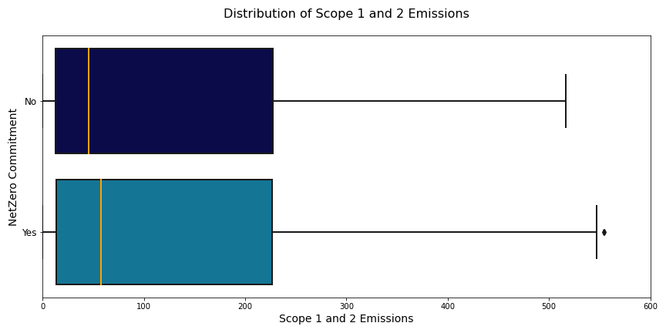
Classification Model - EDA
Lower Median Emission for Companies that did not commit to NetZero

Slide 10
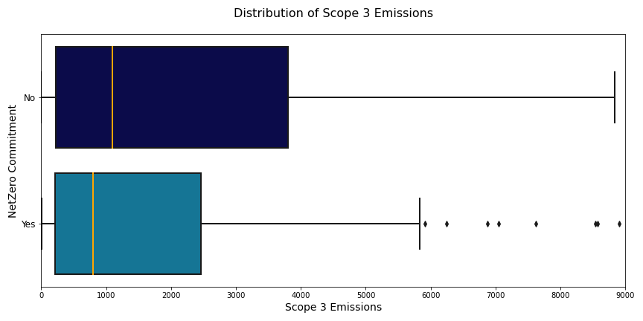
Classification Model - EDA
Lower Median Emission for Companies that did commit to NetZero
Notes:
As we will see shortly in the streamlit app this can have a great impact in the decision making for netzero commitment
Industrials,
Consumer Discretionary - non essential by consumers but desirable if their available income is sufficient to purchase them (automobiles & Components, )
Consumer Staples – goods and services that people use on a daily basis, like food, clothing or other personal products (food & beverage & tobacco)
Information Technology (software and services/ technology hardware & equipment)
Financials (banks insurance)
Communication Services (media & entertainment)
Health Care (pharmaceuticals biotechnology & life sciences
Real Estate,
Materials,
Utilities
Energy

Slide 11
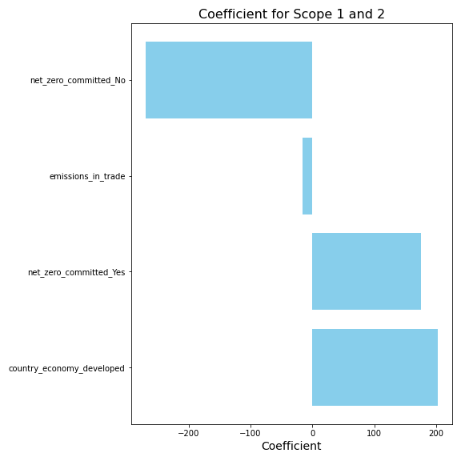
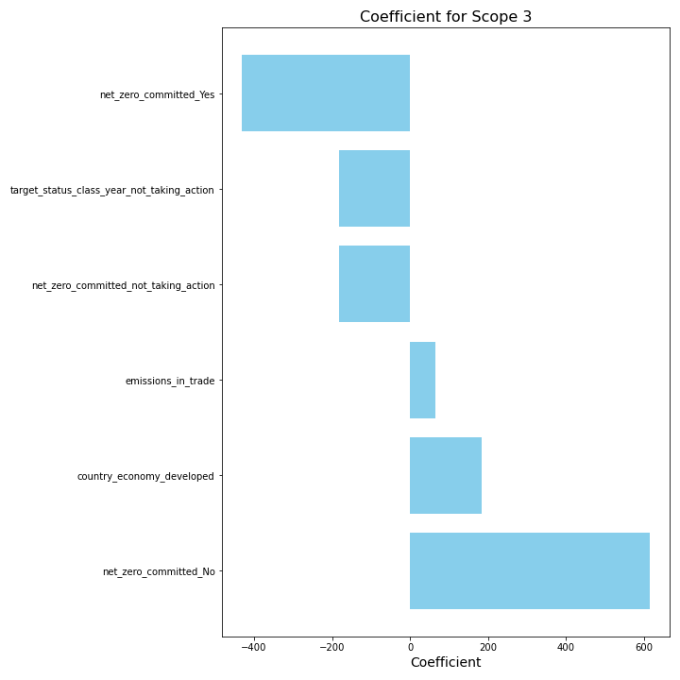
T-Test Analysis & Regression Modeling
Notes:
In the process of EDA, I looked at both correlation and t-test to determine which variables I wanted to include in the regression model. However, because I was interested to detect potential relationship between country level emission data and company climate commitments with company emissions, I decided to select only predictors that passed the ttest. The T-test analysis also helped me understand the final shape of my targets. As previously mentioned, Scope 1, Scope 2 and Scope 3 emissions were provided as three separate target. After running several T-tests, the adjusted R2s were suggesting that predictions were more accurate by combining Scope 1 and Scope 2 emissions together while leaving as a separate additional target Scope 3 emissions. The decision of leaving Scope 3 as a separate target, was supported for the different nature of these types of emissions.

Slide 12
Classification Model - Model Selection
Random Forest
K-Nearest Neighbors
Logistic Regression
Ada
Boost
Bagging
Classifier
Decision
Tree
GridSearch CV
Accuracy: 0.90
Recall: 0.89

Slide 13
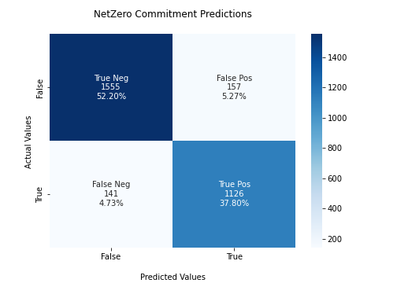
Classification Model - Model Evaluation

Slide 14

Streamlit App!
Notes:
Region: Europe, North America, Japan, Asia/Pacific, Latin America and Africa/Mideast
Sectors: Industrials, Consumer Discretionary, Consumer Staples, Information Technology, Financials, Communication Services, Health Care, Real Estate, Materials, Utilities and Energy
Industrials,
Consumer Discretionary - non essential by consumers but desirable if their available income is sufficient to purchase them (automobiles & Components, )
Consumer Staples – goods and services that people use on a daily basis, like food, clothing or other personal products (food & beverage & tobacco)
Information Technology (software and services/ technology hardware & equipment)
Financials (banks insurance)
Communication Services (media & entertainment)
Health Care (pharmaceuticals biotechnology & life sciences
Real Estate,
Materials,
Utilities
Energy

Slide 15
Conclusion & Next Step
Both Regression and Classification model suggest that there is a strong relationship between company NetZero commitment and its level of emissions.
Results seem to suggest that the likelihood of a company to commit to netzero depend on the level of control the company has on its own carbon footprint; i.e. with higher scope 3 emissions, companies seem to be less keen to commit to netzero.
Developing regression models to impute missing emissions information with without NetZero to measure potential additionality
Expanding the analysis to a broaden universe by trying to update SBTI original dataset

Slide 16
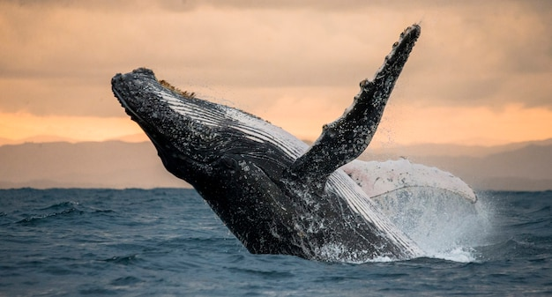
Thanks!
Question?!

