Slide 1


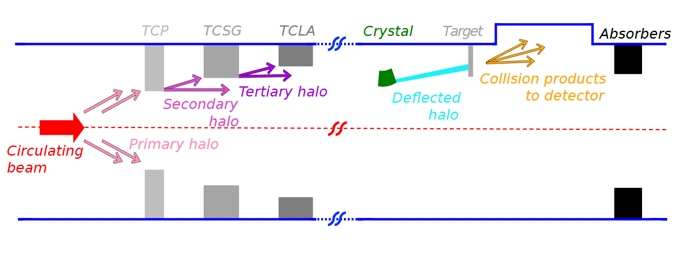
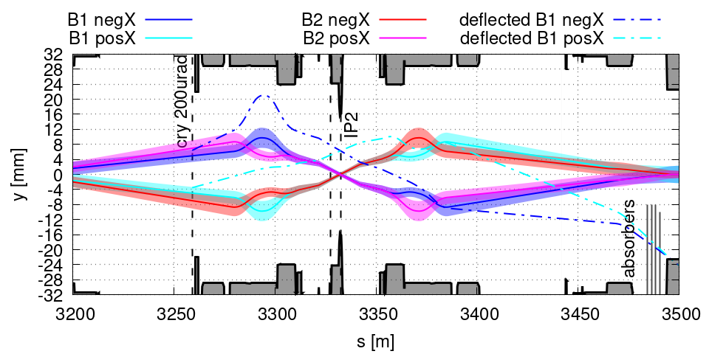
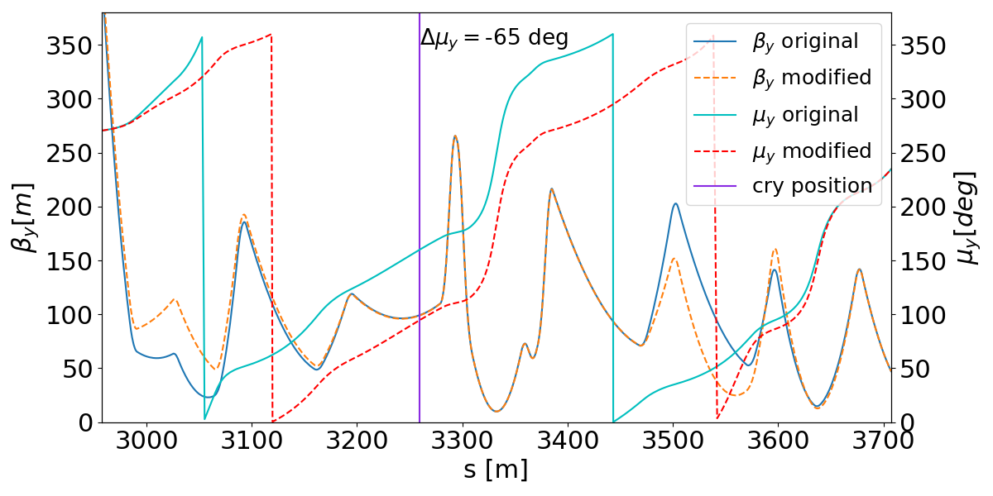
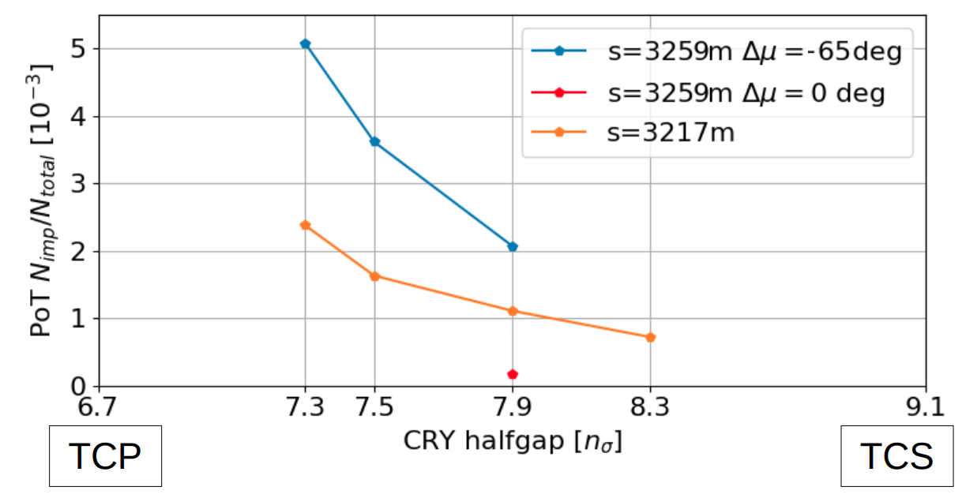
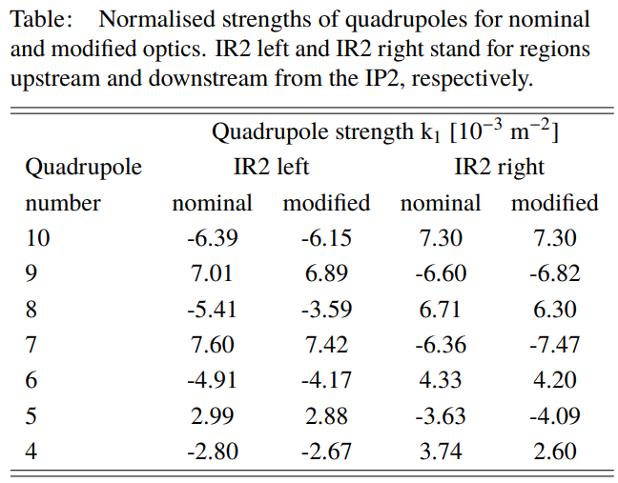

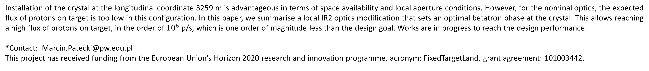
A LOCAL MODIFICATION OF HL-LHC OPTICS FOR IMPROVED PERFORMANCE OF THE ALICE FIXED-TARGET LAYOUT
M. Patecki*, D. Kikoła, Warsaw University of Technology, Faculty of Physics, Warsaw, Poland A. Fomin, P. Hermes, D. Mirarchi, S. Redaelli, CERN, Geneva, Switzerland
The Large Hadron Collider (LHC) at the European Organization for Nuclear Research (CERN) is the world’s largest and most powerful particle accelerator colliding beams of protons and lead ions at energies up to 7 TeV and 2.76 TeV, respectively. ALICE is one of the detector experiments optimised for heavy-ion collisions. A fixed-target experiment in ALICE is considered to collide a portion of the beam halo, split using a bent crystal, with an internal target placed a few meters upstream of the detector. Fixed-target collisions offer many physics opportunities related to hadronic matter and the quark-gluon plasma to extend the research potential of the CERN accelerator complex. Production of physics events depends on the particle flux on the target. The machine layout for the fixed-target experiment is being developed to provide a flux of particles on a target high enough to exploit the full capabilities of the ALICE detector acquisition system. We discuss a method of increasing the system’s performance by applying a local modification of optics to set the crystal at the optimal betatron phase.
Figure 1: Example simulation output
Crystal-based beam splitting layout
Working principle of the crystal-based fixed-target experiment (right side of the graphics) being embedded into the multi-stage collimation system (left side of the graphics). Graphics by D. Mirarchi.
The proposed layout of the ALICE-FT experiment. Both beams (B1 and B2) with their envelopes (7.3 𝜎) are given with solid lines for both ALICE solenoid polarities (posX and negX). Deflected beams are given in dashed blue lines, crystal bending angle is 200 µrad. Machine aperture is given in solid black lines. Vertical dashed lines mark the locations of crystals, target and IP2, respectively. The location of absorbers is marked in the right bottom corner.
Optics modification for an improved proton flux on target
Vertical 𝛽 function and betatron phase for nominal (solid lines) and modified (dashed lines) optics. Position of the crystal is marked with a vertical purple line.
Fraction of particles hitting the target over all particles impacting the collimation system. 3259m is a crystal location characterised with a good space availibility and 3217m is a previously considered location for a crystal.
Optics modification can be easily implemented without any effect for the rest of the machine.
The optimal betatron phase at the crystal can be used.
The expected proton flux on target is in the order of ${10}^{6}$p/s, based of RunII (2018) LHC condifitons.
Up to a factor of 2 increase of the proton flux on target can be expected for HL-LHC (beam intensity larger roughly by a factor of 2).
The ALICE detector can handle up to ${10}^{7}$p/s.
Works in progres to exploit the full capabilities of the ALICE detector.
Conclusions
Installation of the crystal at the longitudinal coordinate 3259 m is advantageous in terms of space availability and local aperture conditions. However, for the nominal optics, the expected flux of protons on target is too low in this configuration. In this paper, we summarise a local IR2 optics modification that sets an optimal betatron phase at the crystal. This allows reaching a high flux of protons on target, in the order of ${10}^{6}$ p/s, which is one order of magnitude less than the design goal. Works are in progress to reach the design performance.
*Contact: Marcin.Patecki@pw.edu.pl
This project has received funding from the European Union’s Horizon 2020 research and innovation programme, acronym: FixedTargetLand, grant agreement: 101003442.

