Slide 1
H2020: SRHC
Smart robot house cleaner
Team members:
Nikola dimitrijević
Strahinja Stanojević
Ana Bajić

Slide 2

Horizon 2020 The EU Framework Programme for Research and Innovation
SRHC
Project type: STREP
Project length: 2 months
Project description:
SRHC is a house cleaning robot, designed to help people in everyday tasks.
It can vacuum, clean, empty its garbage bag and charge, without human intervention.
The robot can access hard-to-reach surfaces and every important area.
Highly resistant to any damage.
Safe to use.
2/37

Slide 3
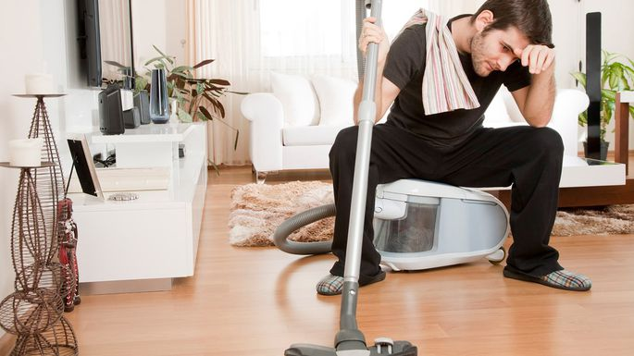
House cleaning
Cleaning the house can be extremly difficult and tiring, especially for working people.
These chores can be monotonous.
People would have a lot more time to spend on activities they enjoy, instead of wasting their time.
3/37

Slide 4
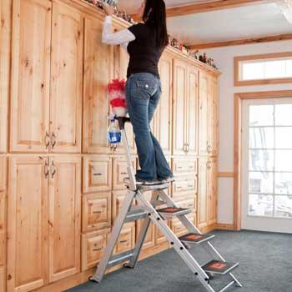
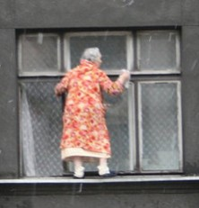
House cleaning
Some places could be out of human’s reach or they could even be dangerous.
What a brave
granny!
4/37

Slide 5
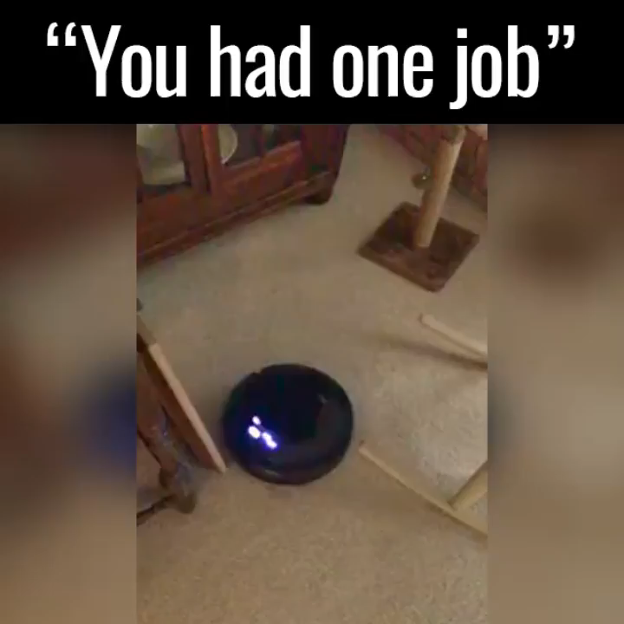
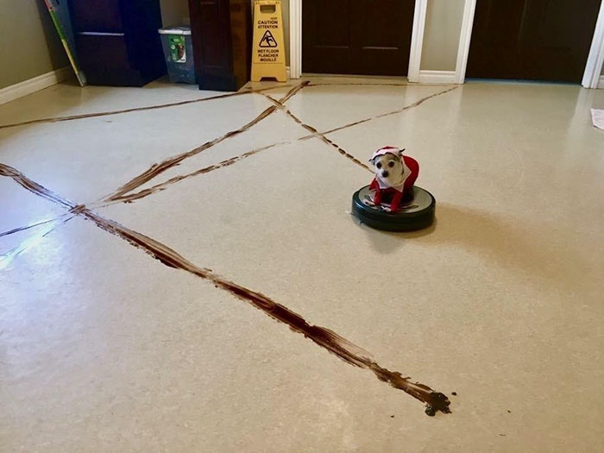
House cleaning existing solution
The existing solution – Roomba robot – tried to do it’s job well, but it soon became the laughing stock of the internet.
5/37

Slide 6
Our solution the srhc
We shall create a powerful cleaning tool, a versatile house helper.
SRHC:
Doesn’t miss important and hard-to-reach surfaces.
Finishes it’s cleaning route without breaking or damaging anything.
6/37

