Slide 1
H2020: SRHC
Smart robot house cleaner
Team members:
Nikola dimitrijević
Strahinja Stanojević
Ana Bajić

Slide 2

Horizon 2020 The EU Framework Programme for Research and Innovation
SRHC
Project type: STREP
Project length: 2 months
Project description:
SRHC is a house cleaning robot, designed to help people in everyday tasks.
It can vacuum, clean, empty its garbage bag and charge, without human intervention.
The robot can access hard-to-reach surfaces and every important area.
Highly resistant to any damage.
Safe to use.
2/23

Slide 3
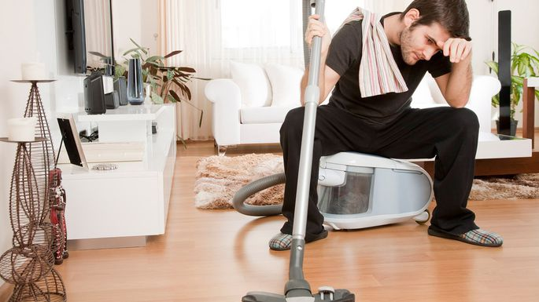
House cleaning
Cleaning the house can be extremly difficult and tiring, especially for working people.
These chores can be monotonous.
People would have a lot more time to spend on activities they enjoy, instead of wasting their time.
3/23

Slide 4
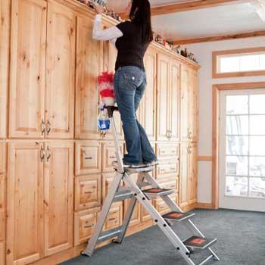
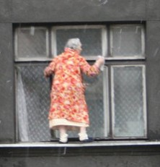
House cleaning
Some places could be out of human’s reach or they could even be dangerous.
What a brave
granny!
4/23

Slide 5
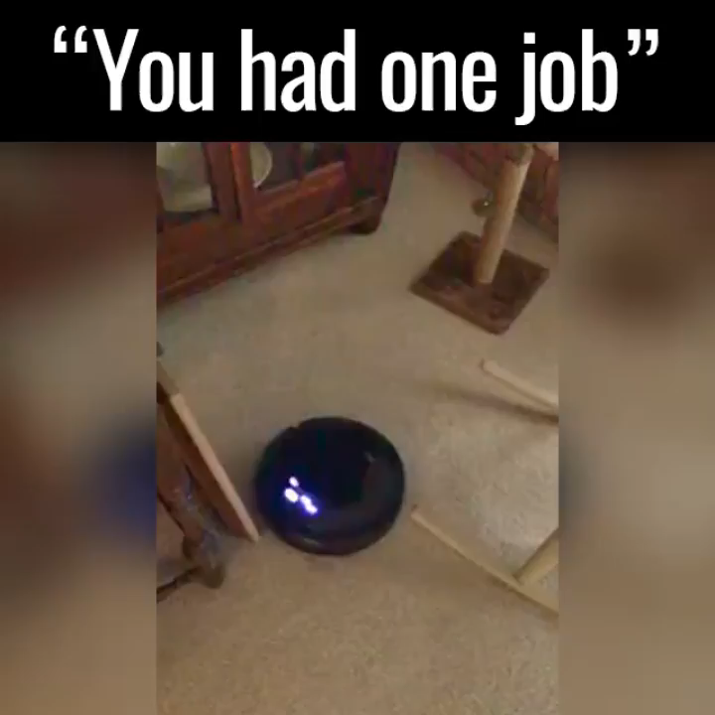
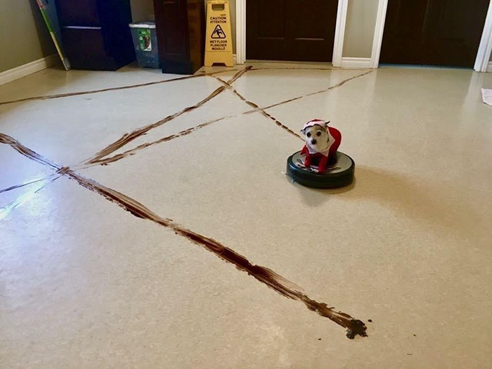
House cleaning existing solution
The existing solution – Roomba robot – tried to do it’s job well, but it soon became the laughing stock of the internet.
5/23

Slide 6
Our solution the srhc
We shall create a powerful cleaning tool, a versatile house helper.
SRHC:
Doesn’t miss important and hard-to-reach surfaces.
Finishes it’s cleaning route without breaking or damaging anything.
Returns to the charging station in time, before the battery runs out.
Isn’t easily broken.
6/23

Slide 7
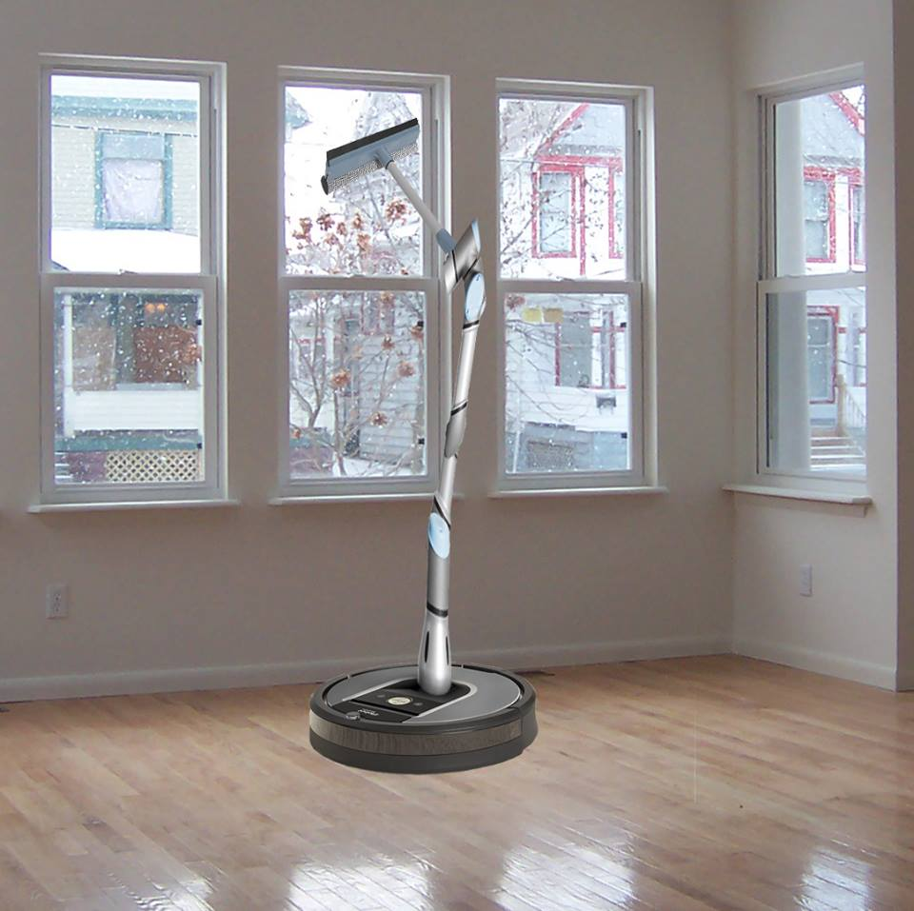
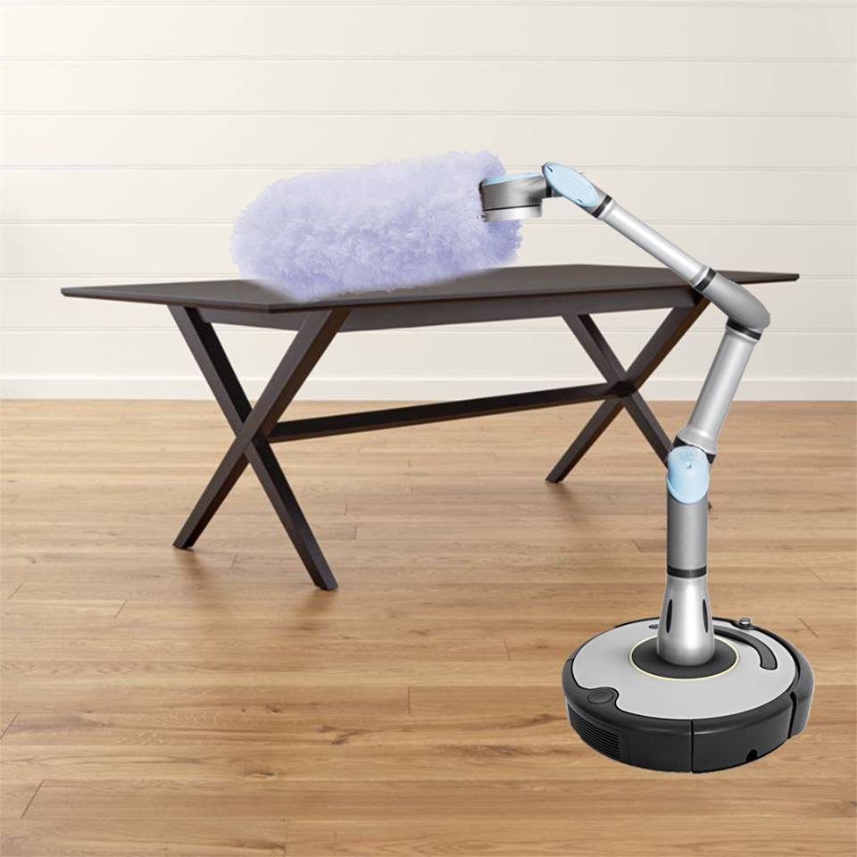
The srhc
The SRHC has many different modes:
Regular vacuuming - just a small robot, able to easily navigate the rooms and reach every location
Window cleaning – SRHC possesses an extendable arm, that can reach any window.
Dusting – SRHC has an extension for dusting as well, attached to an extendable arm so it can reach tables and tall cupboards.
7/23

Slide 8
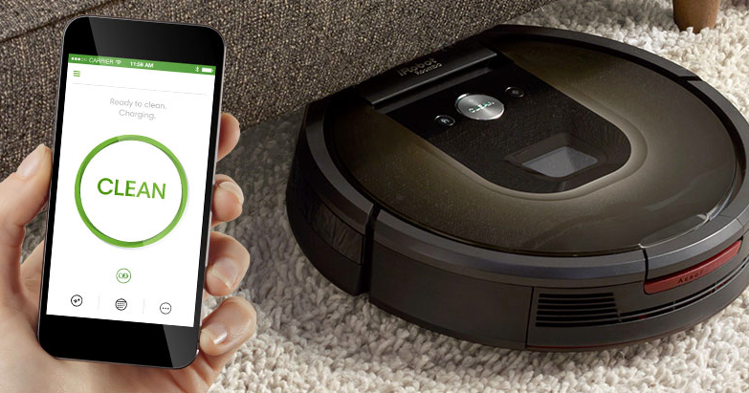
The srhc APP controler
The SRHC is capable of doing everything on its own – it can scan, clean, charge..
Using the app, you can change which rooms it will clean, or a specific mode to be used that day.
After its done with the daily cleaning, it will give a full report:
which rooms it cleaned
locations that took longer to clean
The app also receives calls for help from the SRHC, in case it got stuck.
8/23

Slide 9
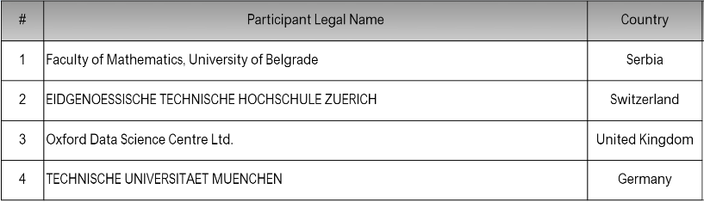
Participants
9/23

Slide 10

Participants matf
Faculty of Mathematics, University of Belgrade, officially exists as independent science and education institution since 1995.
Teaching and research activities are performed by more than 100 teachers and assistants with about 2000 students on undergraduate and postgraduate studies today.
There are 3 academic programs today: Mathematics, Informatics and Astronomy and Astrophysics.
10/23

Slide 11

Participants ETH Zürich
The university for science and technology dates back to the year 1855, when the founders of modern-day Switzerland created it as a centre of innovation and knowledge.
More than 20000 students and 500 professors in the year 2016.
Academic programs include Medicine, Data and Manufacturing technologies.
11/23

Slide 12

Participants ODSC
Oxford Data Science Centre, present on the market since 2003, is a company focused on solving data science and big data related problems.
Wide range of services is offered, including:
assistance in information retrieval,
experiments and analytical protocols design,
statistical analysis and interpretation,
visualisation
12/23

Slide 13

Participants TUM
Member of TU9, an incorporated society of the largest and most notable German institutes of technology.
TUM is ranked 4th overall in Reuters 2017 European Most Innovative University ranking.
TUM's alumni include 17 Nobel laureates, 18 Leibniz Prize winners and 22 IEEE Fellow Members.
13/23

Slide 14
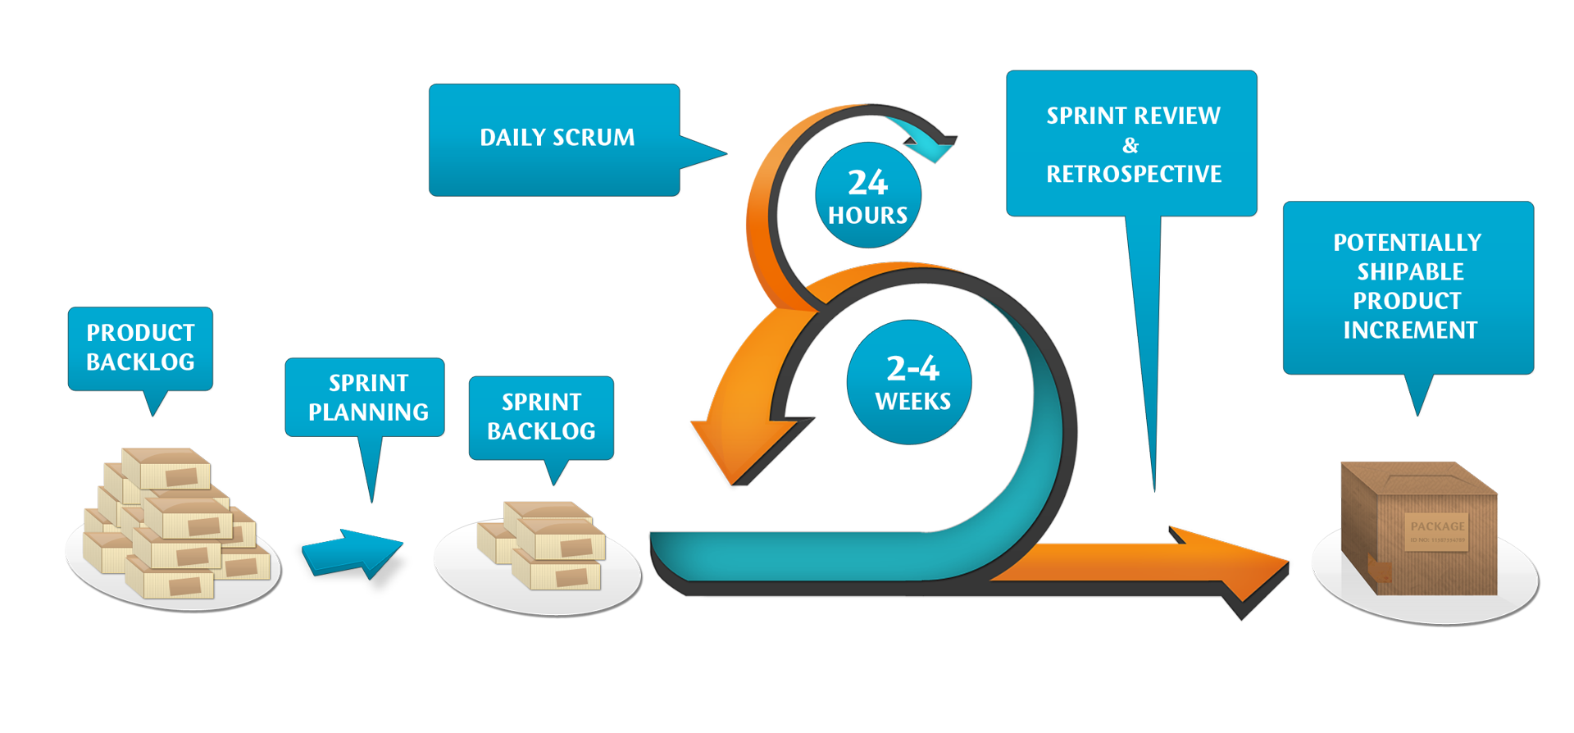
Methodology used scrum
Designed for teams of three to nine developers who break their work into actions that can be completed within timeboxed iterations, called sprints (typically two-weeks).
Progress is tracked and re-planned in 15-minute stand-up meetings, called daily scrums.
14/23

Slide 15
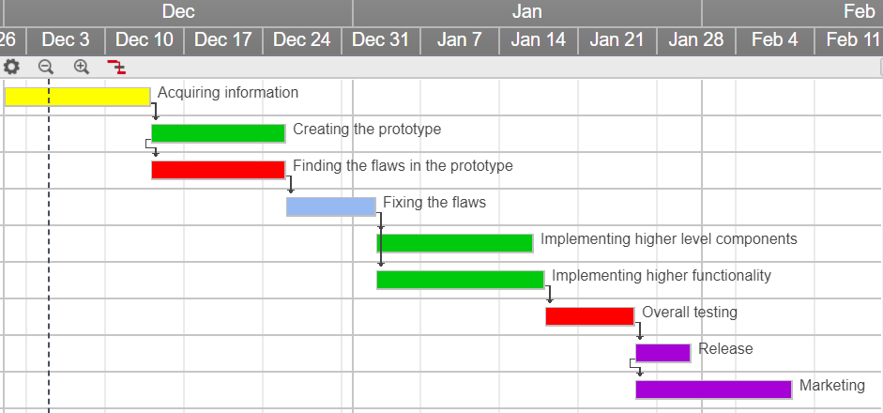
Project schedule gantt chart
15/23

Slide 16
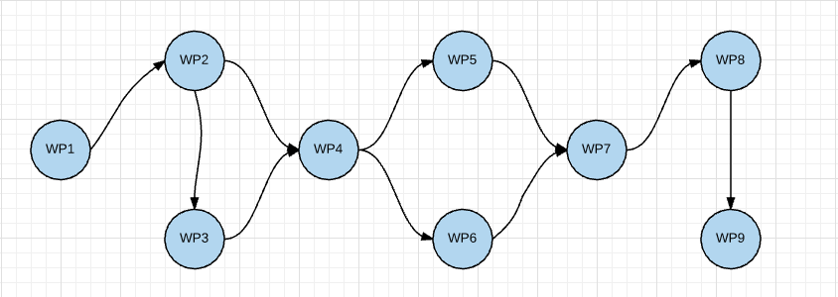
Project schedule pert chart
16/23

Slide 17
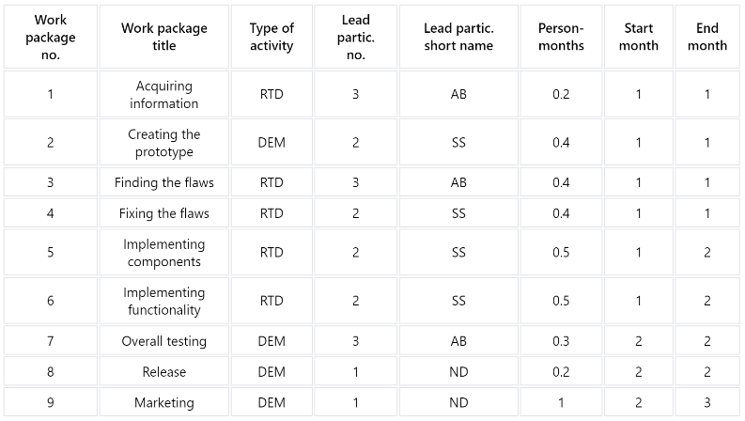
Work Package list
17/23

Slide 18
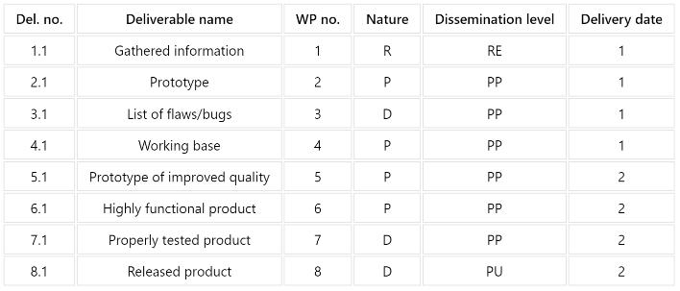
Deliverables list
18/23

Slide 19
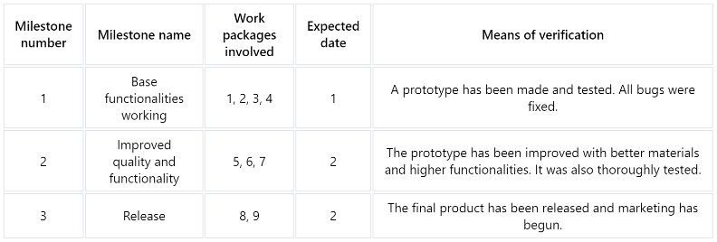
Milestones list
19/23

Slide 20

Released product
The SRHC will be released and available in every European country.
It will be sold at reasonable and affordable prices.
We expect to branch around the world in the future, if the project turns out to be a success.
20/23

Slide 21

Expected results
People using the SRHC will have more free time to:
spend with their families,
do what they love,
take up a sport.
This will increase overall productivity, health and happiness.
21/23

Slide 22
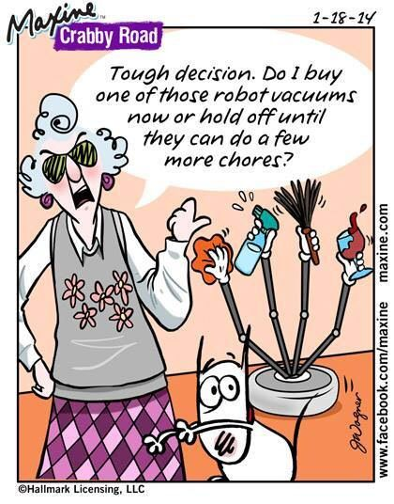
SRHC
Let’s make this decision easier for granny!
Let’s build a robot that can do all of the chores!
22/23

Slide 23
Goodbyes
Contact:
Nikola Dimitrijević – mi171054@alas.matf.bg.ac.rs
Strahinja Stanojević – mi171047@alas.matf.bg.ac.rs
Ana Bajić – mi171089@alas.matf.bg.ac.rs
Thank you for your attention! ☺
23/23

