Slide 1
You got your browser in my virtual machine!
Leveraging sophisticated browser programming models in your Java application

Slide 2

This guy...

Slide 3
This talk
Mostly about JavaScript (booo?)
An introduction to WebExtensions
“Isomorphic applications” and Java’s Nashorn
JavaScript frameworks like ReactJS and VueJS
The FilterBubbler WebExtension I’m collaborating on with Mozilla’s Open Source Experiments group
Maybe some robot stuff for fun

Slide 4
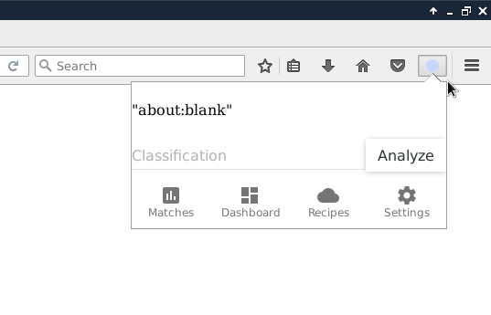
What are WebExtensions?
Plain old JavaScript and HTML

Slide 5
WebExtensions
An API that lets you write add-ons for the web browser
Monitor user activity in the background, inspect tab contents, store data, talk to the network, expose new controls in the browser bar
Portable across multiple browsers (Firefox, Chrome, Opera and Edge)

Slide 6
The basic WebExtension anatomy
Manifest
  manifest.json (drives the naming of other resources)
UI
  popup.html
  popup.js
Background Context
  background.js
Content Context
  content.js

Slide 7
What are Isomorphic Applications?
Code that can run in both the client and the server execution contexts
  Validation logic
  Page templates
  Business logic
Can go both ways
  ClojureScript
  JSweet

Slide 8
JavaScript in your server
Nashorn is the JDK environment for Javascript
JDK9 continues to build on performance improvements from previous releases and now is approaching the speed of v8
How easy is it?
ScriptEngine engine = new ScriptEngineManager()
.getEngineByName("nashorn");
engine.eval("print('Hello World!');");

Slide 9
The Reality
Applets are dead
The web is stronger than ever and that means JavaScript is a reality we must deal with
The pervasiveness of JavaScript continues to expand.
  Mobile via tools like Apache Cordova (aka PhoneGap)
  Server via NodeJS and Nashorn

Slide 10
Evolution in the JavaScript space
Awkward callbacks (aka “the flying V”) have been replaced by progressively more elegant frameworks
Best practices from other branches of computing like Immutables, reactive programming with observable streams and functional programming with pure functions are gaining steam

Slide 11
React/Flux/Redux
React is a popular JavaScript UI model from Facebook
State is immutable, modifications are performed by replacing the “state” object and a virtual DOM is rerendered and diffed against the real DOM
Redux extends this proposition with a single immutable state that is modified by functions called “reducers”

Slide 12
Example Redux Reducer
{
type: ADD_TODO,
text: 'Create portable logic'
}
---
case ADD_TODO:
return Object.assign({}, state, {
todos: [
...state.todos,
{
text: action.text,
completed: false
}
]
})
UI elements emit this object
and don’t care how it
actually happens
Appends the new object
to the existing list

Slide 13
Redux App Flow
A
A
A
A
A
A

Slide 14
Redux App Flow
A
A
A
A
A
A
S1
S2
S3
S4
S5
S6
S7

Slide 15
Time travel and undo/redo
Because action objects are processed synchronously the state of the application is a direct by-product of the event stream
You can record and replay the event stream to replicate the state of your application
This makes some otherwise difficult things very easy, undo is just a matter of restoring the previous state object
Testing is also much easier, just replay the tape

Slide 16
FilterBubbler
A platform for performing text analysis on your own web browsing using the WebExtensions API
Mimics the kind of analysis that big organizations do to you all the time, but under your control
A collaboration with Mozilla’s Open Source Experiments group
Let’s you visualize your “Filter Bubble”

Slide 17
What’s a “Filter Bubble”?
Cognitive bias created by the self-selection of information feeds that agree with your world view (friends, TV shows, books, newspapers, etc.)
Greatly enhanced by deep learning and other AI techniques utilized by social networks and search engines that automatically feed you information that “engages” you
Disagreeable facts never reach us

Slide 18
What does FilterBubbler do?
Text “corpura”
Awesome
Stupid
Text
Classifier
classifier
source
classifier
sink
ie. current page
ie. extension drop down display

Slide 19
What does FilterBubbler do?
Text “corpura”
Awesome
Stupid
Text
Classifier
classifier
source
classifier
sink
ie. last year of browsing history
ie. bookmark folders
(your history sorted into awesome/stupid folders)

Slide 20
Q&A

Slide 21
THANK YOU!
I’ll be continuing to improve this talk and fleshing out my portable JavaScript/Nashorn examples while I’m on the tour
Watch our progress at https://filterbubbler.org/java-tour
https://github.com/filterbubbler
ean@brainfood.com
@schue on Twitter

