Slide 1
Retail Customer Behavior for Growth
MSDSP420 - Group 6 - Summer 2025
Week 10 – 29 August 2025
Shwetha Shenoy-Kamath
Swarnaditya Maitra
Hatim Urabi

Slide 2
Project Scope & Dataset
Goal– Build a reproducible, SQL-ready pipeline that turns dunnhumby’s the Complete Journey household-level transactions dataset, spanning 2 years, into actionable insights for business leaders.
Business questions –
Where is spend shifting?
Which customers drive growth?
Do promotions lift sales?
Dataset in Scope – Two-year history of every item purchased by 2,500 households, enriched with campaign, coupon, in-store display, and demographic overlays.

Slide 3
Schema & Workstreams
Schema– star model — facts (transactions, campaigns) + dimensions (households, products, stores, promos)
Platforms – Postgres, MySQL, SQL Server (Relational), and Mongodb (NoSQL)
Workstreams–
Data engineering – Stage raw CSVs, clean data-quality issues, and load into three RDBMS engines (PostgreSQL 14, MySQL 8, SQL Server 2022), and one NoSQL Mongodb 8.0 engine.
Data modeling – Design schema tables and an ERD linking all tables covering transactions, households, products, and promotions.
Analytics & visualization – Run EDA notebooks to surface spending trends, demographic segments, category lift, and campaign effectiveness.
Benchmarking – Compare query latency, index efficiency, and storage footprint across the three databases.

Slide 4
The trifecta of comparative analysis
Composite Key vs Surrogate Key – MySQL implementation
PostgreSQL server vs Microsoft SQL Server – Composite Key
PostgreSQL vs Mongodb

Slide 5
Retail DB Build: Docker + MySQL Setup
Objective– Reproducible, portable database environment for Complete Journey dataset
Why Docker + MySQL? –
Isolates MySQL from local OS; easy to control versions & map CSV volumes
--local-infile=1 → bulk .csv loads with LOAD DATA INFILE
--lower_case_table _names =1 → avoids case mismatches
Container verified vis docker ps

Slide 6
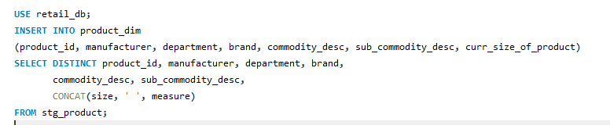
Surrogate Key Star Schema Setup
Staging → Dimensions/Facts
Stage raw CSVs → clean tables → populate SK dimensions
Facts reference surrogate keys for consistent, fast joins
Surrogate Key Approach
Added -*sk auto-increment PKs (household_sk, product_sk, store_sk, week_sk)
3NF lookups( brand, manufacturer, income bands ) slimmed dims & avoided duplication
Indexed on SK FKs(transactions_Fact_coupon, coupond_redemption_fact, promo_fact)
Example code

Slide 7
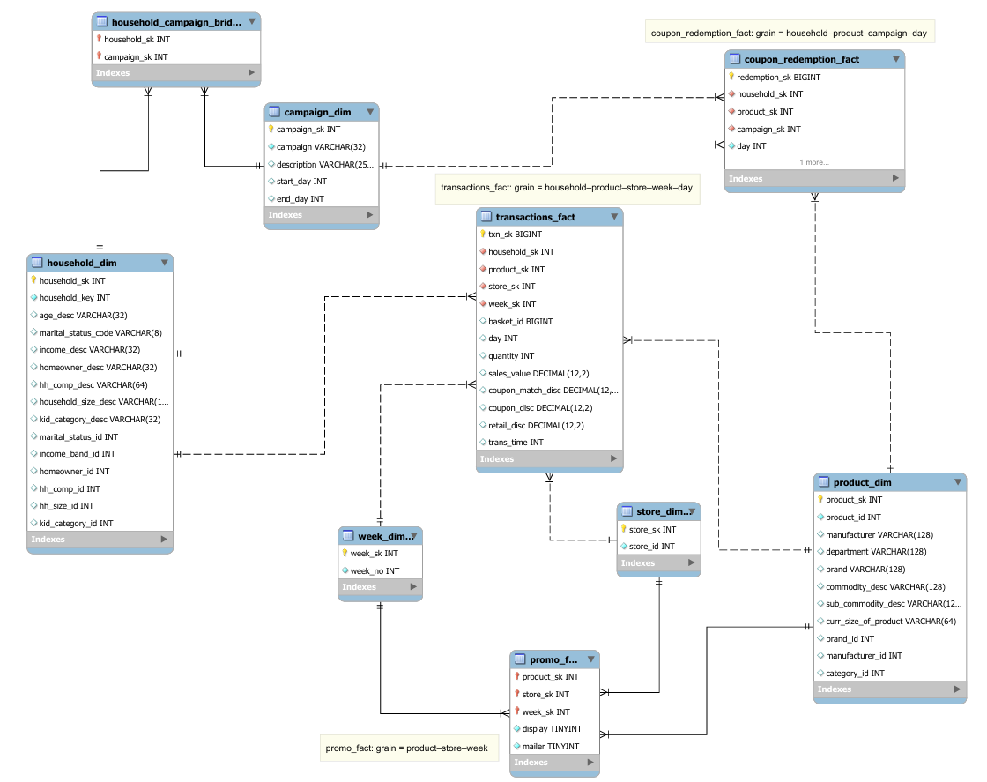

ERD Highlights
Transactions_fact: grain = household–product–store–week–day
Promo_fact: grain = product–store–week
Coupon_redemption_fact: grain = household–product–campaign–day
Surrogate Keys (SK) provide stable IDs & fast joins
Staging
DW with SKs

Slide 8
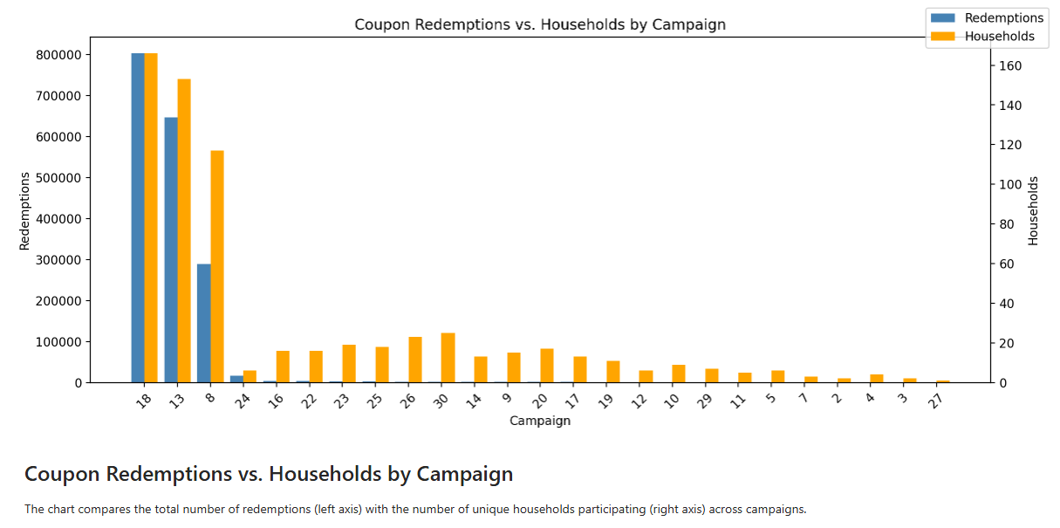
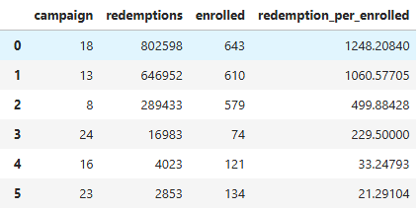

Retail exploratory analysis
Exploratory Insights
Transactions span ~40M rows, 2,500 households, 2 years
Household Demographics: income bands & age segments show clear purchase differences
Product Categories: top spend in grocery, household, and dairy
Promotion Impact: display/mailers correlate with coupon redemptions

Slide 9
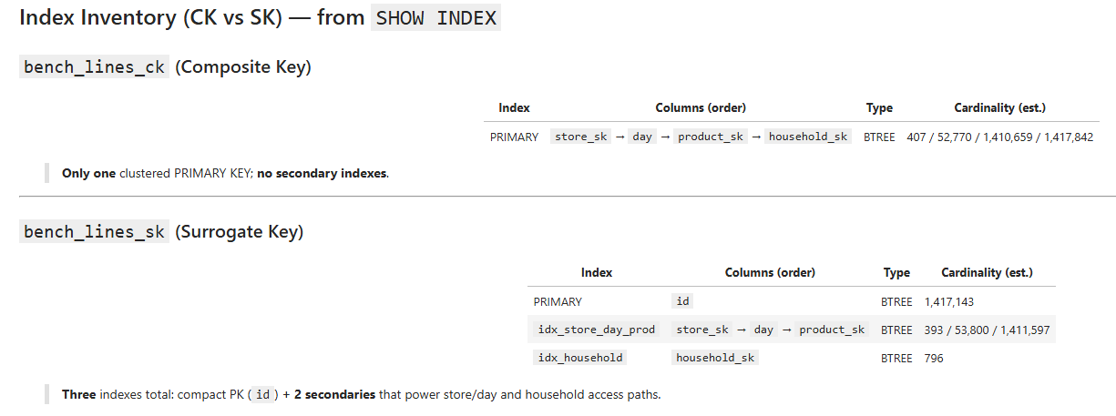
Benchmarking: Query Setup – CK Vs SK
Objective → Compare Surrogate Key (SK) vs Composite Key (CK) schemas
Queries tested (10):
Multi-way joins (transactions ↔ product, household, store, week)
Group-bys & rollups (sales by week, household, product)
Aggregations (sums, counts, averages)
Filters (redemptions, promos)
Metrics: execution time, CPU usage, index size
Index Inventory
CK Vs SK

Slide 10
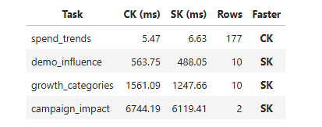
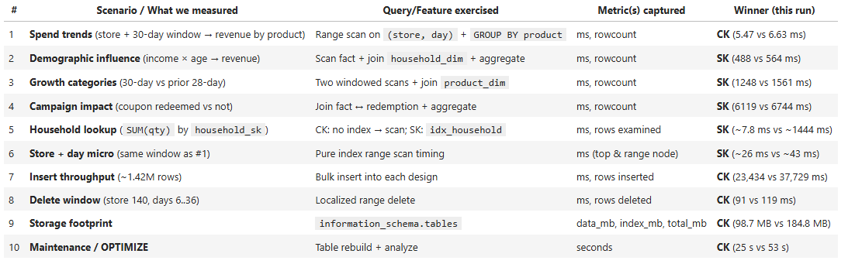
Benchmarking: Results & Takeaways
Findings
SK schema consistently faster (joins & aggregations)
CK joins = heavier (multi-column overhead)
SK indexes = smaller, scale better
Project Deliverables
Benchmark Scenarios
Notes:
Surrogate keys improve performance & maintainability
Recommended schema for production data warehouses

Slide 11
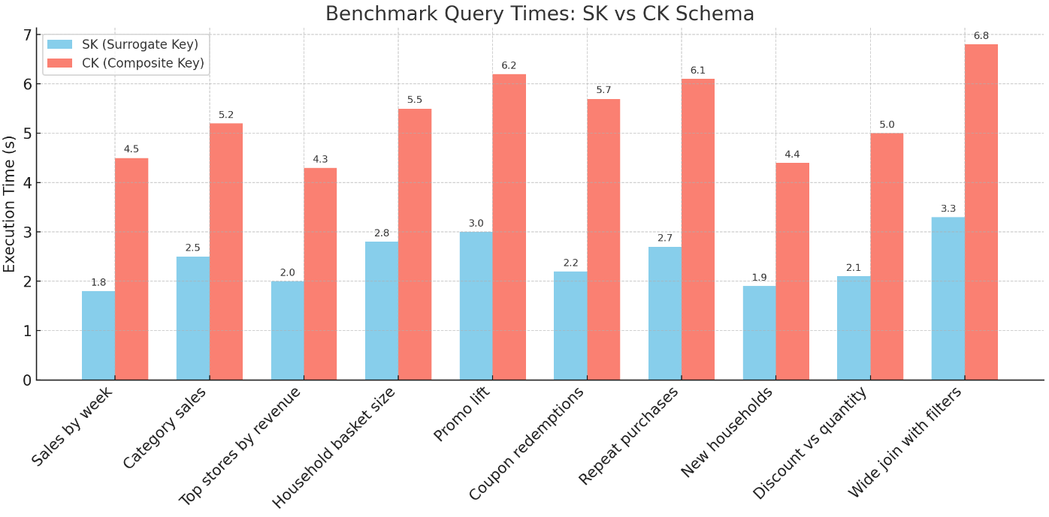
Benchmarking: Query Times
Notes:
Surrogate keys improve performance & maintainability
Recommended schema for production data warehouses

Slide 12
Benchmarking: PostgreSQL vs. SQL Server
A head-to-head comparison on the Dunnhumby retail dataset.
Engines Tested: PostgreSQL 16.10 vs. SQL Server 2022 Developer (both on Docker and on the same machine).
Goal: Measure performance for both initial data loading and a sustained query workload.
Key Finding: Both databases completed the benchmark with zero errors, showcasing different areas of strength.
Rows loaded:
campaign_desc: 30
campaign_table: 7,208
causal_data: 36,786,524
coupon: 124,548
coupon_redempt: 2,318
hh_demographic: 801
product: 92,353
transaction_data: 2,595,732

Slide 13
Load Performance & Storage SQL Server loads faster, but PostgreSQL is more space-efficient.
Load time (sec): PG 644.3, SQL 486.2
32.5% difference
Database size (GiB): PG 2.39, SQL 2.70
11.5% difference

Slide 14
Query Throughput & Latency PostgreSQL sustains higher throughput with lower p95 latency.
Throughput (TPS): PG 2779.4 vs SQL 2599.6
6.9% difference
p95 latency (ms): PG 3.173 vs SQL 3.312
4.2% difference
lower is better

Slide 15
PostgreSQL vs. SQL Server Key Takeaways
The best choice depends on your primary workload: data ingestion or queries.
SQL Server Excels at Ingestion: It's the winner for bulk data loading, finishing the task over 32% faster.
PostgreSQL Excels at Queries: It handles a mixed read/write workload better, delivering ~7% more transactions per second with lower latency.
Storage Efficiency: PostgreSQL provides a more compact on-disk footprint for this dataset, saving over 11% space.
Final Decision: For workloads such as this, prioritize SQL Server if rapid data ingestion is critical. Prioritize PostgreSQL if read-heavy query performance and storage efficiency are more important.

Slide 16
Comparative Analys: PostgreSQL vs. MongoDB
We used both engines to answer the same business questions, then measured where each wins.
Goal: Repeat the same cleaning, modeling, and analytics twice to compare outcomes.
Relational Path (PostgreSQL): Modeled in 3rd Normal Form with strict keys and joins for integrity.
Document Path (MongoDB): Used basket documents embedding items plus denormalized product and campaign views for speed.
TL;DR: PostgreSQL is best for deep multi-table analytics and governance; MongoDB is best for fast rollups inside natural aggregates like baskets and households.

Slide 17
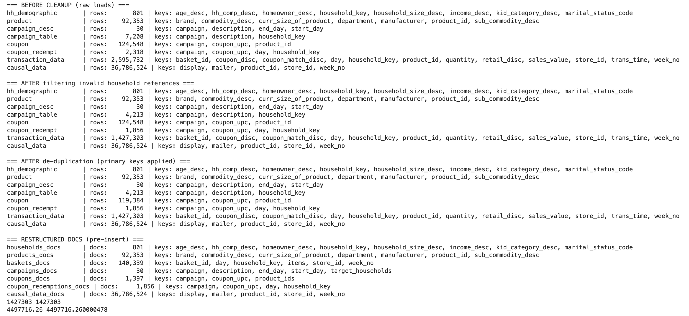
A section within the Mongo ETL pipeline

Slide 18
Modeling and ETL
Normalize in SQL for integrity; embed in Mongo for speed on one-to-many.
PostgreSQL
Facts and dimensions split.
Foreign keys enforce data quality.
COPY for robust bulk loading.
Guarantees integrity, avoids duplication.
Complex multi-table queries with Many-many relationships.
MongoDB
Baskets embed items.
Campaigns embed target households.
Shifts integrity to ETL but simplifies reads.
Stores repeated attributes to cut future joins.
Suitable for dynamically changing data.
Suitable for one-many relationships

Slide 19
Analytics Patterns & Performance
Use the engine that matches the shape of the question. Index strategy matters more than the engine.
MongoDB Wins For:
Basket Metrics: Fast sums of arrays inside single documents (total, item count, recency).
Household Rollups: Quick `$sum` on embedded items without joins.
PostgreSQL Wins For:
Category Growth: Cleaner joins and `GROUP BY` across large fact tables.
Promotion Impact: Straightforward joins between items and promotions.
A/B Testing: Transparent and auditable campaign target vs. control analysis.
Key Performance Lesson
Composite/compound indexes, materialized views (Postgres), and pre-aggregation (Mongo) moved the needle more than the database choice itself.

Slide 20
PostgreSQL vs. MongoDB Recommendation
Keep PostgreSQL as the source of truth; use MongoDB as a fast, read-optimized layer.
Proposed Architecture: A normalized warehouse in PostgreSQL; publish curated aggregate views to MongoDB collections aligned to hot queries.
PostgreSQL Use Cases: Category growth, promotion lift, rigorous campaign A/B testing, and complex joins.
MongoDB Use Cases: Basket/household rollups, real-time dashboards, and app-facing APIs needing sub-second aggregates.
The Decision: Choose by workload. Depth and integrity go to PostgreSQL. Speed on natural aggregates goes to MongoDB. Use both to get reliable insight and fast delivery.

Slide 21
Group 6
Shwetha Shenoy-Kamath
Swarnaditya Maitra
Hatim Urabi

Slide 22
Appendix

Slide 23
Project Scope & Goals
Purpose – Build a reproducible, SQL-ready pipeline that turns dunnhumby’s the Complete Journey household-level transactions dataset, spanning 2 years, into actionable insights for business leaders.
Business questions –
How are customers’ spending patterns shifting?
Which demographics and product categories drive growth?
Does direct marketing lift sales?
Dataset in Scope – Two-year history of every item purchased by 2,500 households, enriched with campaign, coupon, in-store display, and demographic overlays.

Slide 24
Project Workstreams & Deliverables
Workstreams
Data engineering – Stage raw CSVs, clean data-quality issues, and load into three RDBMS engines (PostgreSQL 14, MySQL 8, SQL Server 2022).
Data modeling – Design schema tables and an ERD linking all tables covering transactions, households, products, and promotions.
Analytics & visualization – Run EDA notebooks to surface spending trends, demographic segments, category lift, and campaign effectiveness.
Benchmarking – Compare query latency, index efficiency, and storage footprint across the three databases.
Deliverable – A concise deck + demo schema that equips stakeholders to optimize promotions, inventory, and customer engagement strategies

Slide 25
Dataset in Scope
Source – Dunnhumby’s The Complete Journey public retail dataset (downloaded as raw CSVs).
Coverage – 104 weeks of item-level transactions for ≈ 2,500 households.
Breadth
Basket details: product UPC, quantity, net price, discount, store, day, week.
Promotions: campaign assignments, coupon pools & redemptions, in-store display flags.
Demographics: age-band, income bracket, household size, kids/pets indicators.
Volume – ~40 M line items, 3 data tables, 5 lookup tables, ~3 GB uncompressed.
Analytic potential – Enables spend-trend tracking, demographic segmentation, promo-lift measurement, and category growth analysis.

Slide 26
Relational Schema
Fact (data) tables — the spine of every query
transaction_data | Item-level sales for each basket → 2.6 M rows keyed by household_key, basket_id, product_id, date, store, price.
campaign_table | Connects households to the campaigns they received (household_key, campaign).
hh_demographic | Age, income, and household-size segments for every household_key.
Lookup (dimension) tables — enrich and slice
product | Dept → commodity → SKU hierarchy, brand, pack size (product_id).
campaign_desc | Campaign name, start / end dates (campaign).
coupon & coupon_redempt | Offer details and actual redemptions (link campaign, coupon_upc, product_id).
causal_data | → 36.8 M rows that Flags if a product was in the weekly mailer or on display (product_id, store_id, week_no).

Slide 27
Why Postgres, MySQL 8, and MS SQL Server
PostgreSQL 14+ – Rich analytics (CTEs, JSONB) in a lightweight open-source image, but 22 M-row speed demands tuned work_mem and a post-load vacuum.
MySQL 8.0 – Blazing LOAD DATA INFILE and new window/hash joins, yet FK checks must be disabled and composite indexes /surrogate keys added to keep queries snappy.
MS SQL Server 2022 – Column store indexes and a top-tier optimizer, countered by a heavyweight container and production-license costs.

Slide 28
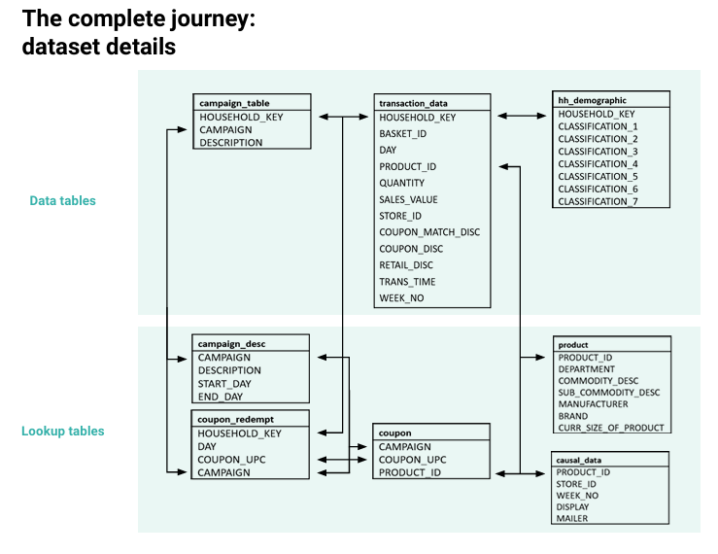
Reference

Slide 29
Integrity & Primary Key Strategy
Pain points
Attribute types out of sync (INT ↔ BIGINT ↔ VARCHAR) • Nulls & duplicates in household_key, basket_id, product_id • hh_demographic has just 801 rows, so many transactions lack a matching household ⇒ decide whether to drop or impute before joins
Option 1 — Surrogate Primary Key (trans_id BIGINT IDENTITY) ✓ Thin joins, simpler indexing, easier sharding later ✕ Still need a unique constraint on the three business columns; analysis adds one hop
Option 2 — Composite Primary Key (household_key + basket_id + product_id) ✓ Preserves natural grain; used for Week 6 EDA and promo joins ✕ Wide key inflates indexes; must dedupe rows first
Chosen path Load a cleaned composite-PK and 3NF/BCNF-normalized table for integrity checks and Week 6 analysis; introduce a surrogate trans_id only if future performance testing shows a need for Week 10 analysis.

Slide 30
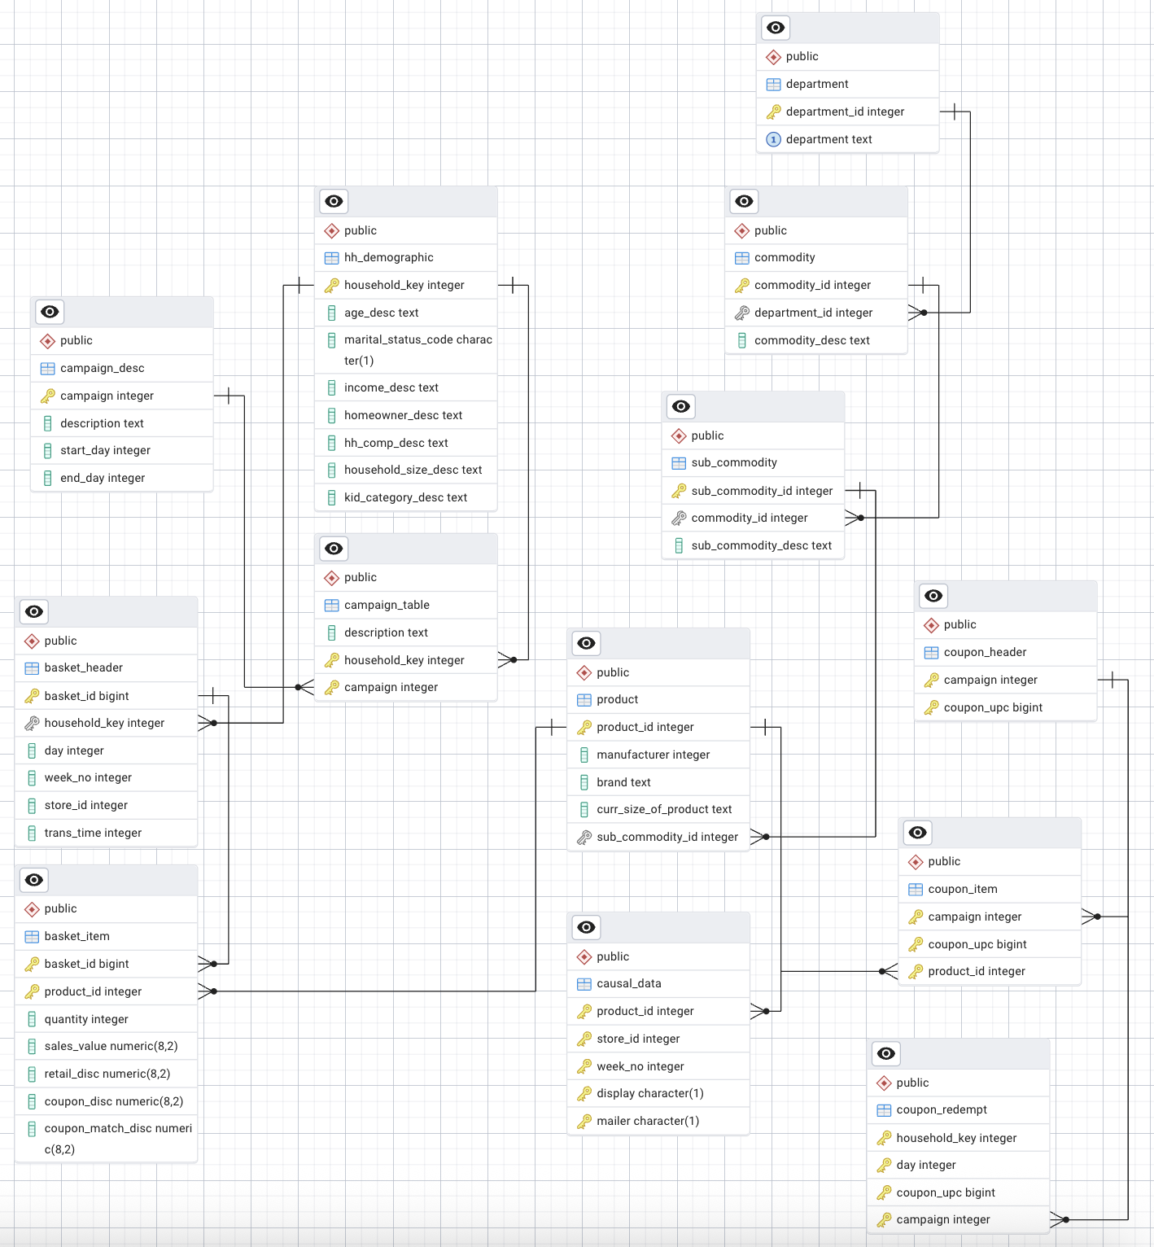
Entity-Relationship Diagram(ERD)

Slide 31
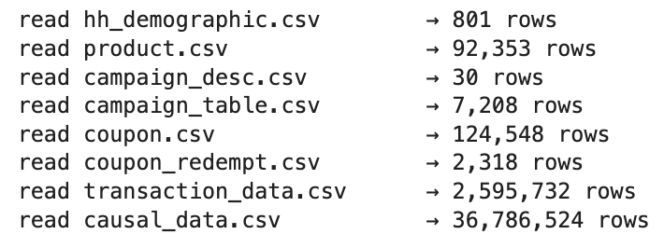
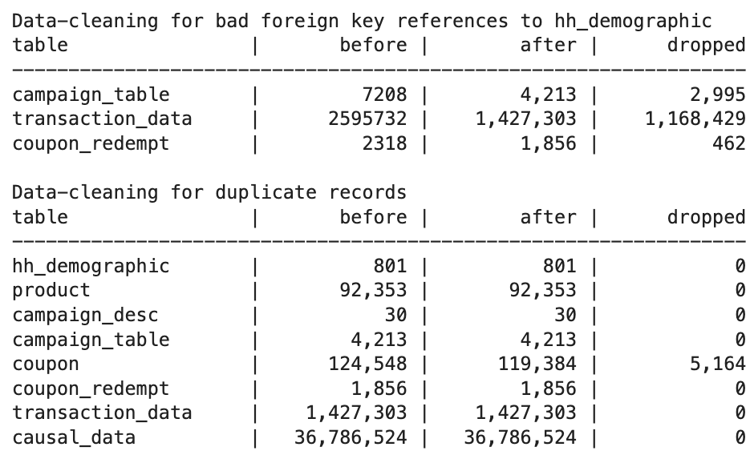
Exploratory Findings
Raw data
Removal of bad FK references
Raw data
Removal of dupe records
Raw data

Slide 32
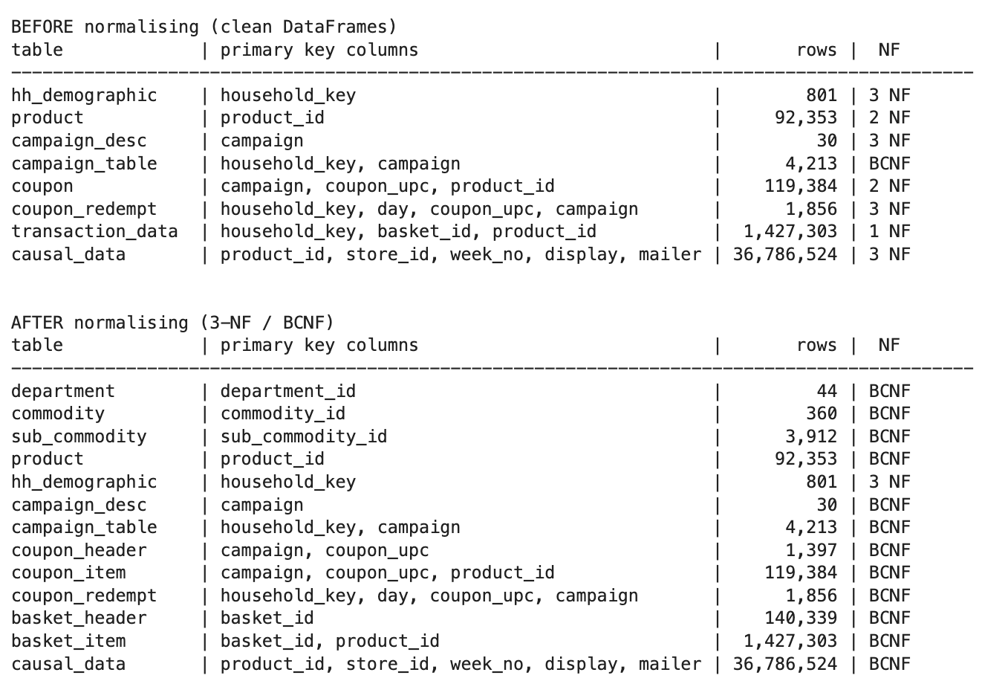
Exploratory Findings
Normalization

Slide 33
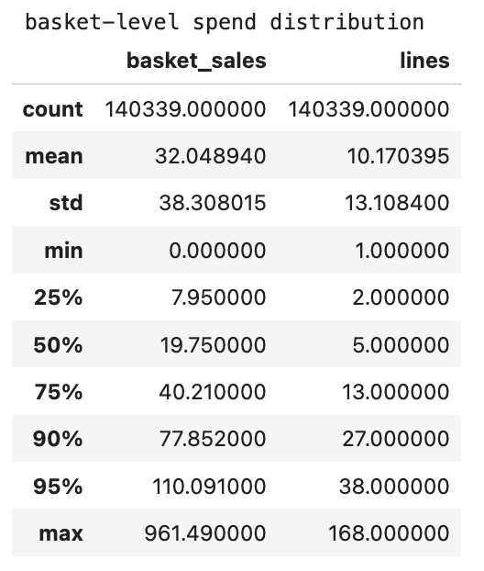
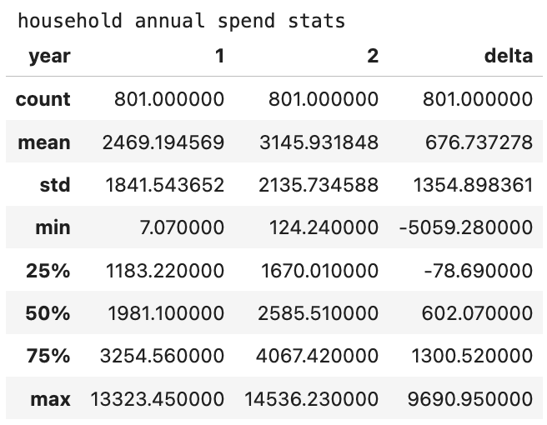
Exploratory Findings

Slide 34
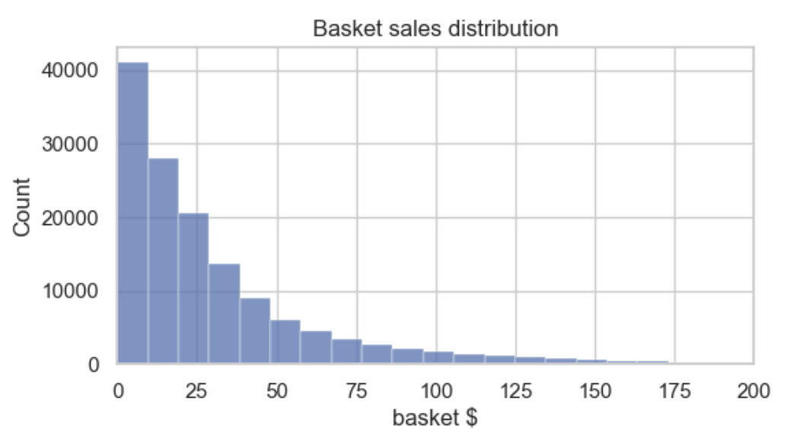
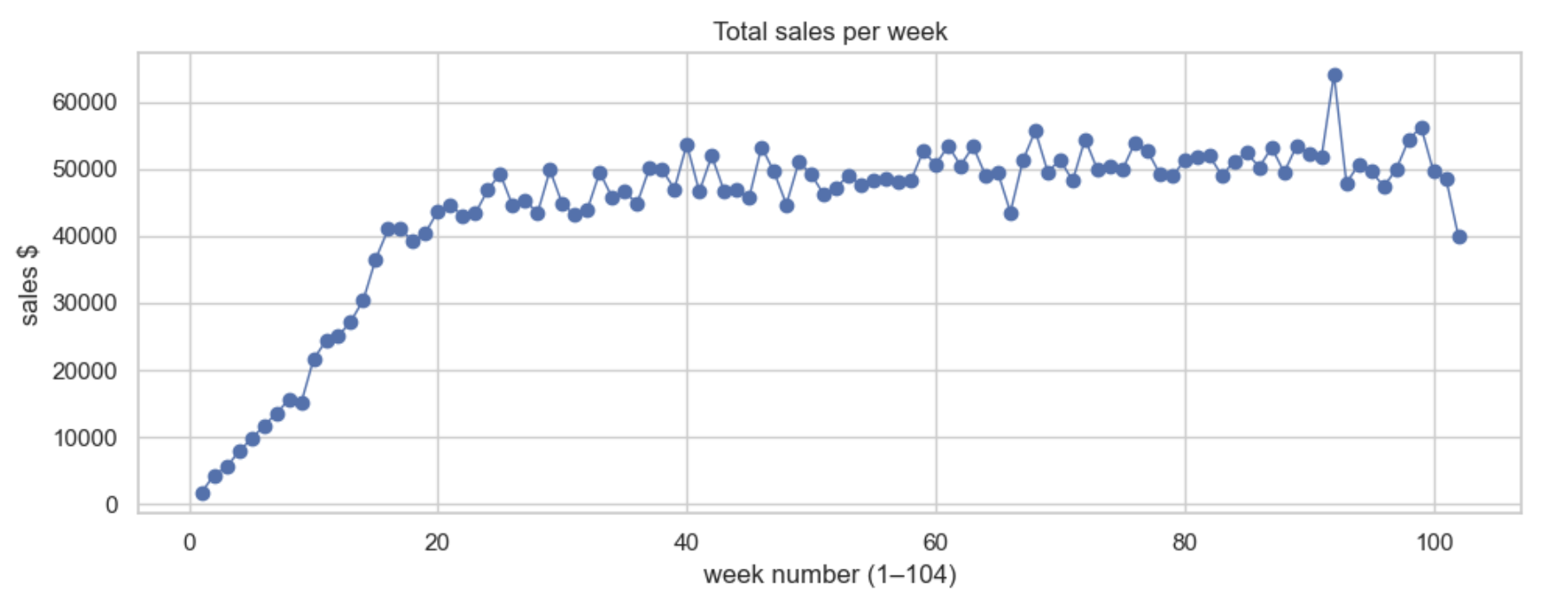
Exploratory Findings
Histogram : Basket sales Distribution
Weekly sales trend

Slide 35
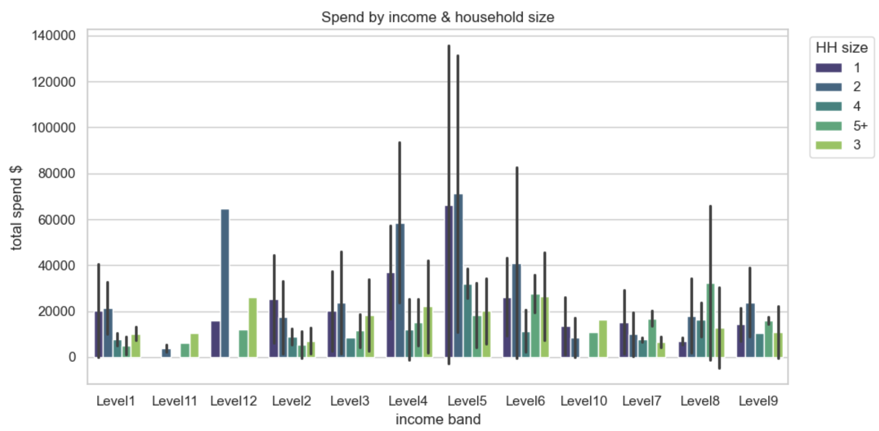
Exploratory Findings
Expenditure by Income and Household size

Slide 36
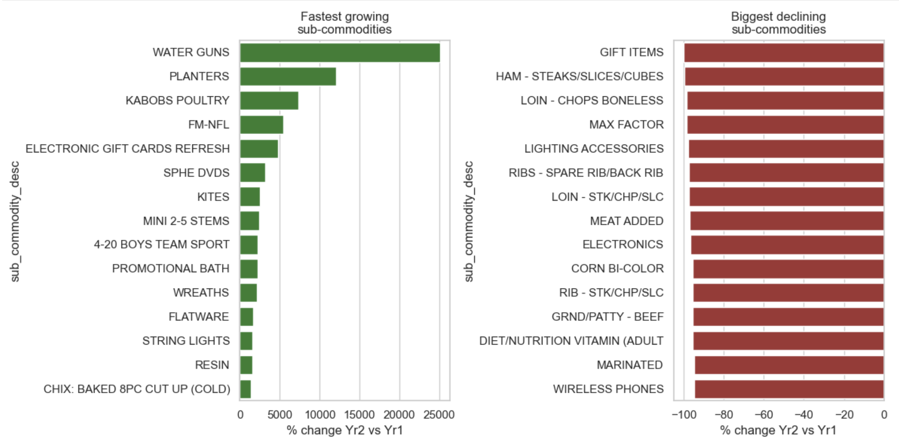
Exploratory Findings
Categories: Fastest Growth & Buggest Incline

Slide 37
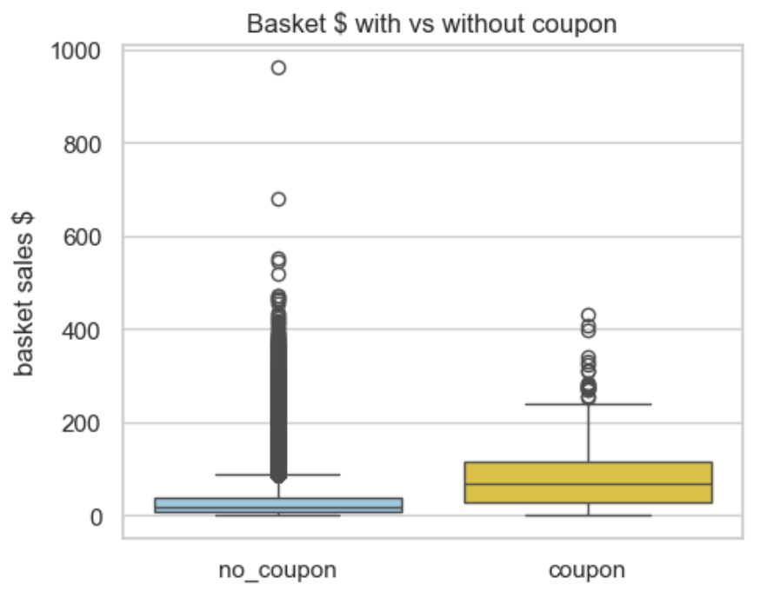
Exploratory Findings
Coupon lift – basket spend distribution

Slide 38
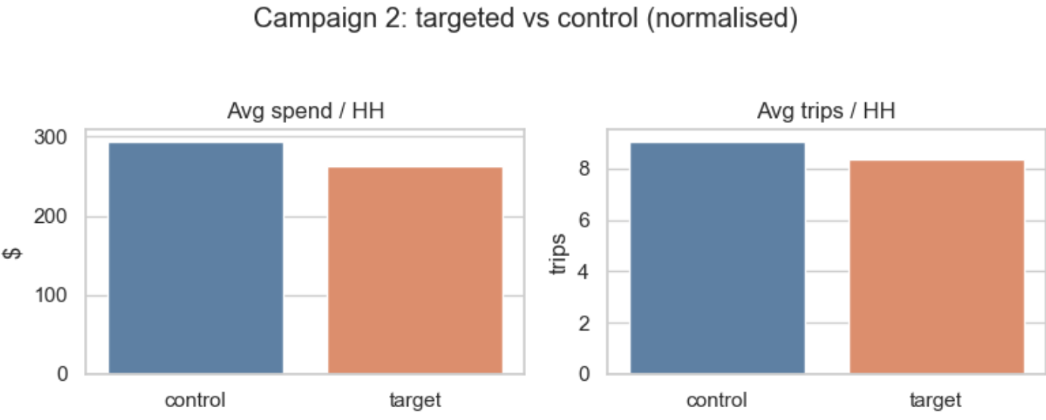
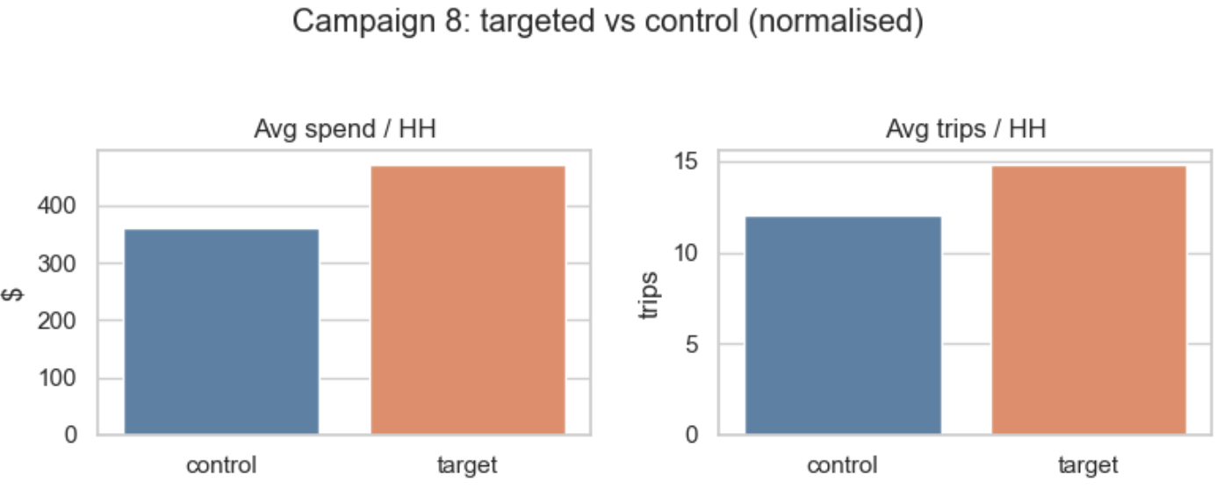
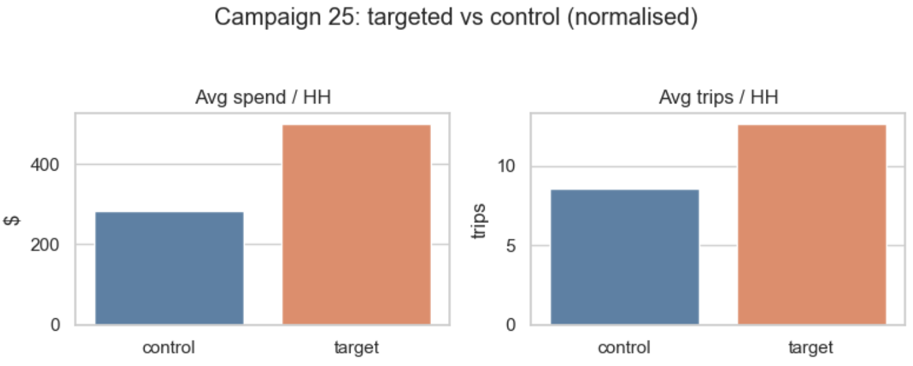
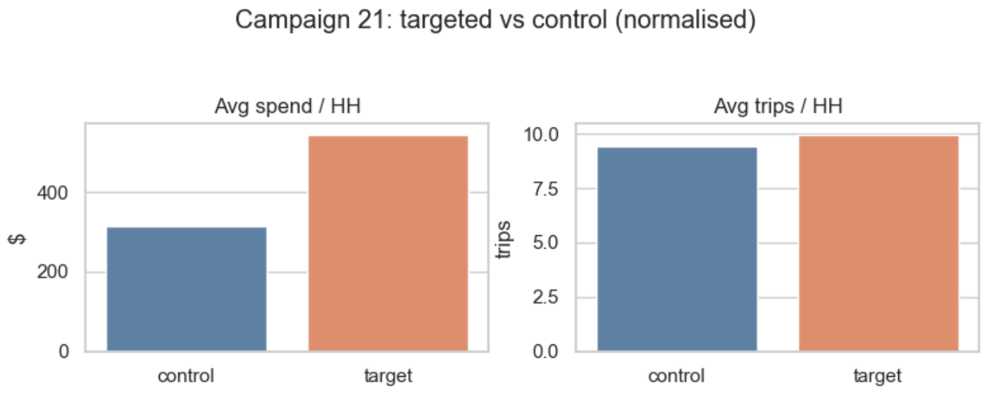
Exploratory Findings
Campaign Effect : Spend & Trips / household

Slide 39
Benchmark Plan (Postgres 14 | MySQL 8 (+Docker)| SQL Server 2022)
Admin tools in scope – SSMS (SQL Server), pgAdmin (Postgres), Workbench (MySQL)w/Docker ; GUI usability is part of the final score.
Level playing field – Engines now run on-different hardware; either use one benchmark box or normalize TPS to cores / RAM / SSD to remove spec bias.
Real workload – Load the raw dunnhumby CSVs (no TPC-C), drive a 50-client read-heavy HammerDB / SQL script drawn from our actual queries.
Metrics & telemetry – Normalized TPS, P95 latency, CPU/MEM/Disk; per-query plans via EXPLAIN, Performance Schema & Query Store; host counters via PerfMon / Activity Monitor and Prometheus → Grafana dashboards.
Scorecard – Rank each engine on speed, latency, tuning effort, GUI maturity, and license cost to reach a balanced recommendation.

Slide 40
Next Steps
Cross-engine EDA : rerun the exploratory queries on MySQL and SQL Server
Tool benchmark : compare pgAdmin, MySQL Workbench and SSMS for load/query/admin speed
Schema test: measure performance of surrogate Vs. composite keys on the same fact table.
NoSQL feasibility check: run the same exploratory queries in a document/column store (e.g., MongoDB or BigQuery, etc) to gauge practicality and effort
Analytics
⁠Review outliers , and analysis with their exclusion
Pure spend patterns : When do people drop the most cash? Repeat buys?
Demographics vs spend : Do income or age groups shop differently?
⁠Promo / campaign impact: Which of the promote truly move the needle?
Growth category identification
Notes:
1.⁠ ⁠Replicating EDA on the other 2 RDBMS engines ( MySQL and SQL Server)
2.⁠ ⁠Benchmarking diff tools
3.⁠ ⁠Benchmarking -Surrogate Key Vs Composite keys

Slide 41
# | table | description | Key_columns | why it exists / how we’ll use it
1 | department | a top-level merchandise department | department_id (PK) | first level of the product hierarchy; needed for category roll-ups and department-level growth analysis
2 | commodity | a sub-department grouping | commodity_id (PK), department_id (FK) | lets you look at finer merchandise groupings (e.g. Produce → Fresh Vegetables)
3 | sub_commodity | the lowest merchandise grouping | sub_commodity_id (PK), commodity_id (FK) | finest category granularity before individual SKUs; useful for “growth category” questions
4 | product | one SKU / UPC | product_id (PK), sub_commodity_id (FK) | connects every transaction line to its category hierarchy and brand/size attributes
5 | hh_demographic | one household | household_key (PK) | carries income band, age band, household size, etc.; drives demographic-impact analysis
6 | campaign_desc | one marketing campaign | campaign (PK) | tells campaign type (A/B/C) and start/end day; base for campaign-effect queries
7 | campaign_table | (household × campaign) receipt | composite PK (household_key,campaign) | which household was targeted by which campaign; join to demographic & redemption data
8 | coupon_header | one distinct coupon (campaign + UPC) | composite PK (campaign,coupon_upc) | header so we know a coupon exists even before linking SKUs
9 | coupon_item | (coupon × product) | composite PK (campaign,coupon_upc,product_id) | enumerates all SKUs a coupon can be redeemed on; needed for product-level uplift
10 | coupon_redempt | one coupon redemption event | composite PK (household_key,day,campaign,coupon_upc) | evidence that a customer actually used the coupon; key to measuring lift
11 | basket_header | one shopping trip / ticket | basket_id (PK) | captures trip date, store, household; basis for basket-size measures, repeat-visit cadence
12 | basket_item | one line item inside a basket | composite PK (basket_id,product_id) | quantity, price paid, discounts; feeds spend totals and price/discount analytics
13 | causal_data | product–store–week promo status | composite PK (product_id,store_id,week_no,display,mailer) | indicates if the item was on display or in the weekly ad; used to isolate promo lift
Updated Table List

Slide 42
Why MySQL in Docker (while Postgres & SQL Server run locally)
Benchmark control – Container caps CPU/RAM and resets caches each run, giving clean, hardware-neutral numbers.
Cloud-native realism – Mirrors how modern apps ship DBs in containers/K8s, so tests reflect real DevOps deployment.
Cost clarity – --cpus & --memory flags map directly to cloud VM SKUs, letting us price MySQL’s footprint to the cent.
Avoid silos – Evaluating both bare-metal installs and containerized services covers the full spectrum of delivery models.

