Slide 1


Drawing-related algorithms
a presentation by Erik Wohlrab and Jeremy Kescher

Slide 2
Table of contents
Flood- /Scanline fill
Demonstration
Bresenham‘s Line Algorithm
Demonstration
Putting the two together (most common real-world applications)

Slide 3
Flood fill
Fills an area which has the same (or similiar) target value
Floods one direction normally, but 4 (or 8) using a queue
4 Directions Version 8 Directions Version

Slide 4
Scanline fill
Similar to flood fill, but fills lines, which is faster by ~40%

Slide 5
Uses
Path finding (Quickest route)
Filling of areas (Paint)
Coding competitions (as seen on the next slide)

Slide 6
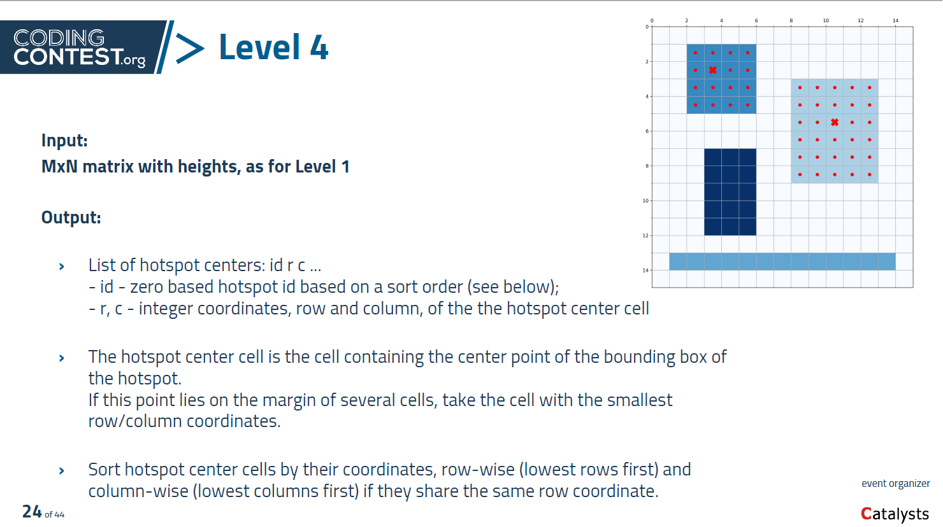

Slide 7
Bresenham's line algorithm
Draws a line by drawing a lot of points.
But how do we get these intermediate points?
By using two simple formulas:
Xᵢ = X₁ + percentage * (X₂ - X₁)
Yᵢ = Y₁ + percentage * (Y₂ - Y₁)

Slide 8
Bresenham's line algorithm

Slide 9
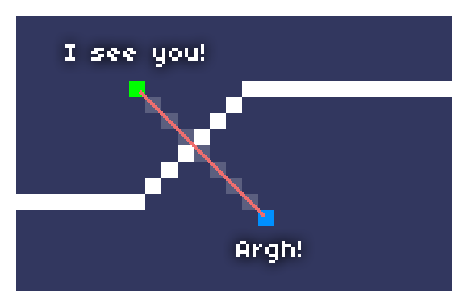
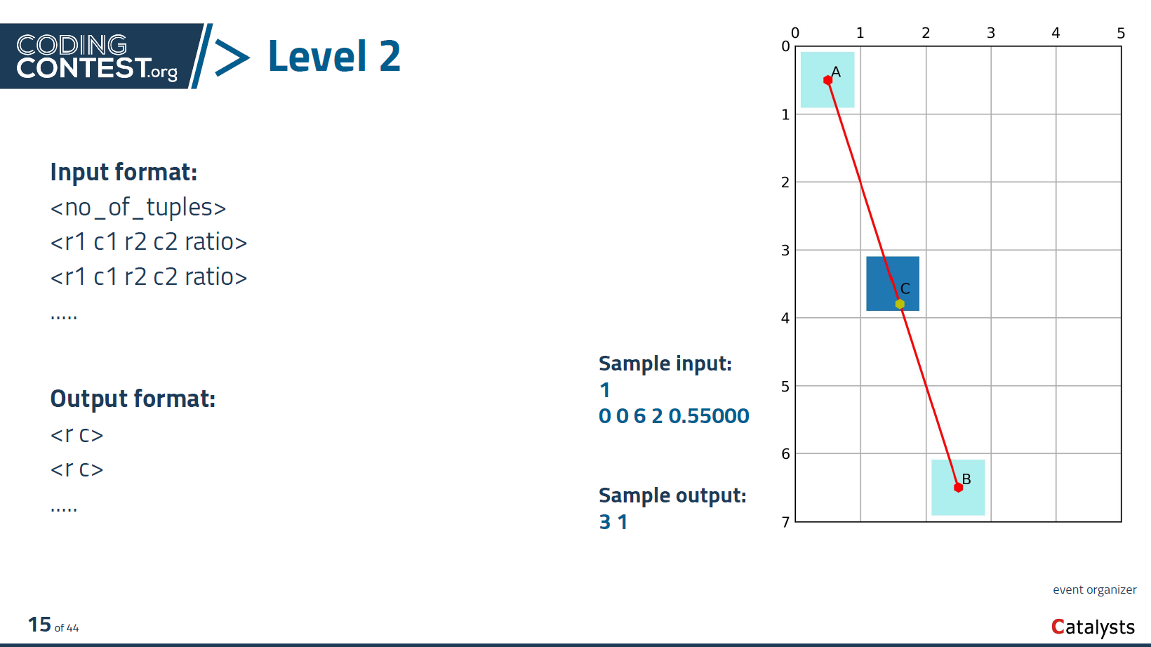
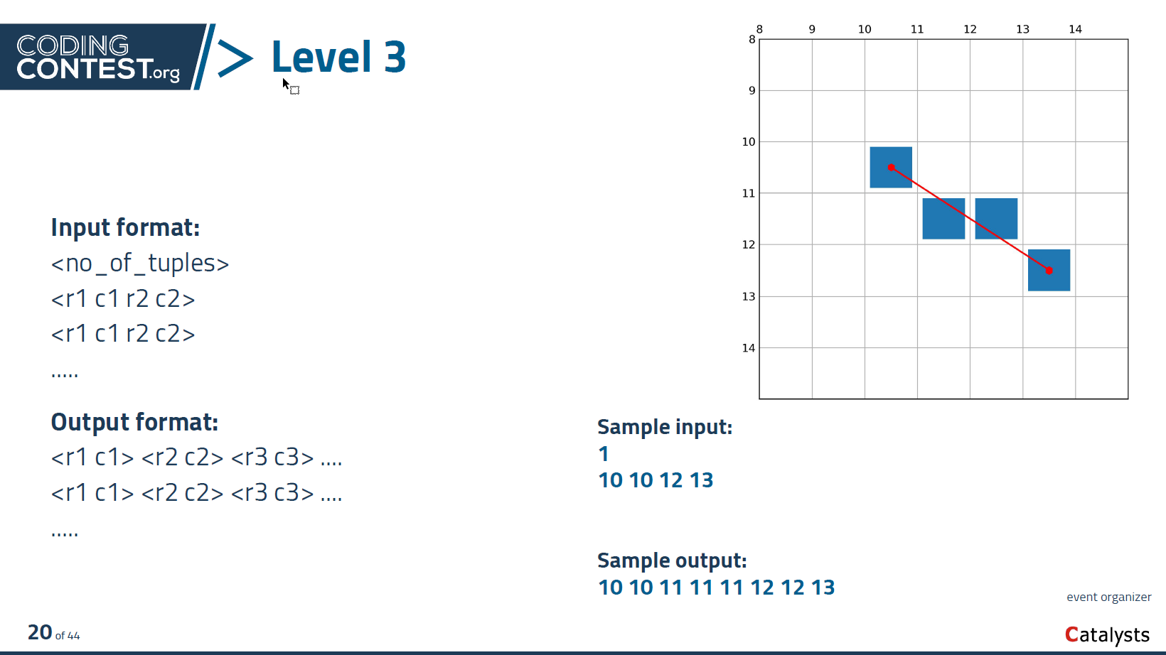
Bresenham's line algorithm
Uses:
Delimiting fill areas (yes, Paint!)
Again, coding competitions!
Collision detection in games (weapon bullets in shooters)

Slide 10
Bresenham's line algorithm

Slide 11
Bresenham's line algorithm

Slide 12
Bresenham's line algorithm

Slide 13
Putting the two together...
Now, what’s the most common use?
PAINT!

Slide 14

