Slide 1
DATA ANALYST PORTFOLIO · 2026
FMCG Sales
Performance Analytics.
An end-to-end analytics project on Indonesian FMCG distribution — turning 15,806 transactions into eight strategic recommendations.
[Your Name]
STACK
Sales & Data Professional · FMCG
SQL · Python · Tableau · Excel

Slide 2

01 · ABOUT
Bridging sales experience with analytics.
I’m Filza Dikaputra, a sales and data professional in the FMCG industry.
CORE STRENGTHS
Data analysis & reporting
After working closely with sales performance, distribution, and channel data, I learned that the most valuable insights rarely come from dashboards alone — they come from connecting numbers to ground reality.
Translate raw sales data into clear narratives
Dashboarding
Tableau Public · Excel scorecards
This portfolio is my transition into a Data Analyst / BI Analyst role: combining domain knowledge of FMCG with analytical rigor in SQL, Python, and Tableau.
Business understanding
Distribution, achievement vs target, channel
[Your Name]
Tools
Sales & Data Professional · FMCG
Target role: Data Analyst · BI Analyst
Excel · Tableau · SQL · Python
FMCG SALES PERFORMANCE · ABOUT
02 / 14

Slide 3
02 · PROJECT
What this portfolio demonstrates.
15,806
24
8
25
clean transactions
months of data
branches across Indonesia
SKUs · 5 principals
Scope
Data preparation → cleaning → SQL analysis → Python visualization → Tableau dashboard → business recommendations.
Real-world FMCG context: actual sales vs target by branch, principal, and SKU; seasonality (Lebaran, year-end); and Pareto distribution of revenue.
FMCG SALES PERFORMANCE · OVERVIEW
03 / 14

Slide 4
03 · METHOD
End-to-end workflow.
01
02
03
Business Questions
Data Preparation
Data Cleaning
Define eight questions a sales leader actually asks
Generate realistic 24-month transaction dataset
Profile, dedupe, fix dates, handle outliers
04
05
06
SQL Analysis
Python & Tableau
Recommendations
Window functions, CTEs, Pareto, achievement
Visualize patterns; publish interactive dashboard
Translate findings into prioritized actions
FMCG SALES PERFORMANCE · METHOD
04 / 14

Slide 5
04 · QUESTIONS
Eight questions, answered with SQL.
01
Total revenue and profit margin in 2024?
05
Monthly trend YoY (2023 vs 2024)?
02
Top principals by revenue contribution?
06
Branch × principal achievement matrix?
03
Branch achievement vs target (2024)?
07
Branch growth: who leads, who lags?
04
Top 10 best-selling products?
08
Pareto: 80% of revenue from how many SKUs?
Techniques used: CTEs · Window functions (RANK, SUM OVER) · CASE WHEN · multi-table JOINs · NULLIF · COALESCE
FMCG SALES PERFORMANCE · QUESTIONS
05 / 14

Slide 6
05 · DATA CLEANING
Real-world data is messy. Here's how I handled it.
Duplicate rows
Missing values
16,045 → 15,966
80 NaN → 0 missing
drop_duplicates(keep='first')
Drop rows where qty / revenue null
Negative values
Whitespace
77 rows → 0 rows
Trimmed branch_id
Filter quantity > 0 AND revenue > 0
Multi-format string normalization
FMCG SALES PERFORMANCE · CLEANING
06 / 14

Slide 7
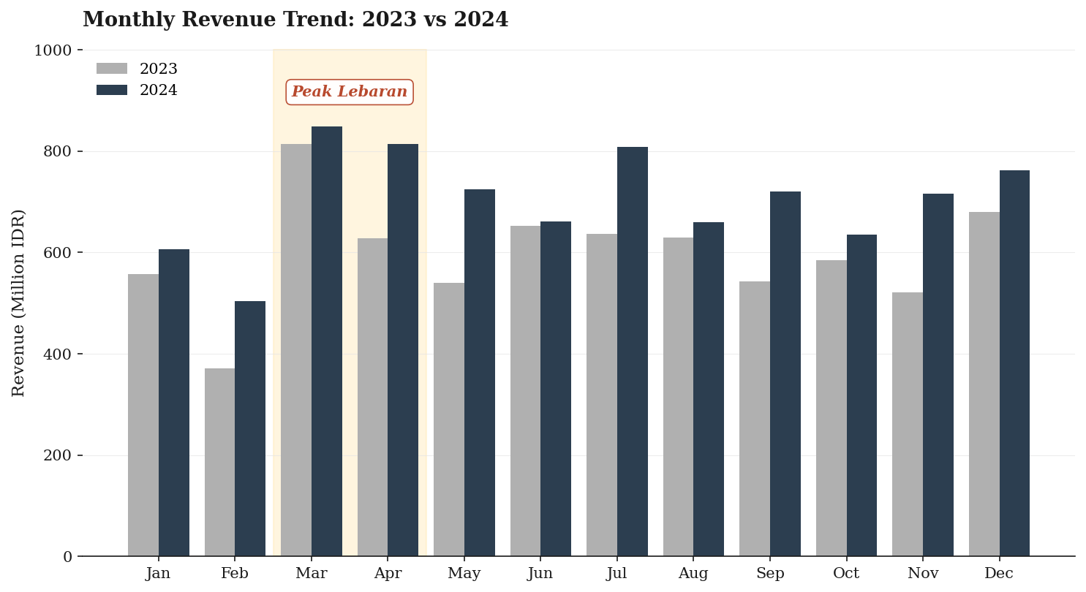
06 · FINDING 01
Lebaran is the single biggest sales lever.
April 2024 grew +29.6% YoY
Lebaran demand drives Q1–Q2 spikes — particularly March and April. The +29.6% jump in April 2024 is not a fluke; it's a recurring window for inventory and promotion planning.
Action: Lock 1.5× safety stock for Mar–Apr; redirect promo budget to recover slower months.
FMCG SALES PERFORMANCE · FINDINGS
07 / 14

Slide 8
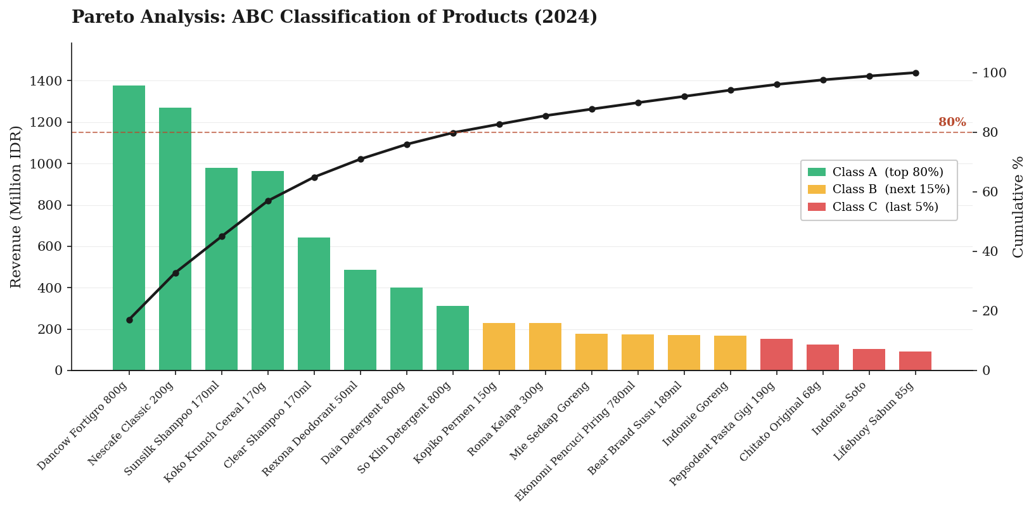
07 · FINDING 02
The 80/20 rule is alive — and well-defined.
10 SKUs
generate 80% of total revenue
15.6%
from one product alone (Dancow)
15 SKUs
contribute only 20% — review for promo
FMCG SALES PERFORMANCE · FINDINGS
08 / 14

Slide 9
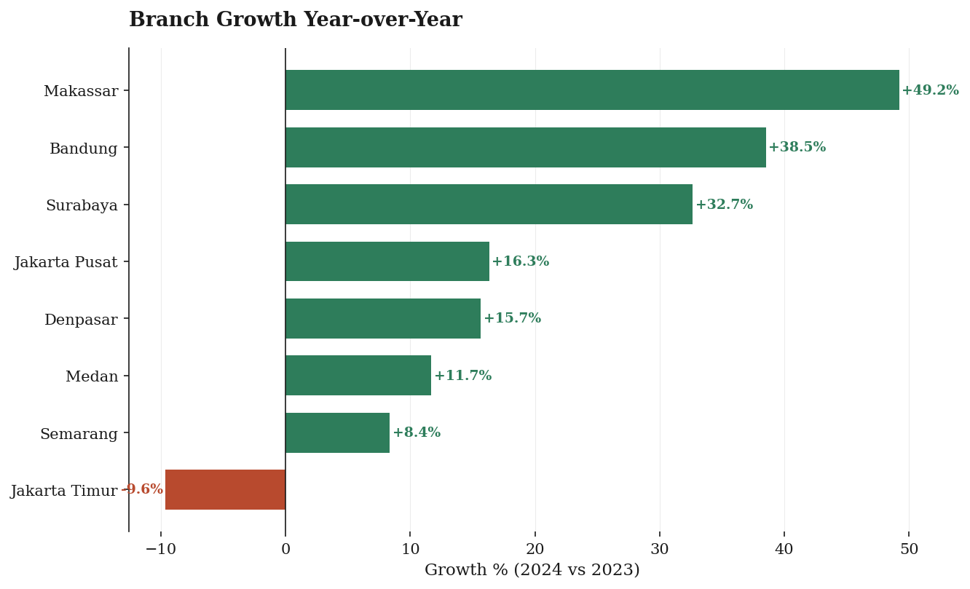
08 · FINDING 03
Branch performance varies by 59 percentage points.
Best:
Makassar +49.2%
Worst:
Jakarta Timur −9.6%
What this tells us
Same products, same targets — yet a 59-point spread. The variance lives in execution: outlet coverage, sales team capability, and trade promotion effectiveness.
Recommendation: cross-pollinate Makassar's playbook; investigate Jakarta Timur's contraction.
FMCG SALES PERFORMANCE · FINDINGS
09 / 14

Slide 10
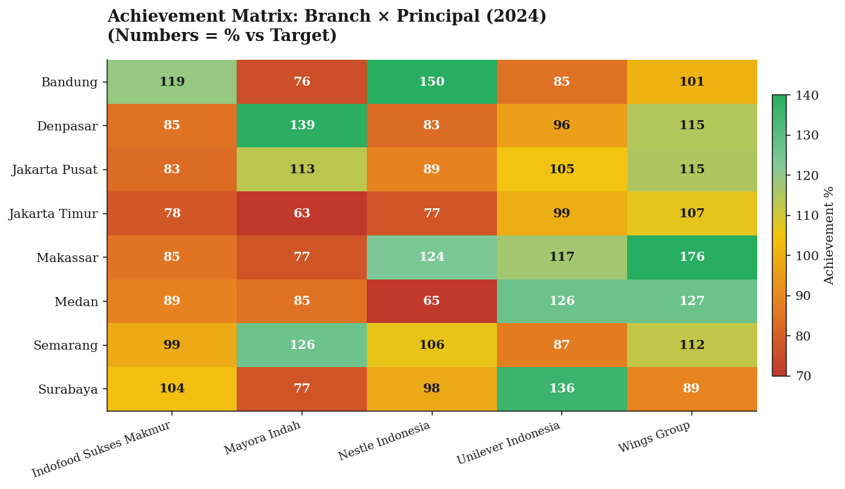
09 · FINDING 04
Where exactly are the gaps?
Branch × Principal achievement matrix reveals specific underperforming combinations.
HOW TO READ
Green
>100% — achieved
Yellow
90–100% — near target
Red
Below 90% — investigate
USE CASE
Identify which branch–principal pairs are bleeding revenue and act on the root cause: pricing, distribution, or sales skill.
FMCG SALES PERFORMANCE · FINDINGS
10 / 14

Slide 11
10 · RECOMMENDATIONS
From insight to action.
TIMING
INITIATIVE
ACTION
IMPACT
P1
0–30 days
Stockout prevention for Class A SKUs
Set safety stock to 2× daily avg for top 10 SKUs; real-time alerts <30% buffer.
+2–3% revenue
P2
30–90 days
Pareto-driven sales targeting
Re-segment outlets; 80% of effort on Class A buyers; cross-sell Class B.
+5% revenue
P2
30–90 days
Lebaran campaign optimization
Lock Q1 inventory + marketing budget; capture predictable +29.6% uplift.
+3–4% revenue
P3
90+ days
Diversify principal mix
Reduce Nestle dependency (46%) by expanding Mayora & Indofood programs.
Risk mitigation
Conservative total impact: +10 to +12% revenue growth vs current baseline.
FMCG SALES PERFORMANCE · RECOMMENDATIONS
11 / 14

Slide 12
11 · DELIVERABLES
What's in the repository.
01
Generated dataset
4 CSVs · 15,806 transactions · 24 months
02
Cleaning pipeline
SQL + Python scripts with profiling logs
03
SQL analysis
8 business-question queries (SQLite-compatible)
04
Python visualizations
Editorial-grade charts (matplotlib + seaborn)
05
Tableau dashboard
Interactive — build guide included
06
Documentation
README · Business insights · Reproduce guide
FMCG SALES PERFORMANCE · DELIVERABLES
12 / 14

Slide 13
12 · TECH STACK
Tools used.
SQL
PYTHON
VIZ
BI
SQLite
Pandas
Matplotlib +
Seaborn
Tableau Public
Window funcs · CTEs · Pareto
Cleaning · pipeline · analysis
Editorial-grade charts
Interactive dashboard
REPRODUCE
$ python data/generate_data.py
$ sqlite3 fmcg.db < sql/01_schema_and_load.sql
$ jupyter notebook python/fmcg_sales_analysis.ipynb
FMCG SALES PERFORMANCE · STACK
13 / 14

Slide 14
Thank you.
Open to data analyst & BI analyst opportunities.
NAME
Filza Dikaputra
EMAIL
dikaputrafilza03@gmail.com
LINKEDIN
linkedin.com/in/filza-dikaputra/
GITHUB
https://github.com/filzadika-cell/fmcg-sales-portfolio
[YOUR NAME] · FMCG ANALYTICS PORTFOLIO

