Slide 1
Bitcoin
Price Prediction
2013210047 박성현
2014210030 지우성
2014210045 강종욱

Slide 2
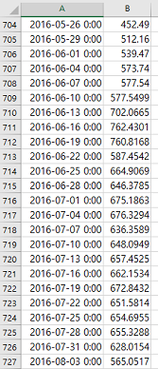
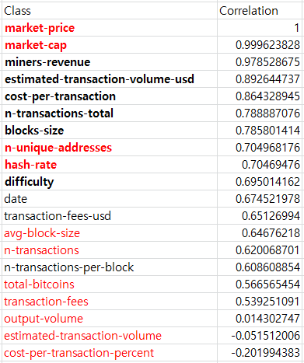
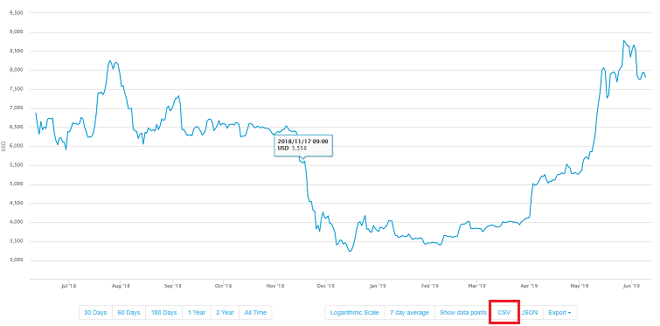
Dataset
We found so much datasets in blockchain.com. There are datasets over 10 years period, but valuable data starts at 2010-08-17, so we preprocessed dataset to start at 2010-08-17. We have total 18 classes and one label (Market Price), each classes and label have 1073 column, 3-days interval.
blockchain.com
Our dataset has enough classes, so we decided not to use all classes in our project. First, we checked correlation with each classes and label, so 9 classes include Market Capitalization is chosen for our dataset. But, our dataset chosen by correlation often get high errors, so we changed our choice of classes little by little with many execution.
[Market price data]
[Correlation Results]
Red – Final Selected Classes Bold – Correlation High Classes

Slide 3
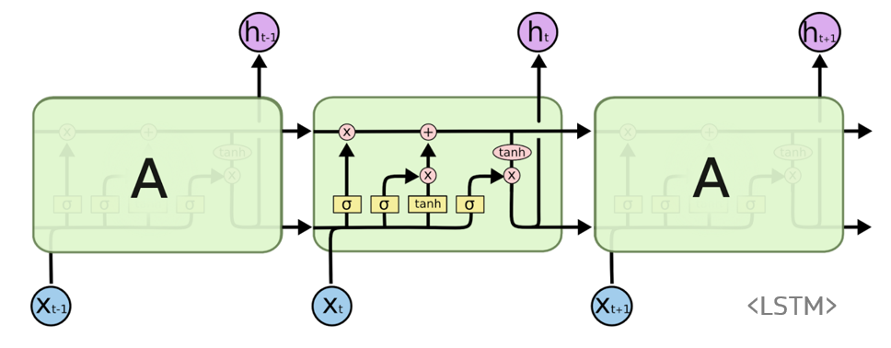
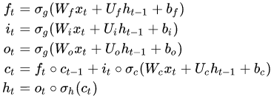
Algorithm - RNN
In this project, our model make result from previous history data(such as bitcoin price history, market volume history), so it must be fit with data with time series. We chose RNN(Recurrent Neural Network) for our data, because it’s very powerful algorithm with time series.
Unlike Normal Feed-Forward Neural Network, RNN has information cycles through a loop. This loop makes RNN to consider current input and also what it has learned from the inputs it received previously.
[LSTM Model Architecture]
We used one type of RNN, Long Short Term Memory (LSTM) which is perhaps the most successful RNN because it overcomes the problems of training RNN and in turn has been used on a wide range of applications such as voice recognition or language translation.
When RNN is learning, it produces output, and it copies that output and gets back into input, and its weight changes with special backpropagation which named with Backpropagation Through Time(BRTT).
[LSTM Formula]

Slide 4
Implementation
01
Dataset which has .csv extension is imported with MATLAB. For this we use getdata.m which is made with Import Data Wizard. These dataset have 18 classes, but some data are same with variance(transaction-fees, transaction-fees-usd), and some data are not fit with our model, so we will use only 9 classes.
Import Data
02
Dataset divided with 90% of train dataset, 5% of validation dataset and 5% of test dataset, and model will be evaluated with test dataset. We use RNN algorithm, and RNN dataset must be serial data. So we get dataset with formal 90% going to train dataset, and later 10% going to validation dataset and test dataset. In addition, we normalize the data with mean and variance of train data.
Preprocess Data
03
For LSTM, we use sequenceInputLayer() and lstmLayer() in our layer. After these two layers, we put fullyConnectedLayer() and regressionLayer so model can predict prices and calculate RMSE. In addition, we use dropout and early stopping with validation data because of avoiding overfitting.
Set Layer
04
We train the model with train dataset. Model train with 500 epoch, and initial 0.005 learning rate, which is slowly decreasing. Training process will plotted with several information. In addition, we save the checkpoint for every epoch.
Train Model
05
Model is tested with test dataset. After all the training process, model will be tested and result is plotted. Result has graph that shows real market prices and our model’s predicted prices. In addition, RMSE is shown, so we can think whether it is good model, or bad model.
Test Model

Slide 5
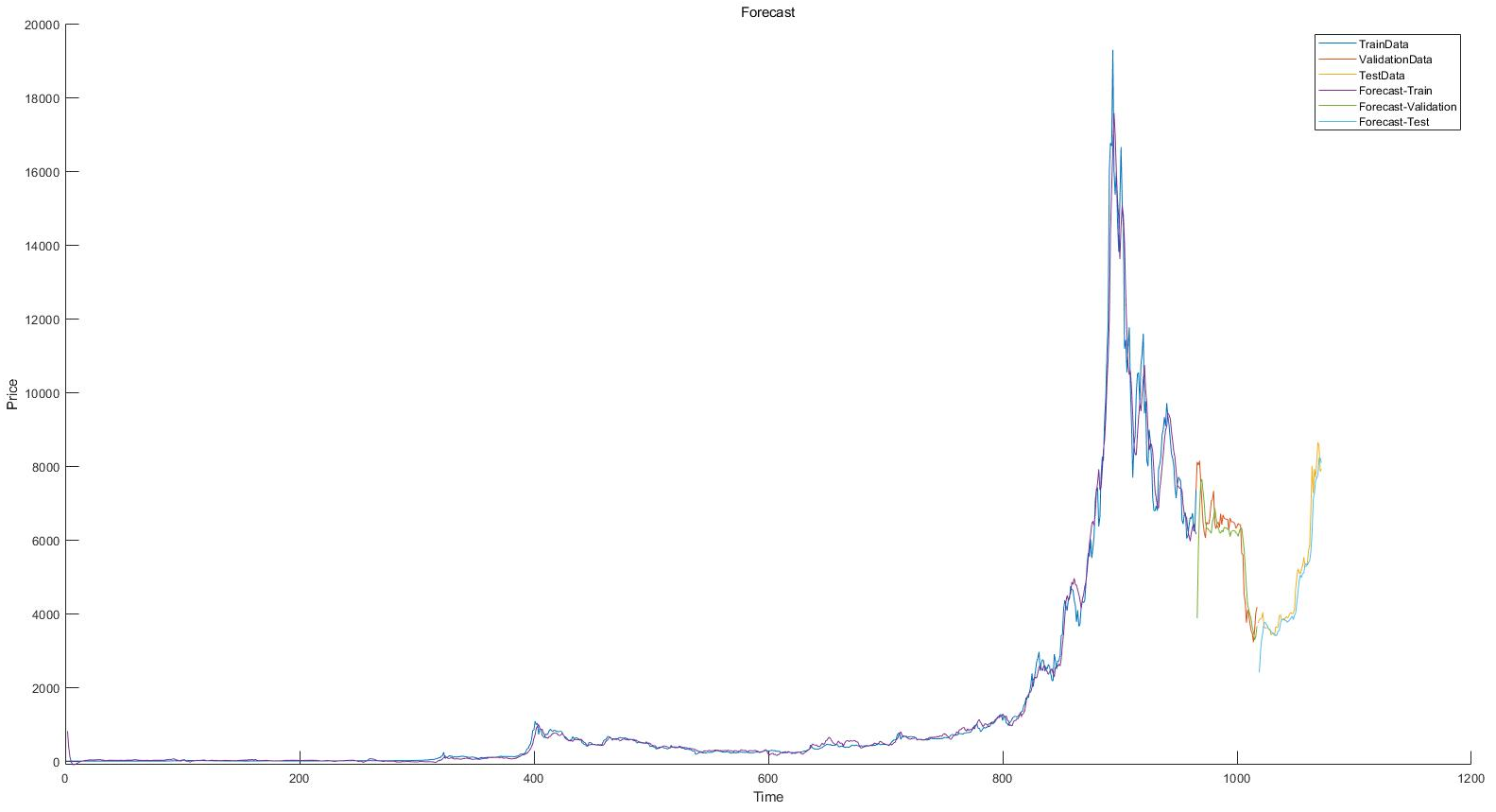
Result
Above is plot that comparing our model prediction with real market prices. We divided data with 90% train, 5% validation, 5% test. Originally, we tried to use 10% of the test and validation data, but recently the price of the bit coin was different from the past so it was reduced to 5%. In the plot, our model seems to follows original data quite well.

Slide 6
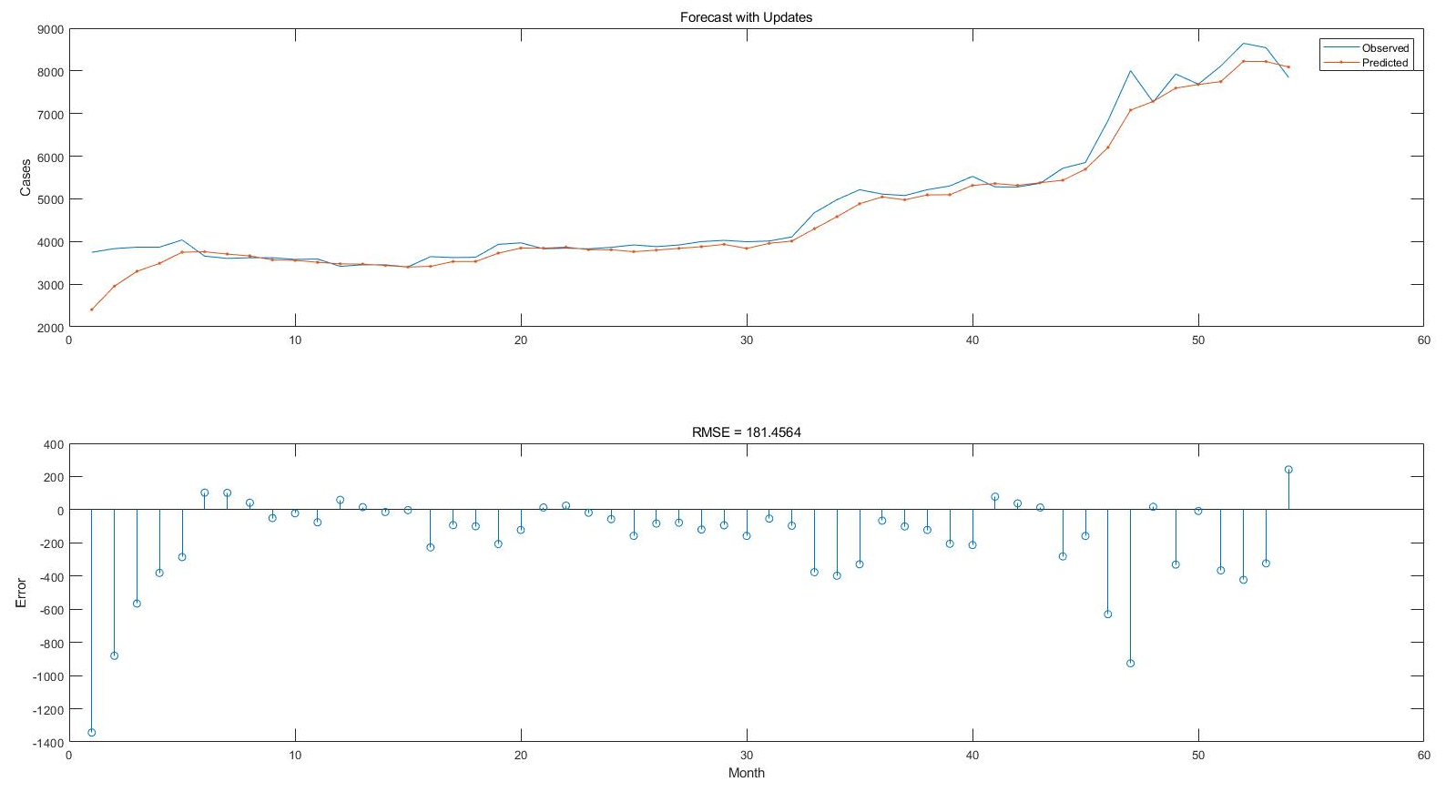
Result - Test
In test dataset, result comes out almost 180 RMSE, and plotted this predicted price graph. It is quite fit with real market price, so we could think that model was well trained.

