Slide 1

AngularJS 2
Fabian Imsand

Slide 2
Overview
Introduction
TypeScript
Architecture
Modules
Components
Templates
Metadata
Data binding
Directives
Services
Dependency injection

Slide 3
Your experience
jQuery
AngularJS
Angular 2
React
Backbone
Twig (PHP)
Sencha
Others?

Slide 4
AngularJS 1 vs Angular 2
Component-Based
Controller and $scope no longer used
Use components and directives instead
Improved dependency injection
TypeScript
ES6 + Types + Annotations
Open Source (Microsoft)
Lambdas
Angular wants to add to what browsers can do, not replicate it
Following standardization plans
Looking towards the future
Notes:
The Angular team does a great job in following the standardization plans while still looking towards the future and giving us tools today. W3C is working on Web Components and WHATWG on the Component model. At the same time Ecma International is working on ECMAScript 6.
Angular 2.0 looks very different from what we're used to. But if we look outside of Angular we start to understand why. Angular wants to add to what browsers can do, not replicate it. So as browsers can do more things, Angular has to do different things and allow the browser to do the things that Angular used to do.

Slide 5
Introduction to AngularJS
Structural framework for dynamic web apps
Extend HTML‘s syntax
Normaly
Library (jQuery)
Framework (Ember)
Angular creates new HTML constructs
Complete client-side solution
Native mobile apps -> Ionic / NativeScript / React Native
Desktop apps accross Mac, Windows, Linux

Slide 6
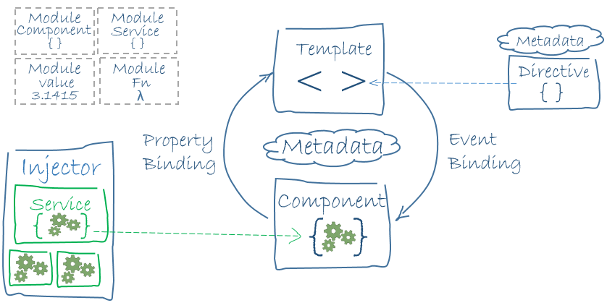
Architecture

Slide 7
TypeScript
Free and open source
Microsoft
Type information
Annotations
Classes
Modules
Arrow function
Strict superset of ECAMScript 2015 standard
JavaScript is valid TypeScript
TypScrip can consume JavaScript
TypeScript to JavaScript compiler

Slide 8
Modules
Modular
Root module / AppModule
Feature modules
Application domain
Workflow
Related set of capabilities
@NgModule
Declarations
Exports
Imports
Providers
Bootstrap
Unrelated to JavaScript module managing
JavaScript each file is a module
Comlementery
Notes:
declarations - the view classes that belong to this module. Angular has three kinds of view classes: components, directives, and pipes.
exports - the subset of declarations that should be visible and usable in the component templates of other modules.
imports - other modules whose exported classes are needed by component templates declared in this module.
providers - creators of services that this module contributes to the global collection of services; they become accessible in all parts of the app.
bootstrap - the main application view, called the root component, that hosts all other app views. Only the root module should set this bootstrapproperty.

Slide 9
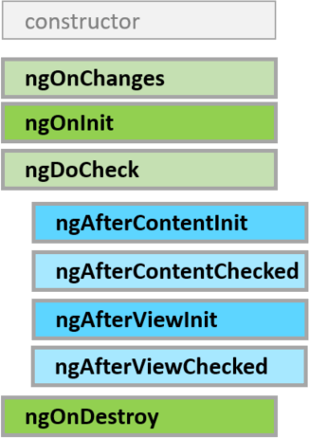
Component
Controlles a part of the screen (view)
Application logic
Components have lifecyvle hooks

Slide 10
Template
Form of HTML
How to render components
Angular’s template syntax
Custom elements

Slide 11
Metadata
How to process a class
Tell Angular what to do with classes
Attach metadata using a decorator
Annotate calsses

Slide 12
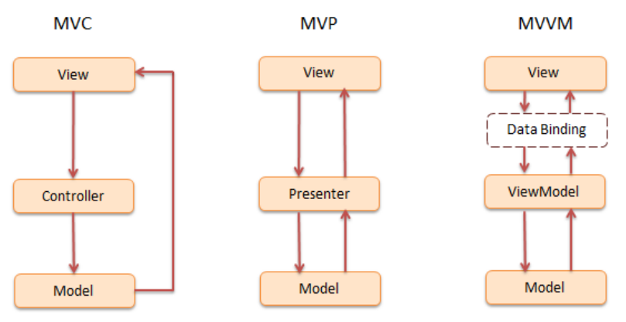
Data Binding

Slide 13
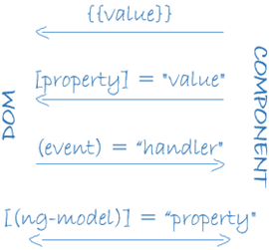
Data Binding
jQuery -> own push/pull logic
Coordinate template with parts of component
Interpolation
Property binding
Event binding
Two-way binding

Slide 14
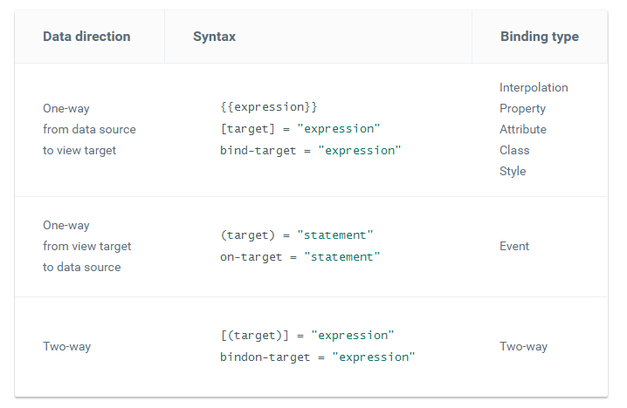
Syntax

Slide 15
Directives
Templates are dynamic
Component
Directive with a template
Technically a directive
Separeted in architectural overview
Structural directives
Alter layout (DOM-Elements)
*ngFor / *ngIf
Attribute directives
Alter the appearance or behavior of an existing element

Slide 16
Services
Almost anything can be a service
Narrow, well-defined purpose
Logging service
Data service
Message bus
Tax calculator
Application configuration
Components consume services

Slide 17
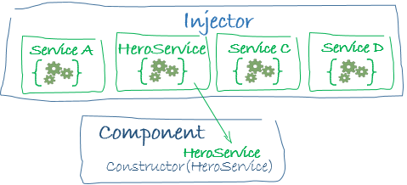
Dependency Injection
Supply new instances of a class
Most dependencies are services
In general, providers are part of the root module

