Slide 1
Deep Convolutional Neural Networks for Sentiment Analysis of Short Texts
Proceedings of the 25th International Conference on Computational Linguistics (COLING), Dublin, Ireland, 2014
Cicero Nogueira dos Santos, Maira Gatti
IIS Lab.
Changyong Jeon
2016.05.23

Slide 2
Contents
Introduction
Proposed Methods
Experiments
Conclusion

Slide 3
Introduction
Sentiment analysis of short texts is challenging because of the limited contextual information that they normally contain.
Proposes a deep convolutional neural network that exploits from character- to sentence level information to perform sentiment analysis of short texts.
Character to Sentence Convolutional Neural Network (CharSCNN)
Uses two convolutional layers to extract relevant features from words and sentences of any size.

Slide 4
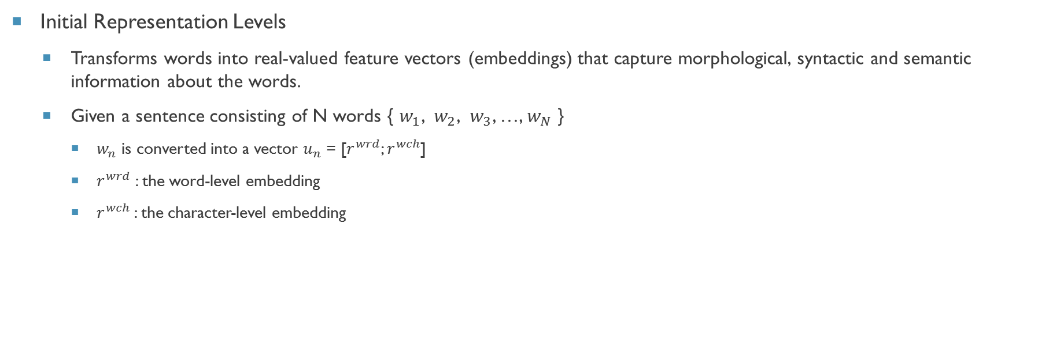
Proposed Methods
Initial Representation Levels
Transforms words into real-valued feature vectors (embeddings) that capture morphological, syntactic and semantic information about the words.
Given a sentence consisting of N words { $w_{1}$, $w_{2}$, $w_{3}$, …, $w_{N}$ }
$w_{n}$ is converted into a vector $u_{n}$ = [$r^{wrd}$; $r^{wch}$]
$r^{wrd}$ : the word-level embedding
$r^{wch}$: the character-level embedding

Slide 5
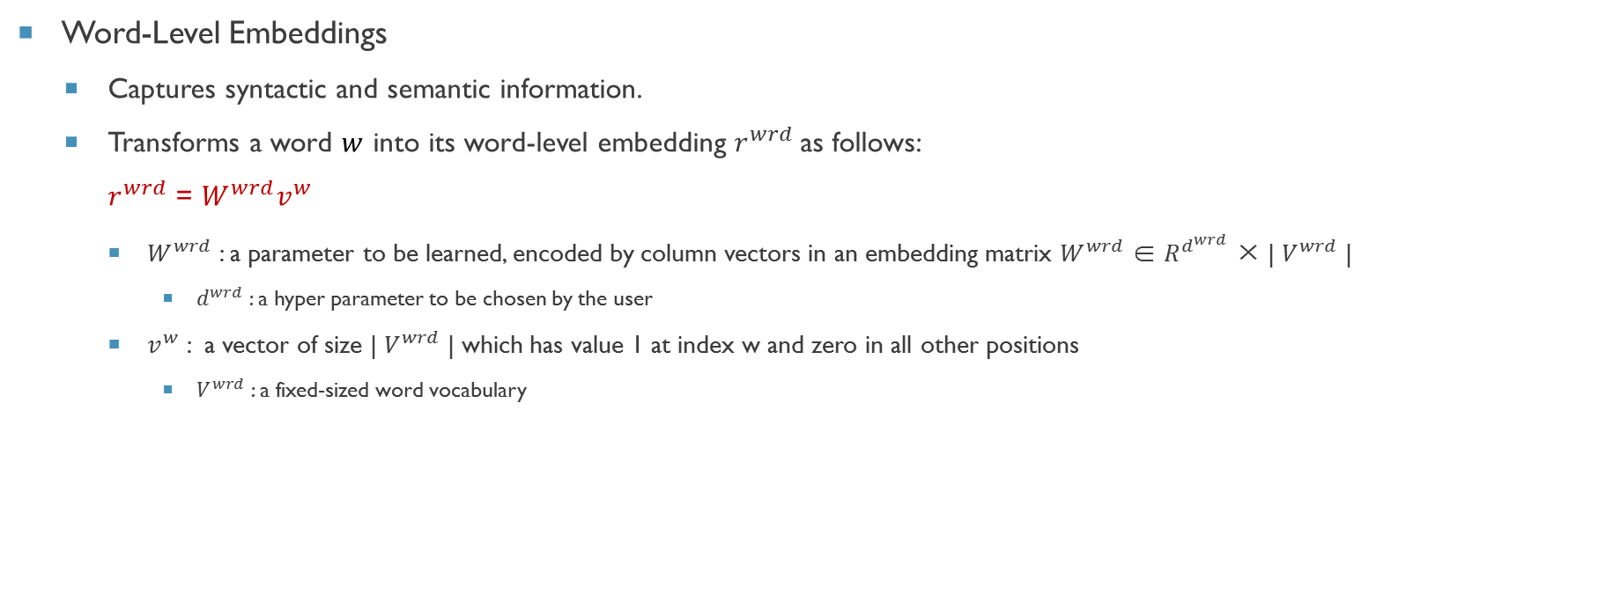
Proposed Methods (cont.)
Word-Level Embeddings
Captures syntactic and semantic information.
Transforms a word $w$ into its word-level embedding $r^{wrd}$as follows:
$r^{wrd}$ = $W^{wrd}v^{w}$
$W^{wrd}$ : a parameter to be learned, encoded by column vectors in an embedding matrix $W^{wrd}$ ∈ $R^{d^{wrd}}$ × | $V^{wrd}$ |
$d^{wrd}$ : a hyper parameter to be chosen by the user
$v^{w}$ : a vector of size | $V^{wrd}$ | which has value 1 at index w and zero in all other positions
$V^{wrd}$ : a fixed-sized word vocabulary

Slide 6
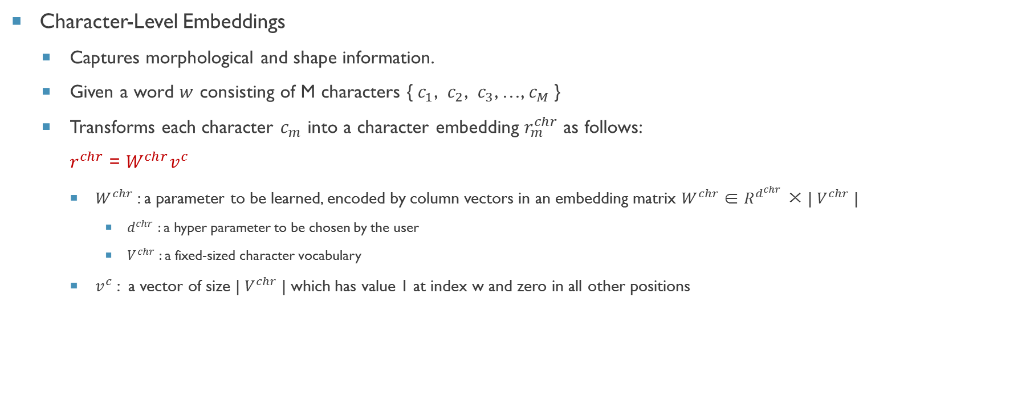
Proposed Methods (cont.)
Character-Level Embeddings
Captures morphological and shape information.
Given a word $w$ consisting of M characters {${ c}_{1}$, $c_{2}$, $c_{3}$, …, $c_{M}$}
Transforms each character $c_{m}$ into a character embedding $r_{m}^{chr}$ as follows:
$r^{chr}$ = $W^{chr}v^{c}$
$W^{chr}$ : a parameter to be learned, encoded by column vectors in an embedding matrix $W^{chr}$ ∈ $R^{d^{chr}}$ × | $V^{chr}$ |
$d^{chr}$ : a hyper parameter to be chosen by the user
$V^{chr}$ : a fixed-sized character vocabulary
$v^{c}$ : a vector of size | $V^{chr}$ | which has value 1 at index w and zero in all other positions

Slide 7
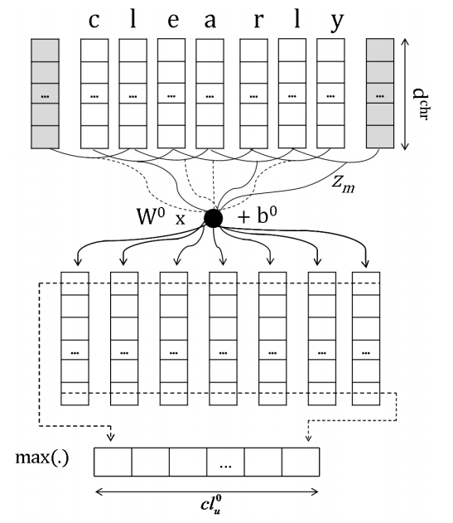
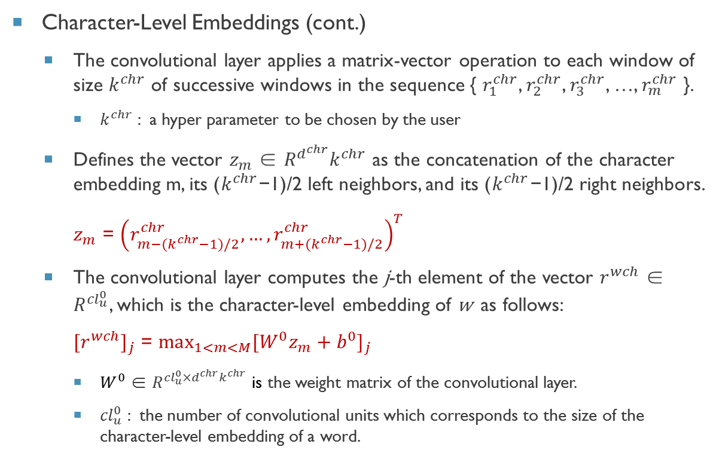
Proposed Methods (cont.)
Character-Level Embeddings (cont.)
The convolutional layer applies a matrix-vector operation to each window of size $k^{chr}$ of successive windows in the sequence { $r_{1}^{chr}$, $r_{2}^{chr}$, $r_{3}^{chr}$, …, $r_{m}^{chr}$ }.
$k^{chr}$ : a hyper parameter to be chosen by the user
Defines the vector $z_{m}$ ∈ $R^{d^{chr}}k^{chr}$ as the concatenation of the character embedding m, its ($k^{chr}$−1)/2 left neighbors, and its ($k^{chr}$−1)/2 right neighbors.
$z_{m}$ = ${\left(r_{m−(k^{chr}−1)/2}^{chr}, …,r_{m+(k^{chr}−1)/2}^{chr}\right)}^{T}$
The convolutional layer computes the j-th element of the vector $r^{wch}$ ∈ $R^{{cl}_{u}^{0}}$, which is the character-level embedding of w as follows:
${[r^{wch}]}_{j}$ = $\max_{1<m<M}{{[W^{0}z_{m}+b^{0}]}_{j}}$
$W^{0}$ ∈ $R^{{cl}_{u}^{0}×d^{chr}k^{chr}}$ is the weight matrix of the convolutional layer.
${cl}_{u}^{0}$ : the number of convolutional units which corresponds to the size of the character-level embedding of a word.

Slide 8
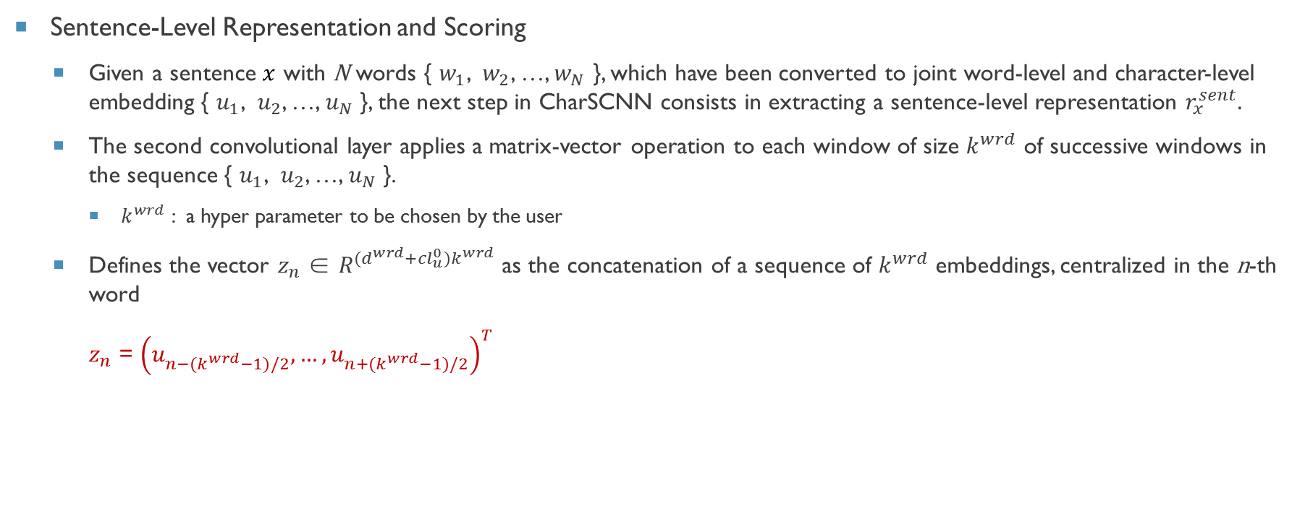
Proposed Methods (cont.)
Sentence-Level Representation and Scoring
Given a sentence $x$ with N words { $w_{1}$, $w_{2}$, …, $w_{N}$ }, which have been converted to joint word-level and character-level embedding { $u_{1}$, $u_{2}$, …, $u_{N}$ }, the next step in CharSCNN consists in extracting a sentence-level representation $r_{x}^{sent}.$
The second convolutional layer applies a matrix-vector operation to each window of size $k^{wrd}$ of successive windows in the sequence { $u_{1}$, $u_{2}$, …, $u_{N}$ }.
$k^{wrd}$ : a hyper parameter to be chosen by the user
Defines the vector $z_{n}$ ∈ $R^{(d^{wrd}+{cl}_{u}^{0})k^{wrd}}$ as the concatenation of a sequence of $k^{wrd}$ embeddings, centralized in the n-th word
$z_{n}$ = ${\left(u_{n−(k^{wrd}−1)/2}, …,u_{n+(k^{wrd}−1)/2}\right)}^{T}$

Slide 9
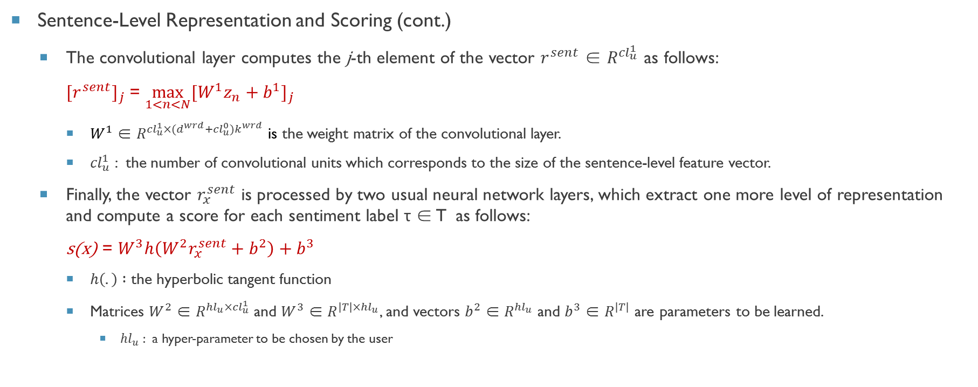
Proposed Methods (cont.)
Sentence-Level Representation and Scoring (cont.)
The convolutional layer computes the j-th element of the vector $r^{sent}$ ∈ $R^{{cl}_{u}^{1}}$ as follows:
${[r^{sent}]}_{j}$ = $\max_{1<n<N}{{[W^{1}z_{n}+b^{1}]}_{j}}$
$W^{1}$ ∈ $R^{{cl}_{u}^{1}×(d^{wrd}+{cl}_{u}^{0})k^{wrd}}$ is the weight matrix of the convolutional layer.
${cl}_{u}^{1}$ : the number of convolutional units which corresponds to the size of the sentence-level feature vector.
Finally, the vector $r_{x}^{sent}$ is processed by two usual neural network layers, which extract one more level of representation and compute a score for each sentiment label τ ∈ T as follows:
s(x) = $W^{3}h\left(W^{2}r_{x}^{sent}+b^{2}\right)+b^{3}$
$h\left(.\right) :\text{the} \text{hyperbolic} \text{tangent}$ function
Matrices $W^{2}$ ∈ $R^{{hl}_{u}×{cl}_{u}^{1}}$ and $W^{3}$ ∈ $R^{|T|×{hl}_{u}}$, and vectors $b^{2}$ ∈ $R^{{hl}_{u}}$ and $b^{3}$ ∈ $R^{|T|}$ are parameters to be learned.
${hl}_{u}$ : a hyper-parameter to be chosen by the user

Slide 10
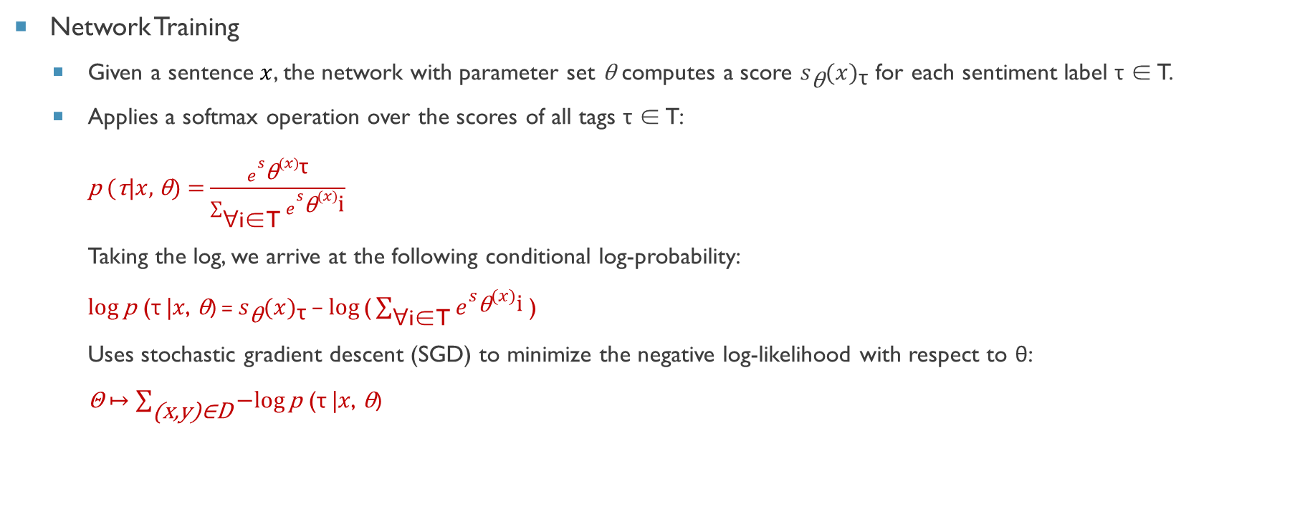
Proposed Methods (cont.)
Network Training
Given a sentence $x$, the network with parameter set θ computes a score $s_{\text{θ}}{(x)}_{\text{τ}}$ for each sentiment label τ ∈ T.
Applies a softmax operation over the scores of all tags τ ∈ T:
p (τ|$x$, θ) = $\frac{e^{s_{\text{θ}}{(x)}_{\text{τ}}}}{\sum_{\text{∀}\text{i}\text{∈}\text{T}}{e^{s_{\text{θ}}{(x)}_{\text{i}}}}}$
Taking the log, we arrive at the following conditional log-probability:
$\log{\text{p}\text{ (}\text{τ}\text{ |}x\text{, }\text{θ}\text{)}}$ = $s_{\text{θ}}{(x)}_{\text{τ}}$ − $\log{\text{(}\sum_{\text{∀}\text{i}\text{∈}\text{T}}{e^{s_{\text{θ}}{(x)}_{\text{i}}}}\text{)}}$
Uses stochastic gradient descent (SGD) to minimize the negative log-likelihood with respect to θ:
Θ $↦\sum_{\text{(}\text{x}\text{,}\text{y}\text{)∈}\text{D}}{−log{\text{p}\text{ (}\text{τ}\text{ |}x\text{, }\text{θ}\text{)}}}$

Slide 11
Experiments
Datasets
Stanford Sentiment Treebank (SSTb)
Includes fine grained sentiment labels for 215,154 phrases in the parse trees of 11,855 sentences.
Focuses in sentiment prediction of complete sentences.
Stanford Twitter Sentiment corpus (STS)
The original training set contains 1.6K tweets that were automatically labeled as positive/negative using emoticons as noisy labels.
The test set was manually annotated by Go et al. (2009)
Uses only a sample of the training data consisting of 80K (5%) randomly selected tweets.
Constructs a development set by randomly selecting 16K tweets from the original training set.
Dataset | Set | # sentences / tweets | classes
SSTb | Train | 8544 | 5
 | Dev | 1101 | 5
 | Test | 2210 | 5
STS | Train | 80K | 2
 | Dev | 16K | 2
 | Test | 498 | 3

Slide 12
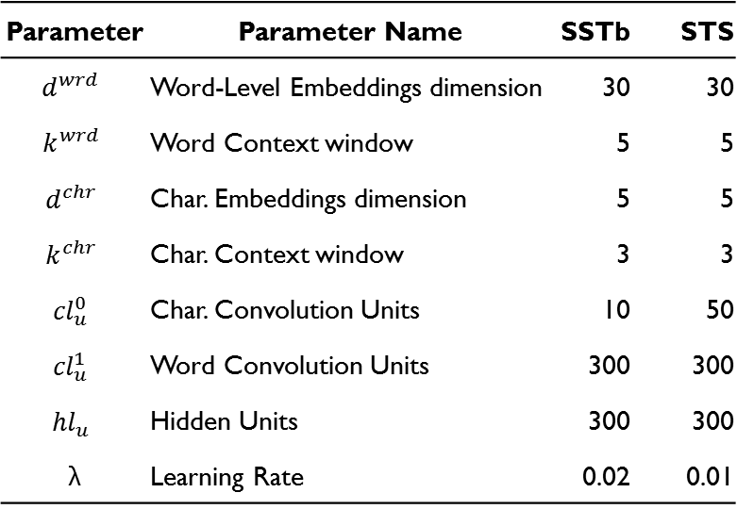
Experiments (cont.)
Model Setup
Uses the development sets to tune the neural network hyper-parameters.
The number of training epochs varies between five and ten.
Parameter | Parameter Name | SSTb | STS
$$d^{wrd}$$ | Word-Level Embeddings dimension | 30 | 30
$$k^{wrd}$$ | Word Context window | 5 | 5
$$d^{chr}$$ | Char. Embeddings dimension | 5 | 5
$$k^{chr}$$ | Char. Context window | 3 | 3
$${cl}_{u}^{0}$$ | Char. Convolution Units | 10 | 50
$${cl}_{u}^{1}$$ | Word Convolution Units | 300 | 300
$${hl}_{u}$$ | Hidden Units | 300 | 300
λ | Learning Rate | 0.02 | 0.01

Slide 13
Experiments (cont.)
Results for SSTb Corpus
The Fine-Grained column contains prediction results for the case where 5 sentiment classes are used (very negative, negative, neutral, positive, very positive).
The Phrases column indicates whether all phrases (yes) or only complete sentences (no) in the corpus are used for training.
CharSCN and SCNN have very similar results in both fine-grained and binary sentiment prediction. These results suggest that the character-level information is not much helpful for sentiment prediction in the SSTb corpus.
Model | Phrases | Fine-Grained | Positive/Negative
CharSCNN | Yes | 48.3 | 85.7
SCNN | Yes | 48.3 | 85.5
CharSCNN | No | 43.5 | 82.3
SCNN | No | 43.5 | 82.0
RNTN | Yes | 45.7 | 85.4
MV-RNN | Yes | 44.4 | 82.9
RNN | Yes | 43.2 | 82.4
NB | Yes | 41.0 | 81.8
SVM | Yes | 40.7 | 79.4

Slide 14
Experiments (cont.)
Results for STS Corpus
As expected, character-level information has a greater impact for Twitter data.
Initializing word-embeddings using unsupervised pre-training gives an absolute accuracy increase of around 4.5 when compared to randomly initializing the word-embeddings.
Model | Accuracy (unsup. pre-training) | Accuracy (random word embeddings)
CharSCNN | 86.4 | 81.9
SCNN | 85.2 | 82.2
LProp | 84.7
MaxEnt | 83.0
NB | 82.7
SVM | 82.2

Slide 15
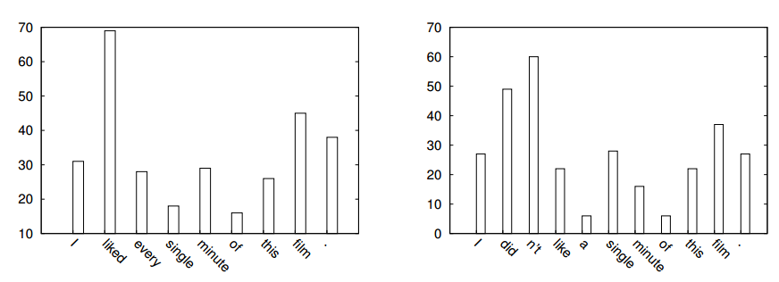
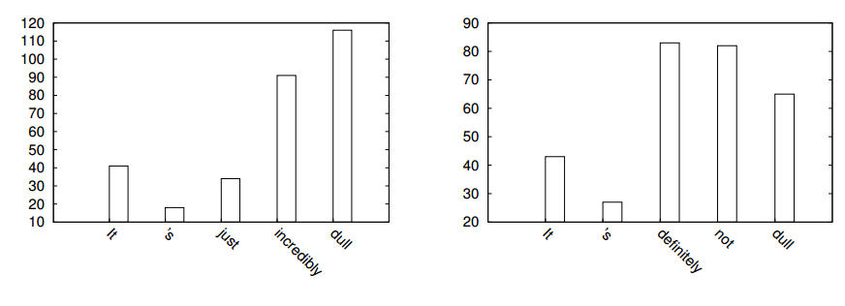
Experiments (cont.)
Sentence-level features
In figures 2 and 3, presents the behavior of CharSCNN regarding the sentence-level features extracted for two cases of negation, which are correctly predicted by CharSCNN.
Figure 2: Number of local features selected at each word when forming the sentence-level representation.
In this example, we have a positive sentence (left) and its negation (right).
Figure 3: Number of local features selected at each word when forming the sentence-level representation.
In this example, we have a negative sentence (left) and its negation (right).

Slide 16
conclusion
The idea of using convolutional neural networks to extract from character- to sentence level features.
The demonstration that a feed-forward neural network architecture can be as effective as RNTN for sentiment analysis of sentences.
The definition of new state-of-the-art results for SSTb and STS corpora.

Slide 17
Thank you

