Slide 1
Meeting Automation
Rakib Sheikh
Id: 1710576142
Ebrahim Ali
Id: 1710376116
Md. Bepul Hossain
Id: 1710976146

Slide 2
Abstract
Web based application.
The resolution will be stored on cloud.
Ones can create a meeting and send details to members.
Members can query resolution

Slide 3
Objectives
Create Meeting.
Store resolution.
Query on resolution.
Give feedback about resolution.
Invite members with details.

Slide 4
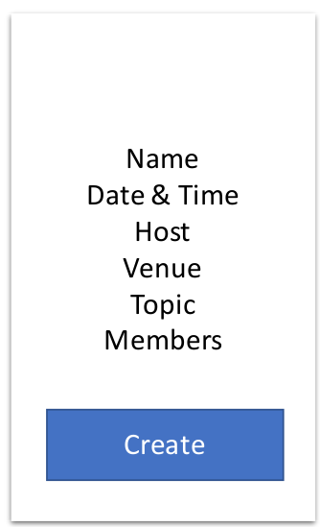
How Meeting automation will work?
Profile
Committee
All Member
Add Members
Admin
All Committee
Create Meeting
Add Committee
Authentication
Invite Members
Invite Head
Add Resolutions
After Meeting
Head of a committee
Feedback
Email With Meeting Resolution
to
Meeting Members
Meeting Resolution

Slide 5
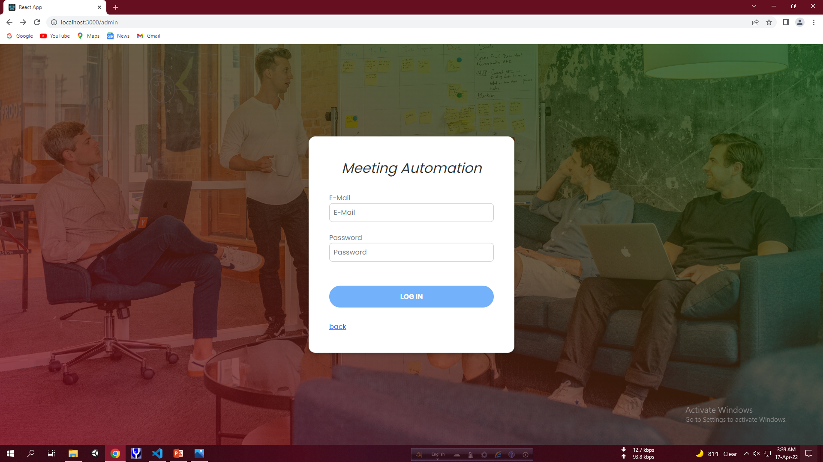
Admin

Slide 6
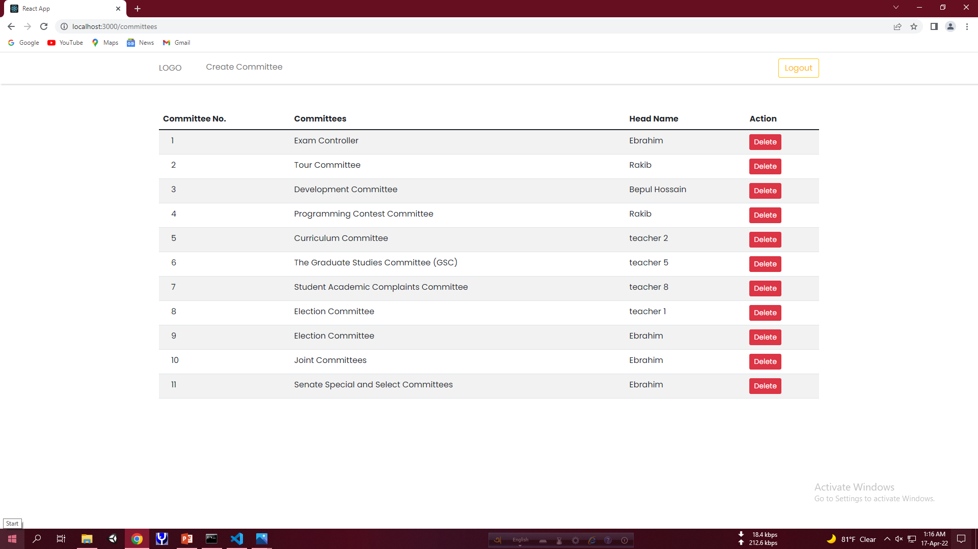
Admin(contd..)

Slide 7
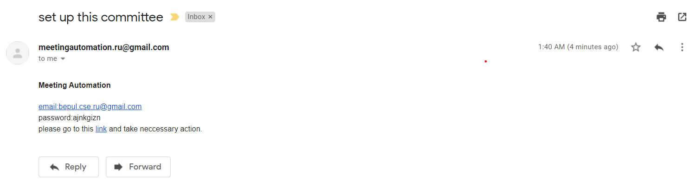
Head

Slide 8
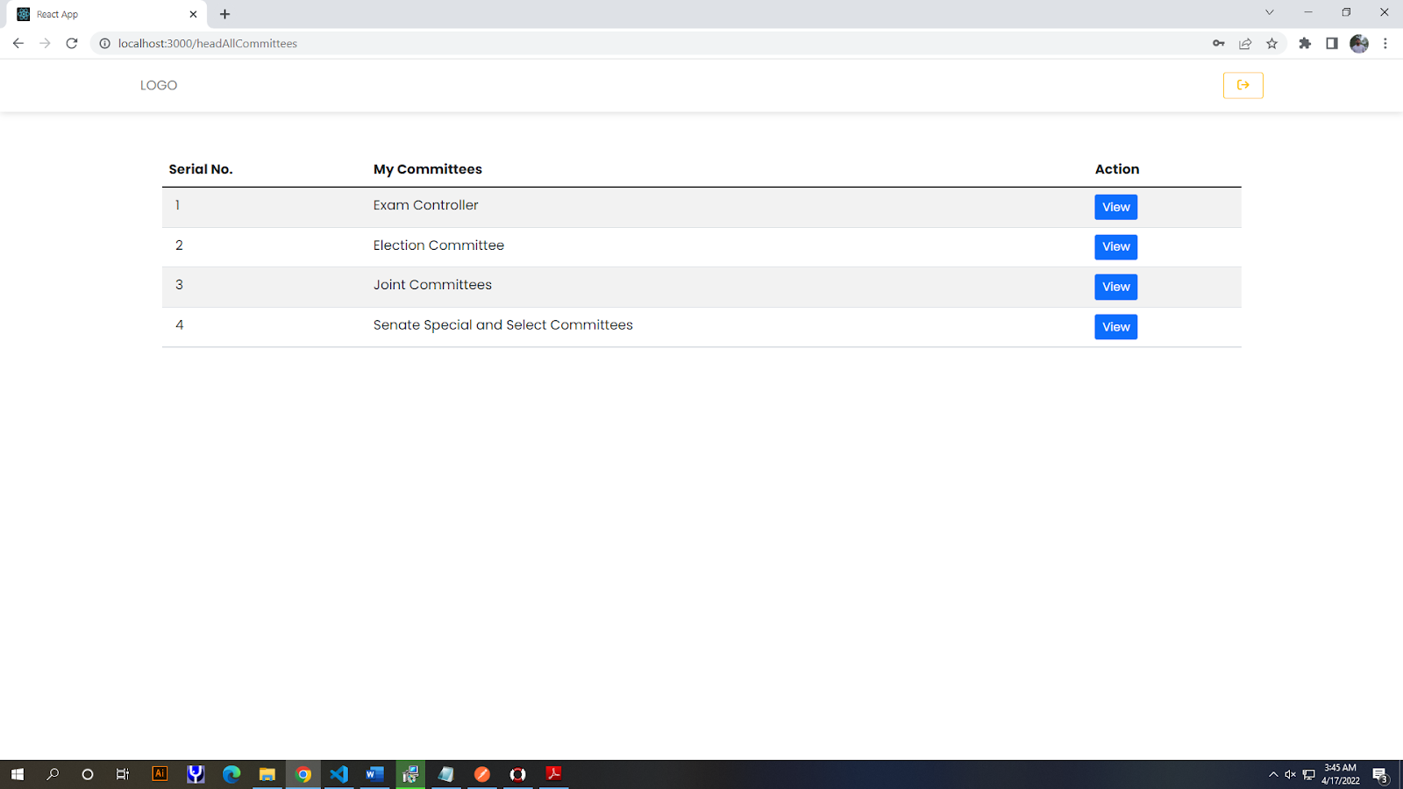
Head(contd..)

Slide 9
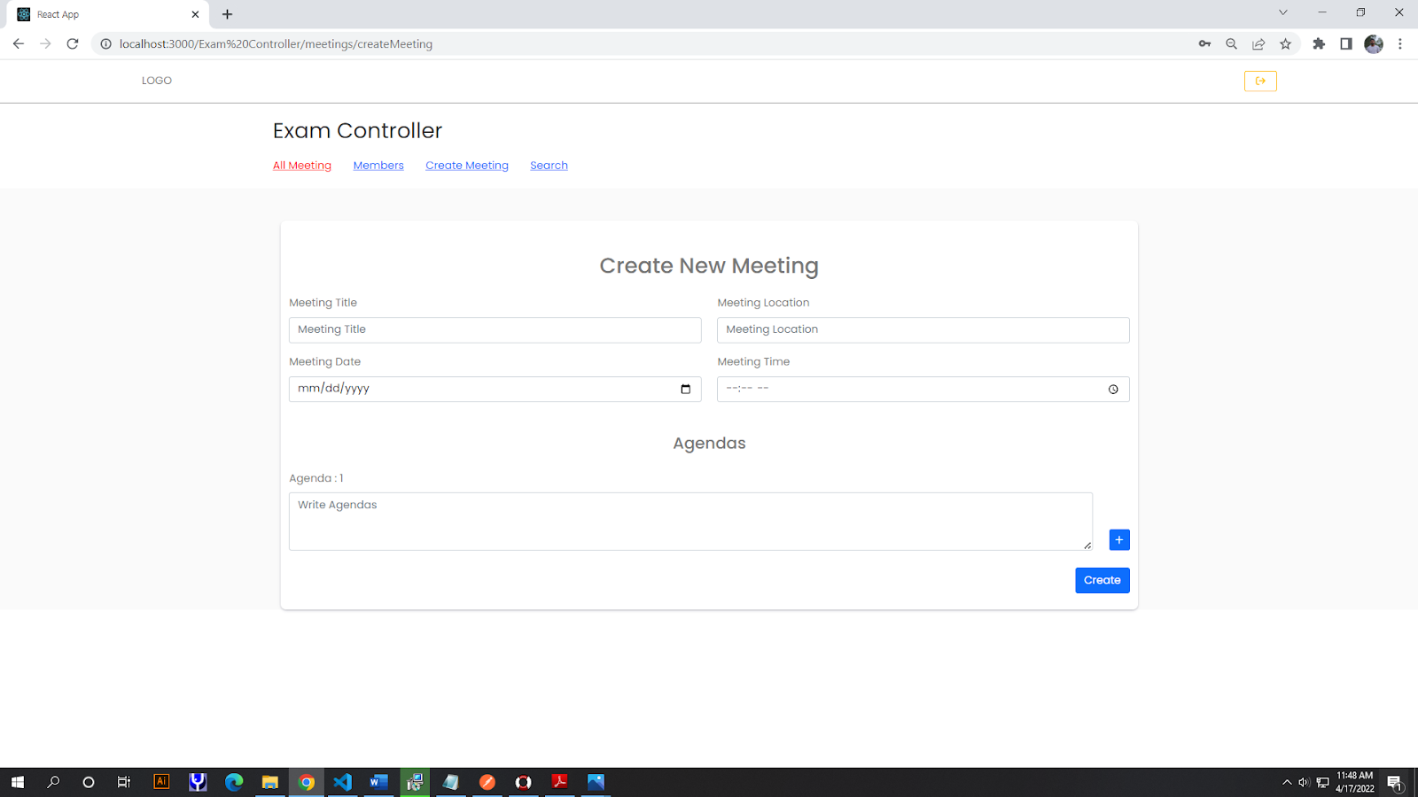
Head(contd..)

Slide 10
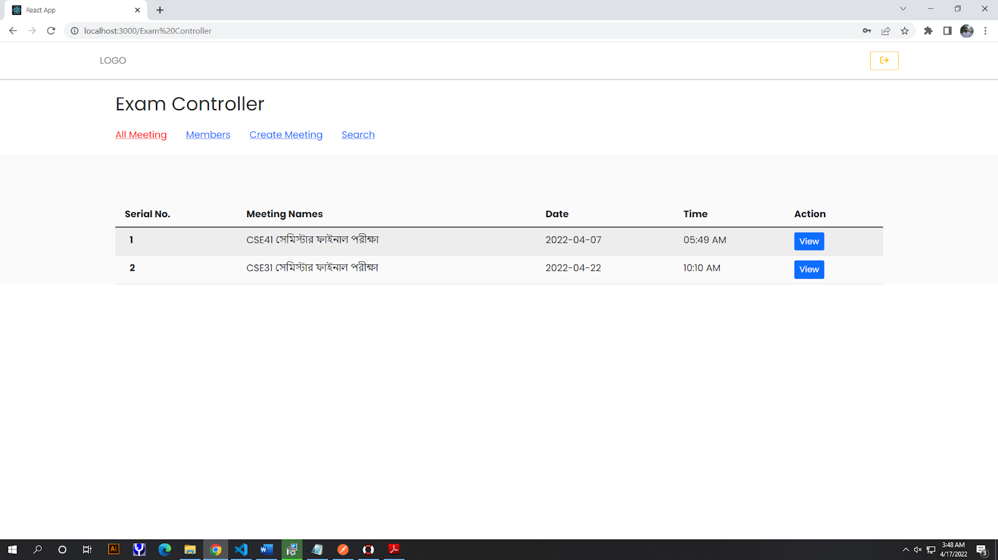
Head(contd..)

Slide 11
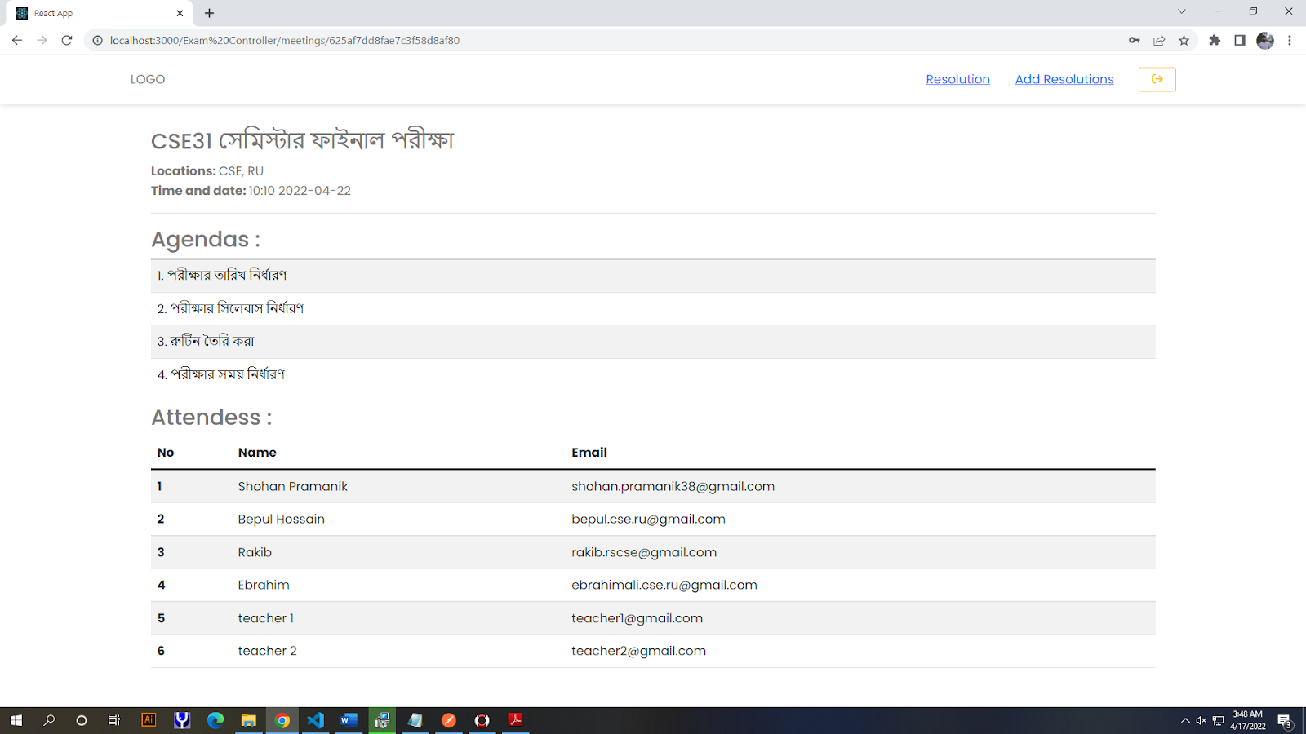
Head(contd..)

Slide 12
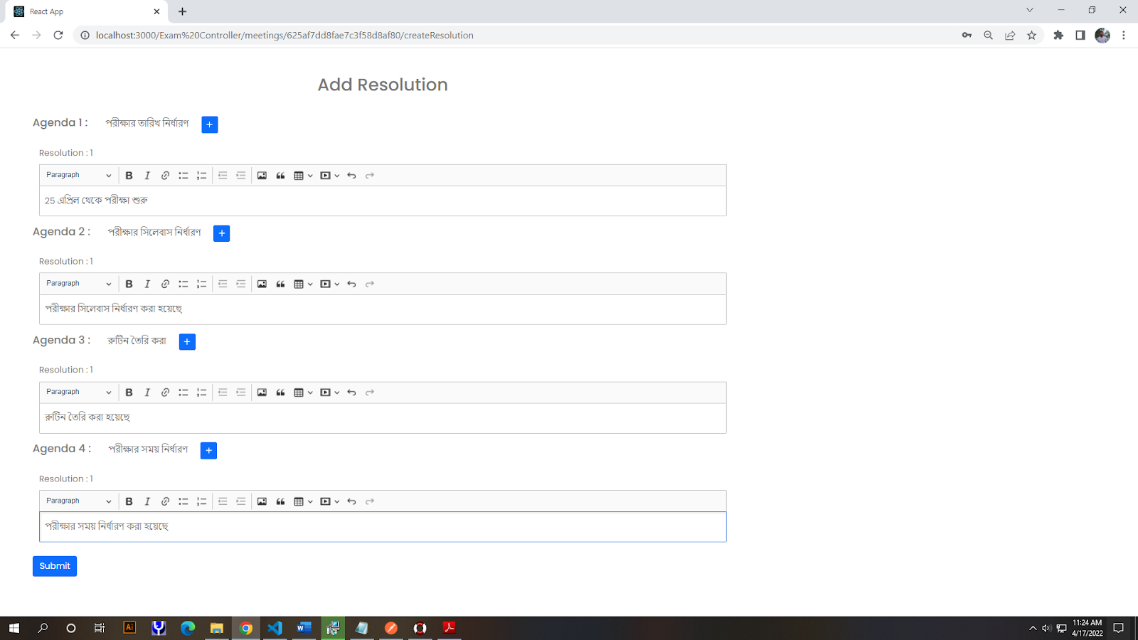
Head(contd..)

Slide 13
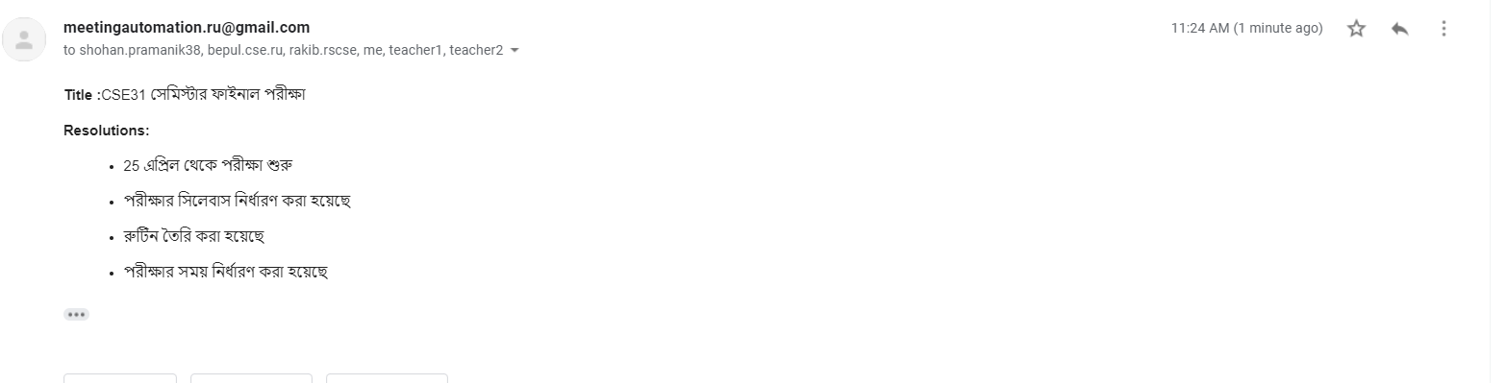
Head(contd..)

Slide 14
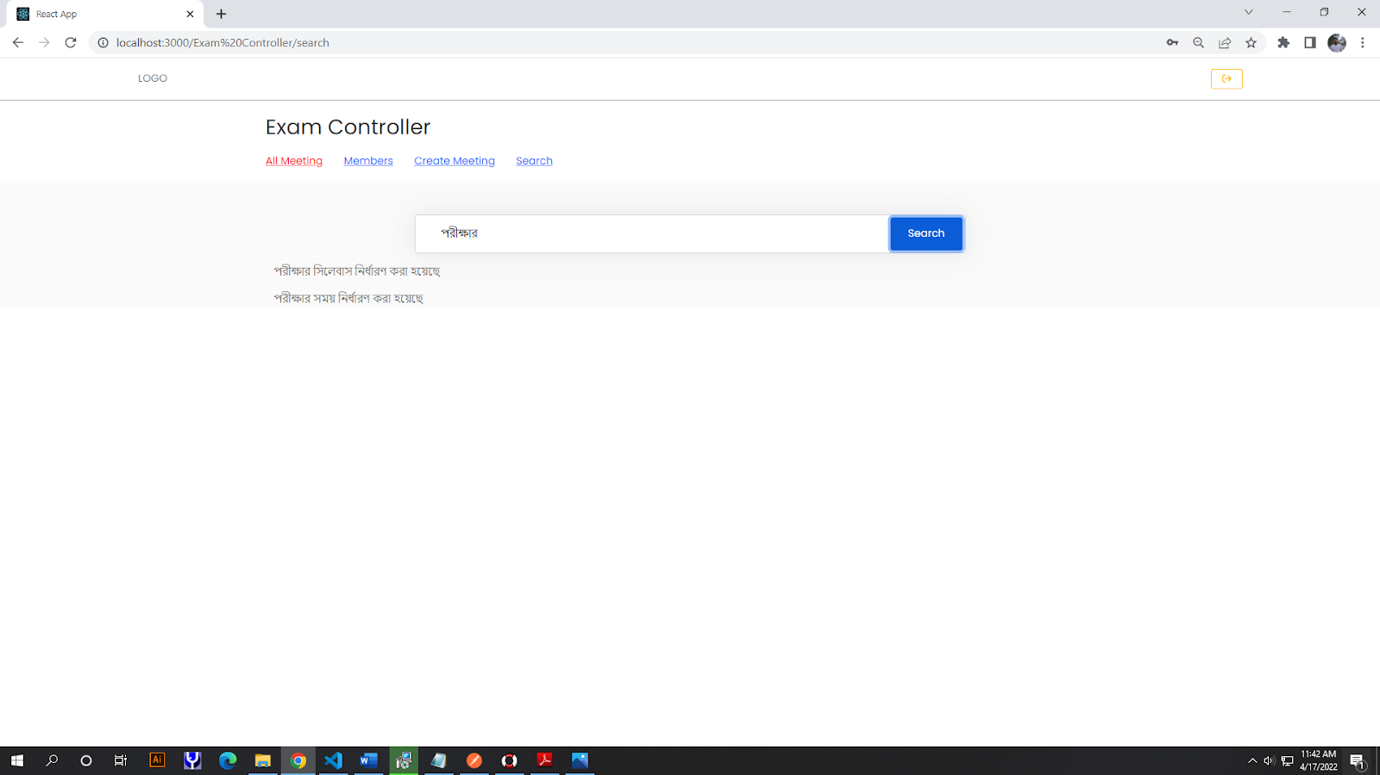
Head(contd..)

Slide 15
Tools and Technology
Node.js
Express.js
Mongodb
React.js/next.js
Redux/Redux toolkit
Bootstrap
Jest
Git

Slide 16
Usefulness
Will remove hard copy issue.
Will find any resolution of a meeting easily.
Auto invitation.

Slide 17
Thank You!!

