Slide 1
Final Presentation for Analysts
EMC Education Services
Data Science & Big Data Analytics
Otto Group Product Classification
19.01.2017
Notes:
EMC Ed Services CA and DCA Launch Master V8

Slide 2
Project Goals
To build a predictive model to distinguish main product categories
Model’s predictive power should be at least as good as currently used techniques by the company
Model should be invariant to adding new product categories

Slide 3
Situation & Project Goals
Situation
In the Otto Group many identical products get classified differently
Recent analysis shows the loss of profit is caused by incorrect clusterization of similar products
Without model implementation the Otto Group risks having huge losses
Goals of the Otto Group Project
To build a predictive model to distinguish main product categories
Model’s predictive power should be at least as good as currently used techniques by the company
Model should be invariant to adding new product categories

Slide 4
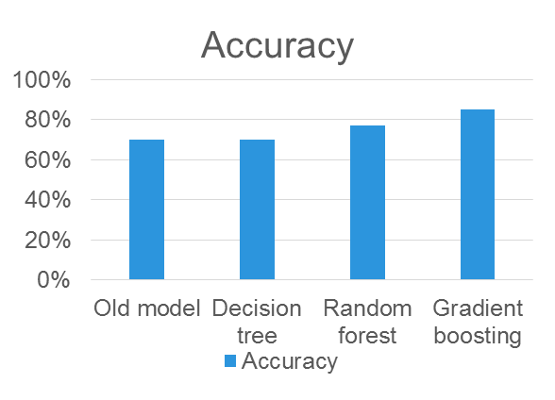
Executive Summary
Running the suggested model can help to rise e-commerce revenues
at least by 8.8% annually and to reach 6.5 billion euros
The suggested model has higher predictive power than previous used in the company
  Built 3 different models(gradient boosting, random forest, decision tree) and compared error rate among models with previous used in the company
Identified most influential features
Computational complexity of the model allows to run it daily

Slide 5
Approach
Given e-commerce product dataset with 93 features for more than 200,000 products. There are 9 categories for all products. Each target category represents one of most important product categories (like fashion, electronics, etc.)
Collaborated with IT to prepare datasets, implement classification
Developed models(gradient boosting, decision trees, random forests) in R
Fitting model with appropriate parameters
Worked with IT to simulate model performance within the Otto Group production environment

Slide 6
Model Description
Overview of Basic Methodology: define the model with high accuracy for identifying future product categories. Identify most influential features
Models: Gradient boosting, decision tree, random forest
Dependent variable: Categorical variable, 9 categories
Scope:
  More than 200,000 the Otto Group products with 93 features, each feature is categorical variable
Sampling
  Training sample: 61,878 observations
  Testing sample: 144,368 observations
Gradient boosting model has predictive power better than decision tree and random forest models
  We created models(gradient boosting, decision tree, random forest) and chose the best model, which can maximize the precision

Slide 7
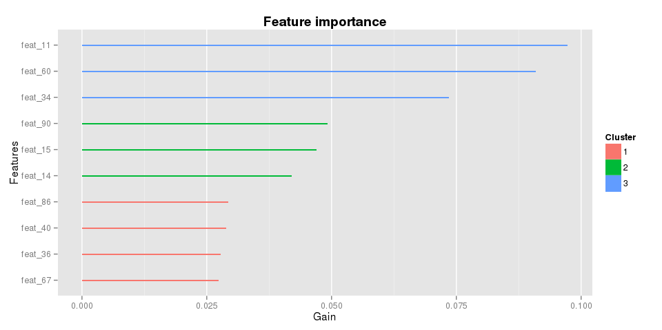
Key Points
Identifying influential features can simplify product categorization

Slide 8
Model Details
Dataset with 93 features for more than 200,000 products. There are 9 categories for all products
Decision tree(rpart) model built in R :
fit <- rpart(as.factor(target) ~ ., data=train, method="class")
Random forest(randomForest) model built in R:
fit <- randomForest(as.factor(target) ~ ., data=strain, importance=TRUE,
ntree=100, mtry=8)
Gradient boosting(gbm) model built in R:
fit <- gbm(target ~ ., data=strain, distribution="multinomial", n.trees=1000,
shrinkage=0.05, interaction.depth=12, cv.folds=2)

Slide 9
Recommendations
Improving model
  Fitting parameters of the suggested model
  Ensemble of different models
Using in other spheres of the company(for example, categorization of personnel and etc.)
Develop targeted customer surveys to create new training datasets

