Slide 1
Campus Lost & Found
SAMPLE
A web application for reporting and reclaiming lost items on campus
[Student name] ([USN]) · [Student name] ([USN])
Guide: [Guide name] · Department of CSE · 2026-27
Campus Lost & Found · Sample Institute of Technology · Dept. of CSE · sample by Final Commit

Slide 2
Problem and objectives
The problem
Lost items are reported on notice boards and group chats that nobody can search.
Finders cannot check that a claimant really owns an item.
Objectives
Searchable lost and found posts with photos
Ownership checked with a proof question
Hand-over arranged in private messages
Moderation by the campus office
SAMPLE
Campus Lost & Found · Sample Institute of Technology · Dept. of CSE · sample by Final Commit

Slide 3
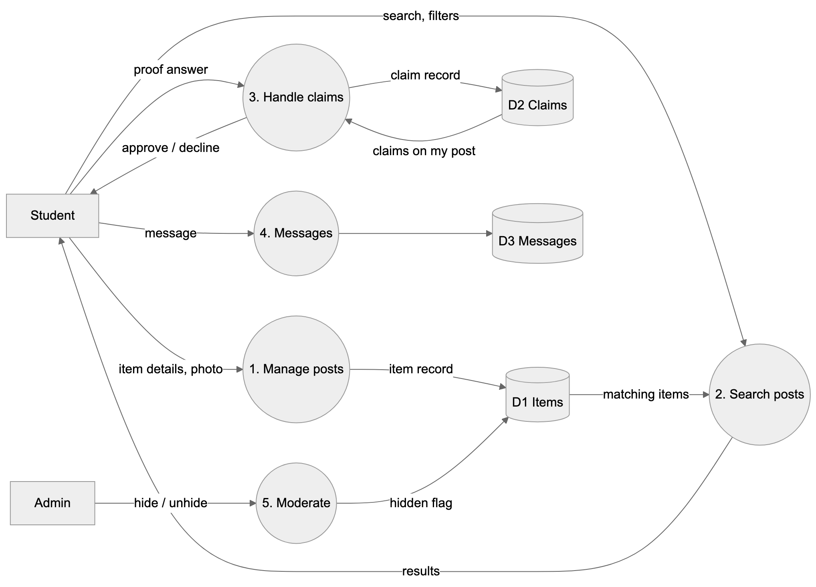
System design: data flow (level 1)
Front end: HTML, CSS, JavaScript modules
API: Node.js + Express (REST, JSON)
Database: SQLite via node:sqlite
Auth: scrypt password hashes, session tokens
SAMPLE
Campus Lost & Found · Sample Institute of Technology · Dept. of CSE · sample by Final Commit

Slide 4
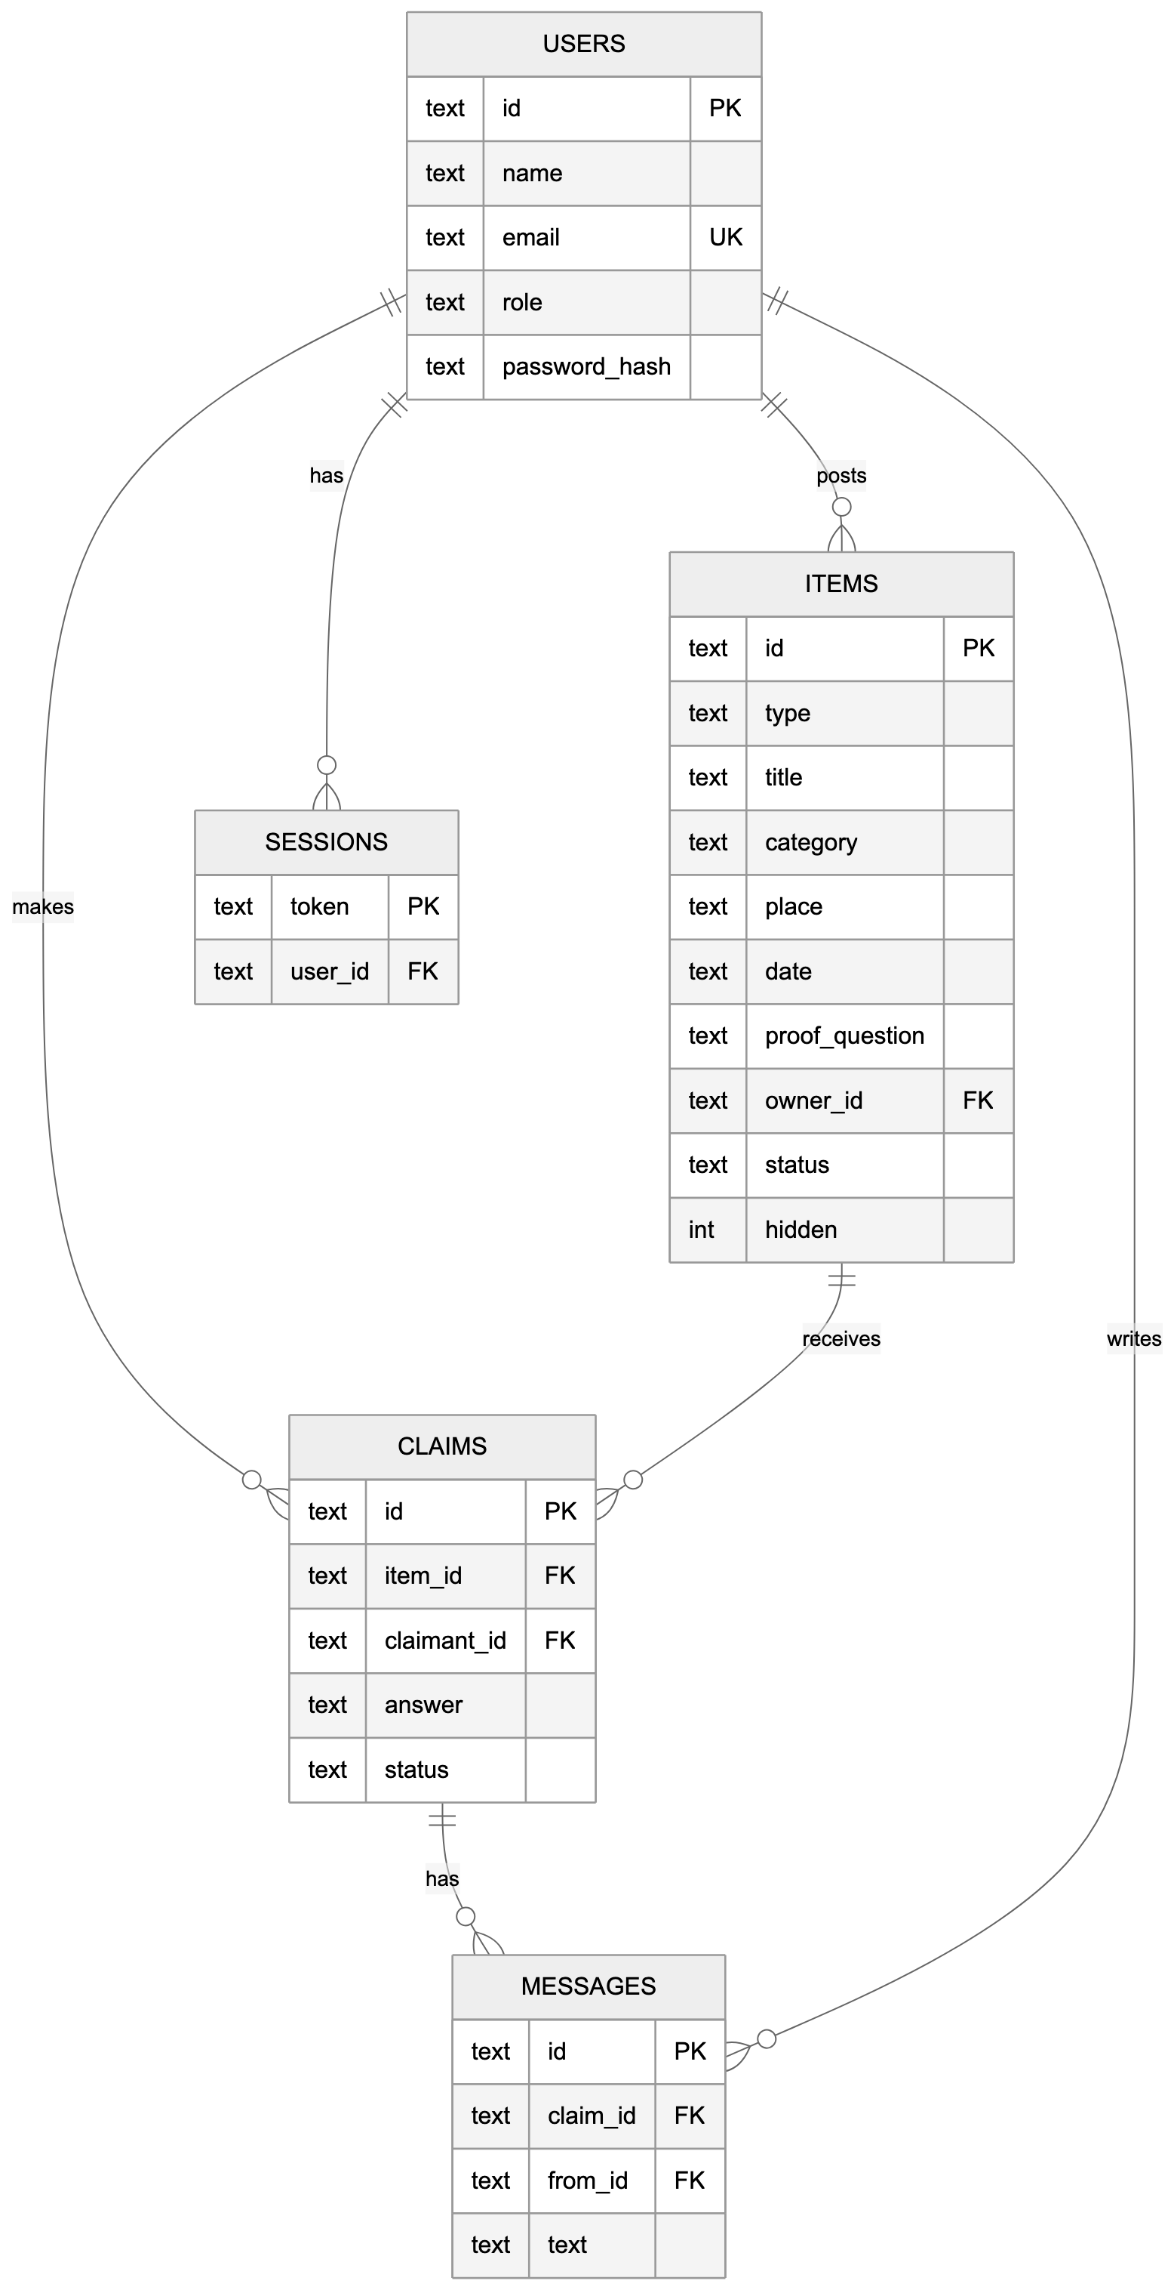
Database design
5 tables: users, sessions, items, claims, messages
UNIQUE (item_id, claimant_id): one claim per person per item
Foreign keys keep claims and messages tied to real items and users
Prepared statements for every query (no SQL injection)
SAMPLE
Campus Lost & Found · Sample Institute of Technology · Dept. of CSE · sample by Final Commit

Slide 5
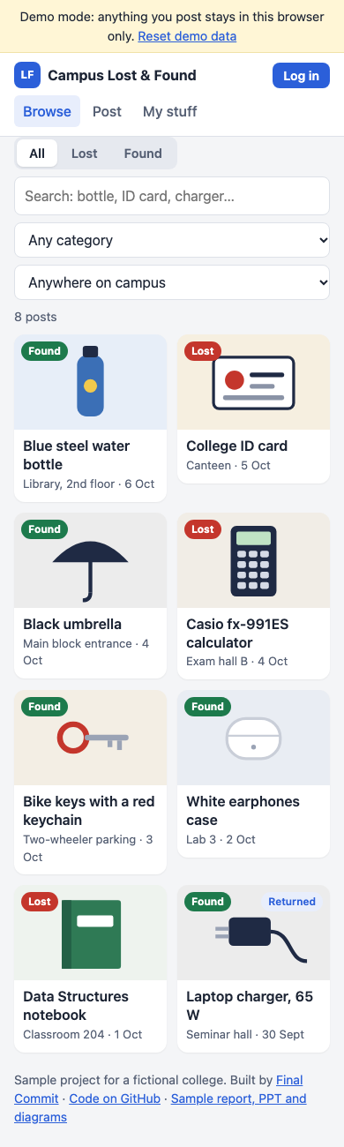
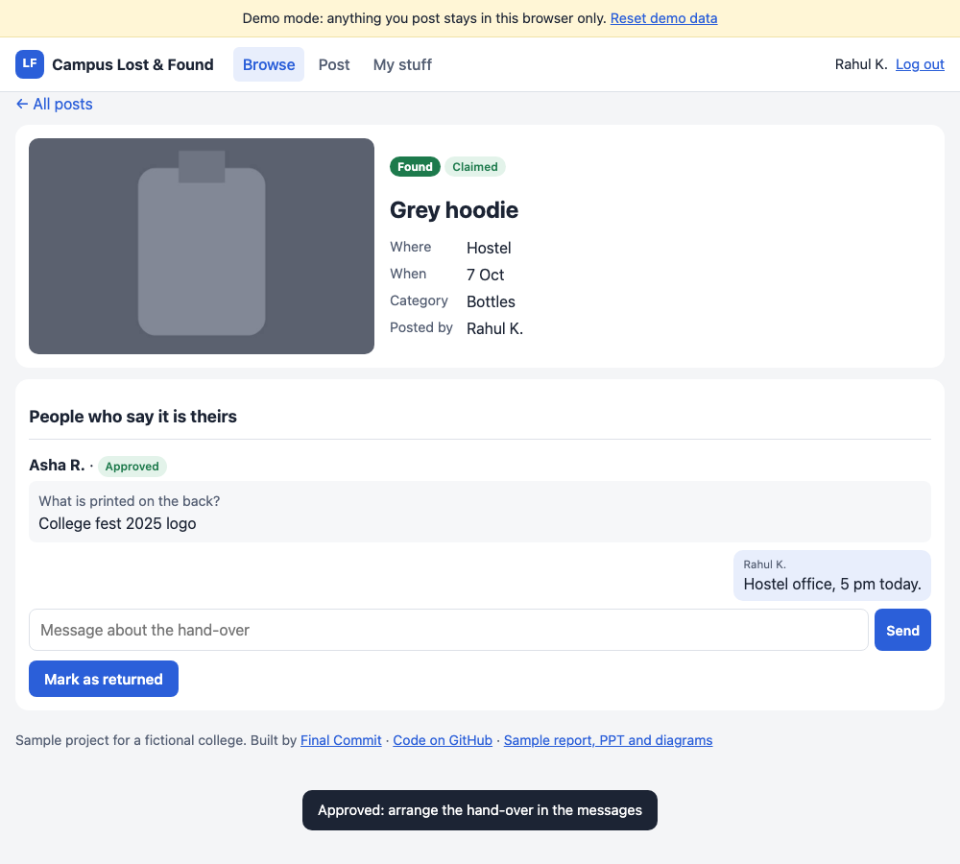
Screens
SAMPLE
Left: browsing posts on a phone. Right: the poster approves a claim and arranges the hand-over.
Campus Lost & Found · Sample Institute of Technology · Dept. of CSE · sample by Final Commit

Slide 6
Testing, results and future work
Testing
18 automated API checks pass, including permission rules
Full flow tested in a browser: post, claim, approve, message, return, moderate
Database file is not downloadable
Future work
Email or SMS alerts when a matching item is posted
Photos in a separate file store
College single sign-on
Image matching between lost and found posts
SAMPLE
Campus Lost & Found · Sample Institute of Technology · Dept. of CSE · sample by Final Commit

