Slide 1



DIMMer: A case for turning off DIMMs in clouds
Dongli Zhang, Moussa Ehsan, Michael Ferdman, Radu Sion
National Security Institute

Slide 2








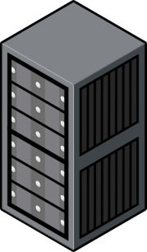



Inconsistency between Capacity and Demand
200B KWh
…
worldwide in 2010
Year 2011
Capacity >>> demand
Energy waste is 90%
200,000
Notes:
Today, companies such as Google, Amazon and Facebook run immense data centers with unimaginable computation and storage capacities. As online services become pervasive, global data centers worldwide in 2010 consumed more than 200B KWh, which is a huge amount of energy.
Google also announced in 2011 that their facilities have a continuous electricity usage equivalent to powering 200,000 homes.
So, do today’s data centers really require such a huge amount of energy? Actually no!
According to a report by The New York Times in 2012, up to 90% of the energy is wasted because data center cannot modulate capacity
So, can we reduce the energy cost by dynamically provisioning servers in data center?

Slide 3
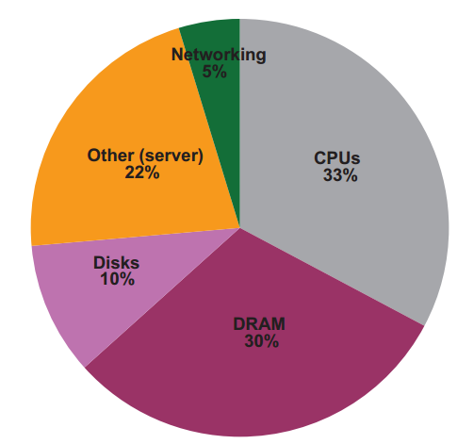
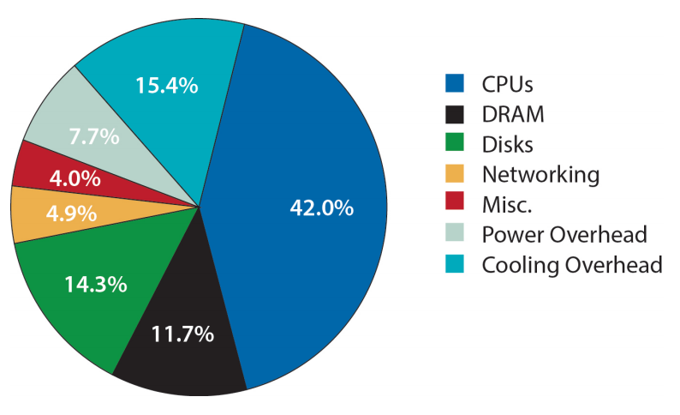
Google Data Center Peak Power Usage Distribution
2007
2012
[The Datacenter as a Computer:
An Introduction to the Design of Warehouse-Scale Machines]
[The Datacenter as a Computer:
An Introduction to the Design of Warehouse-Scale Machines, second edition]
Notes:
The answer is no, because servers may participate in distributed services (e.g., file serving) and the frequent power cycling may increase the failure rates of server’s components, such as power supplies and fans.
We explored into the peak power usage distribution Google data centers. The figures are from the book “The data center as a computer”.
According to Google’s data in both 2007 and 2012, CPU and DRAM consume more than 50% of the data center power cost.
So, can we dynamically provision the server components, such as DRAM and CPU?

Slide 4
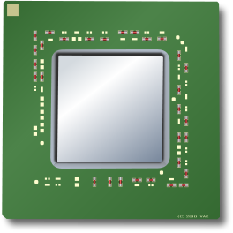


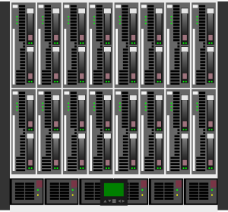
DIMMer Vision
Agile framework
Workload-driven scalability and power reduction
Power off idle DRAM ranks
Power off idle CPU sockets
Save background power
Notes:
We envision DIMMer, an agile framework for workload-driven scalability and power reduction in data centers. During low resource utilization, e.g., during low memory utilization, DIMMer would power off all idle DRAM ranks in data center servers to save DRAM background power.
DIMMer would dynamically provision memory capacity at the granularity of DRAM ranks. Energy costs for additional DRAM capacity are paid only when this capacity is requested by the system.
It is an opportunity to reduce energy consumption of server systems while having little impact on performance.

Slide 5

Vision for Implementation
Modifications to the OS kernel (e.g., Linux) and Hardware:
Rank-Aware Page Allocator
Create a free list for each DRAM rank
Page Migrator
Migrate pages in the background and at low priority
Expose registers in CPU and DRAM controller
To allow full electronically power-off
Provided by hardware manufacturer
Enable DIMMer during low workload
Notes:
The implementation of DIMMer is not hard.
It requires modifications to the memory management subsystem of the OS kernel and also the DRAM controller.
We need a Rank-Aware Page allocator to control the rank of each memory page. Therefore, we need to maintain a page free list data structure for each rank.
To achieve memory pages consolidation, a page migrator is also required. Page migrations will happen in background and at low priority.
Actually, functionalities similar to allocator and migrator have already been implemented in prior works.
DIMMer also requires hardware modification.
To fully electronically power off DRAM, we hope the hardware manufacture could expose the corresponding registers in the future generations of DRAM controllers.
Finally, DIMMer is only enabled during low workload. It will be disabled during peak workload.

Slide 6
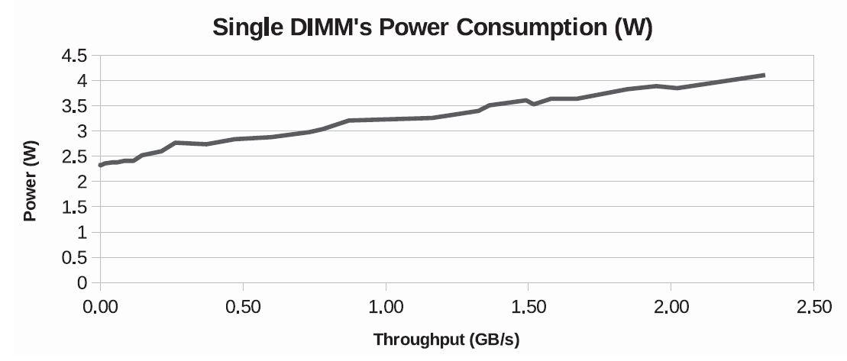


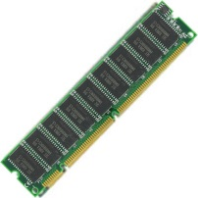
DRAM: Self-Refresh Mode
Low-power mode
Consumes less energy than ACT mode
Data is not lost
State of the Art:
Hot ranks and cold ranks
Maximize the self-refresh time
Idle 8GB DIMM power = 2.3W !
Self-Refresh: Reduce Active Time
DIMMer: Reduce Active Capacity
Notes:
You may ask, wait, instead of powering off DRAMs, why not use self-refresh mode.
Self-refresh mode…….
The state of the art works consolidate hot memory pages on hot ranks, cold pages on cold ranks. They maximize the length of self-refresh time of DRAM ranks.
Why don’t we just consolidate memory pages and switch idle DRAM ranks into self-refresh mode, but not power off them?
To answer this question, we measured the power consumption of a single 8GB DIMM with various workloads from 0 to more than 2GB/s. We find that simply keeping a DIMM powered on with near-zero memory traffic has a constant power consumption of 2.3W, which constitutes more than 50% of each DIMM’s power consumption observed at peak throughput for cloud workloads.
To summarize the difference between DIMMer and self-refresh, self-refresh mode reduces the active time of DRAM and DIMMer reduces the active capacity of DRAM.
Even during self-refresh mode, the idle power is still being consumed.

Slide 7


DIMMer vs. Self-Refresh
CPU+DRAM Power:
Self-Refresh : 66.00W
DIMMer : 64.16W
Saving 3%!
Percentage of Time in
ACT_STBY/PRE_STBY:
Active
100%
Idle
0%
Notes:
Now let’s compare DIMMer with self-refresh mode in a more detailed case.
We assume a dual-node server have two CPUs and 8 DIMMS, that is, 16 ranks.
Memory pages are consolidated on active ranks. Idle ranks contain no active memory page.
In an aggressive case, we assume the percentage of time in ACT_STBY/PRE_STBY is 100% for active ranks and 0% for idle ranks. This is just an aggressive case.
Suppose we have one DIMM idle, that is, two ranks are idle. By switching idle DRAM ranks into self-refresh mode, the total power consumption is 66.0W. By powering off unused ranks, DIMMer consumes 64.16W for CPU and DRAM.
The saving over self-refresh mode is only 3%. What a funny joke!

Slide 8

DIMMer vs. Self-Refresh
Idle CPU socket power = 16W
CPU+DRAM Power:
Self-Refresh : 57.12W
DIMMer : 37.44W
Saving 35%!
Percentage of Time in
ACT_STBY/PRE_STBY:
Active
100%
Idle
0%
Notes:
The story will change if we power off an entire DRAM channel. According to our measurement, the idle power consumption of an 8-core CPU is 16W.
With self-refresh mode, the CPU plus DRAM power consumption is 57.12W. After powering off the entire socket, DIMMer consumes 37.44W.
This time, the saving of DIMMer over self-refresh mode is 35%! The primary saving of DIMMer is achieved by powering off CPU. If we just switch DRAMs into self-refresh mode, we cannot power off the idle CPU.
We are just showing a special case on a single server. It DIMMer applicable to today’s data centers?

Slide 9

Google Cluster Trace
http://code.google.com/p/googleclusterdata/
12000+ servers
Machines, jobs, and tasks
Workload traces (CPU, memory, storage) with normalized data
Resource usage in 5-min granularity of one month
Spawned a number of seminal results
SoCC , ICDCS, ICAC, IC2E …
Notes:
Google cluster trace is published online by Google.
It has data for more than 12 thou servers.
It has detailed information about the servers, jobs and tasks, including CPU, memory, and storage utilization.
It is collected at 5-minute granularity over one month.
It has spawned a number of seminal results

Slide 10
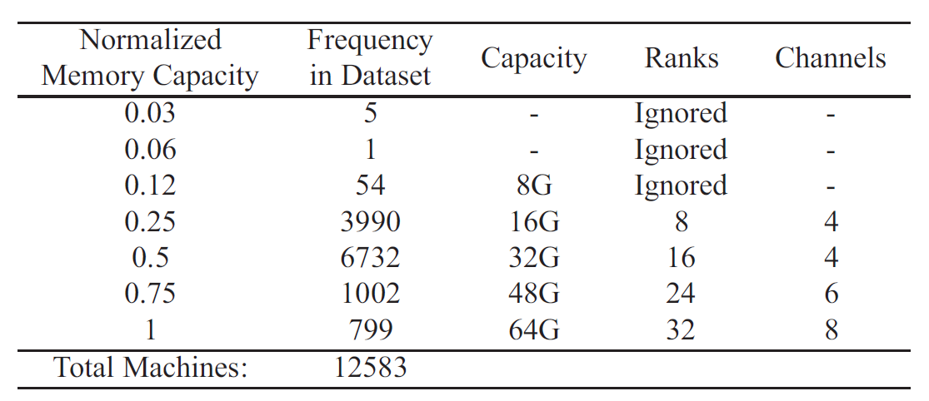

Our Assumptions
Max server DRAM capacity = 64GB
Max server CPU socket = 2
No OS kernel resource usage and job dependencies
Increasing DRAM capacity in data center
Notes:
The google cluster trace used for our study provides relative memory capacities normalized to the machine maximum-capacity present in the cluster.
We estimate per-machine DRAM capacity and number of DIMMs based on the distribution of the machine counts in the dataset, the approximate date of cluster deployment, and the fact that Google populated all server DRAM slots at that time. Machines with unusual memory capacities (likely due to partial memory failures) were ignored.
We assume most servers have 32GB memory, that is, 4 channels, 16 ranks.
We assume the maximum DRAM capacity is 64GB and maximum CPU socket is 2.

Slide 11

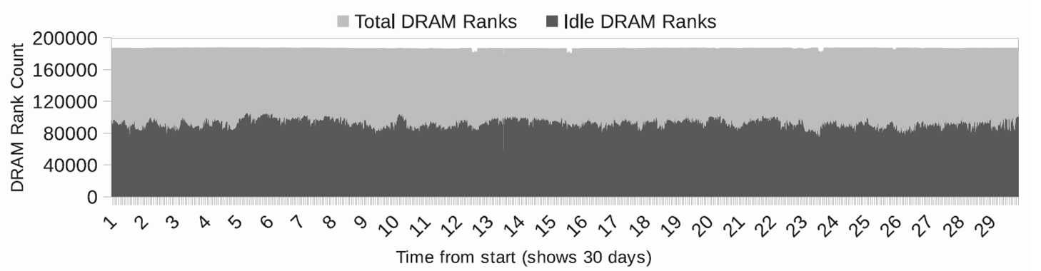
Saving: DRAM
Consolidate memory pages on minimum DRAM ranks on each server
Monthly DRAM Rank Count (total and idle)
50% memory utilization
50% DRAM ranks are idle
Save 30MWh per month
Notes:
We assume the memory consolidation can happen only within each server and we counted the monthly total and idle DRAM ranks in each 5-minute time slot.
On average, during the month, the memory utilization if 50% and 50% of DRAM ranks can be powered off.
Totally, powering off DRAM
Because self-refresh power is proportional to DRAM capacity, the savings of DIMMer are likely to be higher in future systems.

Slide 12

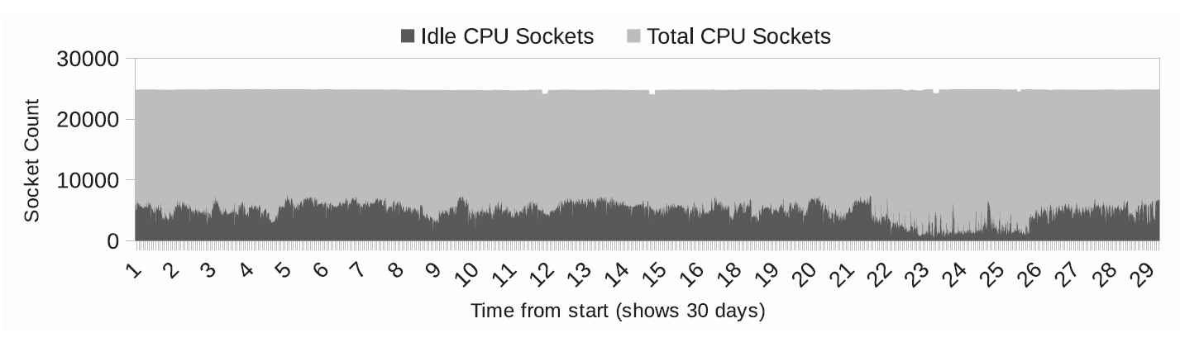
Saving: CPU
Consolidate workloads on minimum CPU sockets on each server
Monthly CPU socket count (total and idle)
50 % CPU utilization
20 % CPU sockets are idle
No PCI devices (e.g. NIC) involved
Save 52MWh per month
+ = 82MWh = 51MT CO₂
Notes:
We also counted the monthly total and idle DRAM ranks in each 5-minute time slot.
Unlike DRAM ranks that can be powered off independently, a CPU can be powered off only when all of its cores and all DRAM ranks attached to its socket are idle. We note that powering off a CPU may have other system implications, such as rendering some PCIe devices unavailable, which may place additional constraints on DIMMer. This provides opportunity for future research, for example, in powering off some of a system’s NICs for further energy reduction.
Changes to the cluster resource management framework can mitigate this inconsistency and maximize the number CPUs that can be powered off.

Slide 13





DIMMer Cost
The story is not finished…
Page Migration
OS Memory
Capacity Resizing
Reduced Cache Capacity
Non-Interleaved
Address Mapping
Physical Memory Address Space
4KB
Page
Addition
Removal
Disk Cache
Notes:
We have demod the opp

Slide 14
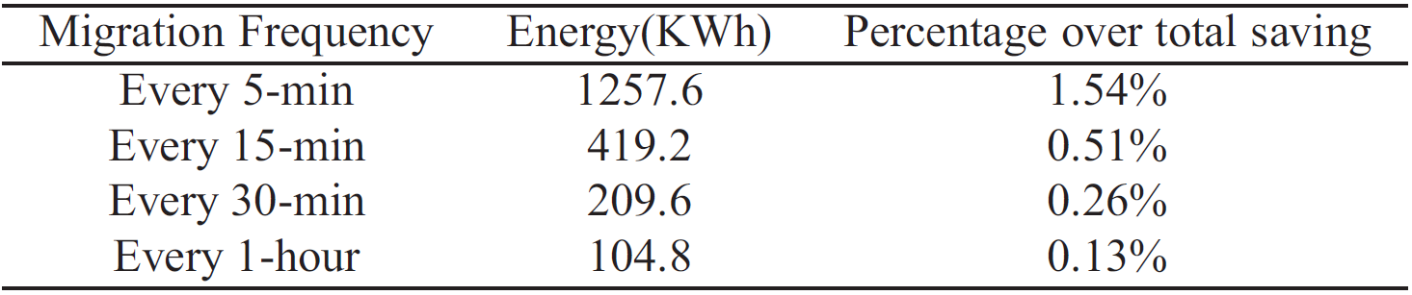
Page Migration
8GB node-to-node migration takes 13.5s
Observation in Google Cluster Trace
30.2% are cache pages
11.2% are caches pages not mapped into process
Tricks:
Only migrate hot cache pages and anonymous pages
Out of band migration
4KB
Page
Notes:
First, let’s discuss page migration cost.
We measured the node-to-node page migration, which we think as the most expensive case. According to our experiment, if there is a 8GB memory migration every 30 mins for one month, the total monthly page migration cost is 210KWh, which is 0.26% of DIMMer’s total savings. On average , each migration will take 13.5 seconds.
Actually, to power off a rank, we do not need to migrate all memory pages of that rank. According to our analysis of Google trace, 30.2% are cache pages and 11.2% are cache pages not mapped into any process. Many of cache pages will only be used once.
Therefore, the tricks….

Slide 15
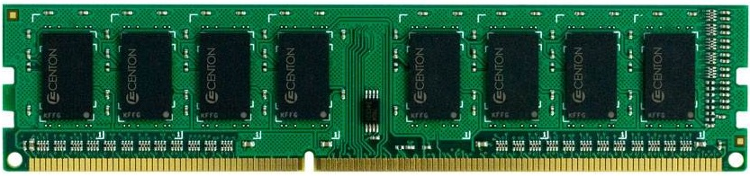
OS Memory Capacity Resizing
Liu et al. (TPDS 2014)
Coarse-grained VM memory hotplug
Dell PowerEdge 1950 & Intel Quad-Core Xeon E5450 3GHz
VM-based 1GB
Memory Addition
VM-based 1GB
Memory Removal
Physical Memory Address Space
0.43s
0.3s
Heavily loaded running TPC-C
Tricks:
Reserve extra DRAM rank to handle spontaneous demand spikes
Notes:
When we power on and power off DRAMs, there is a latency, because kernel needs to resize the memory capacity.
Here we use experimental data from Liu’s paper published on TPDS in 2014. The data is about the course-grained VM memory hotplug.
According to the data, the VM-based 1GB memory addition will consume 0.43s.
The VM-based 1GB memory removal during high workload, heavily loaded running TPC-C, will take 0.3s.

Slide 16
Reduced Cache Capacity
Web Server Disk Cache
Zhu et al. (HotCloud 2012)
Sacrificing a few percent cache hit rate
Reduce cache cost by 90%
Tricks:
Hot cache pages on active rank
Cold cache pages on idle rank
Disk Cache
Notes:
To power off DRAM, we may reduce the disk cache capacity. This will not bring obvious performance impact.
We use experimental evidence with web server disk cache from the prior work to support thi.
Sacrificing a few percent hit rate, the cache costs can be reduced by almost 90%.
Although one cannot reliably infer the performance implications of reducing disk cache for other workloads, these web server results are promising.
Actually, cache pages can be classified as hot pages and cold pages. We can put hot cache pages on hot ranks and cold cache pages on cold ranks.

Slide 17
Non-Interleaved Address Mapping
Channel Interleaving
Ferdman et al. (ASPLOS 2012): Cloud workloads underutilize memory bandwidth
Rank Interleaving
VipZonE (CODES+ISSS 2012): 1.03% execution overhead
Map-Reduce
Web front end
25% of available bandwidth
Media Streaming
Web Search
Tricks:
Reserve certain interleaving-enabled channels
Power off parallel ranks across channels
Notes:
Finally, let’s discuss the interleaving. We have both channel and rank interleaving with DRAM.
Channel interleaving is used to improve memory bandwidth by interleaving physical pages across DIMMs on multiple channels.
Rank interleaving reduces memory latency by spreading each page across many ranks, enabling concurrent accesses by letting the controller open a row in one rank, while another rank is being accessed.

Slide 18
Total Cost of Ownership (TCO)
Model by James Hamilton : http://perspectives.mvdirona.com/
Cost of power: $0.10/KWh
Cost of facility: $50M
Number of servers: 12,583
Cost/Server: $2K
Server Amortization: 36 months
Power Usage Effectiveness: 1.2
Monthly Savings
Over Total: 0.6%
Over Power: 1.4%
Excluding Cooling: 3.15%
Notes:
The story is still not saved. Let me show you the Total Cost of Ownership, that is, what is DIMMer ‘s saving’s percentage in total data center cost.
We use the cost model by James Hamilton. We use the following inputs:
…
With this cost model, the DIMMer’s saving over total monthly data center cost is 0.6%.

Slide 19


DIMMer Summary
DIMMer Vision: Power off idle DRAM and CPU
Vision for Implementation
Improvement over Self-Refresh
Benefit / Cost
50% DRAM and 18.8% CPU background energy
Total Cost of Ownership
Energy-efficient scheduler in the future
Dongli Zhang
Doctoral Student @ Stony Brook University
Email: dozhang@cs.stonybrook.edu
Notes:
It is long-recognized that most server hardware exhibits disproportionately high energy consumption when operating at low utilization [41]. To mitigate this effect, low-power operating modes have been introduced. Moreover, techniques have been developed to maximize the time spent in lowpower states. DIMMer builds on this work and observes that dynamic control of memory capacity presents an additional opportunity to reduce energy consumption of server systems. Using a Google cluster trace as well as in-house experiments, we estimate up to 50% savings on DRAM and 18.8% on CPU background energy. At $0.10/kWh, this corresponds to 0.6% of total data center cost.
Some people think 0.6% is a lot.
You – decide it!

