Slide 1


Xenwatch Multithreading
Dongli Zhang
Principal Member of Technical Staff
Oracle Linux
http://donglizhang.org
Copyright © 2018, Oracle and/or its affiliates. All rights reserved.

Slide 2
domU creation failure: problem
# xl create hvm.cfg
Parsing config from hvm.cfg
libxl: error: libxl_device.c:1080:device_backend_callback: Domain 2:unable to add device with path /local/domain/0/backend/vbd/2/51712
libxl: error: libxl_create.c:1290:domcreate_launch_dm: Domain 2:unable to add disk devices
libxl: error: libxl_device.c:1080:device_backend_callback: Domain 2:unable to remove device with path /local/domain/0/backend/vbd/2/51712
libxl: error: libxl_domain.c:1097:devices_destroy_cb: Domain 2:libxl__devices_destroy failed
libxl: error: libxl_domain.c:1000:libxl__destroy_domid: Domain 2:Non-existant domain
libxl: error: libxl_domain.c:959:domain_destroy_callback: Domain 2:Unable to destroy guest
libxl: error: libxl_domain.c:886:domain_destroy_cb: Domain 2:Destruction of domain failed
Reported by: https://lists.xenproject.org/archives/html/xen-devel/2016-06/msg00195.html
Reproduced by: http://donglizhang.org/xenwatch-stall-vif.patch
Fail
Copyright © 2018, Oracle and/or its affiliates. All rights reserved.

Slide 3

domU creation failure: observation
incomplete prior domU destroy
stalled xenwatch thread in ‘D’ state
xenwatch hangs at kthread_stop()
dom0# cat /proc/38/stack
[<0>] kthread_stop
[<0>] xenvif_disconnect_data
[<0>] set_backend_state
[<0>] frontend_changed
[<0>] xenwatch_thread
[<0>] kthread
[<0>] ret_from_fork
[<0>] 0xffffffffffffffff
dom0# xl list
Name ID Mem VCPUs State Time(s)
Domain-0 0 799 4 r----- 50.2
(null) 2 0 2 --p--d 24.8
dom0# ps 38
PID TTY STAT TIME COMMAND
38 ? D 0:00 [xenwatch]
Copyright © 2018, Oracle and/or its affiliates. All rights reserved.

Slide 4
domU creation failure: cause
vif1.0-q0-dealloc thread cannot stop
remaining inflight packets on netback vif
vif1.0 statistics: sent > success + fail
sk_buff on hold by other kernel components!
static bool
xenvif_dealloc_kthread_should_stop(struct xenvif_queue *queue)
{
/* Dealloc thread must remain running until all inflight
* packets complete. */
return kthread_should_stop() &&
!atomic_read(&queue->inflight_packets);
}
# ethtool -S vif1.0
NIC statistics:
rx_gso_checksum_fixup: 0
tx_zerocopy_sent: 72518
tx_zerocopy_success: 0
tx_zerocopy_fail: 72517
tx_frag_overflow: 0
Copyright © 2018, Oracle and/or its affiliates. All rights reserved.

Slide 5





xen-netback zerocopy
NIC driver
xen-netfront
xen-netback
2. increment infligh packet
and forward to NIC
data
sk_buff
Data mapped from DomU
1.mapped from
domU to dom0
3. NIC driver does not release
the grant mapping correctly!
pending
4. xenwatch stall due to
remaining inflight packet (unmapped grant)
when removing xen-netback vif interface
DomU
xenwatch
Dom0
Copyright © 2018, Oracle and/or its affiliates. All rights reserved.

Slide 6

domU creation failure: workaround?
Workaround mentioned at xen-devel:
https://lists.xenproject.org/archives/html/xen-devel/2016-06/msg00195.html
dom0# ifconfig ethX down
dom0# ifconfig ethX up
Reset DMA buffer and unmap inflight memory page from domU netfront
Copyright © 2018, Oracle and/or its affiliates. All rights reserved.

Slide 7

xenwatch stall extra case prerequisite
application
Map data from blkfront
Encapsulate request as new bio
Submit bio to dom0 block device
file system
loop block (on nfs, iscsi
glusterfs or more)
device mapper
xvda-0 kthread
iscsi
xen-blkfront
Dom0 with
xen-blkback
nvme
DomU
event
channel
Xen Hypervisor
Copyright © 2018, Oracle and/or its affiliates. All rights reserved.

Slide 8

xenwatch stall extra case 1
xenwatch
waiting for
3.xvda-0
hang and waiting for
idle block mq tag
[<0>] kthread_stop
[<0>] xen_blkif_disconnect
[<0>] xen_blkbk_remove
[<0>] xenbus_dev_remove
[<0>] __device_release_driver
[<0>] device_release_driver
[<0>] bus_remove_device
[<0>] device_del
[<0>] device_unregister
[<0>] frontend_changed
[<0>] xenbus_otherend_changed
[<0>] frontend_changed
[<0>] xenwatch_thread
[<0>] kthread
[<0>] ret_from_fork
[<0>] bt_get
[<0>] blk_mq_get_tag
[<0>] __blk_mq_alloc_request
[<0>] blk_mq_map_request
[<0>] blk_sq_make_request
[<0>] generic_make_request
[<0>] submit_bio
[<0>] dispatch_rw_block_io
[<0>] __do_block_io_op
[<0>] xen_blkif_schedule
[<0>] kthread
[<0>] ret_from_fork
Lack of free mq tag due to:
loop device
nfs
iscsi
ocfs2
more block/fs/storage issue...
Copyright © 2018, Oracle and/or its affiliates. All rights reserved.

Slide 9
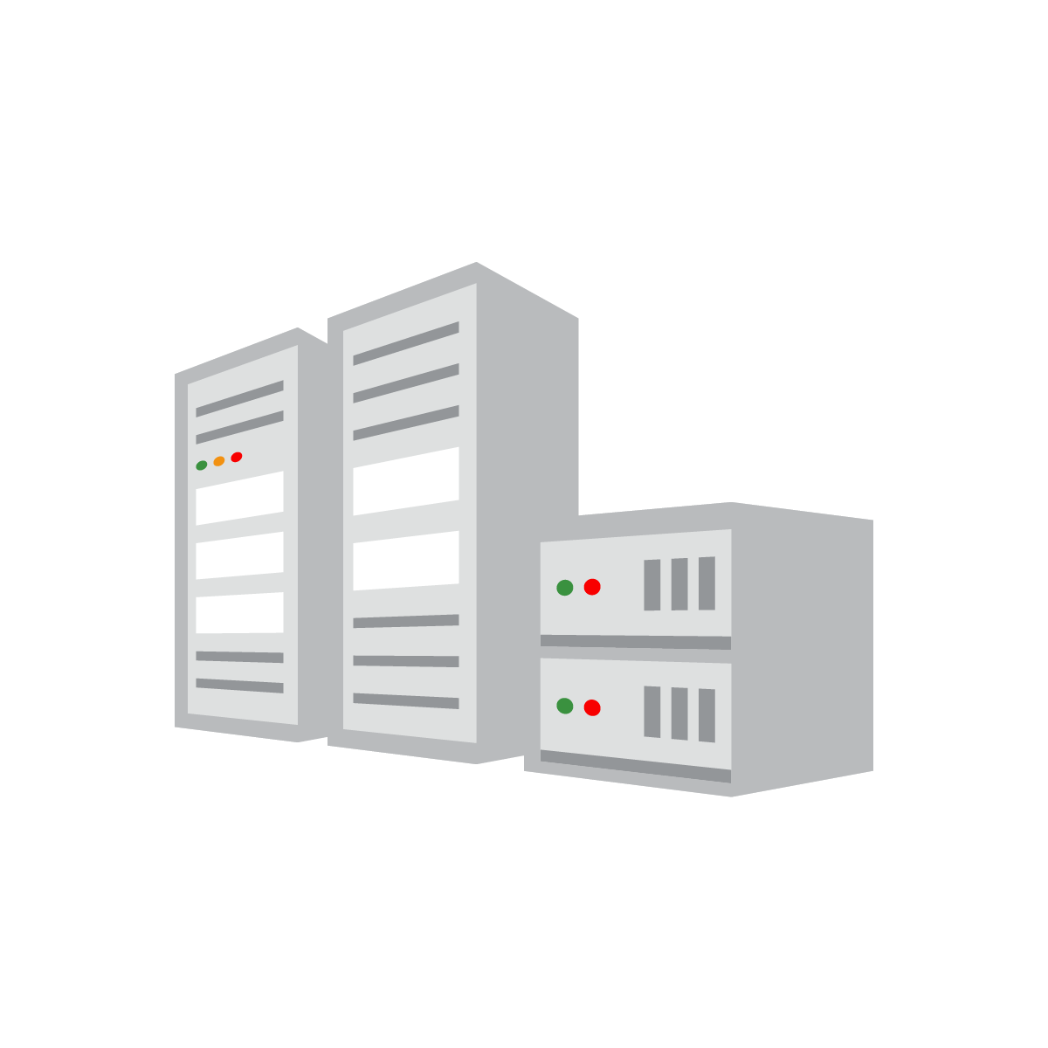

xenwatch stall extra case 2
xenwatch
storage
When disconnecting xen-blkback device,
wait until all inflight persistent grant pages
are reclaimed
[<0>] gnttab_unmap_refs_sync
[<0>] free_persistent_gnts
[<0>] xen_blkbk_free_caches
[<0>] xen_blkif_disconnect
[<0>] xen_blkbk_remove
[<0>] xenbus_dev_remove
[<0>] device_release_driver
[<0>] bus_remove_device
[<0>] device_unregister
[<0>] frontend_changed
[<0>] xenbus_otherend_changed
[<0>] frontend_changed
[<0>] xenwatch_thread
[<0>] kthread
[<0>] ret_from_fork
page_count is invalid as the page
is erroneously on-hold due to
iscsi or storage driver
static void
__gnttab_unmap_refs_async(...)
{
… ...
for (pc = 0; pc < item->count; pc++) {
if (page_count(item->pages[pc]) > 1) {
// delay grant unmap operation
… ...
}
}
… ...
}
Copyright © 2018, Oracle and/or its affiliates. All rights reserved.

Slide 10

xenwatch stall symptom
‘(null)’ domU in ‘xl list’
xenwatch stall at xenstore update callback
DomU creation/destroy failure
Device hotplug failure
Incomplete live migration on source dom0
Reboot dom0 as only option (if workaround is not available)
Xenwatch is victim!
Copyright © 2018, Oracle and/or its affiliates. All rights reserved.

Slide 11







More Impacts
DomU = application
More domU running concurrently
NFV
To quickly setup
and tear down NF
The problem is
much more severe...
Xen developers are fired!
Let’s give up xen!
Copyright © 2018, Oracle and/or its affiliates. All rights reserved.

Slide 12
xen paravirtual driver framework
DomainU Guest
Domain 0 Guest
Application
Networking Stack
Bridging /Routing
Networking Stack
Physical NIC Driver
xen-netfront driver
xen-netback driver
Xen
Hypervisor
Grant Table
Event Channel
Xenbus/Xenstore
Hardware
Physical NIC
Copyright © 2018, Oracle and/or its affiliates. All rights reserved.

Slide 13
Paravirtual vs. PCI
 | PCI Driver | Xen Paravirtual Driver
device discovery | pci bus | xenstore
device abstraction | pci_dev / pci_driver | xenbus_device / xenbus_driver
device configuration | pci bar/capability | xenstore
shared memory | N/A or IOMMU | grant table
notification | interrupt | event channel
Copyright © 2018, Oracle and/or its affiliates. All rights reserved.

Slide 14



device init and config
Xenstore
(Dom0 software
daemon and database
for all guests)
Motherboard
(hardware with
many slots)
plug into slots
dom0# xenstore-ls
local = ""
domain = ""
0 = ""
name = "Domain-0"
device-model = ""
0 = ""
state = "running"
memory = ""
target = "524288"
static-max = "524288"
freemem-slack = "1254331"
libxl = ""
disable_udev = "1"
vm = ""
libxl = ""
insert/update entries
Physical NIC
Physical Disk
Virtual NIC
Virtual Disk
Physical CPU
Physical DIMM
Virtual CPU
Virtual Memory
pci bus
struct pci_dev
struct pci_driver
xenbus bus
struct xenbus_device
struct xenbus_driver
Copyright © 2018, Oracle and/or its affiliates. All rights reserved.

Slide 15


xenstore and xenwatch
watch at xenstore node with callback
callback triggered when xenstore node is updated
both dom0/domU kernel and toolstack can watch/update xenstore
toolstack
2. Insert entries to xenstore:
/local/domain/0/backend/<device>/<domid>/…
/local/domain/7/device/<device>/<domid>/...
1. watch at
/local/domain/0/backend/
1. watch at
/local/domain/7/device
Dom0
3. Notification:
create backend device
3. Notification:
create frontend device
xenstore
DomU
Copyright © 2018, Oracle and/or its affiliates. All rights reserved.

Slide 16
xenwatch with single thread
xenbus_thread appends new watch event to the list
xenwatch_thread processes watch event from the list
read watch
event details
xenstore
ring buffer
wake up
xenstore
event channel
xenbus kthread
struct xenbus_watch
be_watch = {
.node = "backend",
.callback = backend_changed
};
append event to
global list
process
xenwatch kthread
event
event
… ...
event
frontend_changed()
handle_vcpu_hotplug_event()
backend_changed
Copyright © 2018, Oracle and/or its affiliates. All rights reserved.

Slide 17
Xenwatch Multithreading Solution
To create a per-domU xenwatch
kernel thread
on dom0 for each domid
Copyright © 2018, Oracle and/or its affiliates. All rights reserved.

Slide 18
solution: challenges
When to create/destroy per-domU xenwatch thread?
How to calculate the domid given xenstore path?
Split global locks into per-thread locks
xenwatch event path | watched node
/local/domain/1/device/vif/0/state | /local/domain/1/device/vif/0/state
backend/vif/1/0/hotplug-status | backend/vif/1/0/hotplug-status
backend/vif/1/0/state | backend
backend | backend
Copyright © 2018, Oracle and/or its affiliates. All rights reserved.

Slide 19
solution: domU create/destroy 1/2
xl create vm.cfg
xl destroy 7
dom0# xenstore-watch /
/
/local/domain/7
/local/domain
/vm/612c6d38-fd87-4bb3-a3f5-53c546e83674
/vm
/libxl/7
… …
@introduceDomain
/libxl/7/dm-version
/libxl/7/device/vbd/51712
/libxl/7/device/vbd
/libxl/7/device
/libxl/7/device/vbd/51712/frontend
/libxl/7/device/vbd/51712/backend
/local/domain/7/device/vbd/51712
… ...
dom0# xenstore-watch /
/
/local/domain/0/device-model/7
/local/domain/7/device/vbd/51712
… ...
/local/domain/0/backend/vif/7/0/frontend-id
/local/domain/0/backend/vif/7/0/online
/local/domain/0/backend/vif/7/0/state
/local/domain/0/backend/vif/7/0/script
/local/domain/0/backend/vif/7/0/mac
… ...
/local/domain/0/backend/vkbd
/vm/612c6d38-fd87-4bb3-a3f5-53c546e83674
/local/domain/7
/libxl/7
@releaseDomain
Copyright © 2018, Oracle and/or its affiliates. All rights reserved.

Slide 20
solution: domU create/destroy 2/2
creation: watch at “@introduceDomain”
destroy: watch at “@releaseDomain”
list “/local/domain” via XS_DIRECTORY
Suggested by Juergen Gross
watch at
@introduceDomain
watch at
@releaseDomain
dom0
dom0
xenstore watch event
xenstore watch event
List /local/domain to identify which is created
List /local/domain to identify which is removed
Copyright © 2018, Oracle and/or its affiliates. All rights reserved.

Slide 21
solution: domid calculation
Xenwatch subscriber should know the pattern of node path
New callback for ‘struct xenbus_watch’: get_domid()
Xenwatch subscriber should implement the callback
be_watch callback
struct xenbus_watch
{
struct list_head list;
const char *node;
void (*callback)(struct xenbus_watch *,
const char *path, const char *token);
domid_t (*get_domid)(struct xenbus_watch *watch,
const char *path, const char *token);
};
/* path: backend/<pvdev>/<domid>/... */
static domid_t be_get_domid(struct xenbus_watch *watch,
const char *path,
const char *token)
{
const char *p = path;
if (char_count(path, '/') < 2)
return 0;
p = strchr(p, '/') + 1;
p = strchr(p, '/') + 1;
return path_to_domid(p);
}
Copyright © 2018, Oracle and/or its affiliates. All rights reserved.

Slide 22
Xenwatch Multithreading Framework
event
event
… ...
event
process
1. use .get_domid() callback to calculate domid
2. run callback if domid==0
3. otherwise, submit the event to per-domU event list
default
xenwatch kthread
domid=2
xenwatch kthread
process
event
event
… ...
event
domid=3
xenwatch kthread
process
event
event
… ...
event
Copyright © 2018, Oracle and/or its affiliates. All rights reserved.

Slide 23
xenbus_watch unregistration optimization
By default, traverse ALL lists to remove pending xenwatch events
.get_owner() is implemented if xenwatch is for a specific domU
Only traverse a single list for per-domU xenwatch
struct xenbus_watch
{
struct list_head list;
const char *node;
void (*callback)(struct xenbus_watch *,
const char *path, const char *token);
domid_t (*get_domid)(struct xenbus_watch *watch,
const char *path, const char *token);
domid_t (*get_owner)(struct xenbus_watch *watch);
};
domid=1
xenwatch
event
event
domid=9
xenwatch
event
domid=11
xenwatch
event
event
default
xenwatch
event
event
event
event
event
Copyright © 2018, Oracle and/or its affiliates. All rights reserved.

Slide 24
Switch to xenwatch multithreading
Step 1: implement .get_domid()
Step 2: implement .get_owner() for per-domU xenbus_watch
+static domid_t otherend_get_domid(struct xenbus_watch *watch,
+ const char *path,
+ const char *token)
+{
+ struct xenbus_device *xendev =
+ container_of(watch, struct xenbus_device, otherend_watch);
+
+ return xendev->otherend_id;
+}
+
+
+static domid_t otherend_get_owner(struct xenbus_watch *watch)
+{
+ struct xenbus_device *xendev =
+ container_of(watch, struct xenbus_device, otherend_watch);
+
+ return xendev->otherend_id;
+}
// e.g., /local/domain/1/device/vbd/51712/state
static int watch_otherend(struct xenbus_device *dev)
{
struct xen_bus_type *bus =
container_of(dev->dev.bus, struct xen_bus_type, bus);
+ dev->otherend_watch.get_domid = otherend_get_domid;
+ dev->otherend_watch.get_owner = otherend_get_owner;
+
return xenbus_watch_pathfmt(dev, &dev->otherend_watch,
bus->otherend_changed,
"%s/%s", dev->otherend, "state");
Copyright © 2018, Oracle and/or its affiliates. All rights reserved.

Slide 25
Test Setup
Patch for implementation:
    http://donglizhang.org/xenwatch-multithreading.patch
Patch to reproduce:
    http://donglizhang.org/xenwatch-stall-vif.patch
Intercept sk_buff (with fragments) sent out from vifX.Y
Control when intercepted sk_buff is reclaimed
Copyright © 2018, Oracle and/or its affiliates. All rights reserved.

Slide 26
Test Result
sk_buff from vifX.Y is intercepted by xenwatch-stall-vif.patch
[xen-mtwatch-2] is stalled during VM shutdown
[xen-mtwatch-2] goes back to normal once sk_buff is released
dom0# xl list
Name ID Mem VCPUs State Time(s)
Domain-0 0 799 4 r----- 50.2
(null) 2 0 2 --p--d 29.9
dom0# cat /proc/2196/stack
[<0>] kthread_stop
[<0>] xenvif_disconnect_data
[<0>] set_backend_state
[<0>] frontend_changed
[<0>] xenwatch_thread
[<0>] kthread
[<0>] ret_from_fork
[<0>] 0xffffffffffffffff
dom0# ps -x | egrep "mtwatch|xen-xenwatch"
PID TTY STAT TIME COMMAND
39 ? S 0:00 [xenwatch]
2196 ? D 0:00 [xen-mtwatch-2]
Copyright © 2018, Oracle and/or its affiliates. All rights reserved.

Slide 27
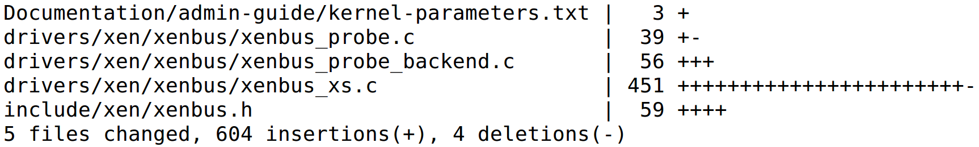
Current Status
Total LOC: ~600
Feature can be enabled only on dom0
Xenwatch Multithreading is enabled only when:
    xen_mtwatch kernel param
    xen_initial_domain()
Feedback for [Patch RFC ] from xen-devel
Copyright © 2018, Oracle and/or its affiliates. All rights reserved.

Slide 28
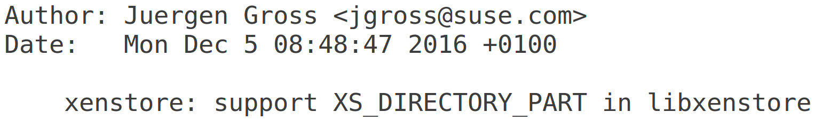
Future work
Extend XS_DIRECTORY to XS_DIRECTORY_PART
    To list 1000+ domU from xenstore
    Port d4016288ab from Xen to Linux
Watch at parent node only (excluding descendants)
    Only parent node’s update is notified
    Watch at “/local/domain” for thread create/destroy
Copyright © 2018, Oracle and/or its affiliates. All rights reserved.

Slide 29

Take-Home Message
There is limitation in single-threaded xenwatch
It is imperative to address such limitation
Xenwatch Multithreading can solve the problem
Only OS kernel is modified with ~600 LOC
Easy to apply to existing xenbus_watch
Question?
Copyright © 2018, Oracle and/or its affiliates. All rights reserved.

