Slide 1


TZVisor: Decouple the Trusted Execution from Hypervisor
Dongli Zhang
National Security Institute

Slide 2

Objective of Talk
Idea of TZVisor
Flow of the presentation
Confusion
Design Problem
Weakness
ARM Virtualization and Security Extensions

Slide 3


Infrastructure as a Service (IaaS)
Virtualization
IaaS
Applications
VM (OS)
VM (OS)
Data, Runtime, Middleware
You manage
OS
Virtualization (Hypervisor)
Virtualization
Storage
Others manage
Physical Machine
Networking
Notes:
Infrastructure as a service (IaaS) is a type of cloud computing in which a third-party provider hosts virtualized computing resources over the Internet.

Slide 4



Security Sensitive Block
Processing Password
password
SSH Service
Security Sensitive
VM (Guest OS Kernel)
Remote User
Vulnerable Service Application
Vulnerable (or Malicious) Guest OS Kernel
Vulnerable Hypervisor
Malicious Cloud Administrator
Hypervisor (KVM, Xen)
Cloud
Notes:
Password-based authentication with SSH: Since people tend to use the same password for multiple independent computer systems, a compromise on one system may yield access to other systems
makes it possible to restrict access to the user’s cleartext
password on the server to a tiny TCB (the PAL
to the CA’s private signing key. Thus, the key will
remain secure, even if all of the other software on the

Slide 5
TrustVisor (S&P 2012)
Security Sensitive Code as PAL (Pieces of Application Logic)
Tiny hypervisor for isolation of code PAL (S)
Hardware memory virtualization
Privacy & Integrity
No scheduling or Inter-Process Communication
Software-emulated TPM and Hardware TPM
TCB = Trusted Hardware + TrustVisor
Limitations
Cannot support multiple VMs
No scheduling of PAL
Small TCB = Less Functionality
Untrusted
App
App
S
Trusted
OS
V
white
Attestable
TrustVisor
HW

Slide 6
State of the Art
Solution | Research Works
Trusted Hardware | Flicker (EuroSys 2008), TrustVisor (S&P’10)
Hypervisor | OverShadow (ASPLOS’08), InkTag (ASPLOS’13), TrustVisor (S&P’10), CloudTerminal (ATC’12)
SFI | VirtualGhost (ASPLOS’14)
This Talk: ARM TrustZone

Slide 7







ARM vs. x86
ARMv7 (32-bit) -> ARMv8 (64-bit)
Marvel’s ARM chipse tin Baidu’s server in 2013
AMD Cortex-A57 server platform for developers in 2014
Qualcomm joined ARM server chip business in 2014
Lenovo's ARM-based NextScale in 2015
Notes:
Marvell (Nasdaq: MRVL) today announced the inclusion of its chipset in the world's first commercial deployment of ARM-based servers at Chinese search engine giant Baidu. As the first organization in the world to leverage ARM servers for commercial use, Baidu is pioneering a new era of more cost-effective and environmentally friendly data centers that feature power-sipping consumption and greater performance.
NeXtScale System offers an innovative approach to maximum usable density and enables flexible, mix-and-match configurations of servers, chassis, networking.

Slide 8
ARM Hardware Virtualization
KVM/ARM: The Design and Implementation of the Linux ARM Hypervisor. ASPLOS’14
ARM Fast Models (ARMv7 32-bit)
ARM Foundation Model (ARMv8 64-bit)
Arndale Board with Samsung Exynos 5250
Chromebook with Samsung Exynos5250
Omap5, VExpress, Cubieboard
Xen on ARM
ARM Fast Models (ARMv7 32-bit)
ARM Foundation Model (ARMv8 64-bit)
Arndale Board with Samsung Exynos 5250
Chromebook with Samsung Exynos5250
Cubieboard
non-root mode (guest)
PL1 mode
(kernel, svc)
root mode
(host)
PL2 mode
(hyp)
x86 HV
ARM HV
Notes:
Interrupts can be configured to trap to either Hyp or kernel mode. Trapping all interrupts to kernel mode and letting OS software running in kernel mode handle them directly is efficient, but does not work in the context of VMs, because the hypervisor loses control over the hardware.
The GIC v2.0 includes hardware virtualization support in the form of a virtual GIC (VGIC) so that receiving virtual interrupts does not need to be emulated in software by the hypervisor.

Slide 9

Limitations of Using Hypervisor
Vulnerable hypervisor (KVM, Xen), CVE-2007-4993
Large Trusted Code Base (TCB)
Large Trusted Employee Base (TEB)
Complex hypervisor code modification
Ease of porting (w/ or w/o hypervisor)
Trusted
Untrusted
…
Hypervisor
VM
VM
Admin

Slide 10
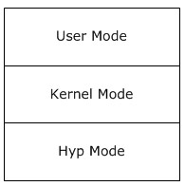
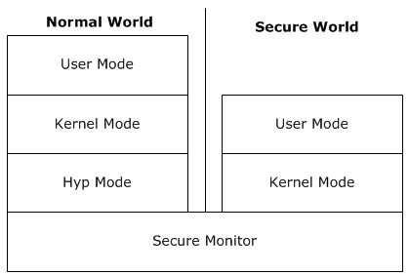
ARM TrustZone
ARM Security Extension
Secure World & Normal World
Memory Region
Peripherals
DMA Protection
Interrupt Isolation
Security-aware Debug
State of the Art
Trusted Sensors (MobiSys’12)
TLR (ASPLOS’14)
VeriUI (HotMobile’14)
TrustUI (APSys’14)
TrustDump (ESORICS’14)
SPROBES (Most’14)
TZ-RKP (CCS’14)
SeCReT (NDSS’15)
Notes:
Therefore, the TrustZone architecture provides separate signals to control secure
and normal world software debugging such that secure world debugging can be enabled when the device
is in a physically trusted location – for example, where trusted software is being developed – and disabled
in production devices

Slide 11

TZVisor Objective
Minimized Trusted Code Base (TCB)
Decouple TEE from hypervisor
Minimized Trusted Employee Base (TEB)
Multiplexing Secure World - IaaS (Multi-Tenant) vs. Smartphone
Two-Level Isolation
Tiny Fair Scheduling
Remote Attestation

Slide 12
TZVisor Design
Secure World
Normal World
…
PAL
PAL
Application
…
…
LKM
Agent
Agent
VM (Linux Kernel)
LKM
Secure Tiny Kernel (STK)
KVM

Slide 13
Trust Model
Entity | Work | Trust | Not Trust
Remote Client (optional) | Use service in IaaS VM’s application | Secure Service Provider | IaaS User, IaaS Admin
IaaS User | Deploy VM kernel and applications | Secure Service Provider | Remote Client, IaaS Administrator
IaaS Admin | Administrate IaaS, including hypervisors (Normal World) | Secure Service Provider | Remote Client, IaaS User
Secure Service Provider | Install STK (Secure World) | N/A | Remote Client, IaaS User, IaaS Administrator

Slide 14
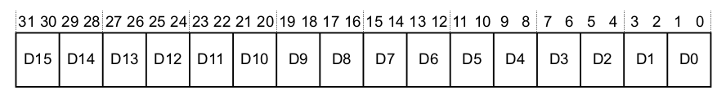
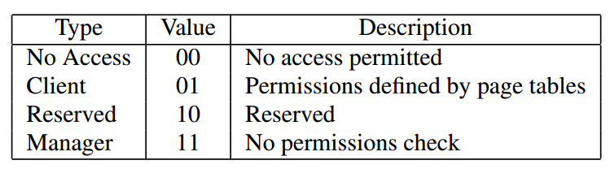
ARM Memory Domain
Segmentation in ARM (MMU enabled)
Domain Access Control Register (DACR)
16 domains
4-bit domain ID in 1st-level page table entry

Slide 15
Two-Level Isolation
Minimize Secure Tiny Kernel
Leverage non-kernel function to user
STK – Agent – PAL
DACR_DOM1 & DACR_DOM2
Pieces of Application Logic (PAL)
0x00000000
128MB
0x08000000
Dom 1
Data Buffer
64MB
0x0c000000
Agent (Forwarder & TPM, etc)
Dom 2
64MB
DACR_DOM1
DACR_DOM2
0x10000000
User
…
Kernel
Secure Tiny Kernel (STK)
0xc0000000
Domain Access Control Register (DACR)

Slide 16



Scheduling 1
Secure World
Normal World
Running!
…
PAL
PAL
Application
…
…
LKM
Agent
Agent
VM (Linux Kernel)
Secure Tiny Kernel (STK)
LKM
KVM
Schedule …
Timer
Context Switch
Scheduling Decision

Slide 17
Scheduling 2 – nonblocking call
again:
call vm_call_pal
if finish
return
else if not finish
go to again
end if
TrustZone Secure World
Secure Tiny Kernel (STK)

Slide 18
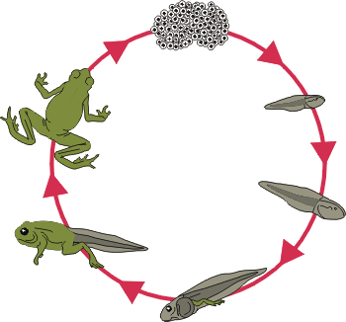
PAL Life Cycle
PAL Registration
PAL Invocation
PAL Unregistration
PAL TPM Operations
KVM Module
libtzsec
VM Module
libtznorm

Slide 19

Secure Boot
Only signed (private key) image can boot the ARM board
Private key is confidential to regular IaaS administrators
Boot ROM does integrity check of the first image (secure world)
Secure World
Normal World
Verify and boot
boot
boot
Boot ROM
Secure Tiny Kernel (STK)
Hypervisor
VM OS
Manufacturer
IaaS User
Core Admin or Manufacturer
Hyp Admin

Slide 20
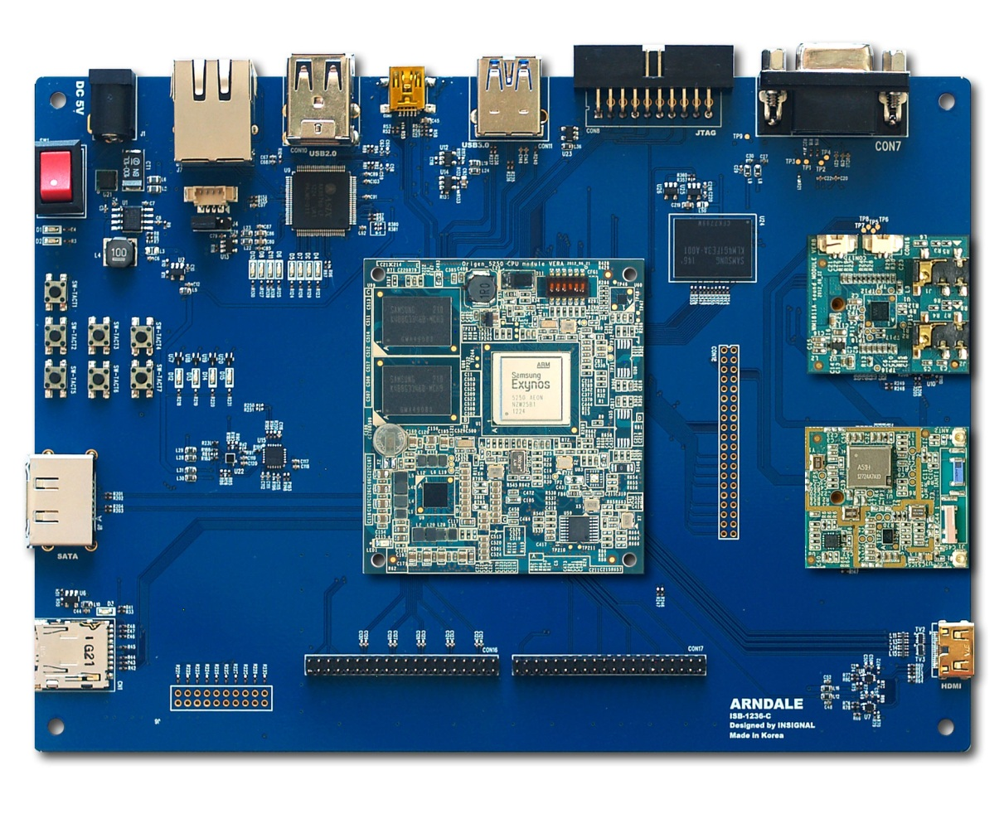
Implementation
Platforms (32-bit)
ARM Fast Models 9.1 Cortex-A15x1
Samsung Exynos 5250 Arndale Board Cortex-A15x2
Secure World
Boot-wrapper (Fast Models)
U-Boot(Arndale Board)
xv6-armv7 < 10k LOC
Normal World
Linux 3.14 (Guest and Host)
KVM Module, VM Module
libtzvsec, libtzvnorm
Port SSH

Slide 21

Limitation
ARMv7 (32-bit) vs. ARMv8 (64-bit)
TZASC Performance Overhead
TZASC on DDR channel
TZASC is under NDA
[Freescale i.MX6DQ Reference Manual]: Enabling TZASCs is expected to have a slight impact on memory performance. Exact value cannot be stated, since varies, depending on specific application software.
Secure Boot is under NDA
DOS Attack
Secure Channel between Application and PAL (SeCReT, NDSS’15)
Limited functionality in PAL

Slide 22

Evaluation
Lines of Code (LOC)
TCB Size = STK
LOC modified in KVM (and Xen)
Total LOC (modules, libraries)
Microbenchmarks
Macrobenchmarks
Porting Effort

Slide 23
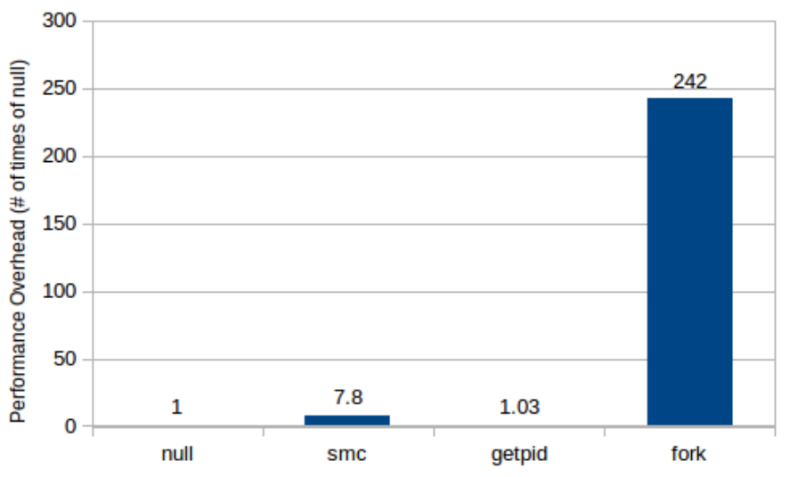
Preliminary Data
Freescale i.MX53 Quick Start Board
i.MX53 1 GHz ARM Cortex-A8 Processor
1GB DDR3 memory
Normal World
Linux 2.6.35 (ARMv7)
Secure World
Bare-metal code
Instruction cached disabled
Data cached disable
MMU disabled

Slide 24
Summary
First ARM based trusted execution framework (KVM, Xen) in IaaS (with evaluation)
Scheduling & Two-Level Isolation
Remote Attestation
Trusted execution management is decoupled from hypervisor
Hypervisor is decoupled from TCB
Trusted Employee Base (TEB) is minimized
Trusted
Untrusted
Secure Tiny Kernel
Hypervisor
VM
Core Admin
Hyp Admin

