Slide 1
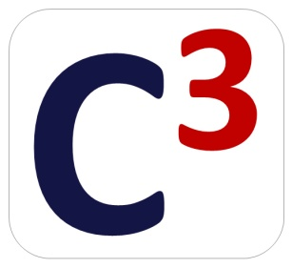





Secure Execution of Mutually Mistrusting Software
@ RPE 2014
Dongli Zhang
dozhang@cs.stonybrook.edu
National Security Institute
ver 2.7 widescreen

Slide 2




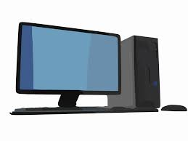
Use Case 1 (PC)
Introduction
Application
Application
Application
Application
Vulnerabilities
Operating System
Vulnerabilities
Notes:
First I will discus two case on the execution of mutually mistrusting software on commodity operating system.
PC is becoming significant indispensable.
We always run many

Slide 3



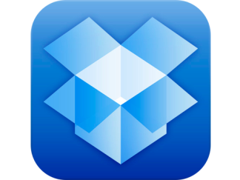
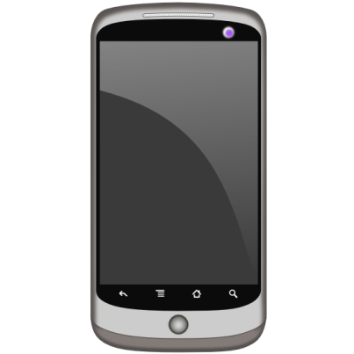
Use Case 2 (Android)
Introduction
Application
Application
Application
Application
Native Android Runtime
Linux Kernel

Slide 4
Problems
Introduction
Three problems with execution of mutually mistrusting software
Protecting benign app from malicious OS
Protecting benign OS from untrusted app
“Two-way” protection
distrust
Application
OS
distrust

Slide 5

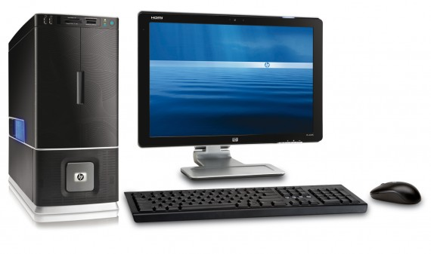
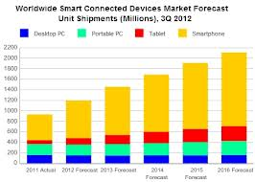
Motivation
Introduction
Daily work on desktop and server (Quarner: 82.6M@4th Quarter in 2013)
Increasing smartphone market (Canalys: Smartphone outsold PC in 2011)
PaaS (1M active apps on Google App Engine 2012)

Slide 6
Organization
Introduction
Evolution of prior works on three problems
Benign OS and Untrusted App
Untrusted App on Benign OS
Two-Way Protection
Challenges & Solutions
Future work

Slide 7
State of the art
Introduction
Year | Research Paper
2006 | PittSFIeld (USENIX Security)
2008 | Flicker (EuroSys), OverShadow (ASPLOS)
2009 | Native Client (S&P)
2010 | TrustVisor (S&P)
2011 | TrustDroid (SPSM), Cells (SOSP)
2012 | Cloud Terminal (ATC)
2013 | InkTag (ASPLOS), Krude & Meyer (CCSW)
2014 | VirtualGhost (ASPLOS), TLR (ASPLOS), VeriUI (HotMobile), TrustUI (APSys), AirBag (NDSS), KVM/ARM (ASPLOS), MiniBox (ATC)

Slide 8
State of the art
Introduction
OverShadow
Flicker
PittSFIeld
InkTag
TrustVisor
Native Client
Krude & Meyer
App: Trusted
OS: Not Trusted
App: Not Trusted
OS: Trusted
VirtualGhost
CloudTerminal
TrustDroid
TLR
Cells
VeriUI
KVM/ARM
TrustUI
AirBag
MiniBox
App: Not Trusted
OS: Not Trusted

Slide 9
Problem 1: Benign App & Untrusted OS
Problem 1: Benign App & Untrusted OS
OS can read and manipulate the memory code & data of application
OS provides services (file access, network I/O, memory management) for application
Iago Attack (ASPLOS 2013)
p = mmap(NULL, 1024, prot, flags, -1, 0);
read(fd, p, 1024);
Memory
OS services
Notes:
A carefully chosen sequence of integer return values to Linux system calls can lead a supposedly protected process to act against its interests

Slide 10
1. Trusted Hardware based Solution
Problem 1: Benign App & Untrusted OS
App
App
Flicker (EuroSys 2008)
Late Launch with SKINIT on AMD
Pause
Execute security-sensitive code
Resume previous execution
Extensions
Attest code execution and input/output
Preserve state securely across invocations with sealed storage
OS
OS
Outputs
Module
S
Inputs
0
0
0
Module
Module
S
Shim
Shim
SKINIT
TPM
…
Reset
PCRs:
0 | H | 0
 |  | 0
7 | 2 | 9
0 | 0 | 0
CPU
0 | h | 0
RAM
K₋₁
10

Slide 11
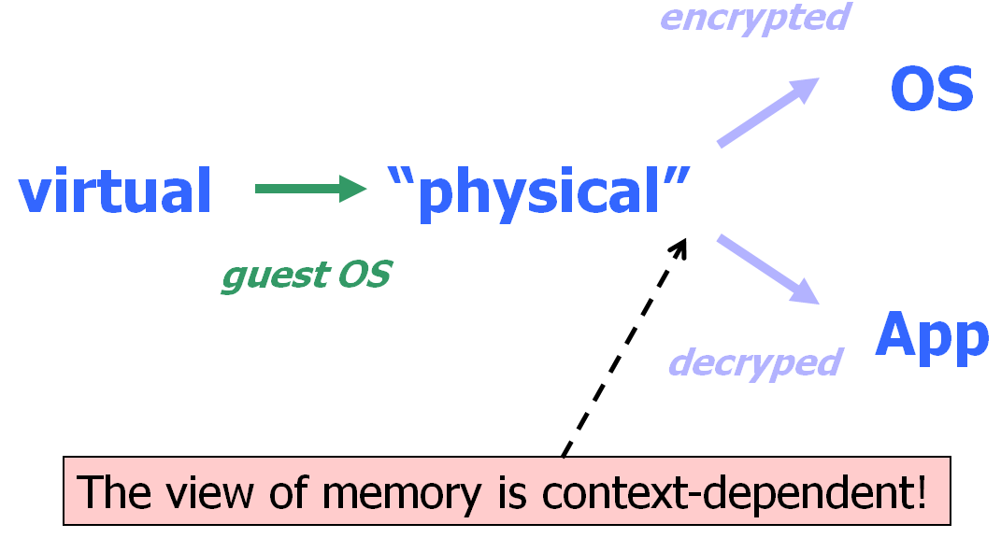
2. Hypervisor based Solution
Problem 1: Benign App & Untrusted OS
OverShadow (ASPLOS 2008) & InkTag (ASPLOS 2013)
Hypervisor isolates application from OS (with SPT or NPT)
Cloaking
OS accesses application’s page → encrypt
Application accesses OS-touched page → decrypt
Hypervisor is responsible for context switch
Protect application privacy and integrity
Notes:
Maulti-shadowing = Single VP to Multiple PP

Slide 12
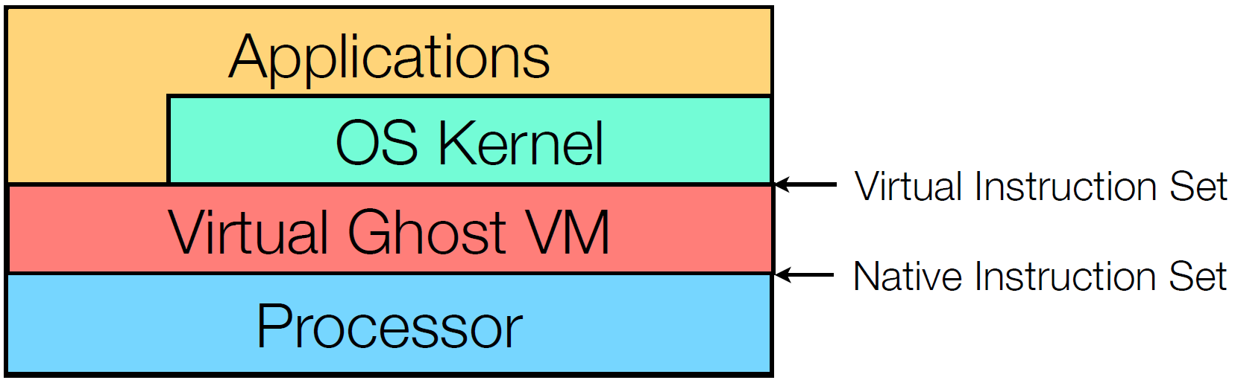
3. Instrumentation based Solution
Problem 1: Benign App & Untrusted OS
Virtual Ghost (ASPLOS 2014)
Protects application data (Ghost Memory) confidentiality and integrity
Uses compiler techniques (Secure Virtual Architecture)
OS (and module) compiled by LLVM to virtual instruction set
Designed to be easy to analyze and instrument
Low-level instructions (SVA-OS) replace assembly code
Virtual instructions are translated to native instruction
load/store/mmu are instrumented
Kernel Control Flow Integrity
Notes:
load/store instrumentation
CFI

Slide 13
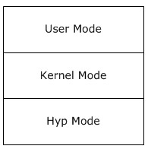
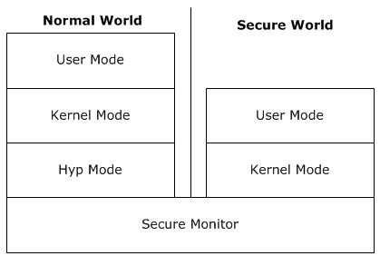
4. TrustZone based Solution
Problem 1: Benign App & Untrusted OS
Two separated worlds: normal and secure world
Memory region and peripheral could be assigned to secure world accessible only, or both
DMA protection
memory-to-peripheral DMA is world sensitive
Interrupt isolation
an interrupt can be configured as secure or non-secure

Slide 14
Fundamental
Problem 1: Benign App & Untrusted OS
Isolation
Trusted Hardware
OverShadow
Flicker
InkTag
TrustVisor
Services
Hypervisor
VirtualGhost
CloudTerminal
TLR
Solution | Research Works
Trusted Hardware | Flicker, TrustVisor
Hypervisor | OverShadow, InkTag, TrustVisor, CloudTerminal
Instrumentation | VirtualGhost
TrustZone | TLR, VeriUI, TrustUI
VeriUI
TrustZone
TrustUI
Notes:
Side effect

Slide 15
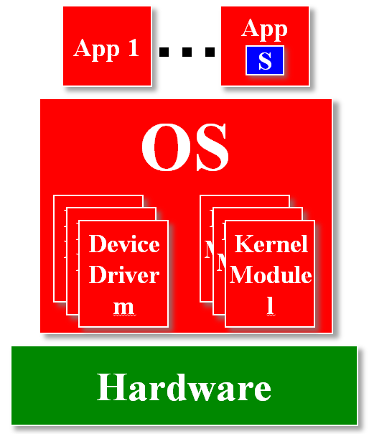
TrustVisor: Efficient TCB Reduction and Attestation (S&P 2010)
Problem 1: Benign App & Untrusted OS
TrustVisor
Problem
Execute Pieces of Application Logic (S)
Integrity and privacy requirements
Is similar to a Flicker session
General-purpose computing
Example
SSL Session Initialization

Slide 16
Meet TrustVisor
Problem 1: Benign App & Untrusted OS
TrustVisor
TCB = Trusted Hardware + TrustVisor + PAL (S)
Tiny hypervisor for isolation of code PAL (S)
No scheduling or Inter-Process Communication
Software-emulated TPM and Hardware TPM
External verification of Output = PAL(Input)
Protected storage for PAL (S)
TrustVisor outperforms Flicker
Untrusted
App
App
S
Trusted
OS
V
white
Attestable
TrustVisor
HW

Slide 17
Boot TrustVisor
Problem 1: Benign App & Untrusted OS
TrustVisor
TrustVisor:
Virtualizes RAM, CPU
Restricts DMA
Restricts TPM to Locality 1
App
1
…
App
n
OS
Device Drivers
White
TrustVisor
TPM Driver
Locality 1
Locality 2
Hardware
DMA Devices (Network, Disk,
USB, etc.)
TPM
CPU, RAM
Chipset
Notes:
TPM chips are memory-mapped to multiple addresses, each corresponding to a different privilege level called a locality
TrustVisor’s memory protections prevent the legacy guest from accessing privileged localities.

Slide 18
Identifying S to TrustVisor
Problem 1: Benign App & Untrusted OS
TrustVisor
Applications identify S via registration
Page-level protection granularity
Applications make “normal” function calls
TrustVisor detects switch to S via traps
S runs with no access to legacy OS
One set of Inputs and Outputs per invocation

Slide 19
PAL (S) Execution
Problem 1: Benign App & Untrusted OS
TrustVisor
App
1
…
App
n
TrustVisor API
Registration
Invocation
Micro-TPM
S
OS
TrustVisor
S
μTPM
S State
DMA Devices (Network, Disk,
USB, etc.)
TPM
CPU, RAM
Chipset

Slide 20
Sensitive Code Timeline (Multiple Invocations)
Problem 1: Benign App & Untrusted OS
TrustVisor
Multiple invocations of PAL (S) during a single registration cycle
Invoke S: SSL Session Init
S Complete: Session active
Invoke S: SSL Session Init
S Complete: Session active
Initialize TrustVisor
Application Starts
Application Exits
Register S
Unregister S
…
S’s Runtime State Protected

Slide 21
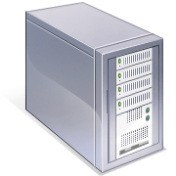
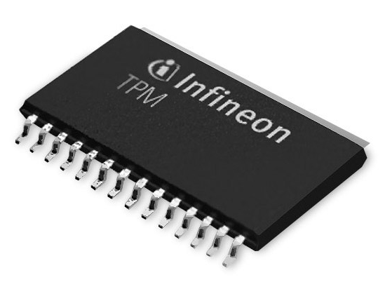

External Verification: Attestation
Problem 1: Benign App & Untrusted OS
TrustVisor
What code are
you running?
Verifier
Target
(
)
K_{TPM}, K⁻¹
Sign
S
Inputs
, K⁻¹
TrustVisor
Outputs
Trust in attestation rooted in hardware TPM (Trusted Platform Module)
Attestation
HW TPM: TrusrVisor
SW TPM : PAL (S) + Input/Output
SSL-enabled web server scenario:
Client can evaluate server before sending data
Enables more meaningful SSL server validation

Slide 22
Limitations
Problem 1: Benign App & Untrusted OS
TrustVisor
Design-level
Does not currently provide trusted path to user
Requires application awareness
Prototype-level
No SMP support (currently single CPU)
Executable code for S must be proactively paged into memory before registration
AMD-only

Slide 23
Summary : TrustVisor (Oakland 2010)
Problem 1: Benign App & Untrusted OS
TrustVisor
Tiny hypervisor to support isolation
Software-emulated TPM
Compelling performance argument
Externally verifiable via attestation
Requires no OS changes
TrustVisor

Slide 24
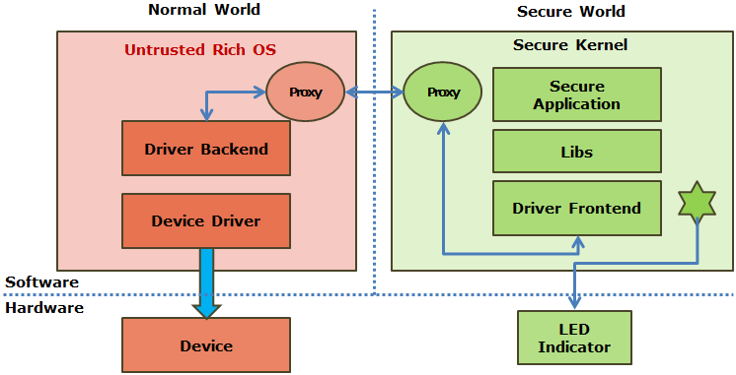
TrustUI: Building Trusted Path on Untrusted Device Drivers for Mobile Devices (APSys 2014)
Problem 1: Benign App & Untrusted OS
TrustUI
Secure login panel to remote service
Provides a trusted path between services and end users
Isolate Secure Login Panel in Secure World
Properties TrustUI should have
TCB should be minimal
deployable to existing mobile devices
A security-oriented split driver model
front and backend
Notes:
Back End: Unmodified Driver and Wrapper
Front End: Provide safe access to device

Slide 25
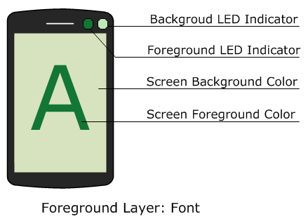
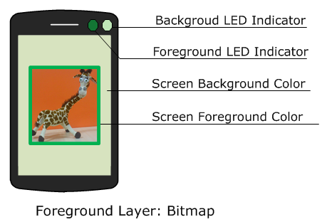
Sample Attacks: Framebuffer Overlay
Problem 1: Benign App & Untrusted OS
TrustUI
Normal world allocates framebuffer for secure world
Screen Hijacking Attack
Pass a pointer of frame buffer with low priority to the secure world, and operate on a higher layer frame buffer
Two display layers in secure display
same color as LED and periodically change them
foreground font element
foreground bitmap element

Slide 26
TrustUI: Secure Display
Problem 1: Benign App & Untrusted OS
TrustUI
Normal World
Secure World
Untrusted Rich OS
Secure Kernel
Proxy
Proxy
Secure Application
Display Backend
Display Lib
Display Driver
Display Frontend
Software
Hardware
Display Device
Frame Buffer
Unsecure Memory
Secure Memory
LED Indicator
Memory

Slide 27
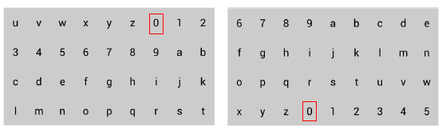
Sample Attacks: Touch Logger
Problem 1: Benign App & Untrusted OS
TrustUI
Keyboard Randomization
touch position: regenerate the keyboard layout after entering a character by adding an offset for each key
input length: generate a random pop-up button on the screen within the keyboard area for the user to click

Slide 28
TrustUI Design: Secure Input
Problem 1: Benign App & Untrusted OS
TrustUI
Normal World
Secure World
Untrusted Rich OS
Secure Kernel
Proxy
Proxy
Secure Application
Touch Backend
UI Element Randomization
Touch Driver
Input Frontend
Software
Hardware
Touch Screen
Unsecure Memory
Secure Memory
Frame Buffer
LED Indicator
Display Device
Memory

Slide 29
Security Challenges of TrustUI
Problem 1: Benign App & Untrusted OS
TrustUI
Security Property | Attack | Solution
Code Integrity | Code Tampering | Secure Booting
Availability | Denial-of-Service | Detect by User
Input Privacy | Touch Logger | Input Randomization
Display Integrity | Frame Buffer Overlay | Display Randomization
Display Privacy | Screen-Capture | Secure Framebuffer

Slide 30
Summary : TrustUI (APSys 2014)
Problem 1: Benign App & Untrusted OS
TrustUI
TrustUI: a system aiming at providing trusted path for mobile devices
Excluding commodity software stack as well as drivers for user-interacting devices out of its TCB
Limitation
TrustUI only supports secure login panel
TrustUI cannot prevent general touch-logger
TrustUI

Slide 31
Problem 2: Untrusted App & Benign OS
Problem 2: Untrusted App & Benign OS
Granularity | Papers
Intra-process | PittSFIeld (USENIX Security 2006), Native Client (S&P 2009)
Inter-process | Native Client (S&P 2009), Krude & Meyer (CCSW 2013)
Inter-namespace | Cells (SOSP 2011), AirBag (NDSS 2014), TrustDroid (SPSM 2011)
Inter-VM | KVM/ARM (ASPLOS 2014)

Slide 32
Challenges
Problem 2: Untrusted App & Benign OS
Isolated (Sandboxed) code interacts with OS
Performance
Implementation Overhead
Limited resource on mobile phone

Slide 33
1. Intra-Process Solution
Problem 2: Untrusted App & Benign OS
Isolate instructions in sandbox
Instrument Store/Load instructions
Instrument Control Flow instructions
Binary or Assembly code
Text/Data Region
(Sandboxed Native Code)
Service Runtime

Slide 34
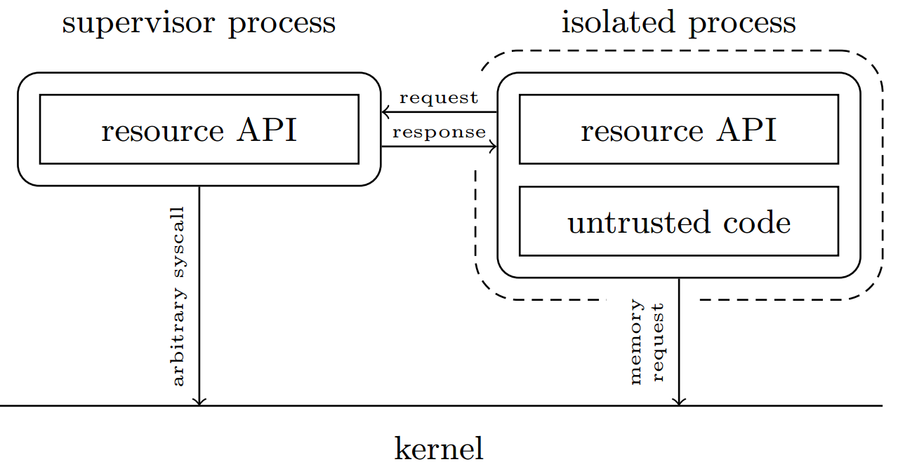
2. Inter-Process Solution
Problem 2: Untrusted App & Benign OS
Memory Protection: process barrier
System call access: system call policy

Slide 35
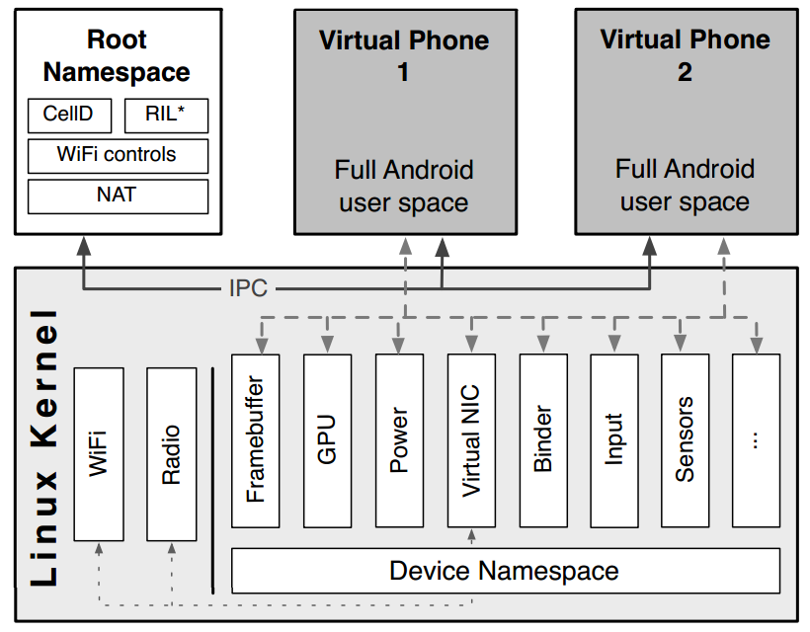
3. Inter-Namespace Solution
Problem 2: Untrusted App & Benign OS
Linux Namespace
OS-level virtualization, like LXC
PID Namespace Isolation
Network Namespace Isolation
UTS Namespace Isolation
Mount Namespace Isolation
IPC Namespace Isolation

Slide 36
Fundamental
Problem 2: Untrusted App & Benign OS
PittSFIeld
Isolation
Intra-process
Krude & Meyer
Native Client
Inter-process
TrustDroid
Service
Cells
KVM/ARM
AirBag
Inter-namespace

Slide 37
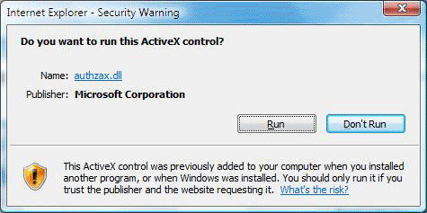
Native Client: A Sandbox for Portable, Untrusted x86 Native Code (S&P 2009)
Problem 2: Untrusted App & Benign OS
Native Client
The modern web browser brings together a remarkable combination of resources.
JavaScript
Document Object Model (DOM)
…
It remains handicapped in a critical dimension: computational performance.
Newtonian physics
High-resolution scene rendering
…
ActiveX and NPAPI rely on non-technique measures for security

Slide 38
Native Client (NaCl) Architecture
Problem 2: Untrusted App & Benign OS
Native Client
Inner Sandbox (binary validation)
Segmentation based isolation
No load/store outside sandbox
No control transfer outside sandbox
Runtime Service
create a security subdomain within a native operating system
The service runtime provide a set of system services
Server
game.nexe
Browser
IMC
Storage
Service runtime
<embed src=“game.nexe”>

Slide 39
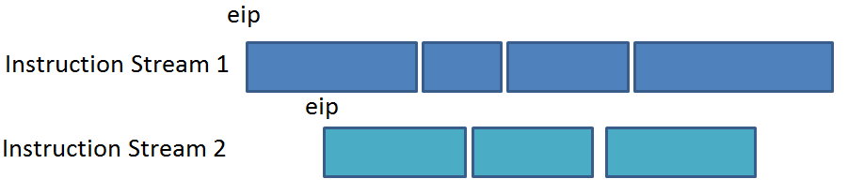
NaCl Inner Sandbox
NaCl module is compiled with NaCl-aware compiler
Use nacljmp for indirect jump
and %eax, 0xffffffe0
jmp *%eax
Disassemble the binary (NaCl module)
Verify if binary conforms constraints for NaCl binaries
Segmentation based isolation
No unsafe instructions(syscall, segmentation, privileged instructions, far call, etc)
Data Integrity: no loads or stores outside of data sandbox
Direct Control Flow
Indirect Control Flow: Use 32-byte alignment

Slide 40
NaCl Service Runtime
Problem 2: Untrusted App & Benign OS
Native Client
4KB
For service runtime
Trampoline
Springboard
64KB
Text Region
Service Runtime

Slide 41
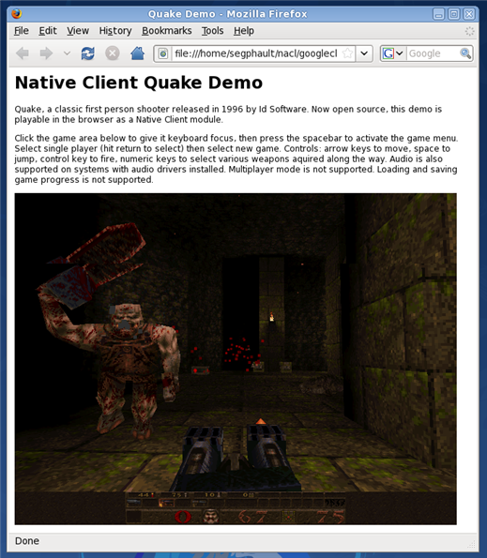
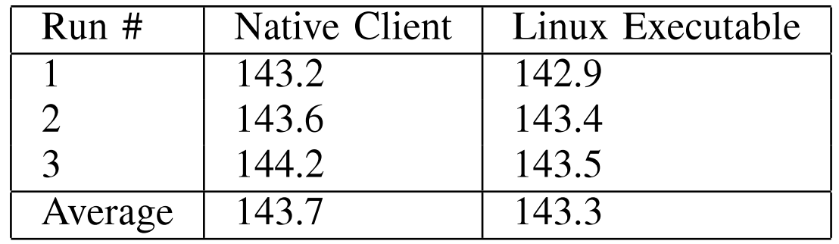
NaCl Developer Tools - Building
Problem 2: Untrusted App & Benign OS
Native Client
Modify gcc (NaCl-compliant binaries)
-falign-functions to 32-byte aligned
-falign-jumps (jumped target) to 32-byte aligned

Slide 42
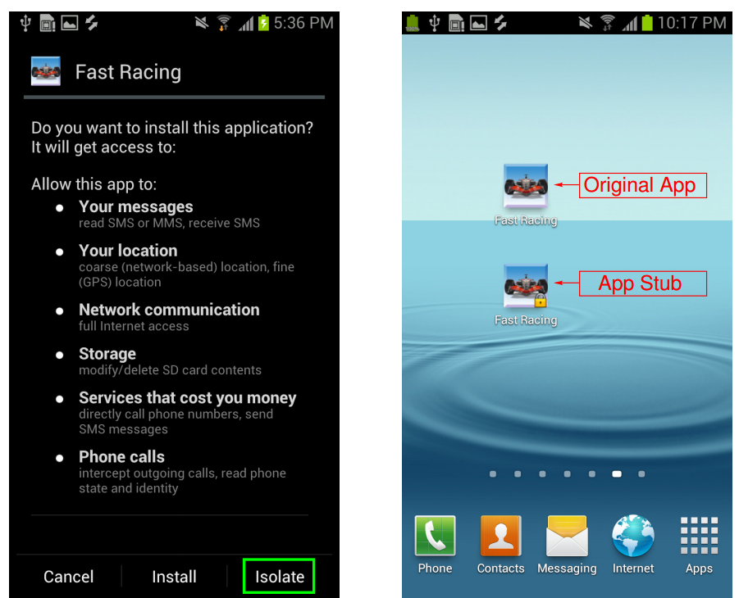
AirBag: Boosting Smartphone Resistance to Malware Infection (NDSS 2014)
Problem 2: Untrusted App & Benign OS
AirBag
Goal: Isolate and prevent untrusted app from infecting system or stealthily leaking privacy
Threat Model
Users will download and install third-party untrusted apps
TCB = kernel + native Android runtime

Slide 43
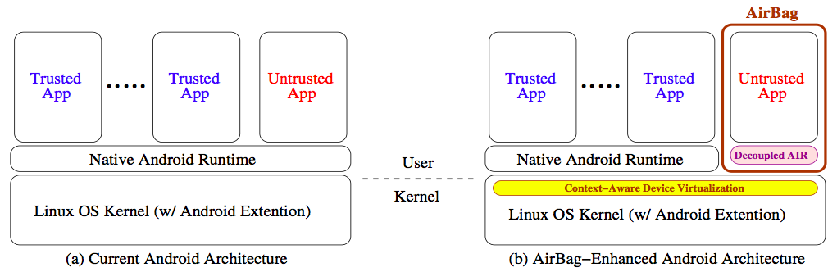
AirBag System Design
Problem 2: Untrusted App & Benign OS
AirBag
Decoupled app isolation runtime (AIR)
Java & Native Libraries
Application Framework (e.g. SurfaceFlinger service)
Dalvik Virtual Machine
Namespace and filesystem isolation
Context-aware device virtualization

Slide 44
AirBag: Namespace/Filesystem Isolation
Problem 2: Untrusted App & Benign OS
AirBag
A separated namespace (airbag_init)
Apps inside AirBag cannot interact with outside ones
A separated filesystem (pivot_root)
All modifications are inside AirBag
Copy-on-write filesystem
Does not affect original filesystem
Easy to provide “restore to default” feature

Slide 45
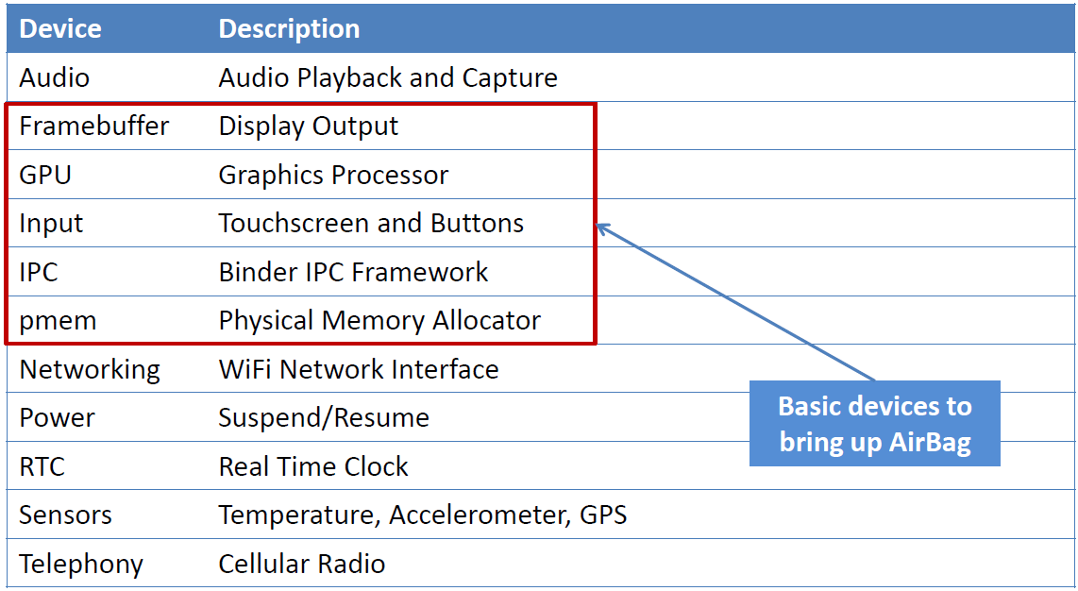
AirBag: Context-aware Device Virtualization
Problem 2: Untrusted App & Benign OS
AirBag
Multiplexing system resources between AIR and native Android runtime
Create a duplicate copy of resource
Create a proxy to mediate resource access

Slide 46
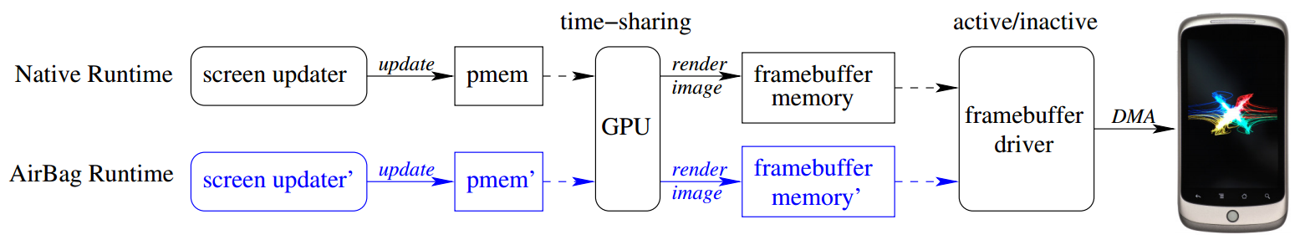
AirBag: Framebuffer
Problem 2: Untrusted App & Benign OS
AirBag
All the visual content to be shown by running apps are synthesized by the screen updater (SurfaceFlinger) to the framebuffer memory
Solution: allocates a second framebuffer
Userspace screen updater uses device /dev/pmem
Solution: creating a separate /dev/pmem device for each namespace

Slide 47
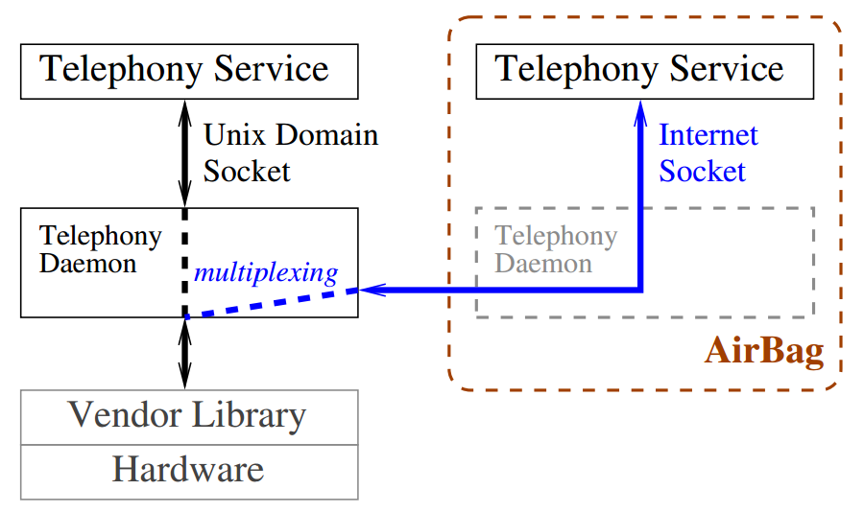
AirBag: Telephony
Problem 2: Untrusted App & Benign OS
AirBag
A service daemon, rild, loads vendor-proprietary library
AirBag multiplex the hardware access at the user level rild by creating a TCP socket, allowing outgoing calls

Slide 48
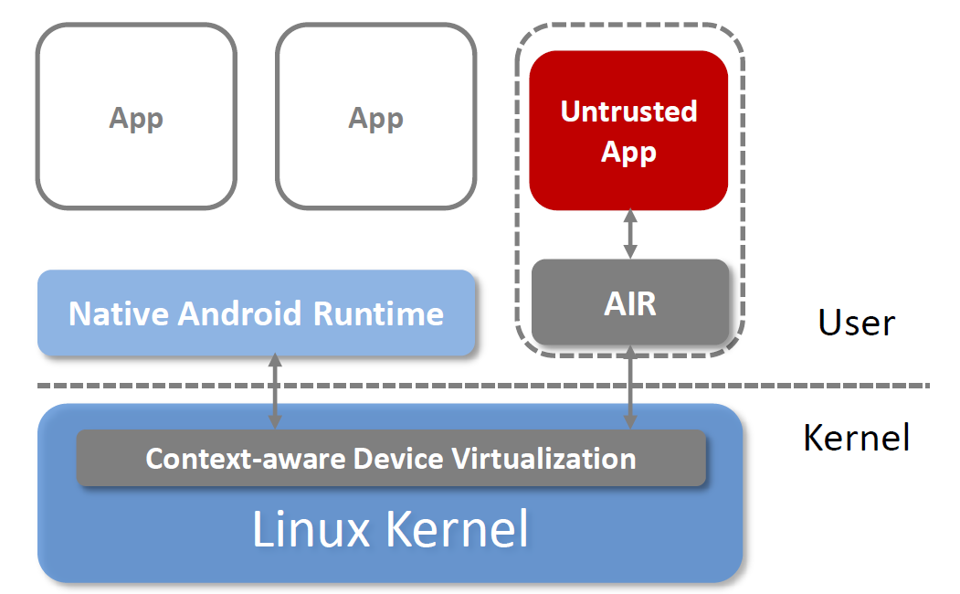
Summary
Problem 2: Untrusted App & Benign OS
AirBag
AirBag: a light-weight solution to effectively and efficiently isolate untrusted apps
Limitations
Adaptively switch the application between AirBag and Native Runtime
Single Instance Support

Slide 49
MiniBox: A Two-Way Sandbox for x86 Native Code (ATC 2014)
Problem 3: Two-way Protection
OverShadow
Flicker
PittSFIeld
Platform as a Service (PaaS)
Contributions
First two-way sandbox for x86 native applications
Prevent Iago attack
InkTag
TrustVisor
Native Client
Krude & Meyer
VirtualGhost
CloudTerminal
TrustDroid
TLR
Cells
VeriUI
KVM/ARM
TrustUI
AirBag
MiniBox

Slide 50
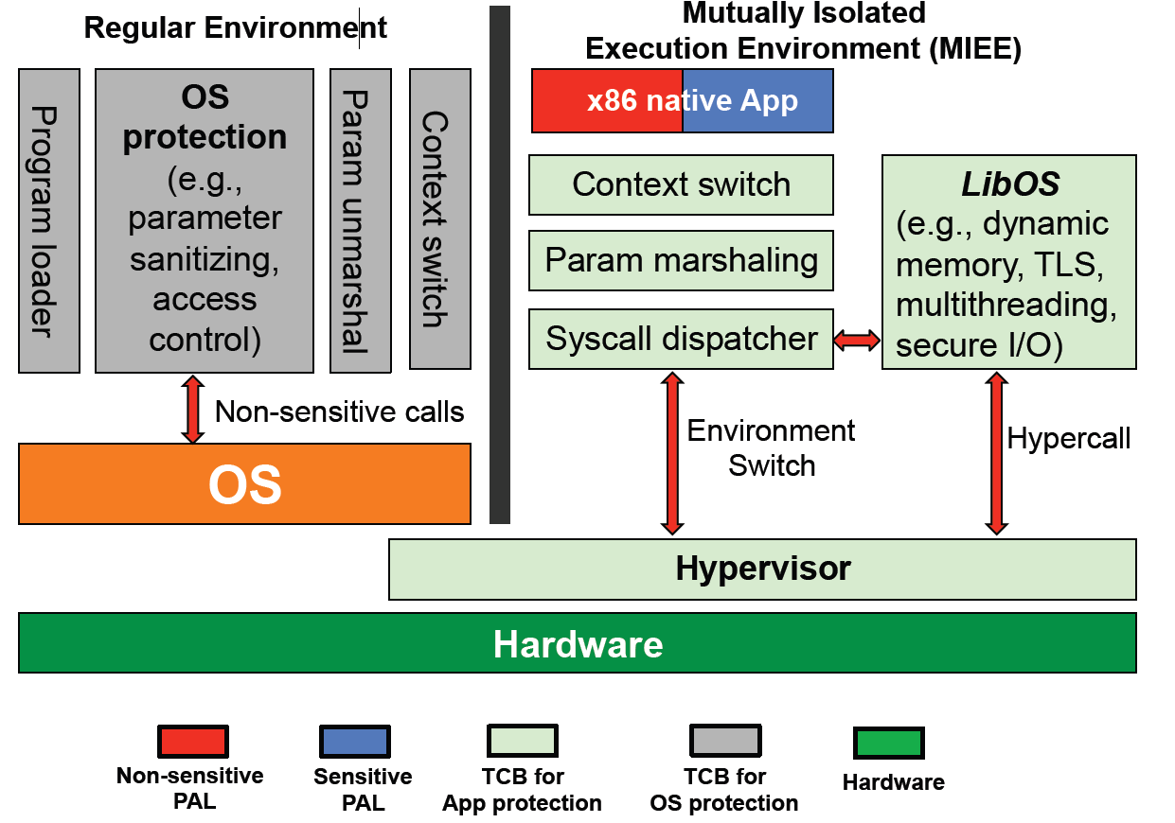
MiniBox Architecture
Problem 3: Two-way Protection
MiniBox

Slide 51
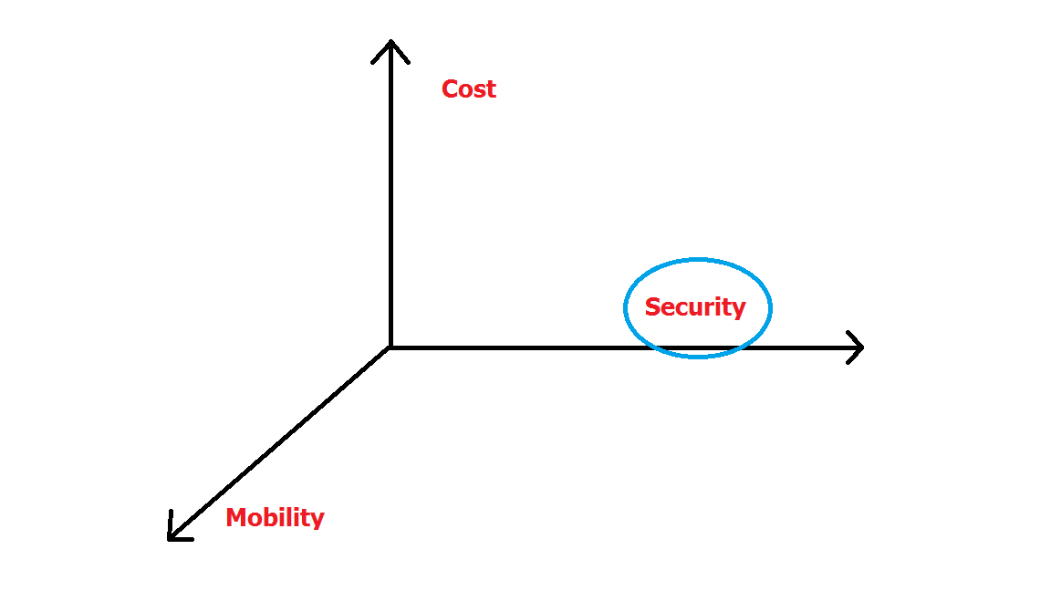
Future Work: Balance Security, Cost and Mobility
Future Work
Replace x86 with ARM
Notes:
Now, I will start my future work. Prior works focus on security problems on server and in cloud based on x86 architecture.

Slide 52
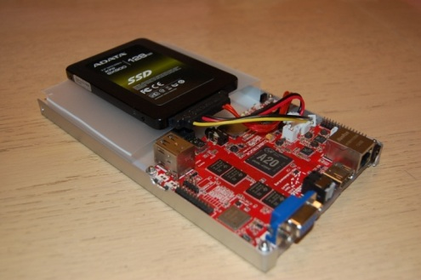
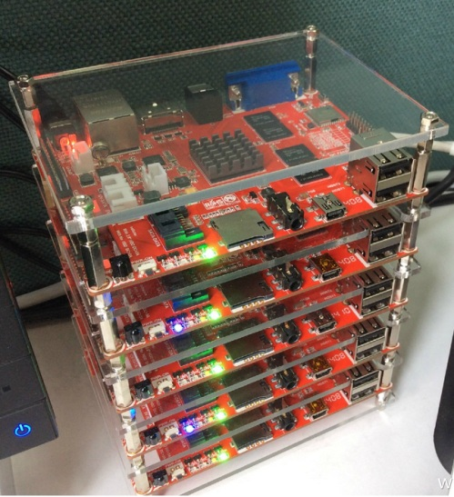
Future Work: Secure PAL Execution on ARM Architecture
Future Work
Objective
Provide secure execution environment for PAL with minimal TCB
Motivation
ARM is energy efficient
Various ARM boards (AMD, Raspberry Pi, CubieBoard, etc)
Hardware virtualization not available on all ARM Chips
Current ARM board has limited resources
Prior works are only on smartphone
Challenges
No Late Launch on ARM
No Virtualization
Shared Secure Environment
Contribution
Design the first framework to execute PAL on ARM (applicable to cloud environment)
Prevent Iago attack
Notes:
Sok paper

Slide 53

Secure PAL Execution on ARM based Cloud
Future Work
Secure World
Normal World
PAL
PAL
Application 1
Application 2
Sandbox 1
Sandbox 2
Micro-TPM
Micro-TPM
Secure World Tiny Kernel
Linux Kernel
Late Launch Handler
Sensitive System Call Handler
TrustMod
ARM TrustZone Hardware

Slide 54
Secure PAL Execution on ARM based Cloud
Future Work
Integrity and Privacy
Secure Boot
Key pairs on ROM
Remote Verification
Small TCB
Shared by multiple applications (users)
Low implementation overhead
Applicable to most ARM chips

Slide 55
Summary: Other Dimensions
PC vs. Smartphone
Locally vs. Cloud
Single Instance vs. Multiple Instance
PAL vs. Application
Modification vs. No Modification
Isolation
Service

Slide 56
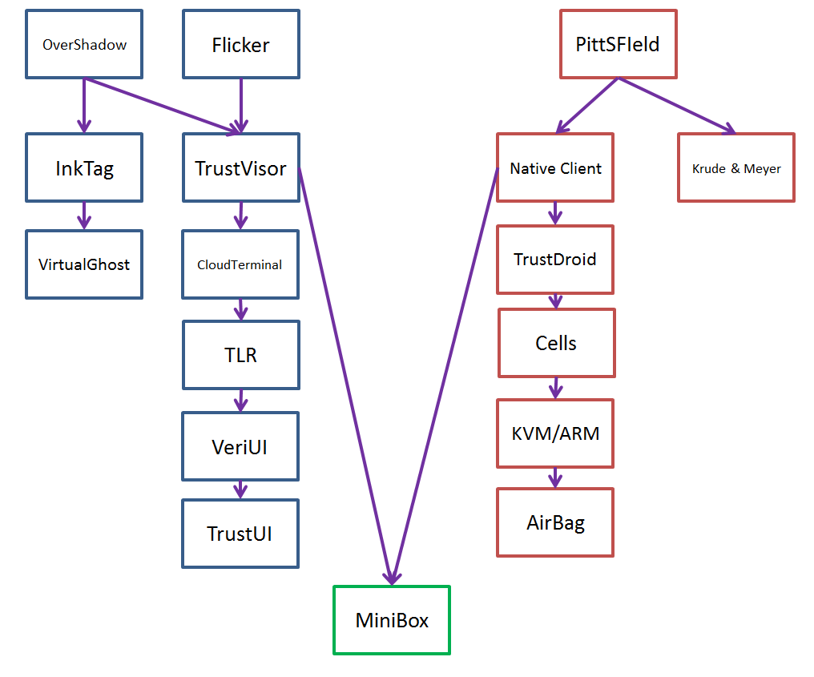
Summary
Survey of prior works
Remove trust between app and OS
More hardware, VMFUNC and Intel SGX
Security on energy efficient ARM architecture

Slide 57
Thank you!
Question?

