Slide 1
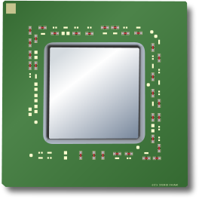
Domain 0
PVM
HVM
PVHVM
xen_evtchn_do_upcall
will traverse and handle
each pending event
xen_evtchn_do_upcall
will traverse and handle
each pending event
xen_evtchn_do_upcall
will traverse and handle
each pending event
Guest will handle interrupt
as native machine
IRQ handler for vector 0xf3 is called
vcpu
vcpu
vcpu
vcpu
vcpu
vcpu
vcpu
vcpu
Global Event Channel Info
Per-vcpu Event Channel Info
Global Event Channel Mask
Per-vcpu Event Channel Mask
Global Event Channel Mask
Per-vcpu Event Channel Mask
Global Event Channel Mask
Per-vcpu Event Channel Mask
set eip to
xen_hypervisor_callback
during scheduling
if vcpu has pending event
set eip to
xen_hypervisor_callback
during scheduling
if vcpu has pending event
Intel-vt based
interrupt injection and
one vector for each irq
Intel-vt based
interrupt injection and
vector 0xf3 for each event
Xen Hypervisor

