Slide 1
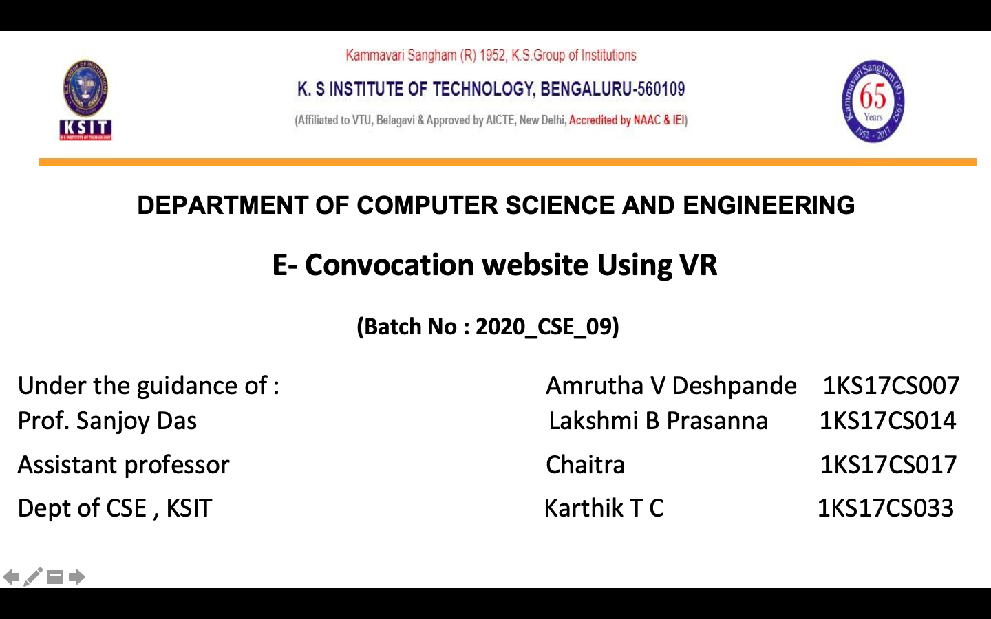

Slide 2






Contents
Introduction
Literature review
Problem Identification,Statement
Objectives & Scope
Methodology
Results
Conclusion
References

Slide 3

Introduction
Due to COVID-19 restrictions, the better way of attending graduation is by VIRTUAL GRADUATION where students and staff members from various colleges can attend the annual convocation in their VR models. While the students are not physically present at the dais, they could be seen getting on dais and receiving their graduation degrees with the same enthusiasm.
A virtual graduation ceremony using VR is certain in this pandemic period which utilises the technology in hand, can be more efficient and progressive. This project aimed to establish a platform for ceremonies to happen virtually along with the participation of each and every individual through VR.
Model of each graduate accept the degree certificate
from the personalized 3d model of the professor. It
will provide the student with the same experience
an in-person event despite the restrictions posed by the
pandemic.

Slide 4
Literature Survey
Factors affecting mass gatherings in this COVID situation:
Most recent events and summits have been postponed or cancelled altogether due to travel bans and work-from-home policies resulting from the pandemic.
The coronavirus pandemic's unprecedented impact on events offers a unique opportunity for virtual reality.
Face detection:
This section gives an overview on the face recognition techniques that apply mostly to frontal faces. The methods considered are frontal face detection and neural networks. The approaches are analysed in terms of the facial representations..
Face landmark detection:
The locations of the facial landmark points around facial components and facial contour capture the rigid and non-rigid facial deformations due to head movements and facial expressions. They are hence important for various facial analysis tasks.

Slide 5
Problem Identification ,Statement
Across the nation, due to the pandemic, Some schools and colleges are tentatively planning to cancel or postpone the graduation ceremony. But the math of social distancing doesn't add up to even delayed events being a good solution.
In this pandemic time even if colleges plan to arrange graduation ceremonies offline then there would be huge amount of health risks.
Keeping all the above-mentioned points in the mind we have come up with a solution where colleges can deal with the graduation ceremonies virtually based on Virtual Reality.

Slide 6
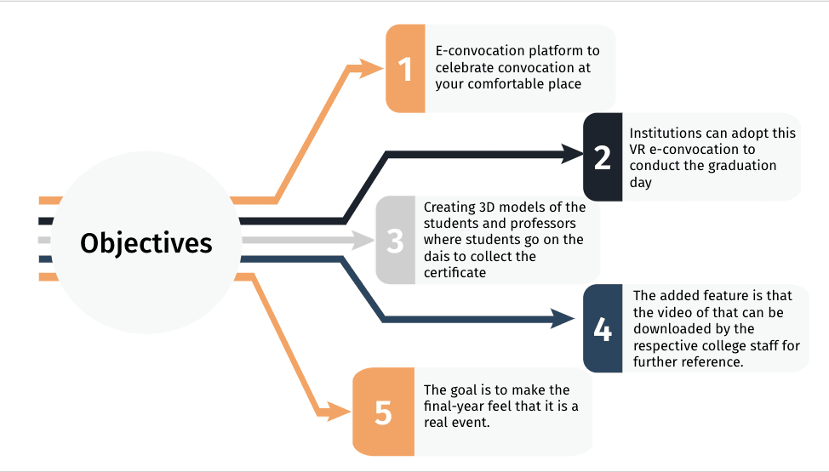
Objectives & Scope

Slide 7
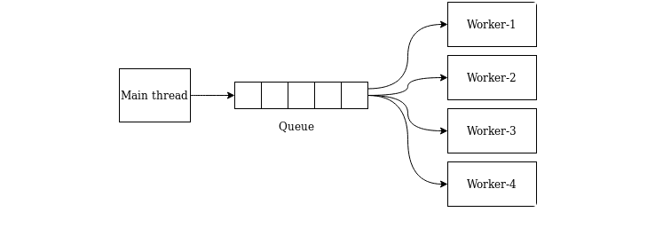
Methodology
Here, we’ll be using job scheduling which we run it in the background. Mean Thread is the user interface.
So, we’ll be designing a job queue. When a user submits a photo, then it goes and sits in the queue.
The process in the AI part, like face extraction, face alignment, face swap will be created as workers.
Worker-1: Face detection.
Worker-2: Face extraction.
Worker-3: Face swapping.
Worker-4: Generating a video.

Slide 8
Basically, the queue will act as an input source for workers.
Face detection from the source image.
Frames extraction from the destination video.
Each frame undergoes face detection, face extraction and that face will be the target face. The source image will be the reference face. The reference face also undergoes face detection, facial landmark detection and then it gets swapped with the target face.
Merging – after the face extraction from the source image and frame extraction from the destination video, it's time to merge learned face over original frames to form final video (convert).
Conversion of frames back into video -After the face swap process the frames will be merged and converted into a video. It'll be containing all the frames that makeup a video.

Slide 9
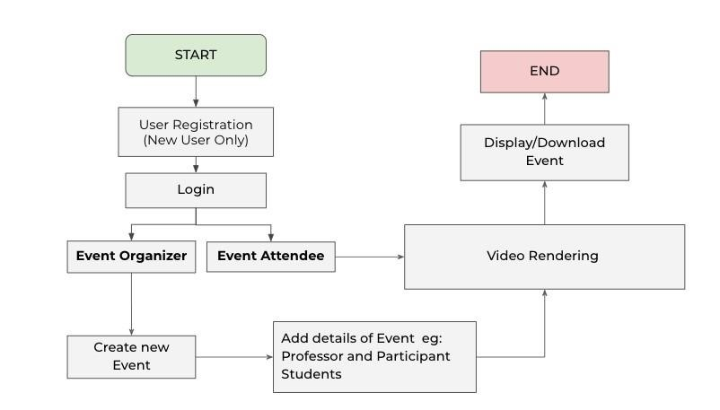
Flowchart

Slide 10
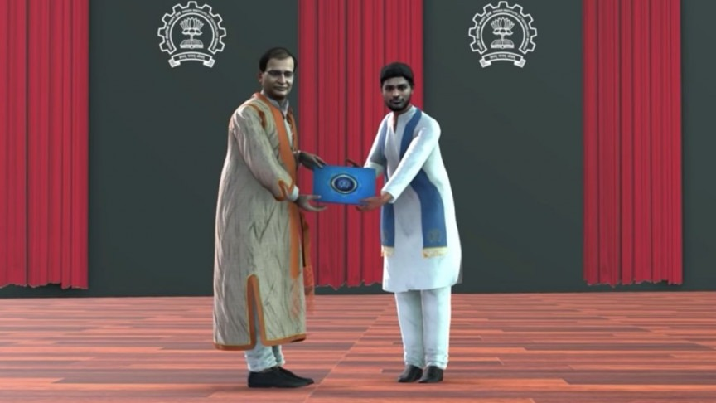
Results
Colleges can attend the annual convocation in their VR models. While the students are not physically present at the dais, they could be seen getting on dais and receiving their graduation degrees with the same enthusiasm.
The personalized 3d model of each graduate accept the degree certificate from the personalized 3D model of the professor.

Slide 11
Conclusion
Our project, a virtual graduation ceremony platform is certain in this pandemic period which utilizes the technology in hand, can be more efficient and progressive.
This project aimed to establish a platform for ceremonies to happen virtually along with the participation of each and every individual through VR.
Colleges can arrange graduation ceremonies online then there would not be huge gathering in this pandemic time.

Slide 12
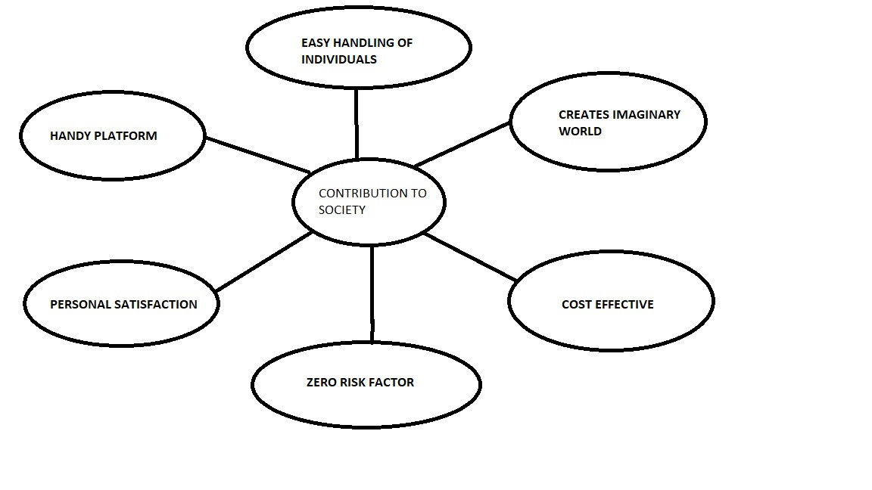
Contribution

Slide 13
References
1.Face Feature Extraction E. Bagherian and R. W. O. K. Rahmat, "Facial feature extraction for face recognition: a review," 2008 International Symposium on Information Technology, Kuala Lumpur, 2008, pp. 1-9, doi: 10.1109/ITSIM.2008.4631649.
2.Automated Face Swapping Y. Zhang, L. Zheng and V. L. L. Thing, "Automated face swapping and its detection," 2017 IEEE 2nd International Conference on Signal and Image Processing (ICSIP), Singapore, 2017, pp. 15-19, doi: 10.1109/SIPROCESS.2017.8124497.
3.Srushtika Neelakantam and Tanay Pant,“Learning Web based Virtual Reality”. “Build and Deploy Web based Virtual Reality Technology”.
D. Bitouk, et al. "Face swapping: automatically replacing faces in photographs." ACM Transactions on Graphics (TOG). Vol. 27. No. 3. ACM, 2008.
5.V. T. Nguyen, R. Hite and T. Dang, "Web-Based Virtual Reality Development:," 2018 IEEE International Conference on Artificial Intelligence and Virtual Reality (AIVR), Taichung, Taiwan, 2018, pp. 11-18, doi: 10.1109/AIVR.2018.00010.

Slide 14
Thank You!

