Slide 1
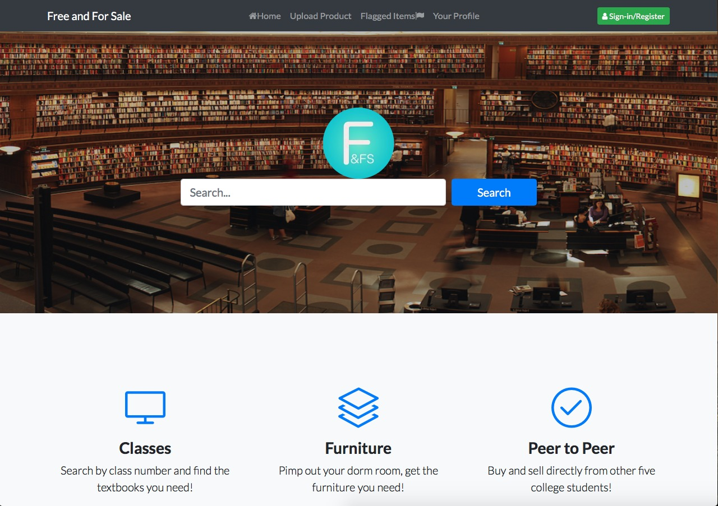
Free and For Sale
Team: Bootstrap

