Slide 1

AIR Quality Andrew finch

Slide 2

AGENDA
Hypothesis: Rural or less-populated areas will have a higher chance to have lower levels of PM2.5 than urban areas?

Slide 3

PM2.5 AQI Value – PM2.5 is fine particulate matter and AQI is the air quality index AQI Value – is the measure of the air quality with various p0llutants OZONE AQI Value – OZONE Levels (an additional pollutant) NO2 AQI Values – Measure of nitrogen Dioxide Cities – Major and minor cities compared

Slide 4
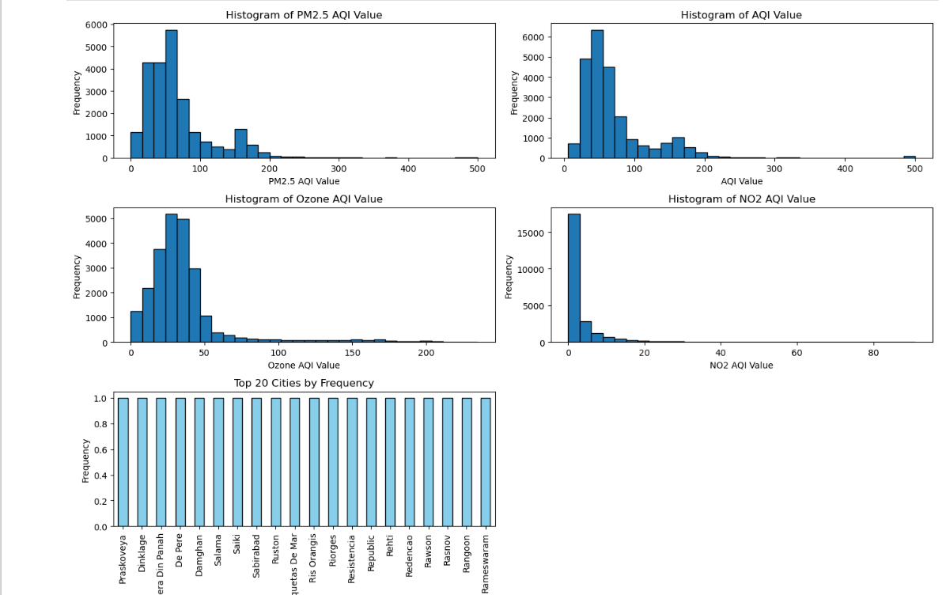


Slide 5

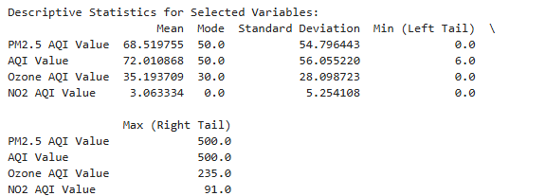

Slide 6
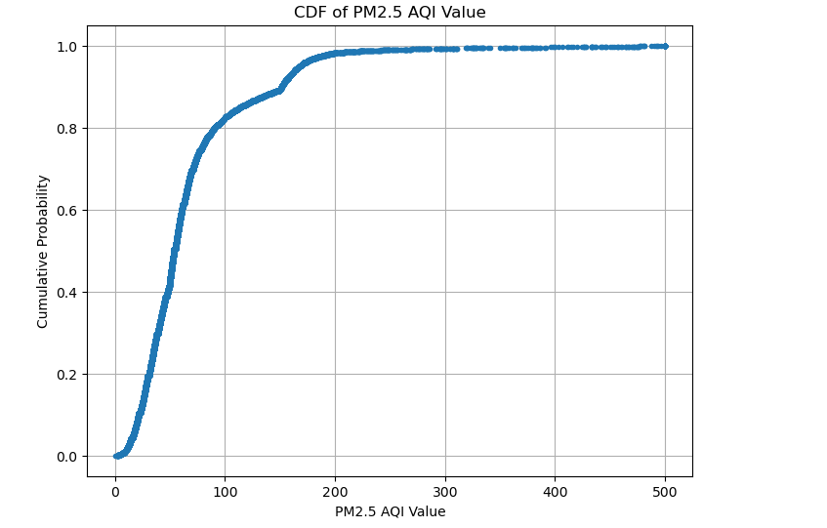
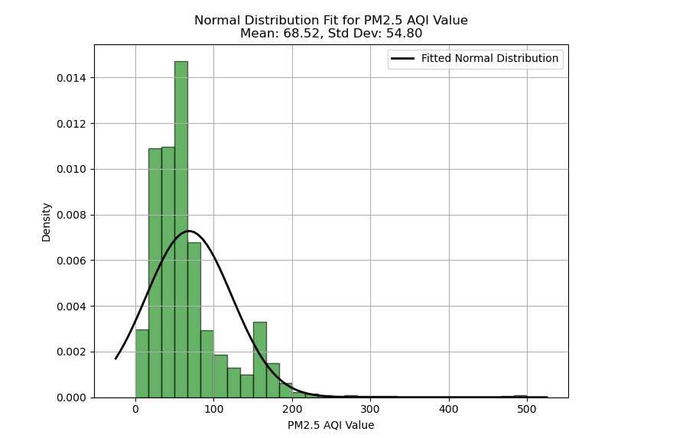

Slide 7
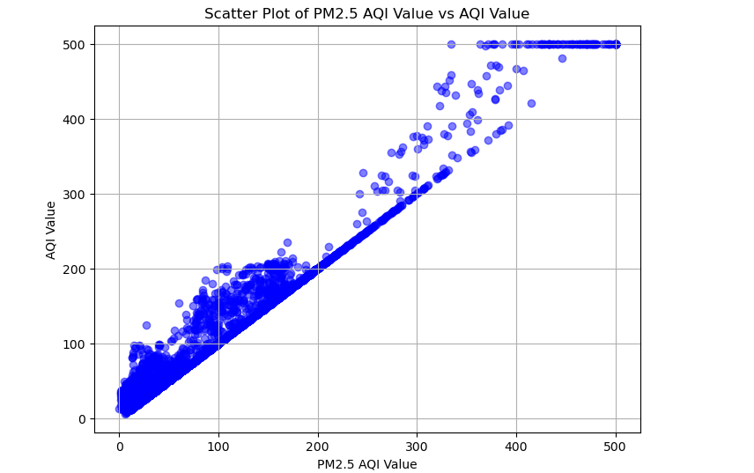
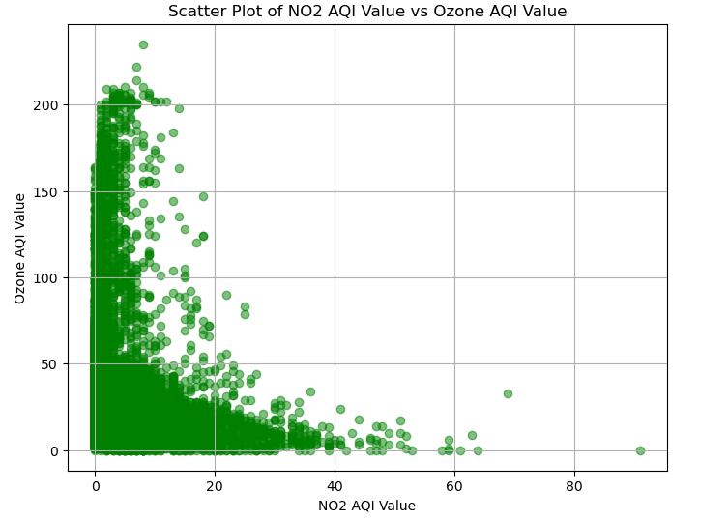


Slide 8
Statistical Significance is low

Slide 9

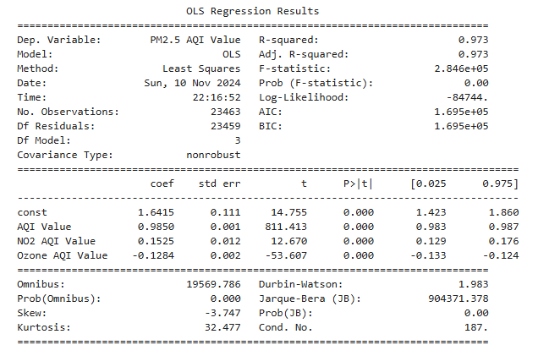

Slide 10
Summary
The analysis focused on answering the question, “are rural areas more likely to have less levels of PMI2.5 compared to urban areas? The data revealed that urban areas exhibited slightly higher levels of PMI2.5 but based on the statistics (p-value .44), this wasn’t significant. A strong correlation was observed through scatter plots of the relationship between AQI and PM2.5. This indicates that PM2.5 contributes heavily to the poor air quality. The regression analysis showed that AQI and NO2 levels significantly impacted PM2.5 concentrations, with AQI having the most substantial effect, thus supporting the hypothesis. One limitation was the absence of labels of rural or urban cities. Cities with both extremes were used as examples. Categorization of rural and urban would’ve strengthened the results of the study. An additional variable that could’ve helped strengthen the study would include population density. Slight assumptions were made to put certain cities in either rural or urban were made but with little research, I was confident with where I placed each city. The main challenge of this study was the lack of categorization of cities. Also, more variables would’ve provided more context into the amount of low air quality. Overall, statistical significance couldn’t be found data was found that supported the claim.

