Slide 1
GPS Slides
Logan

Slide 2
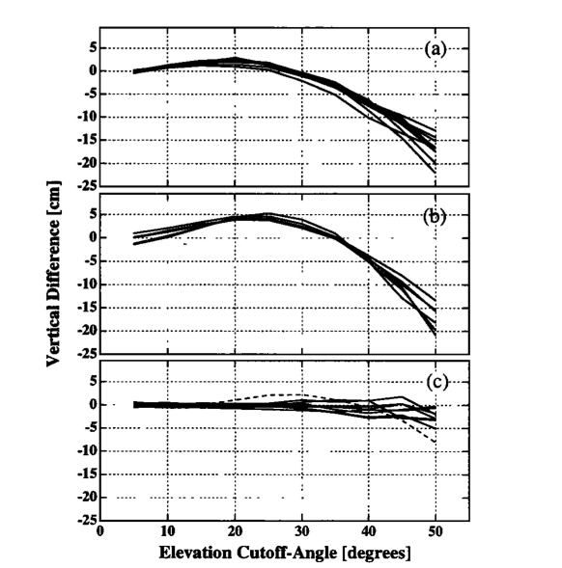
Effect of snow on position estimates
Snow causes:
Signal scattering
Excess electrical path length
Result (from Jaldeha et. all)
Vary elevation cutoff angle used for solution
A ~ snow on antenna
B ~ snow on antenna
C ~ no snow on antenna
Found this too late to process data from snow events in this manner

Slide 3
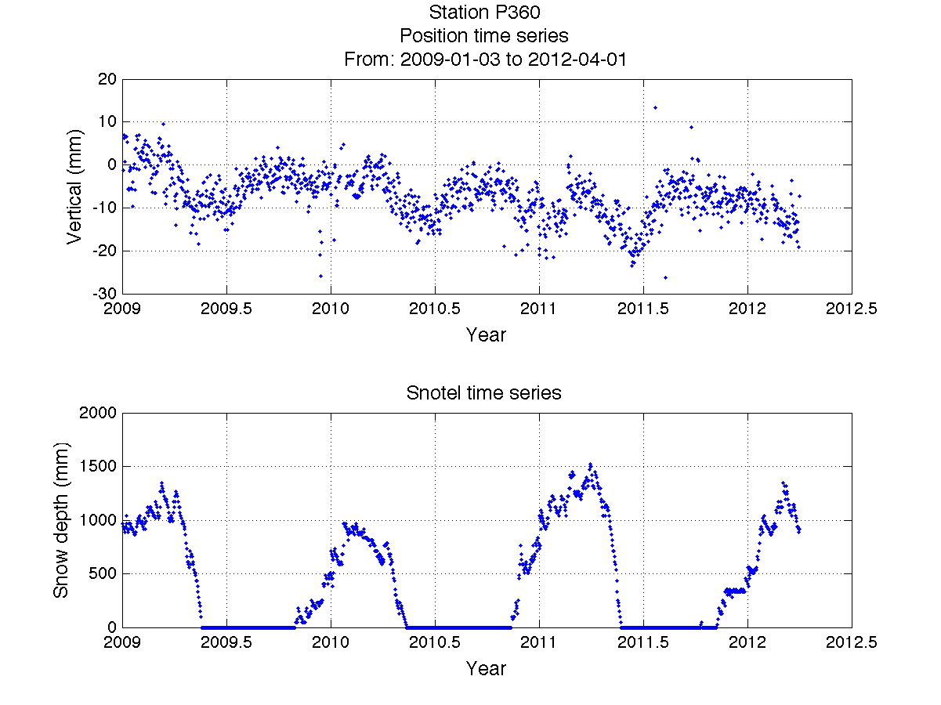
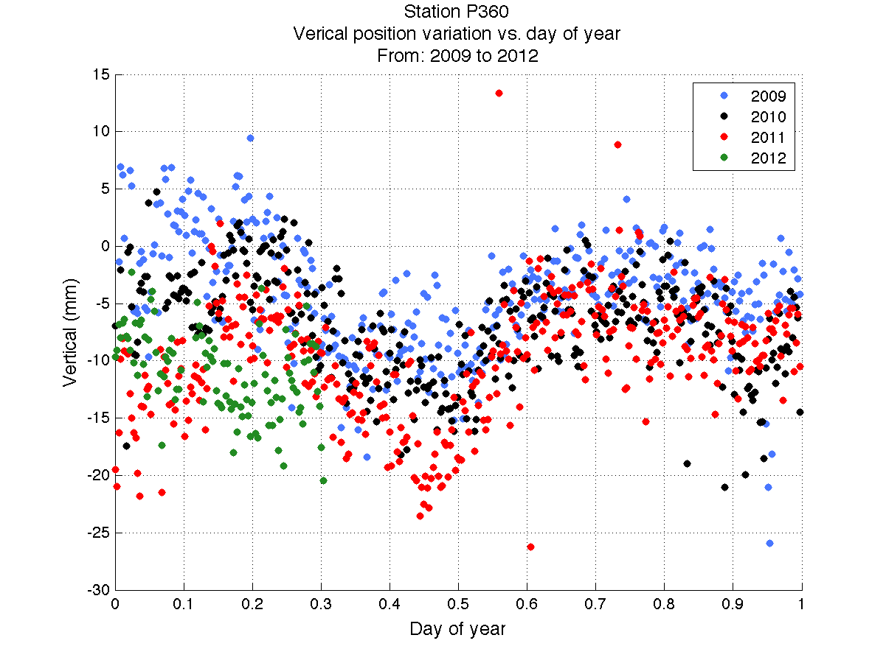
Position time series – P360
2009 – 2012

Slide 4
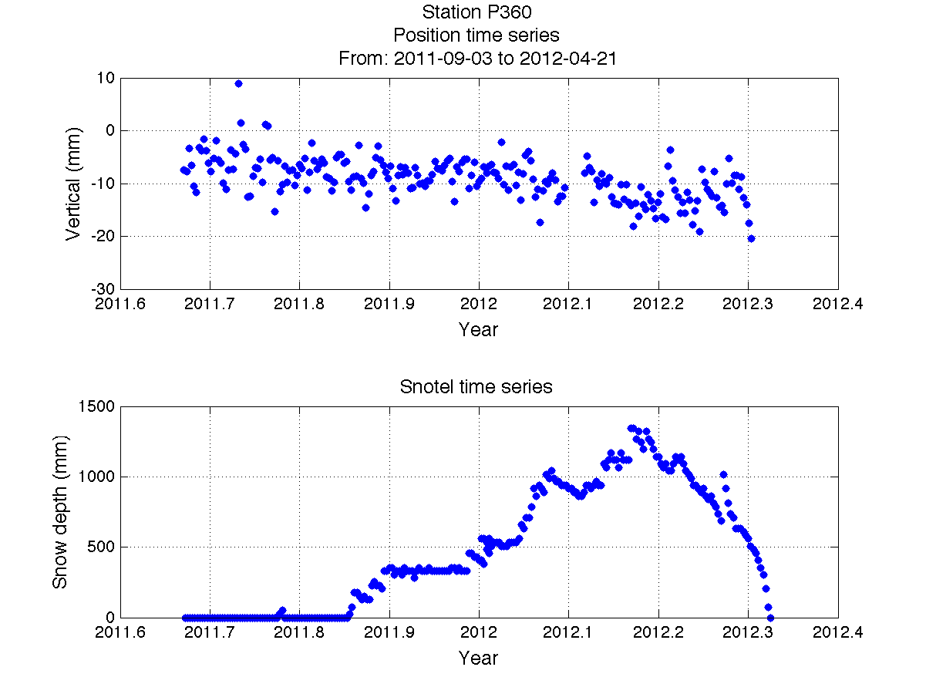
Position time series – P360
2012 snow data
Snow depth uncorrelated with vertical position time series

Slide 5
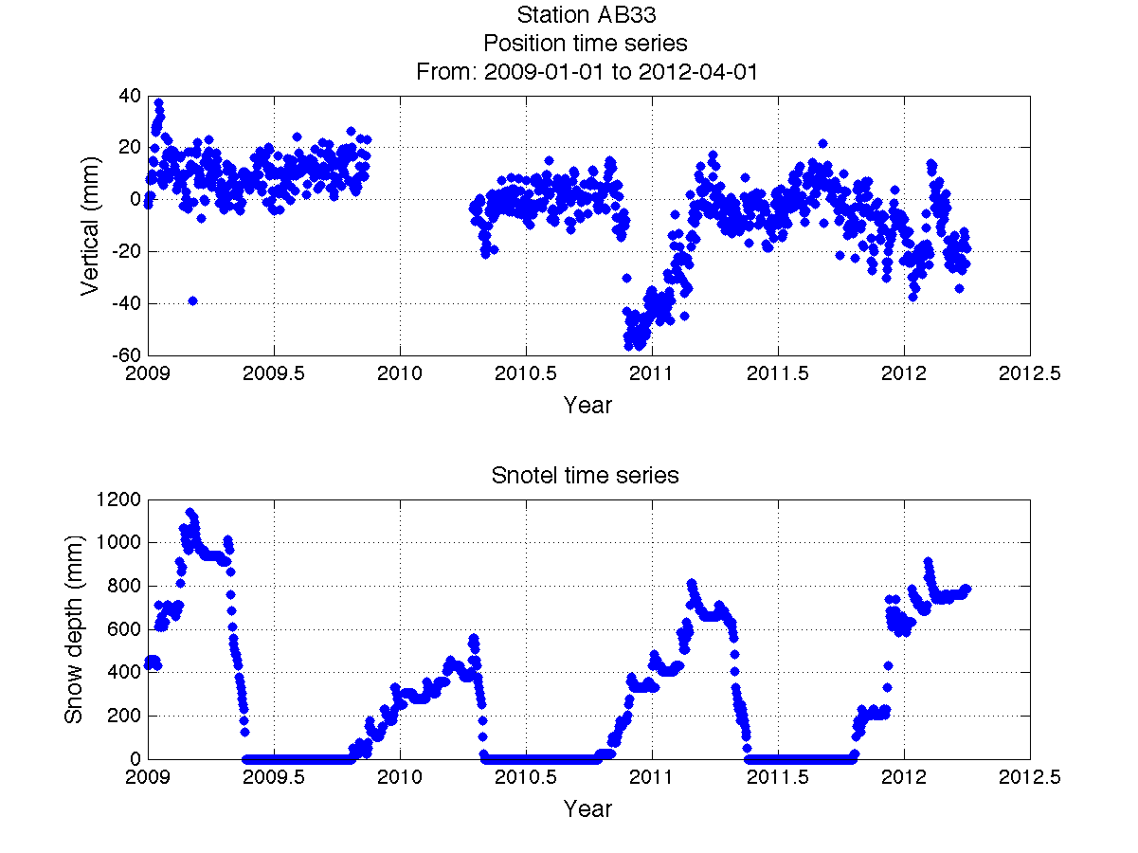
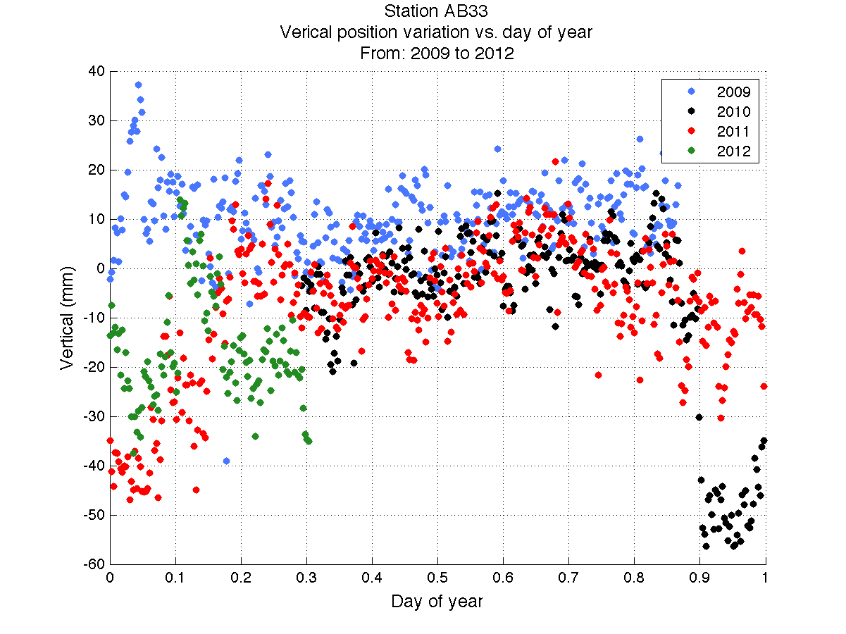
Position time series – AB33
2009 – 2012

Slide 6
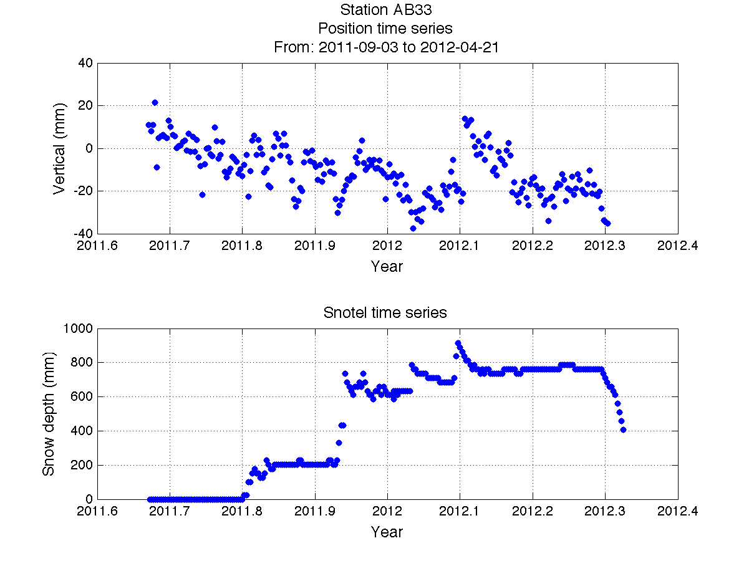
Position time series – AB33
2012 snow data
Snow depth uncorrelated with vertical position time series

Slide 7
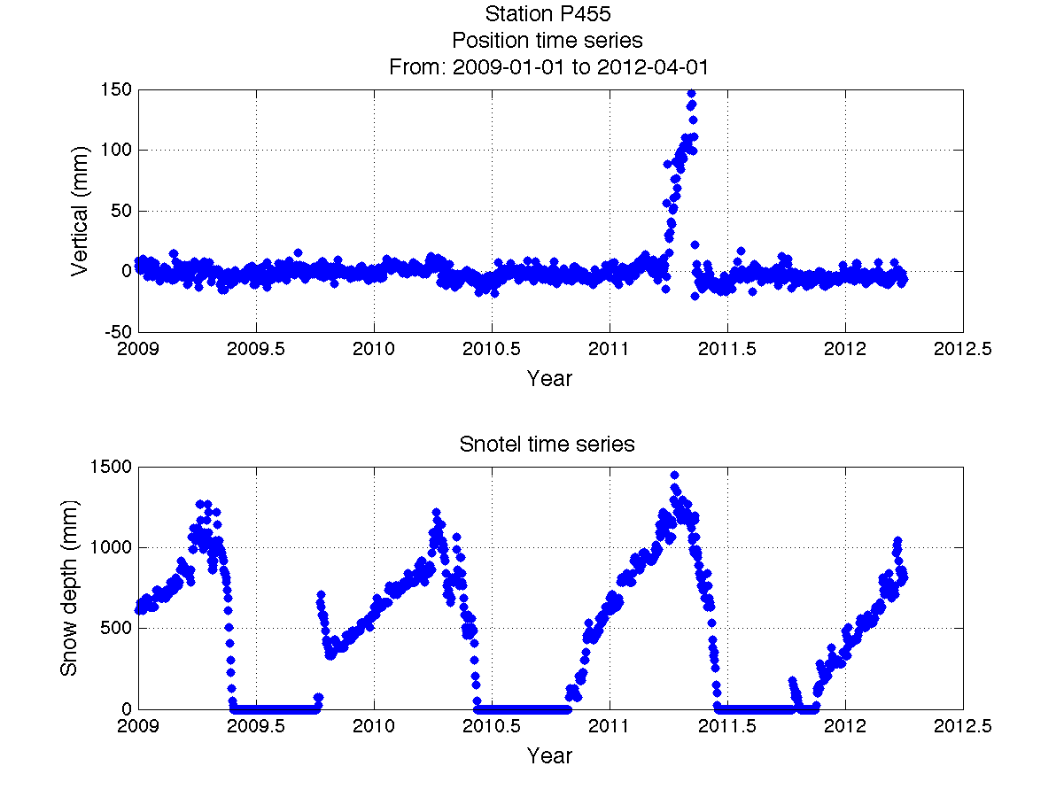
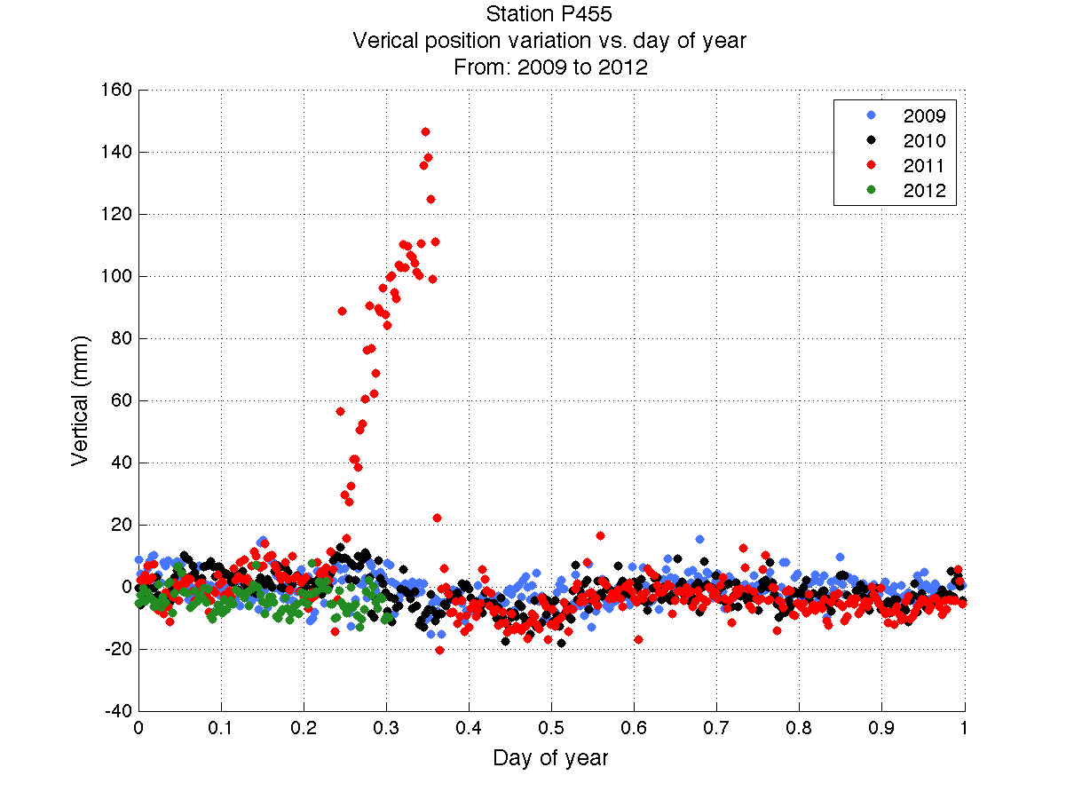
Position time series – P455
2009 – 2012

Slide 8
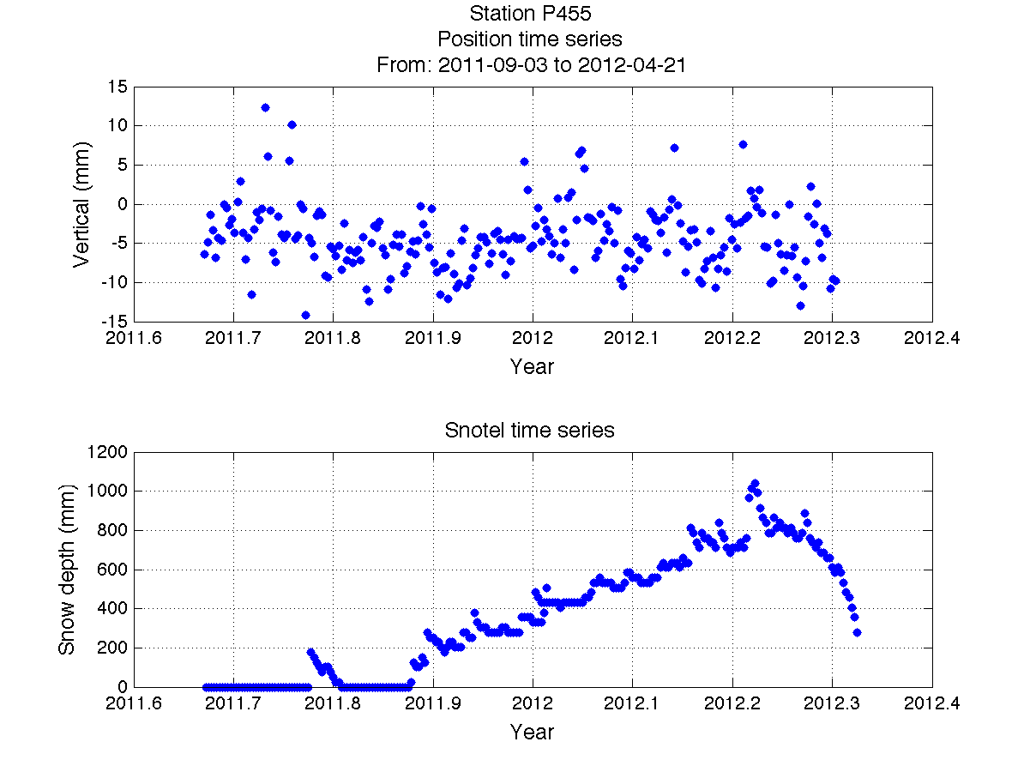
Position time series – P455
2012 snow data
Snow depth uncorrelated with vertical position time series

Slide 9
Sources
"Geodesy using the Swedish permanent GPS network: Effects of snow accumulation on estimates of site position." Geophysical Research Letters. 23. (1996): 1601-1604. Web. 4 May. 2012. <http://www.agu.org/pubs/crossref/1996/96GL00970.shtml>.

