Slide 1
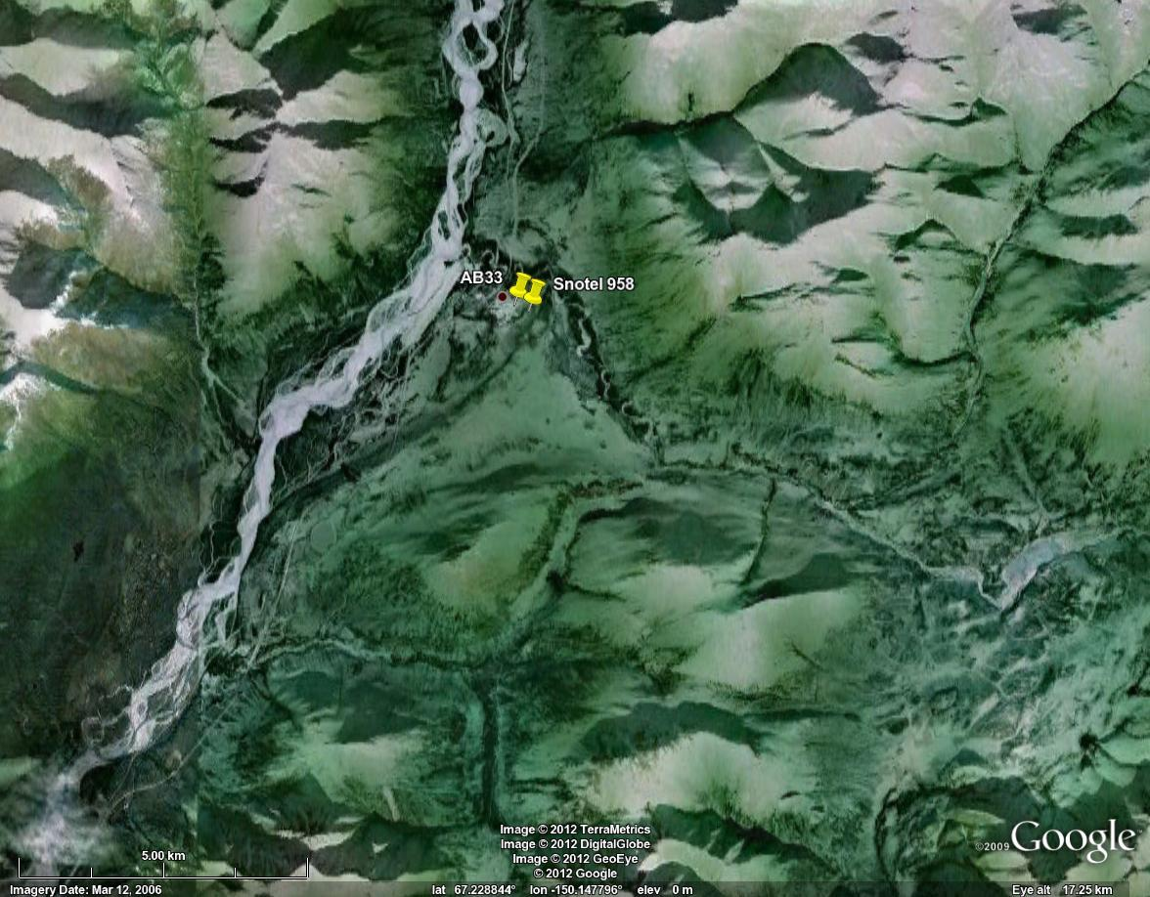
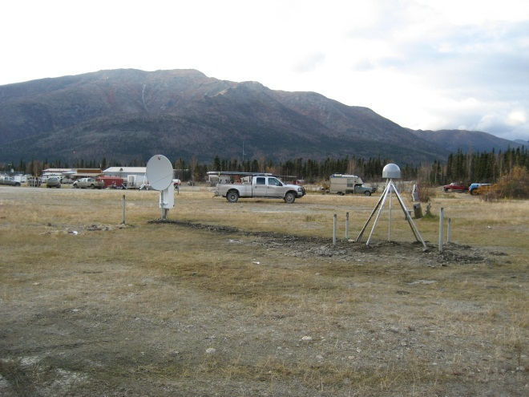
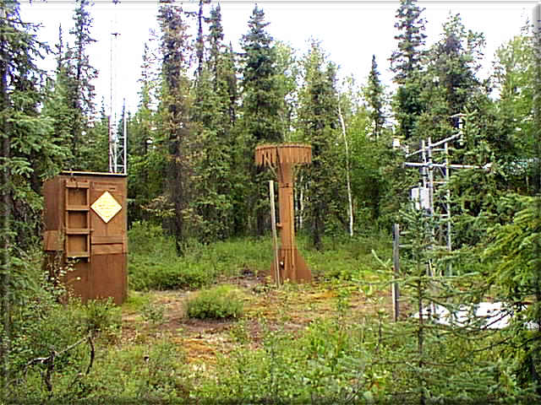
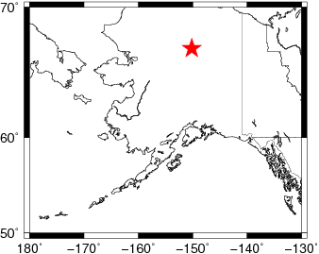
AB33 - Alaska
Coldfoot <300m

Slide 2
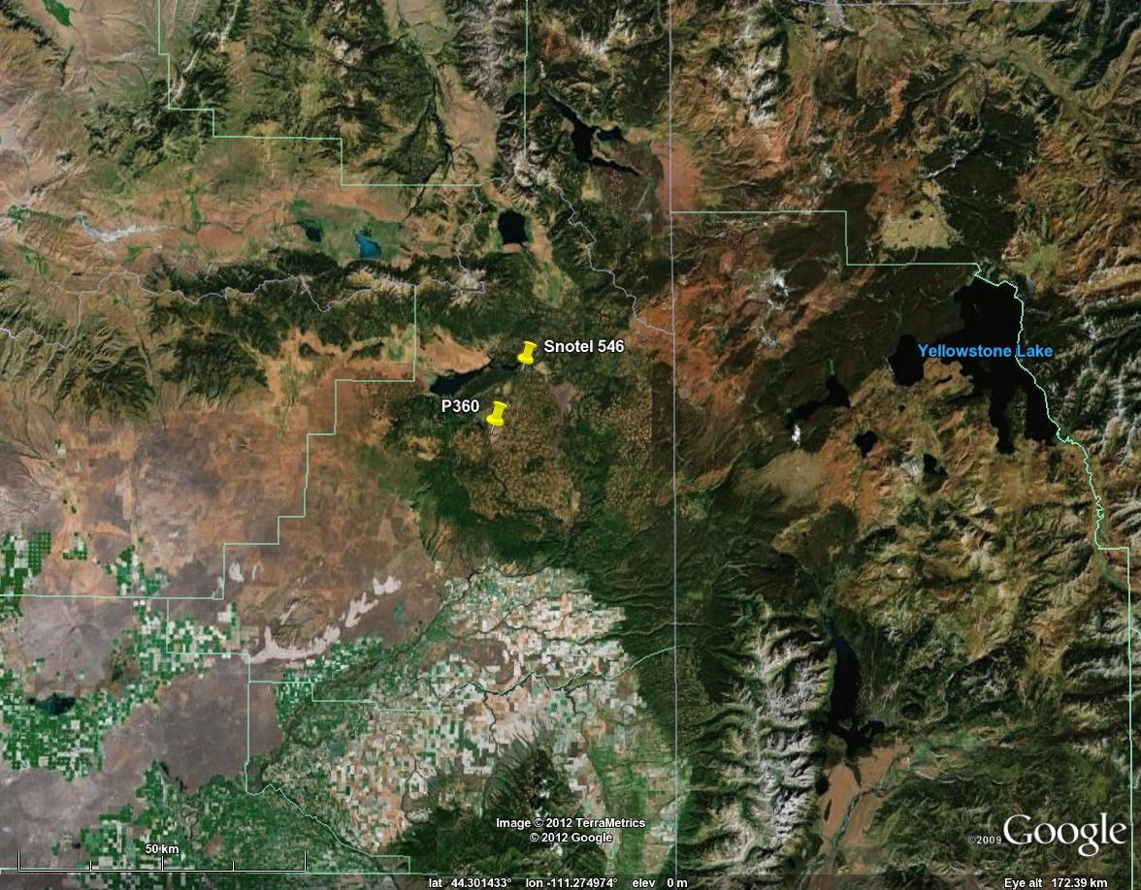
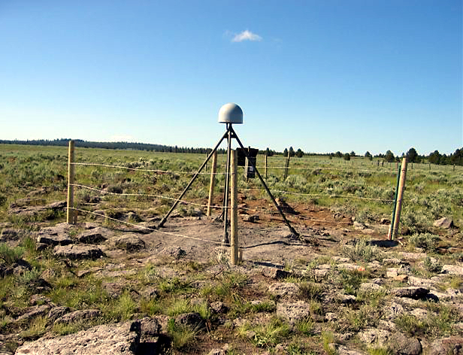
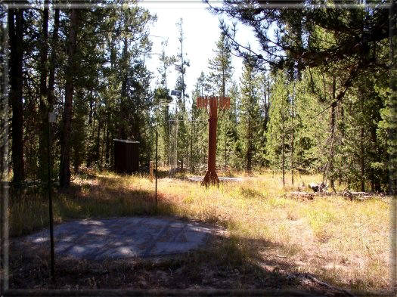
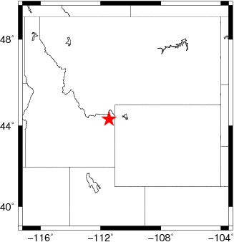
P360 - Idaho
Island Park <12.5 km

Slide 3
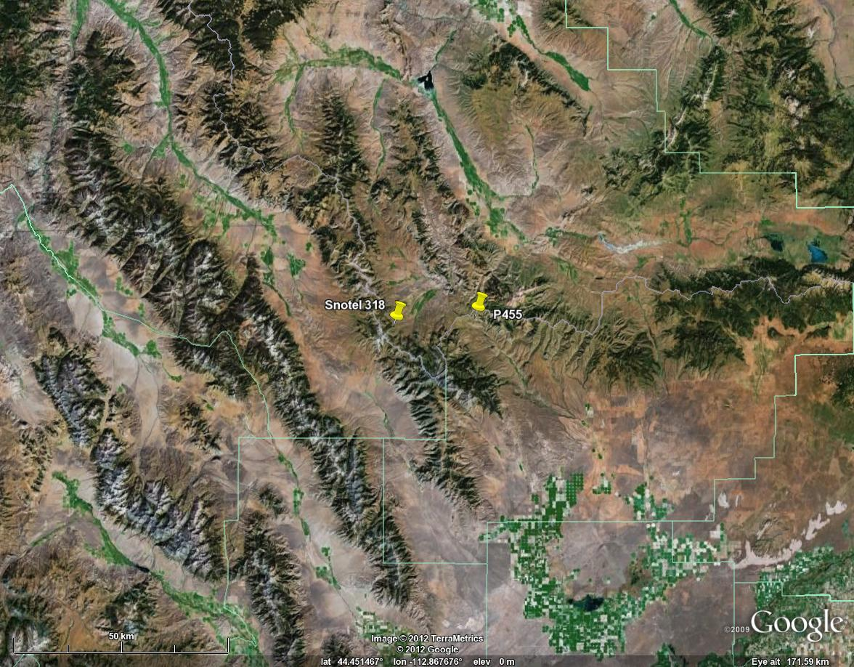
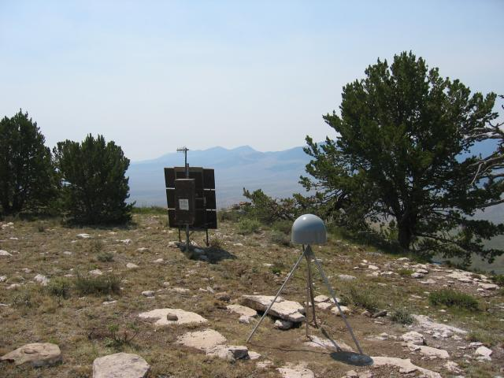
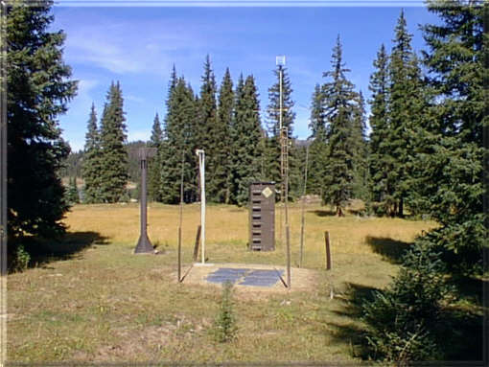
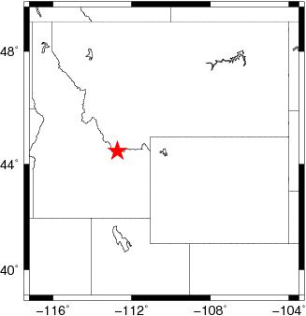
P455 - Idaho
Beagle Springs <19.2 km

Slide 4
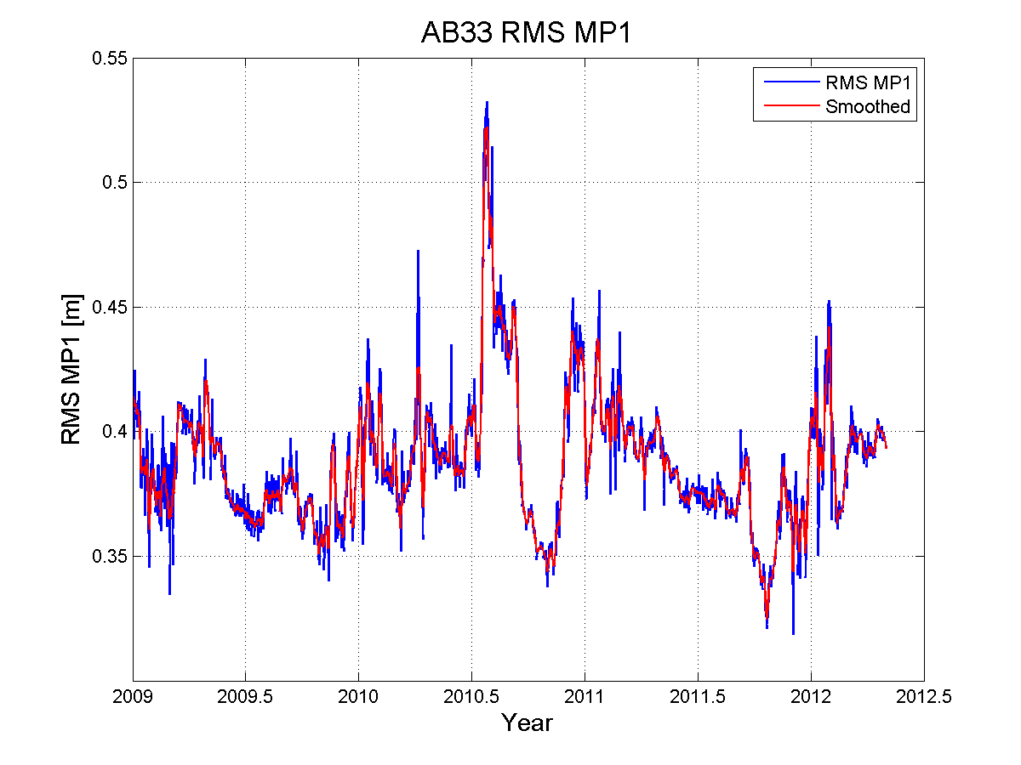
AB33 RMS MP1

Slide 5
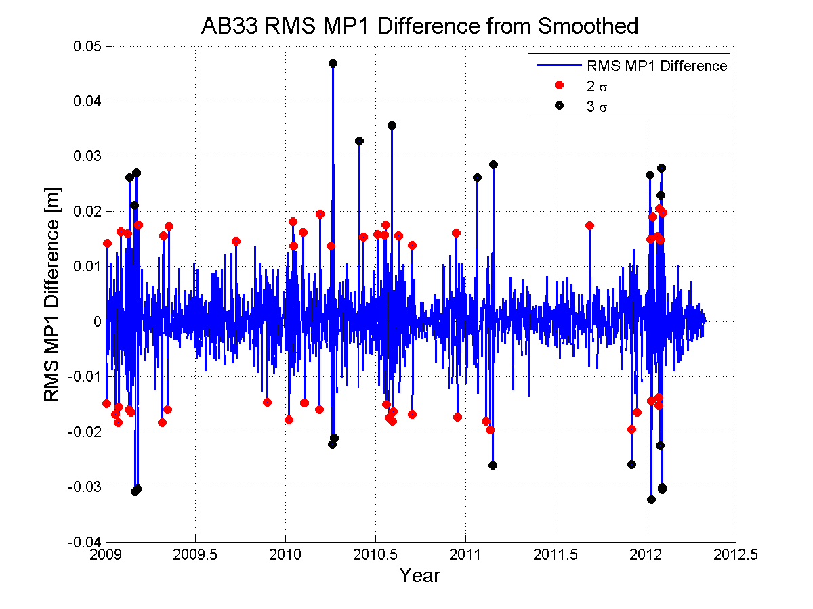
AB33 MP1 Difference

Slide 6
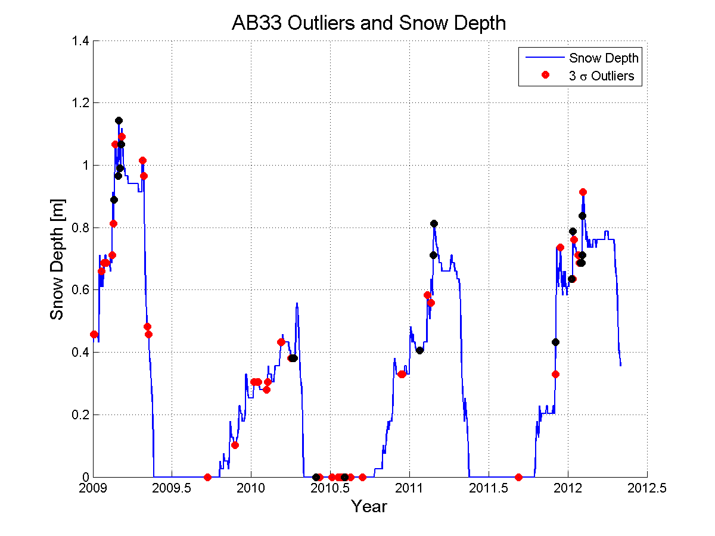
AB33 Snow Depth

Slide 7
AB33 Summary
16/21 3σ values Correspond to falling or recently fallen snow
13 within 1 day of a major snowfall
5 During the Summer
2σ has many more correlations
Not all snowfalls recorded however

Slide 8
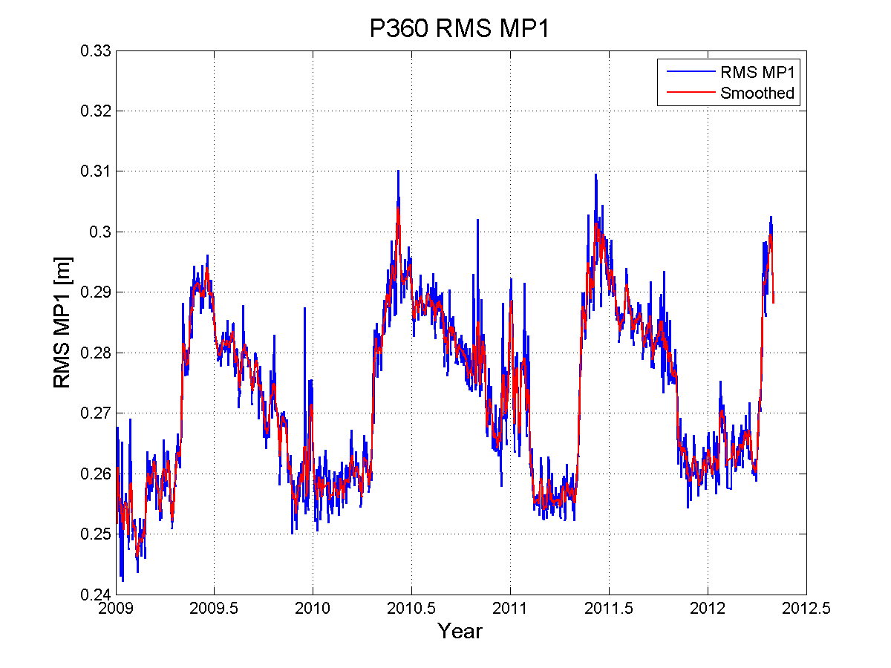
P360 RMS MP1

Slide 9
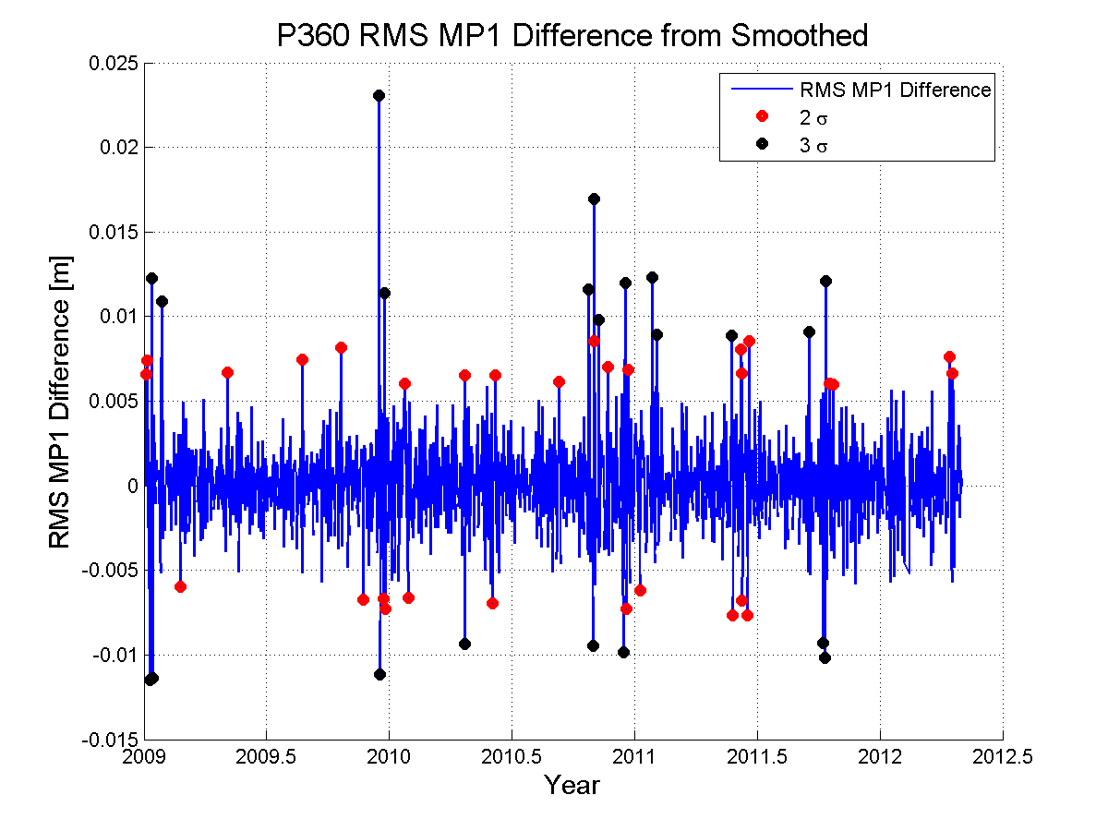
P360 MP1 Difference

Slide 10
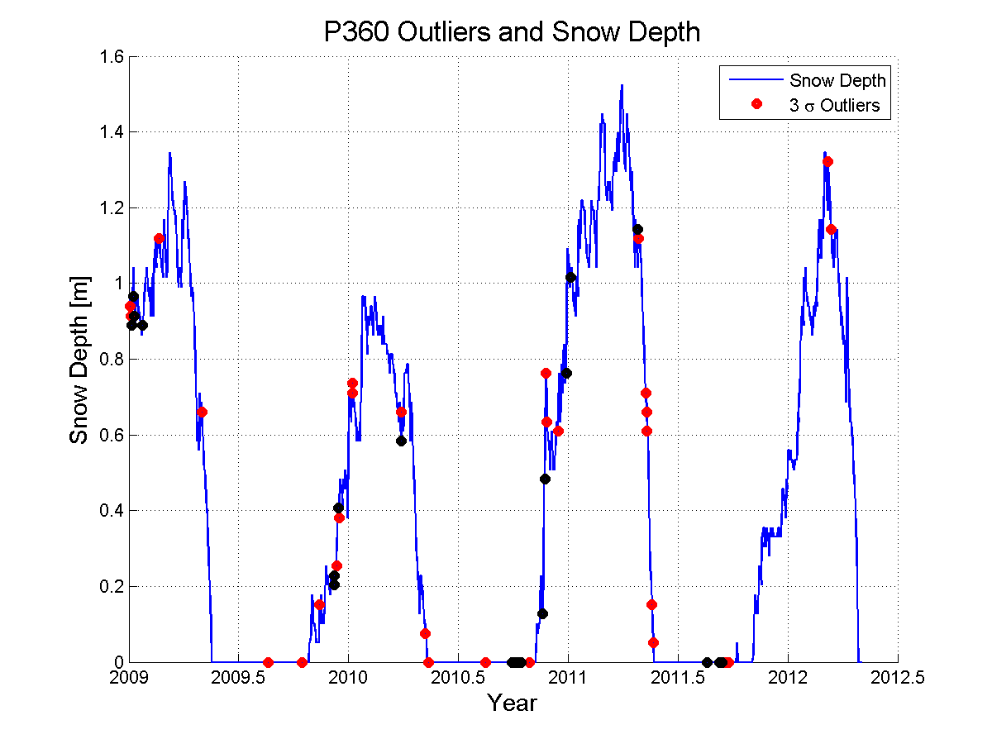
P360 Snow Depth

Slide 11
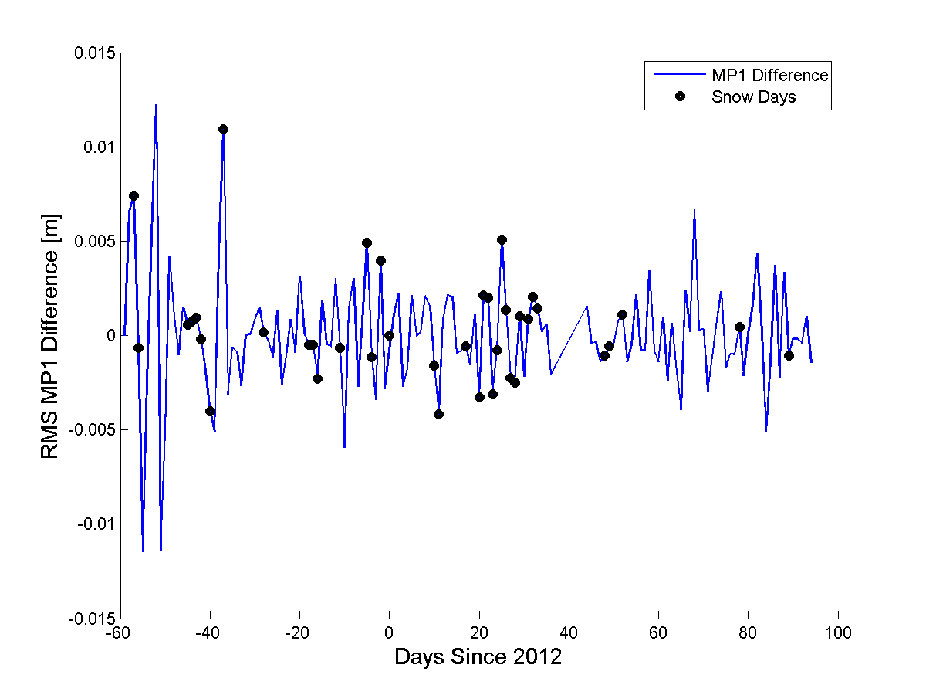
P360 Truth Measure

Slide 12
P360 Summary
Less matching than AB33 showed
Does not always show days with snow on antenna
Better outlier finding could help

Slide 13
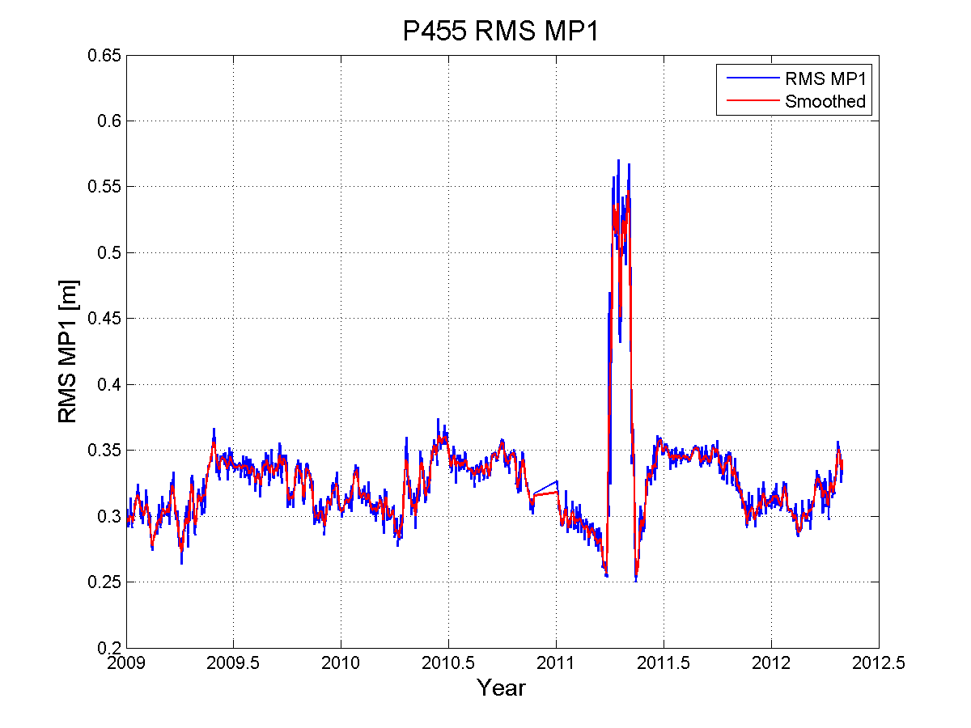
P455 RMS MP1

Slide 14
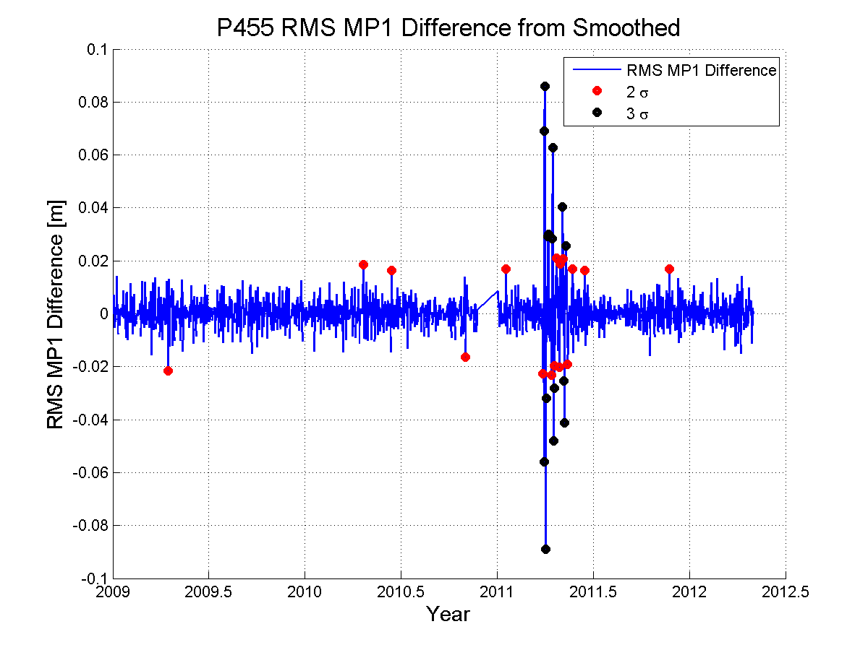
P455 MP1 Difference

Slide 15
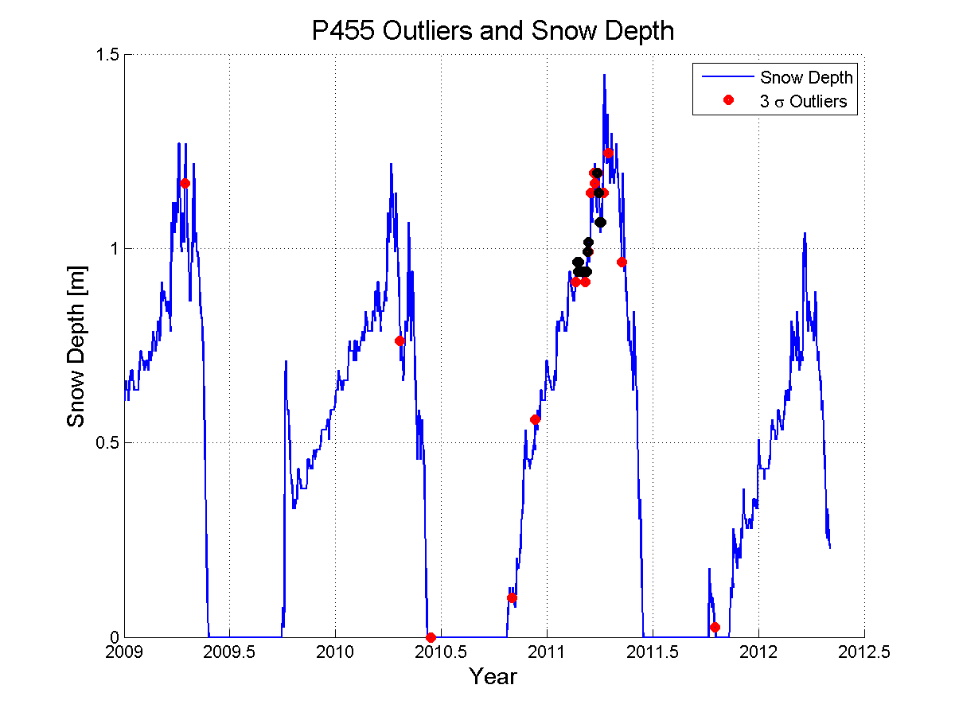
P455 Snow Depth

Slide 16
RMS MP1 Difference Summary
Could be used to remove some “very bad” data sets
Seems to be more coincidental than anything
Not reliable to detect all days with snow on the antenna however.

