Slide 1
Modeling Snow on the Antenna
Logan Finch
Praveen Vikram
Kyle Wolma

Slide 2
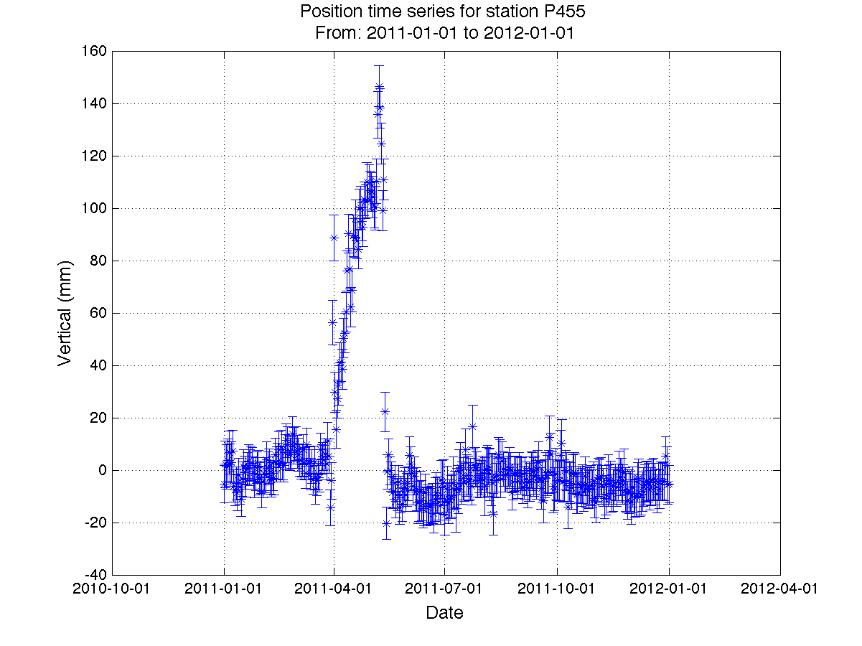
P455 2011 Position Time Series

Slide 3
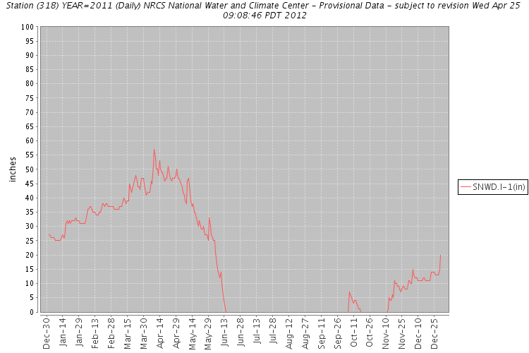
P455 2011 SNOTEL

Slide 4
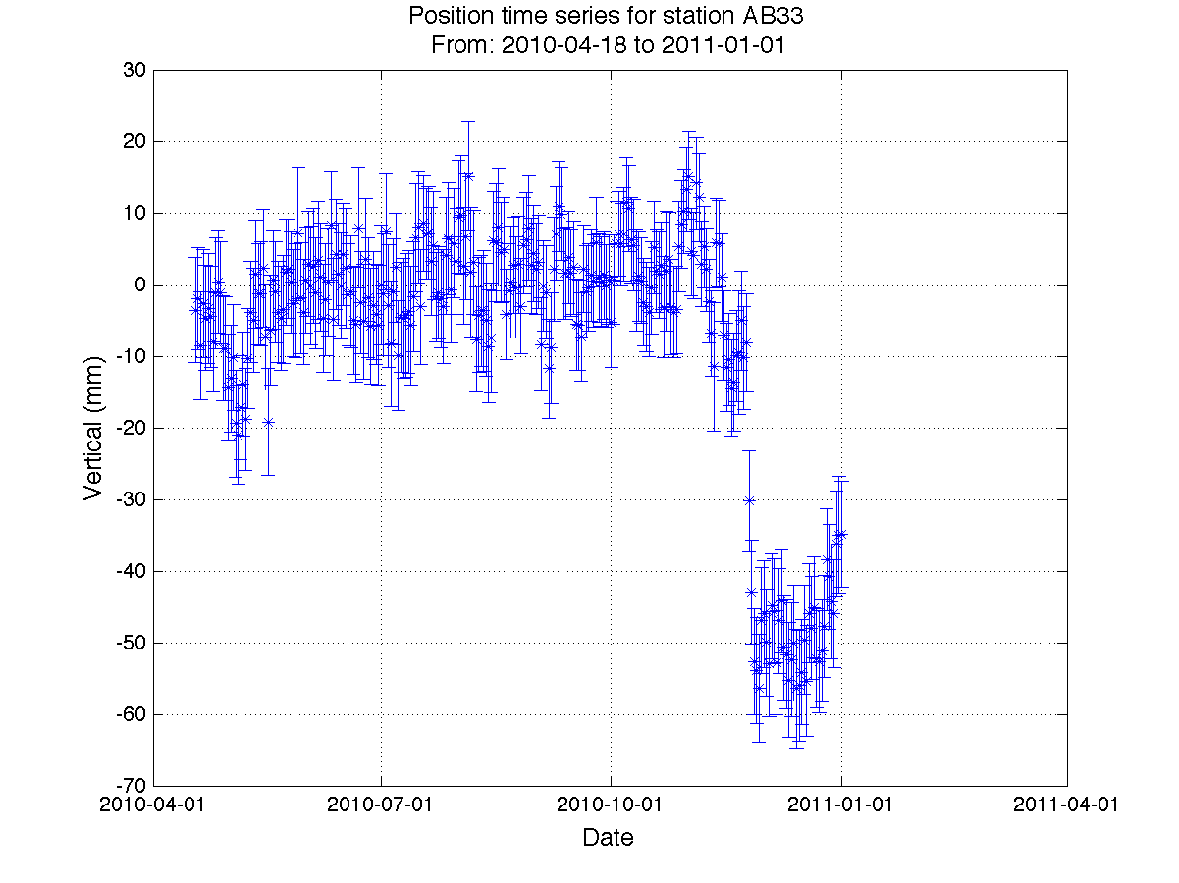
AB33 2011 Position Time Series

Slide 5
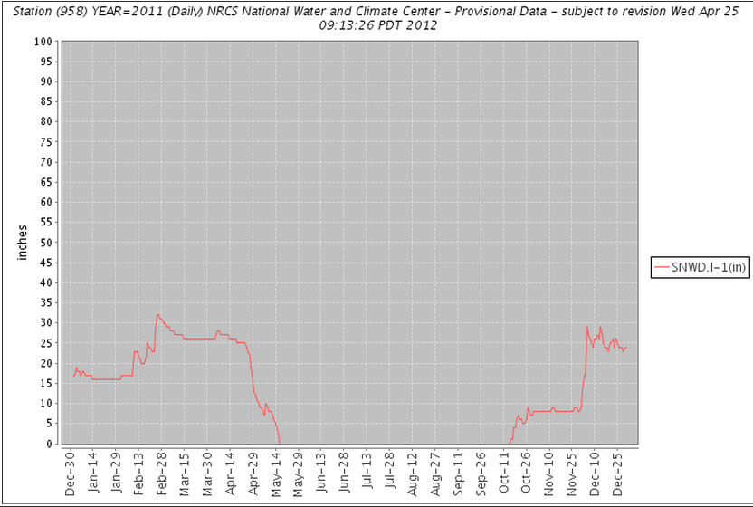
AB33 2011 SNOTEL

Slide 6
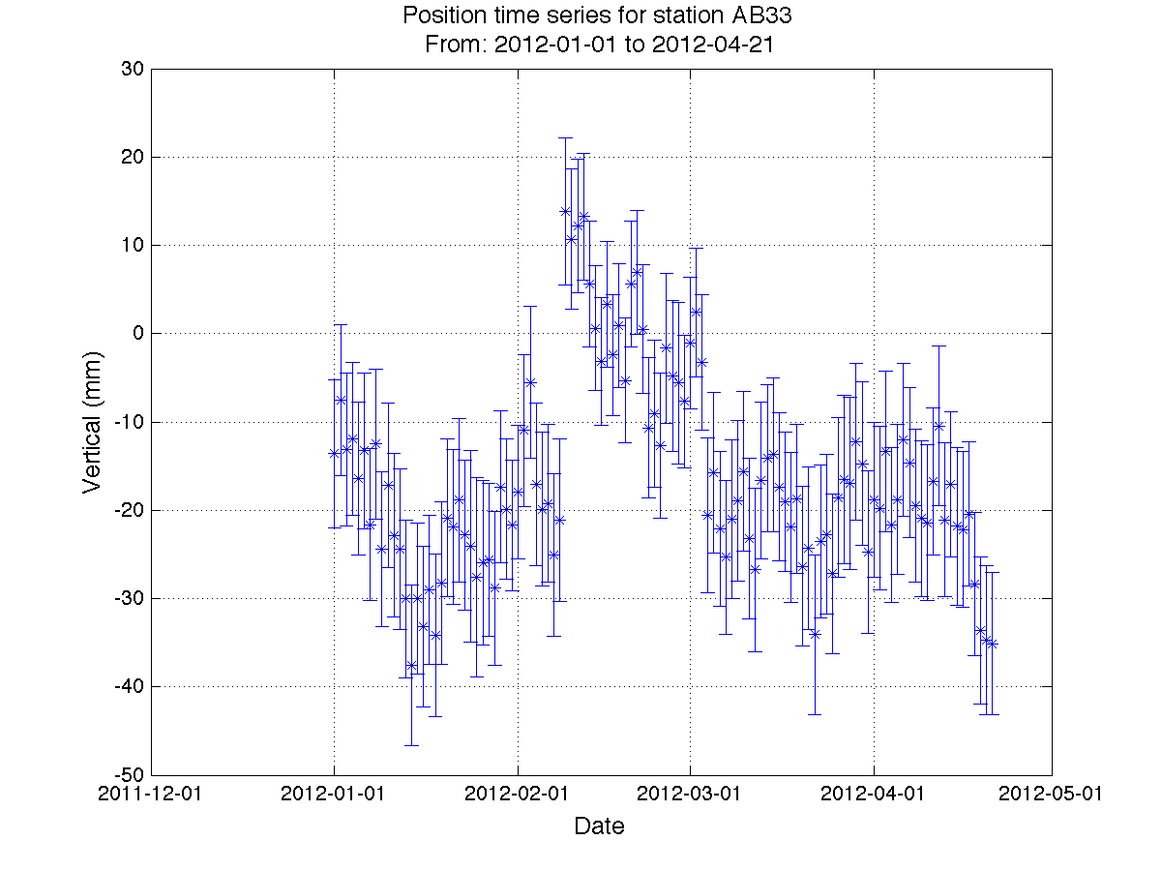
AB33 2012 Position Time Series
DOY 12
DOY 33-34

Slide 7
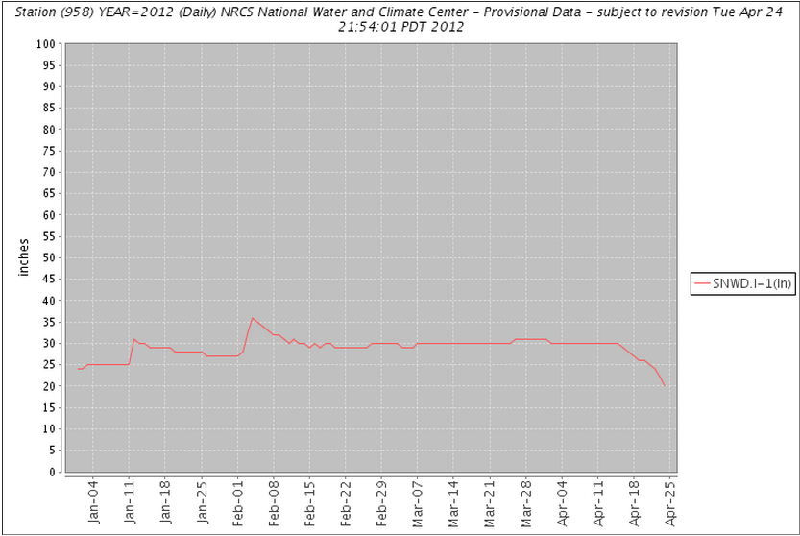
AB33 2012 SNOTEL
DOY 12
DOY 34-35

Slide 8
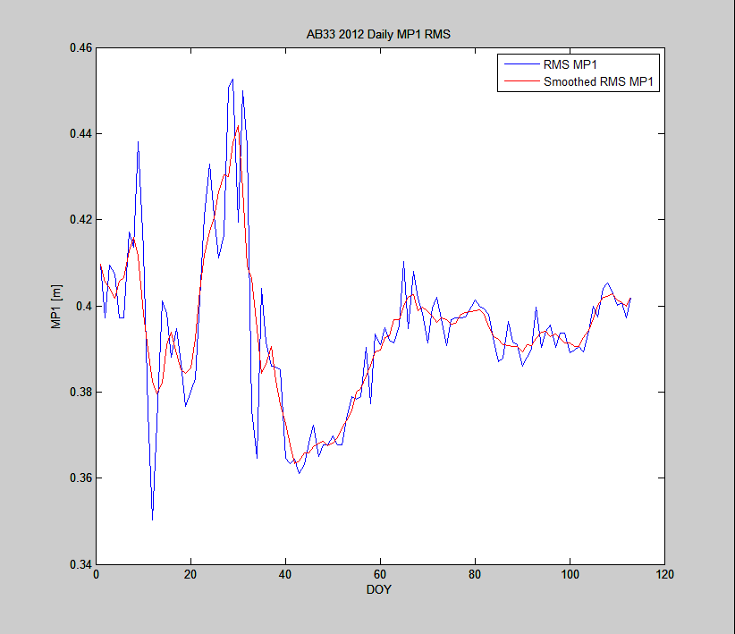
AB33 RMS MP1

Slide 9
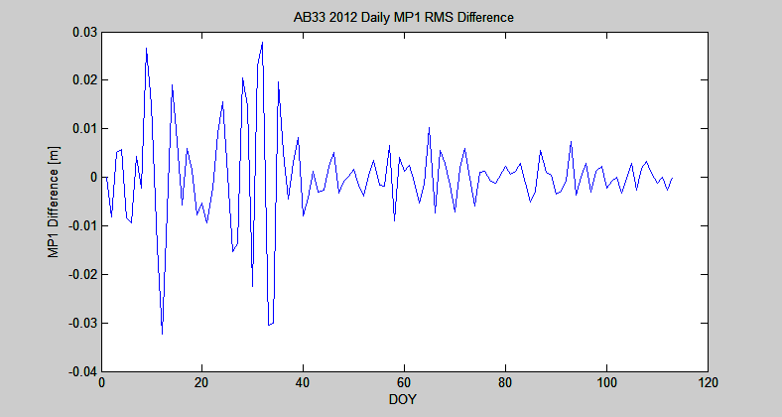
AB33 RMS MP1 Difference
DOY 12
DOY 33-34

Slide 10
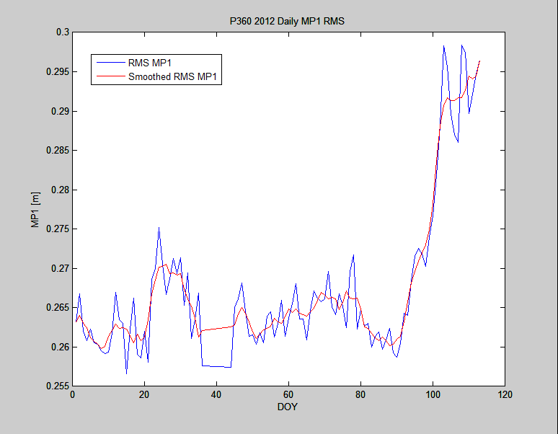
P360 RMS MP1

Slide 11
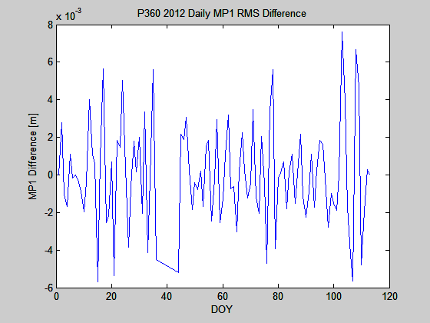
P360 RMS MP1 Difference

Slide 12
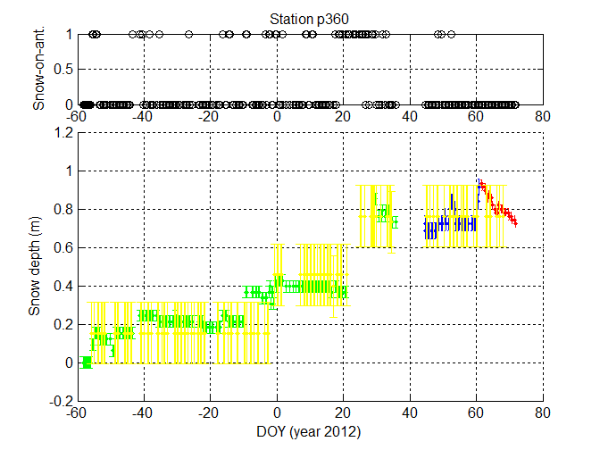
P360 Snow Truth

Slide 13
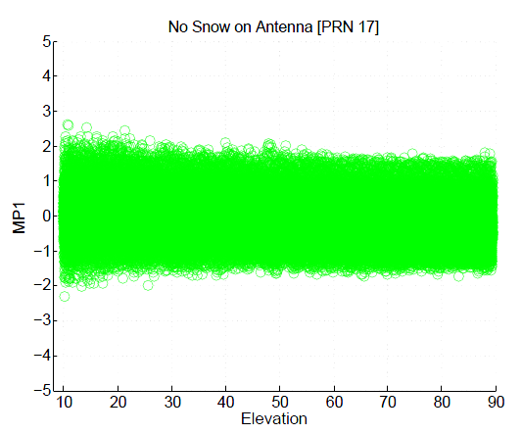
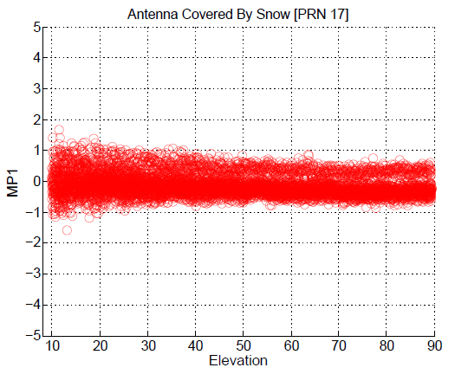
P360 MP1 PRN 17
Data from Feb through Mar 2012

Slide 14
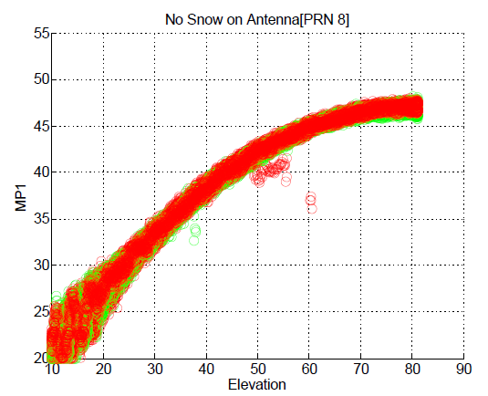
P360 SNR PRN 8
Data from Feb through Mar 2012

Slide 15
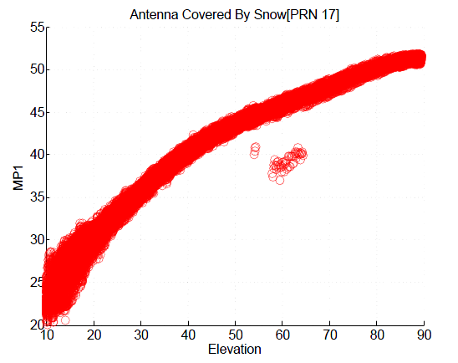
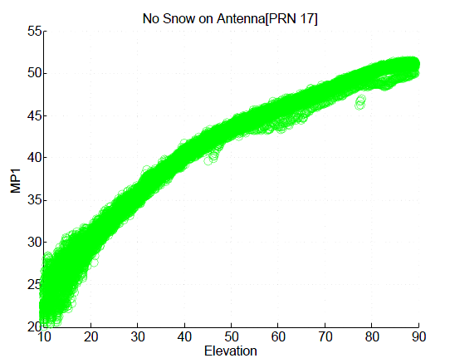
P360 SRN PRN 8
Data from Feb through Mar 2012

