Slide 1

Batch 1905-aug05 Dr. Vinay Ingalahalli

Slide 2

Application Purpose
The RevDoc app is to give Revature Associates a way to search for nearby doctors once they’ve reached deployment stage. The RevDoc app will also allow doctors to register themselves to the application so Revature associates can find them.
Notes:
Mention the fact that the project is a continuation of the BA batch work.

Slide 3
Team Structure
Four teams
Two of three and two of four
Scrum Masters
Jessica Archerd
Aaron Gauntt
Thanh Huynh
Brittany Vipperman
Samuel Ybarra (Scrum Lead)
Project Managers
Quintin Donnelly
Vinay Ingalahalli
Notes:
Jessica describe the three works worth of work we’ve done and how we split up the teams.
Brittany describe the Agile process and how we used it for our standups.

Slide 4







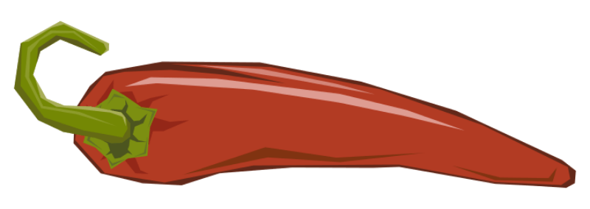
Technologies & Tools
Java
Spring Tools Suite
Spring Framework
Spring Boot
JPA Repository
Lombok
Maven
Hibernate
+
+
Notes:
Quinn will talk about how we used STS to write our Java code and briefly go over how Java is used in Enterprise applications
Ethan will speak about how Spring boot helped us write the application much faster than and by adding Lombok made it even faster. (Lombok lets us use annotations instead of writing out constructors, setter, getters, and overriding the toString method)
Sam A will talk about how the testing technology functions then speak about the test results on his test (we might add another side to show off the results of all the tests)
Aaron (User UI) Can’t think of anything specific. Hope you remember what Vinay said :P

Slide 5







Technologies & Tools
Visual Studio Code
Angular
Jasmine
Karma
Postman
Junit
GitHub

Slide 6
Burndown chart
Notes:
Josue, Kumar. I will sit with you both to talk about how the burndown chart works.

Slide 7
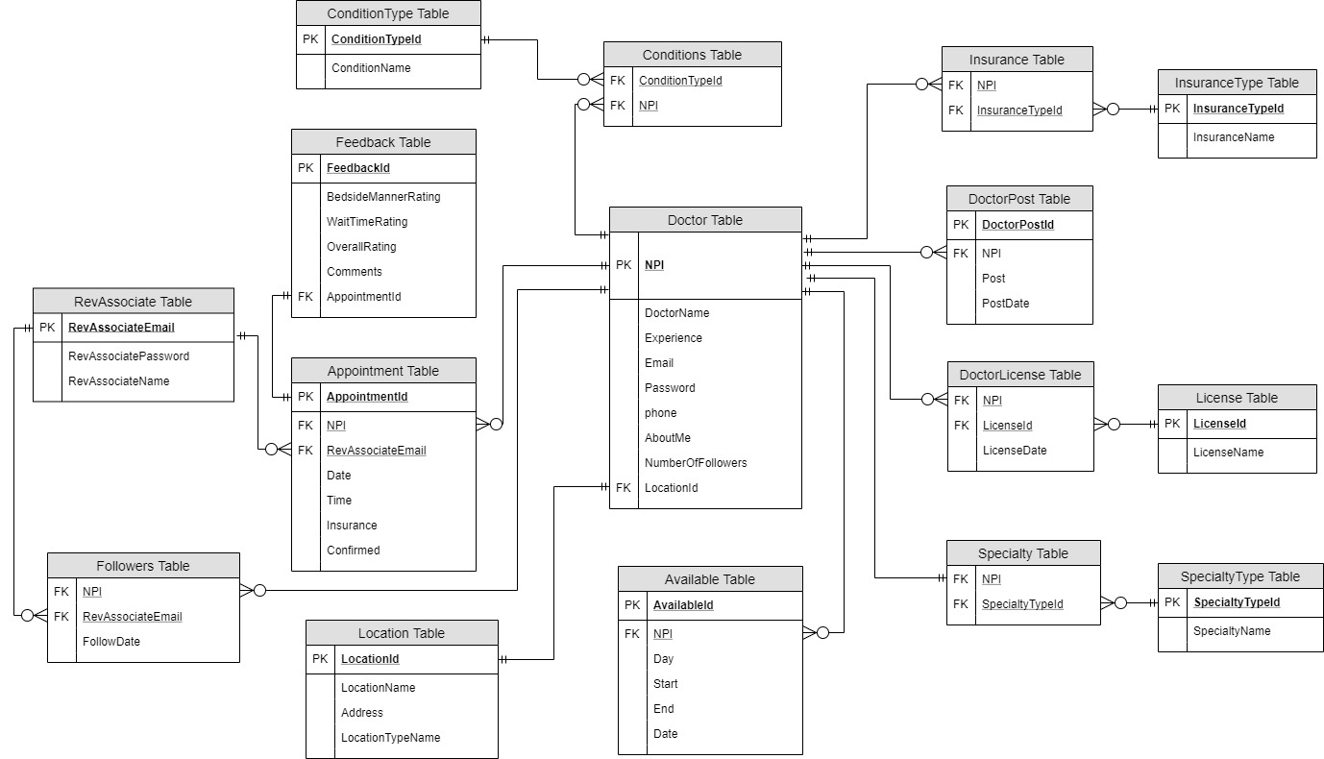
Entity Relational Diagram
Notes:
Robert, Thanh speak about the POJO classes, the Angular classes, and how they are tied to the ORM.

Slide 8
Team Thanh
As a Revature Associate I want to search for a doctor by specialty, condition, or insurance provider so that I can find a doctor quickly.
As a Revature Associate, I want to be able to find an experienced doctor in the location I am moving to, So that I can receive the best possible care for my heart condition.
As a Revature Associate I want to be able to sort by Experience so that I can see the best doctors first.
As a Revature associate I want to make an appointment with a doctor online so that I don't have to call in or go into an office to make an appointment.
Demo
Obstacles and problems

Slide 9
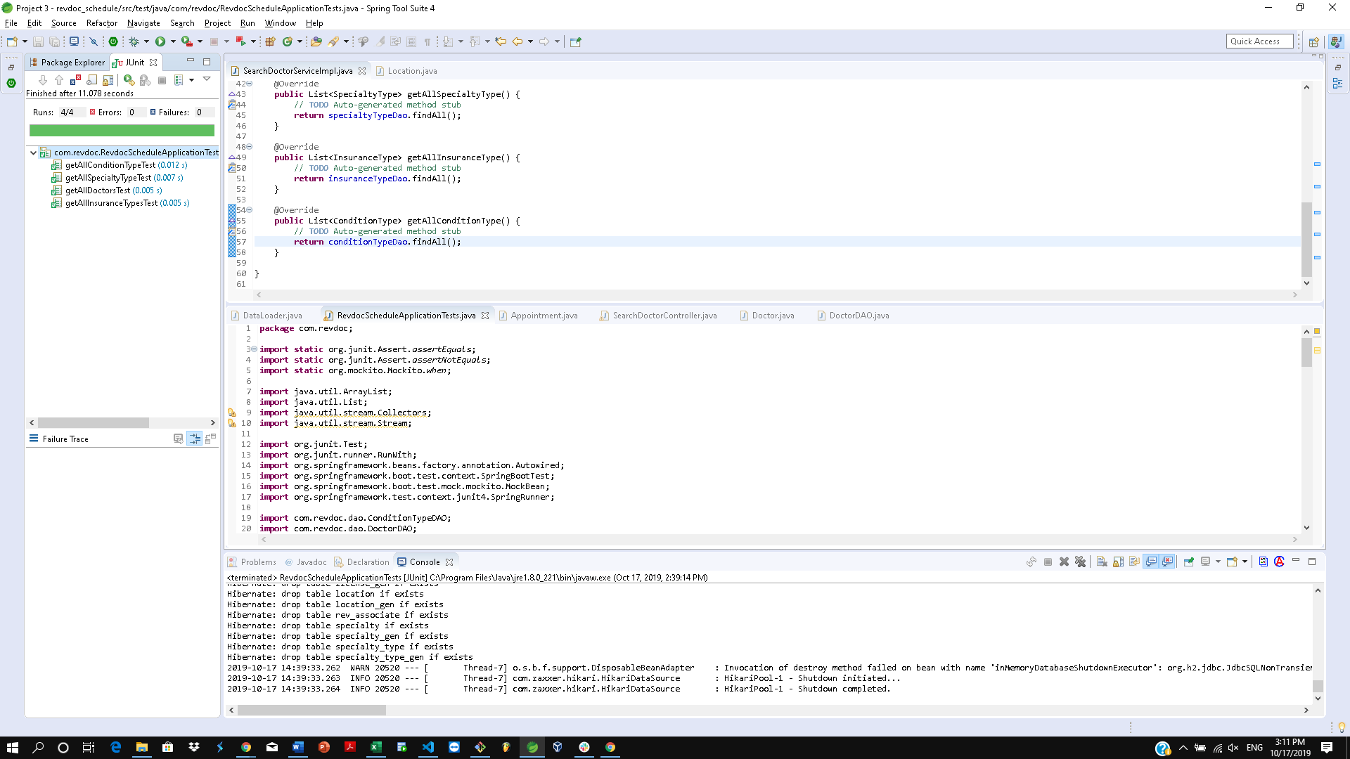
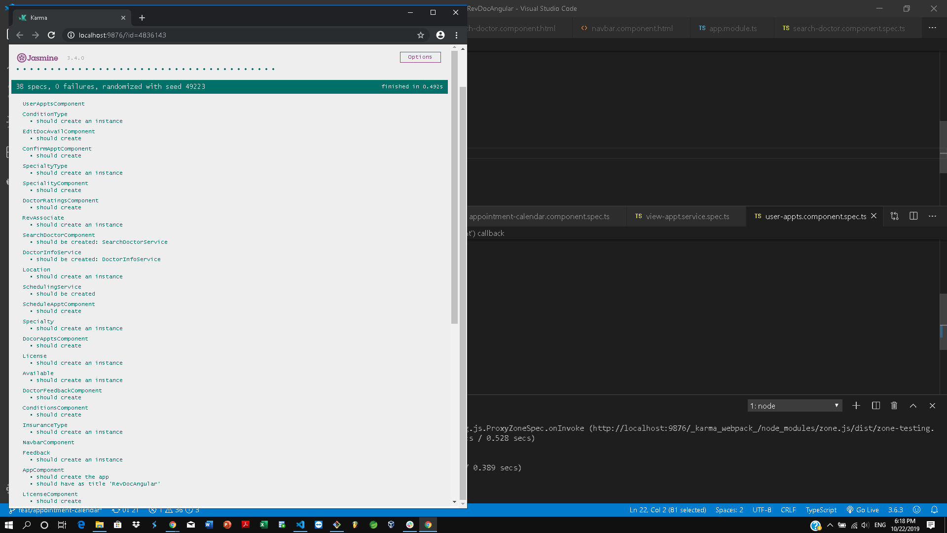
Testing Results

Slide 10
Team Aaron
As a doctor I want to view the associates who have appointments with me so that I know who will come in to see me and at what time.
As a Revature Associate, I want a profile page, so that I can see my activity on the site.
Need a Login in Page to simulate log in
Need a Revature Associate home page to have framework for profile page in next sprints
Demo
Obstacles and problems

Slide 11
Team Jessica
As a Revature Associate I want to follow a doctor so that I can be connected to that doctor.
As a Revature associate, I want to be able to comment on doctors, so that others will know my experience with that doctor.
As a Revature associate I want to rate a doctor on Wait Time, Bedside Manner, and Overall Rating so others will know how good this doctor was in those areas.
As a Revature associate, I want to see which licenses a doctor has, so that I will know if a doctor is legit.
Need a Doctor home page to have a framework for profile page in next sprints
Demo
Obstacles and problems

Slide 12
Team Brittany
As a doctor, I want to edit my availability schedule, so that I can cross out times that I will not be able for.
As a doctor I want to update my ‘About Me’ section so that customers have a summary about myself
Demo
Obstacles and problems

Slide 13
Future Enhancements
Monolith architecture to Micro Services
Revature Associate receiving email and text for appointment confirmation and rating the appointment
Hosting to Cloud service
Adding mobile compatibility to the application
Expanding Time zone capability to cover the time zones across the US.
Adding a registration page for doctors to join the app
Adding editing doctor page optional fields
Adding Admin user to monitor and track user usage of the application
Notes:
Courtney, Yen, Khalid will speak about their respective group's enhancements to the project. No one from Thanh’s group. Holograms are our limit. :P

Slide 14
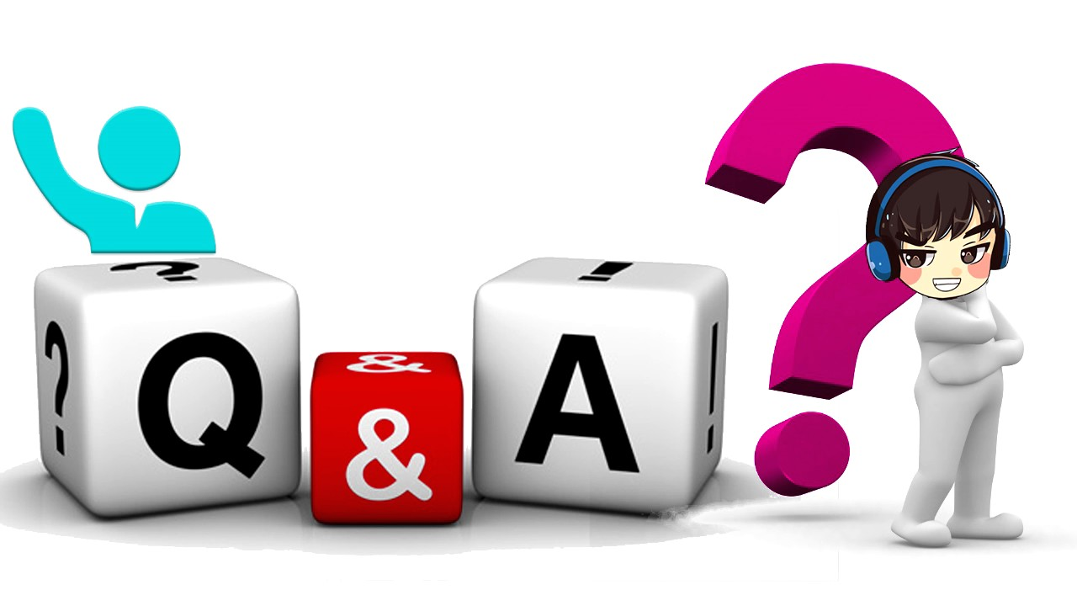
Special Thanks
UTA Revature Staff
Questions time
Notes:
Brief recap on the project. Open to questions.

