Slide 1
Decentralized News Platform
報告人：黃畊彰
學號： R07921079

Slide 2
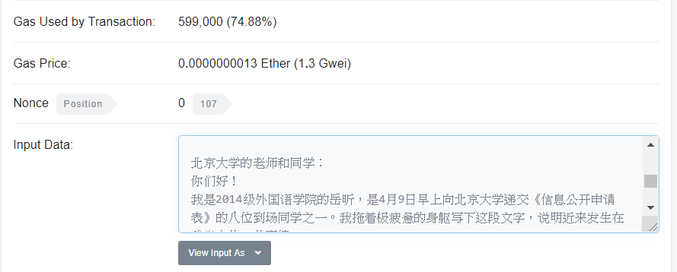
Motivation
#MeToo activists use blockchain to skirt China censors [1]
[2]

Slide 3
Solution
transaction
title
article
List<tx_hash>
Poster
Contract

Slide 4
Solution
Reader
txhashes
Contract
txhashes
article
Full Node

Slide 5
Solution
Put news at the data field of the transaction.
Title of news and the transaction number inside a contract.
User can download a reader to read news on blockchain.

Slide 6
Reference
[1]
https://news.abs-cbn.com/overseas/04/27/18/metoo-activists-use-blockchain-to-skirt-china-censors
[2] https://etherscan.io/tx/0x2d6a7b0f6adeff38423d4c62cd8b6ccb708ddad85da5d3d06756ad4d8a04a6a2

Slide 7
Thank You

Slide 8
DNS Service via blockchain
報告人：黃畊彰

Slide 9
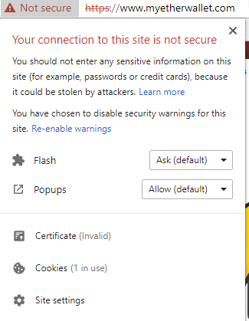
Motivation
Current DNS protocol might be tampered easily.
Myetherwallet Servers Are
Hijacked in DNS Attack [3]

Slide 10
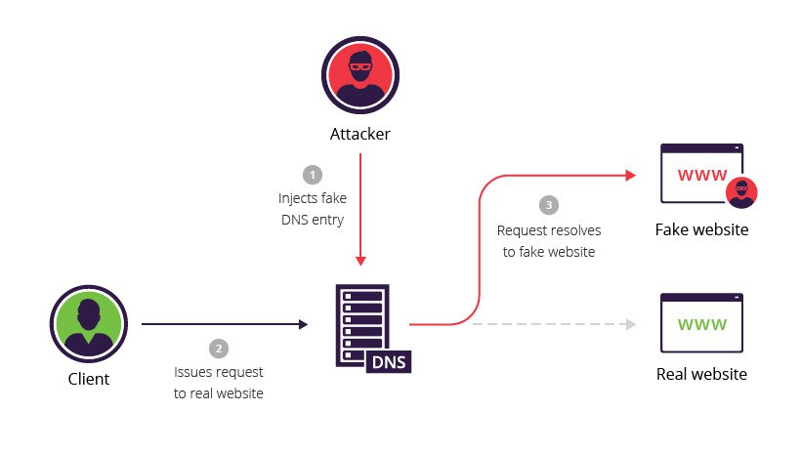
DNS Poisoning
[4]

Slide 11
DNS via blockchain
Site owner can register/modify their ip in a contract.
The contract will verify if the site’s certificate is OK.
Browser should use ips on blockchain instead of

Slide 12
site address &
ip
Site
Owner
CA
site address &
ip

Slide 13
site address
User
ip
Block Chain

Slide 14
[1]
https://news.abs-cbn.com/overseas/04/27/18/metoo-activists-use-blockchain-to-skirt-china-censors
[2] https://etherscan.io/tx/0x2d6a7b0f6adeff38423d4c62cd8b6ccb708ddad85da5d3d06756ad4d8a04a6a2
https://www.thenewslens.com/article/94409
https://news.abs-cbn.com/overseas/04/27/18/metoo-activists-use-blockchain-to-skirt-china-censors
https://news.bitcoin.com/myetherwallet-servers-are-hijacked-in-dns-attack/
https://www.incapsula.com/web-application-security/dns-spoofing.html

