Slide 1
BlockBoard
何配瑜、林哲偉、黃畊彰
(依姓名筆劃排序)

Slide 2
Objective
An app that makes it easy to leave/fetch messages on ethereum.
All operations can be done in dicentralized manner.

Slide 3
Post
reply_txhash
article
List<txhash>
Poster
Contract

Slide 4
Fetch articles
Reader
txhashes
Contract
txhashes
article
Full Node

Slide 5
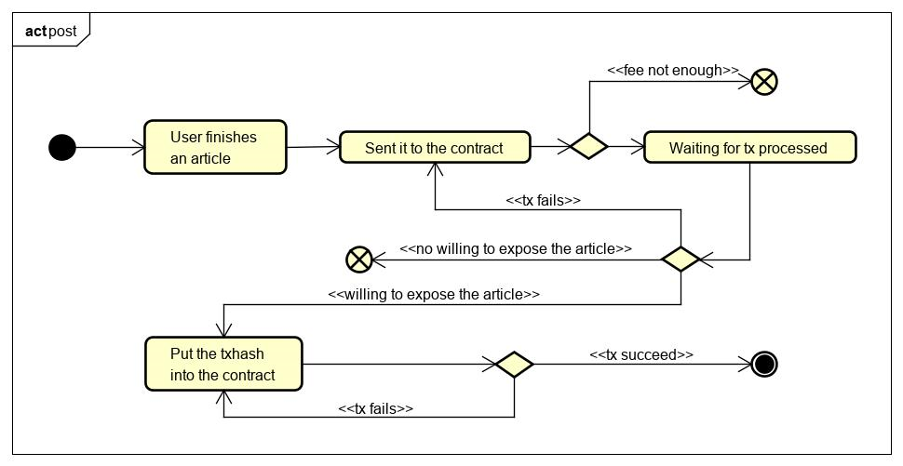
Activity diagram - post

Slide 6
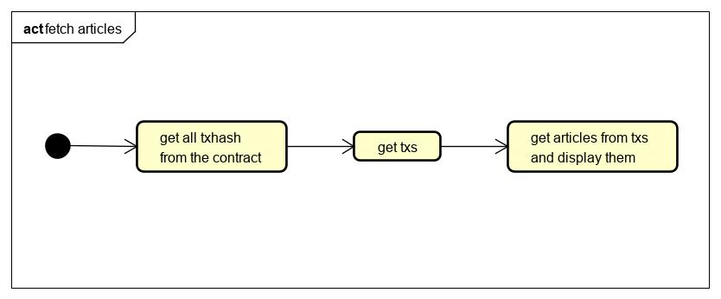
Activity diagram - fetch articles

Slide 7
DEMO

Slide 8
Thank you
Q & A

