Slide 1
Introduction to Bayesian Analysis with Python
Jun Tian
2018-03-06

Slide 2
Bayes' theorem
Posterior Calculation
Using PyMC3 to do Bayesian Analysis
Discussion

Slide 3
An Example
Suppose some dark night a policeman walks down a street, apparently deserted; but suddenly he hears a burglar alarm, looks across the street, and sees a jewelry store with a broken window. Then a gentleman wearing a mask comes crawling out through the broken window, carrying a bag which turns out to be full of expensive jewelry. The policeman doesn’t hesitate at all in deciding that this gentleman is dishonest. But by what reasoning process does he arrive at this conclusion?
——Probability Theory: The Logic of Science
https://www.zhihu.com/question/68122813
Notes:
What is Probability?
An explanation from Bayesian. Measure the belief degree of some statement.

Slide 4

Bayes' theorem
Data(Observation): The road is wet in the morning.
Hypothesis: It rained last night.
Prior: Describe how often it rains in Beijing.
Likelihood: The probability that the road is wet this morning, given that it rained last night.
Posterior: The probability that it rained last night, given that the road is wet this morning.
$$p\left(\left.H\right|D\right)=\frac{p\left(\left.D\right|H\right)p\left(H\right)}{p\left(D\right)}$$

Slide 5
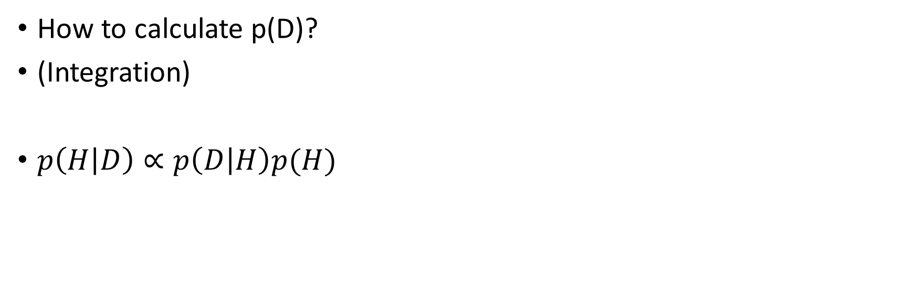

The hardest part
$$p\left(\left.H\right|D\right)=\frac{p\left(\left.D\right|H\right)p\left(H\right)}{p\left(D\right)}$$
How to calculate p(D)?
(Integration)
$p\left(H | D\right)∝p\left(D | H\right)p(H)$

Slide 6

How to calculate posterior?
Analytical
Using conjugate prior
Markov Methods
Metropolis-Hastings
Hamiltonian Monte Carlo
No U-Turn Sampler
…
Non-Markov Methods
Grid Search
Quadratic approximation
Variational Methods
$$p\left(\left.H\right|D\right)=\frac{p\left(\left.D\right|H\right)p\left(H\right)}{p\left(D\right)}$$
Notes:
Most of the algorithms are supported in PyMC3

Slide 7
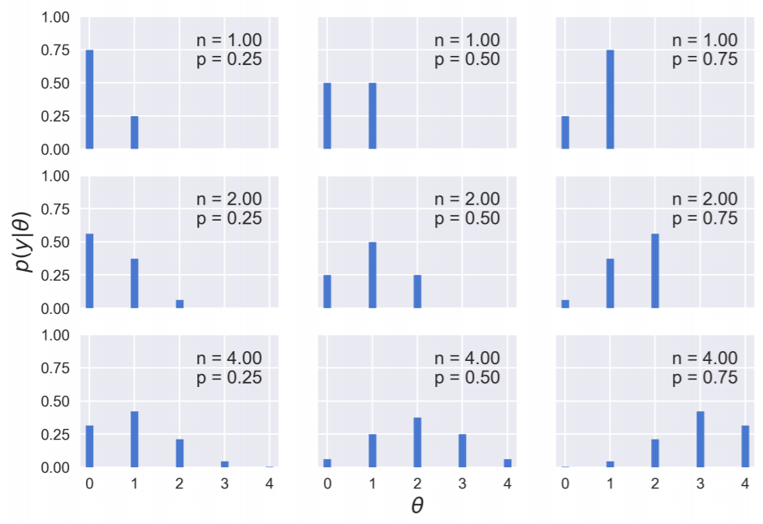
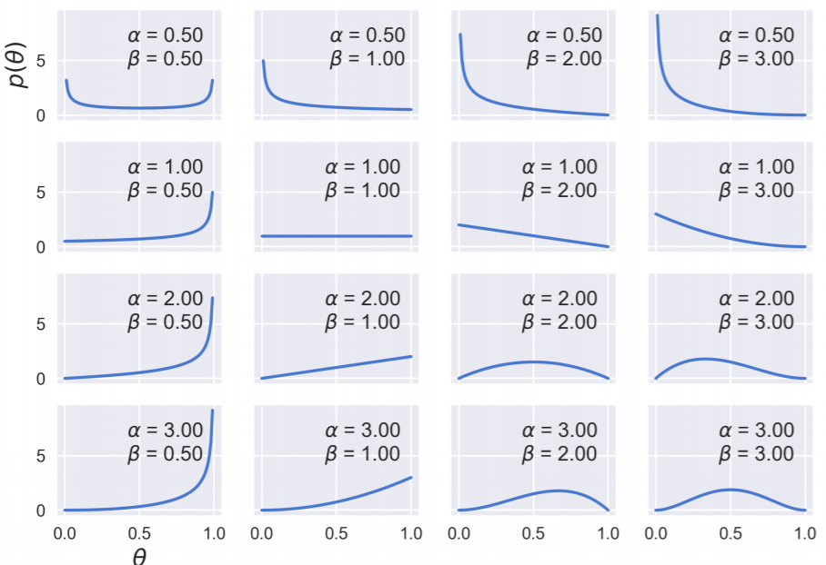
Single Parameter Estimation
Beta Distribution
Binomial Distribution

Slide 8
MCMC
Markov Chain
How to build a Markov Chain?
Why it works?
Monte Carlo
How to simulate?
Markov Chain Monte Carlo
http://twiecki.github.io/blog/2015/11/10/mcmc-sampling/

Slide 9
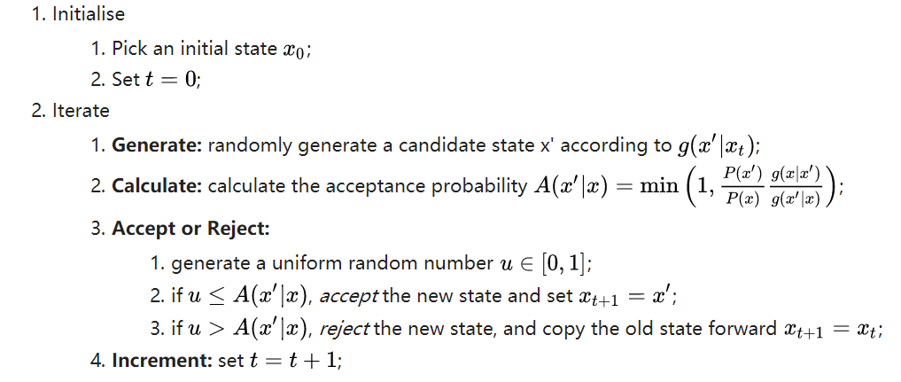
Metropolis Algorithm
Metropolis Algorithm explained in simple example.
Dynamic IMG insert here.
Python Code Here

Slide 10
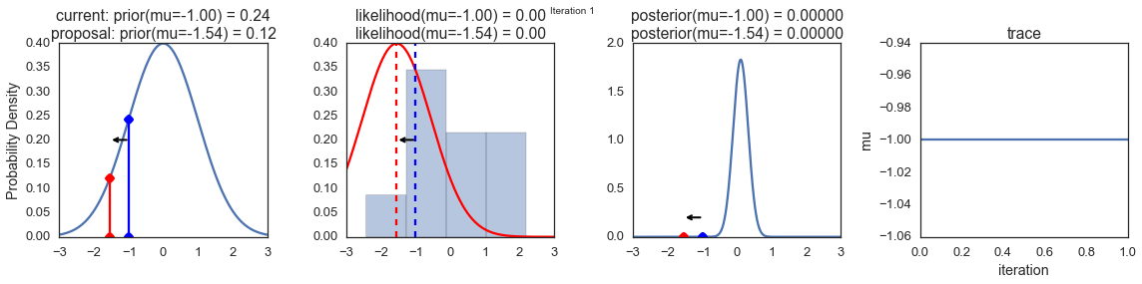
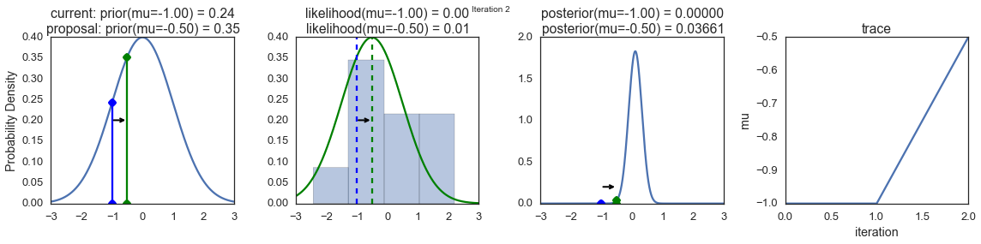

Slide 11
HMC
Why HMC?
Speed
Less reject

Slide 12
Variational Methods
Cross Entropy
ELBO
Compared with MCMC methods
Recommend Papers:

Slide 13
PyMC3
Current Status
Backend of theano is not maintained now.
More algorithms are added

Slide 14
A simple introduction

Slide 15
Edward
Mostly focus on variational methods.
Tensorflow as backend

Slide 16
Some other packages
Tensorflow probability
Stan
Turing

Slide 17
Reading List
Statistical Rethinking
Doing Bayesian Data Analysis, Second Edition
Probability Theory: The Logic of Science
Causality 2nd
Bayesian Reasoning and Machine Learning

