Slide 1
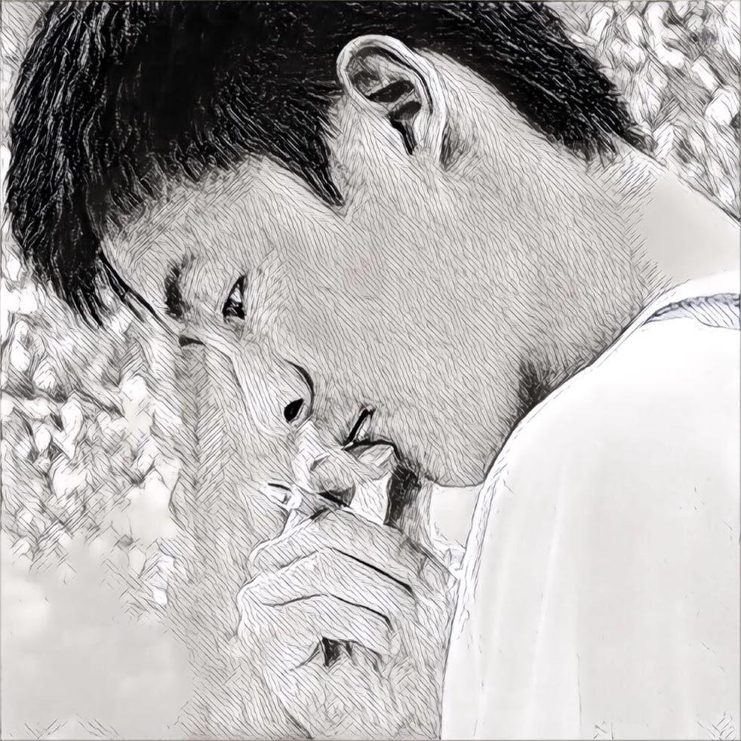
A Practical Guide to the Julia Programming Language
Jun Tian
2020/01/03

Slide 2
Motivation
Speed
Walks Like Python. Runs Like C.
Parallel Programming
Usability
Python/MATLAB/C/C++/CLR/Java
Multiple Dispatch
Traits
Transparency
Beyond Meta-Programming

Slide 3
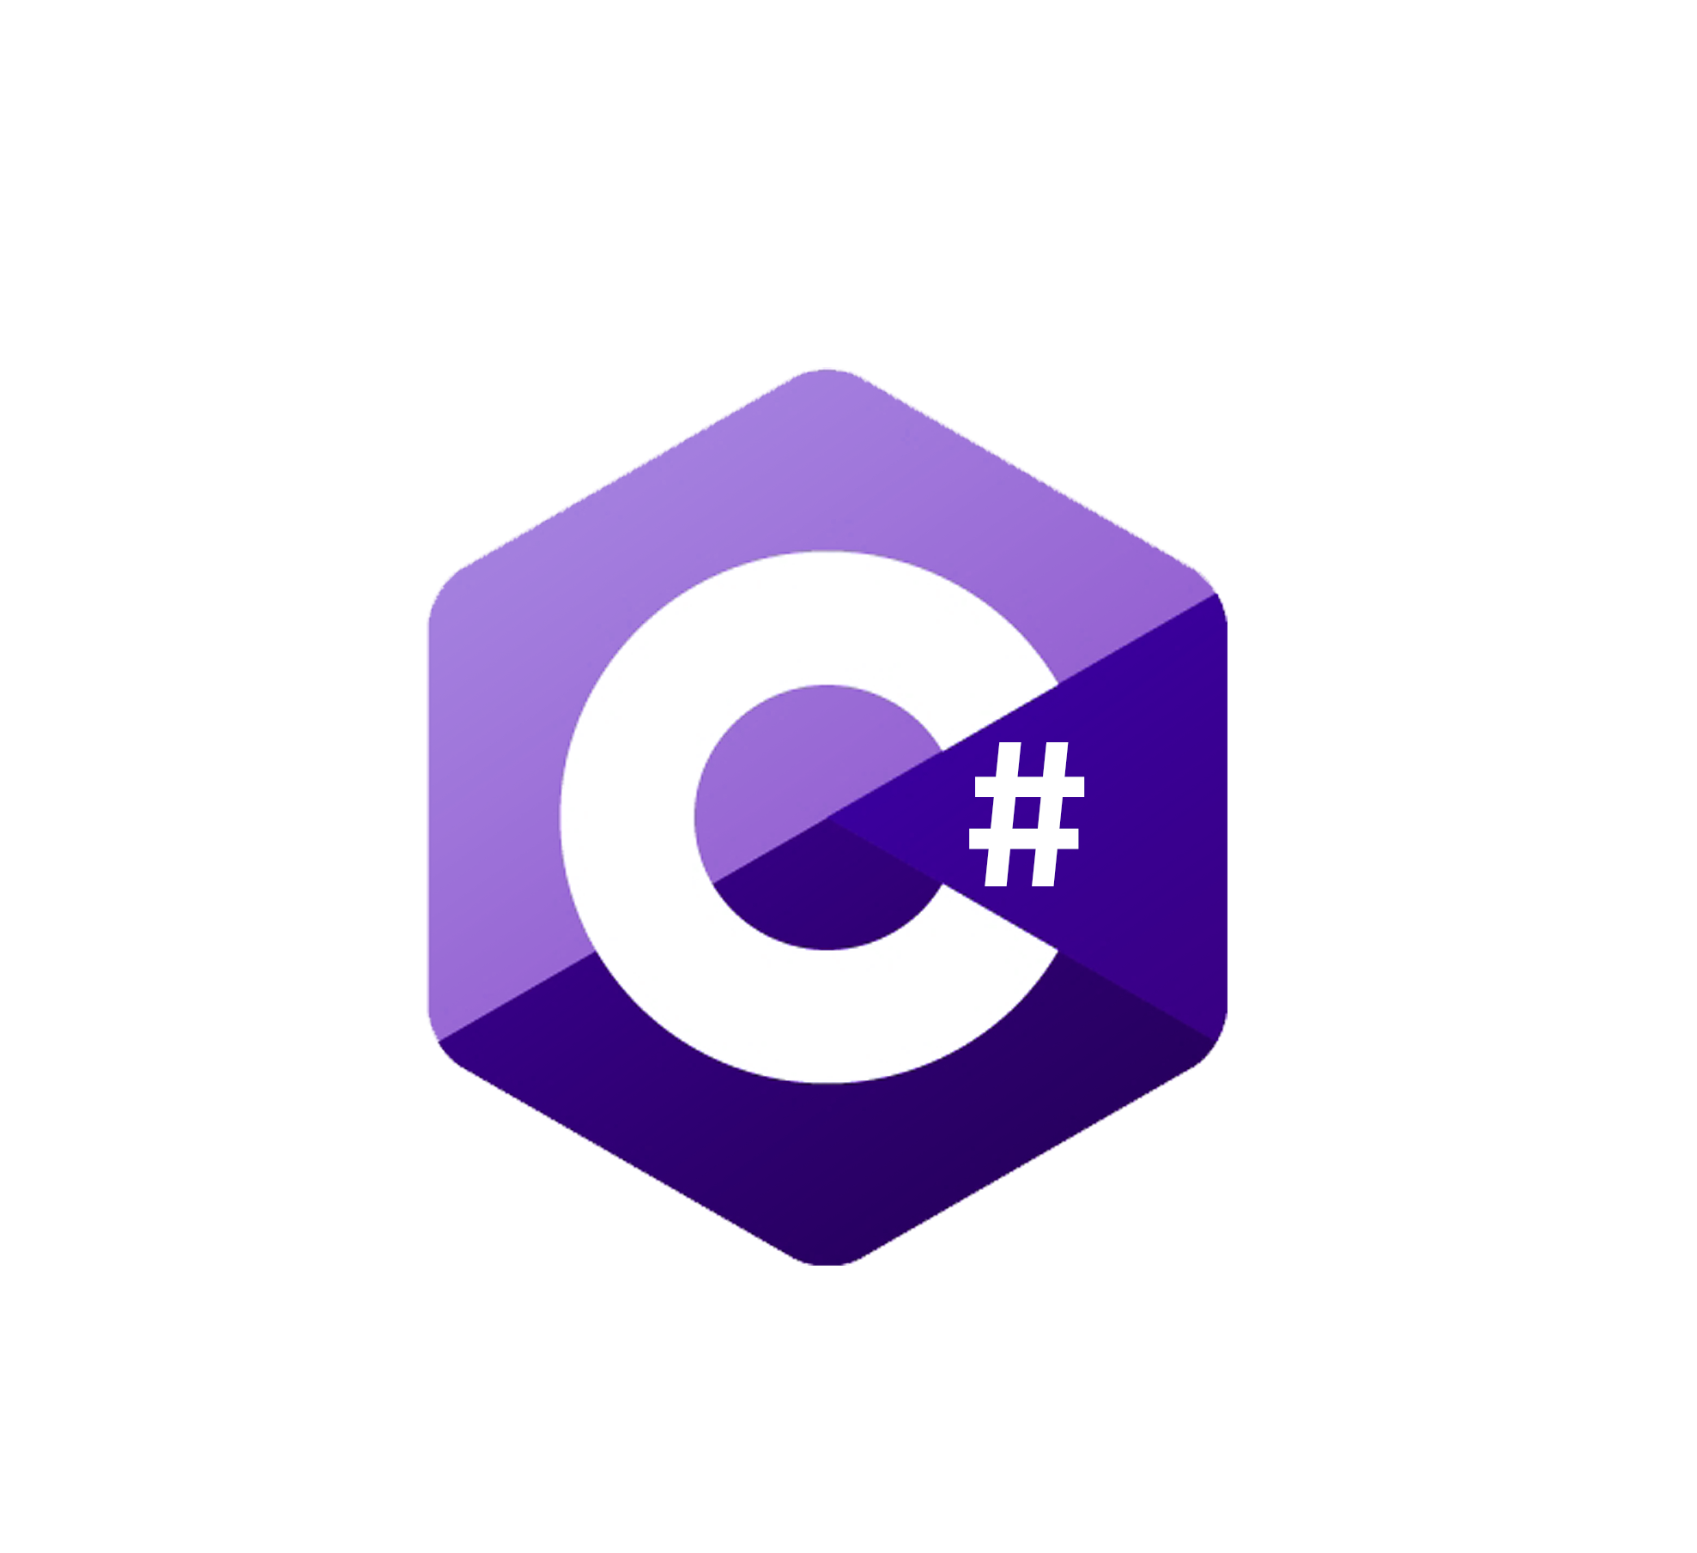


Slide 4





Slide 5
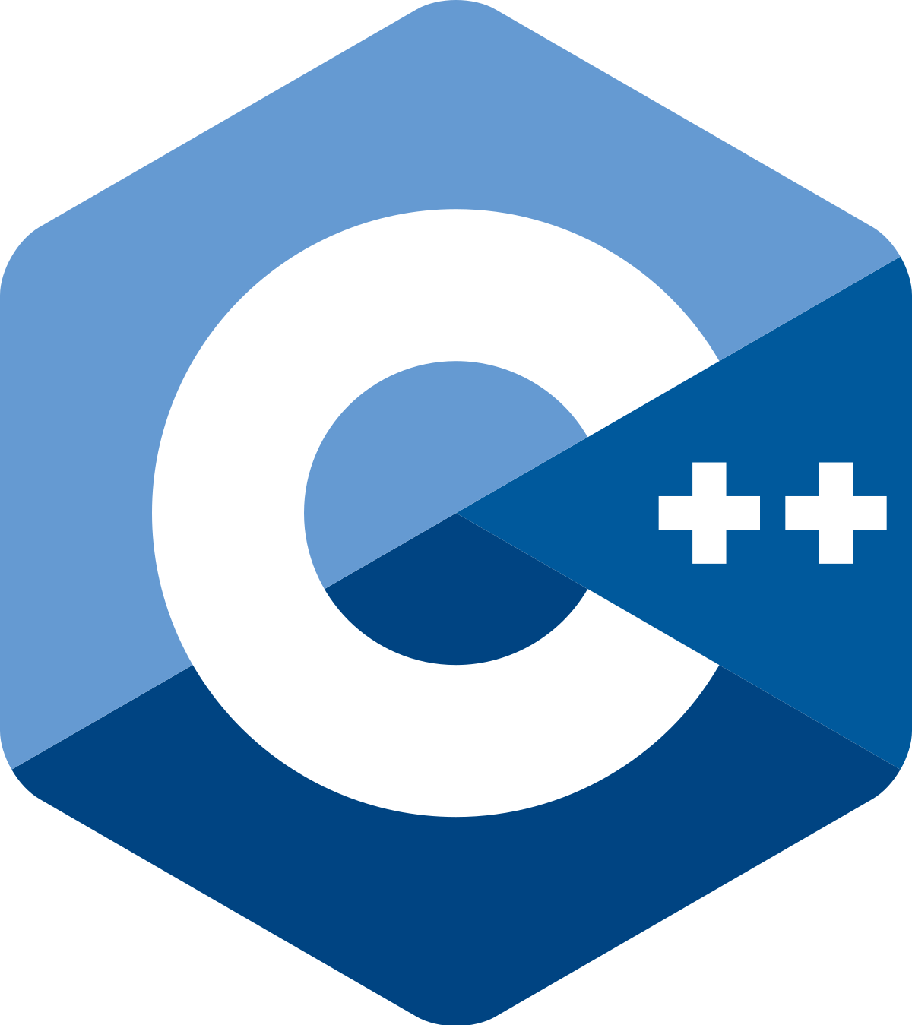


Slide 6





Slide 7

How Long Does It Take to Learn XXX?
这些我全都要！！！

Slide 9
Familiar
Daily Job
Develop Package
Type System
Multiple Dispatch
“Practice Makes a Man Perfect!”
Meta Programming
1 Day ~ 1 Week
1 Day ~ 1 Week
1 Day ~ 1 Week
https://learnxinyminutes.com/docs/julia/

Slide 10
References
https://nextjournal.com/kolia/why-i-love-julia

