Slide 1


Using the Portable Antiquities Scheme data to create a provincial picture of Roman coin use and loss in Britannia
Philippa Walton
Institute of Archaeology, UCL & the British Museum

Slide 2
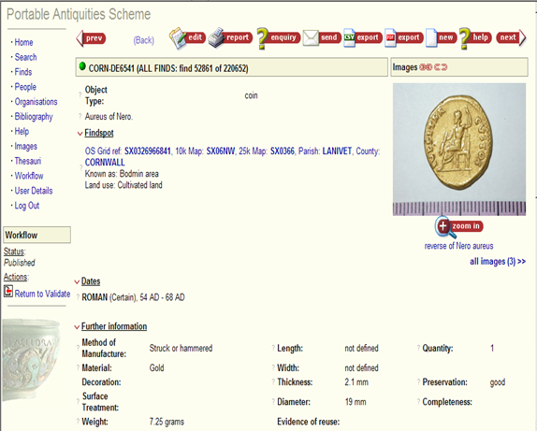
The PAS dataset
58284 Roman coins on database (March 2008)

Slide 3
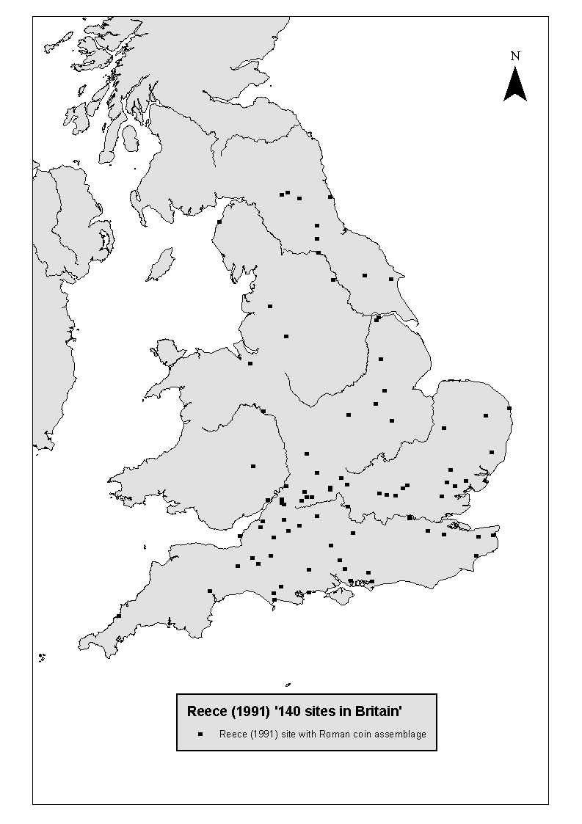
Research background
Excavated urban, military, temple and villa sites with southern bias
Richard Reece’s ‘140 sites in Britain’ (1991)

Slide 4
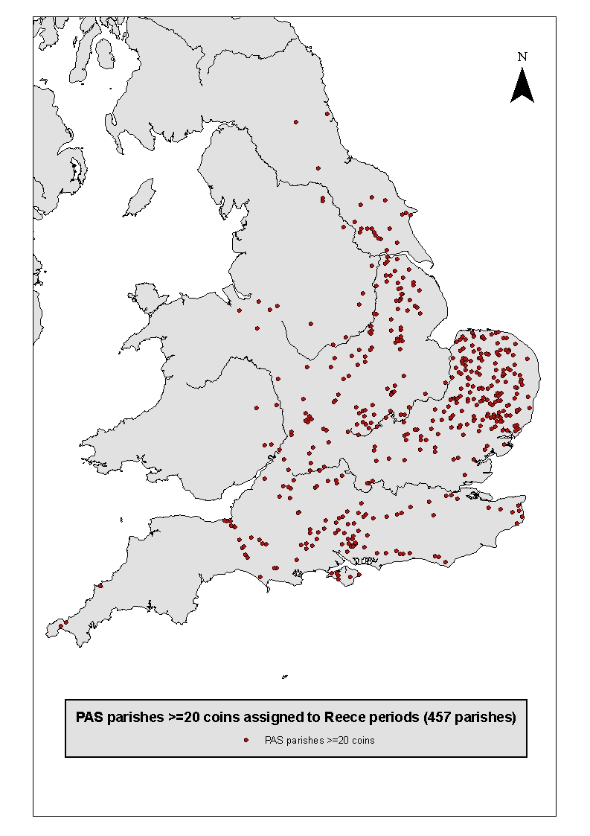
The national picture using the PAS
2850 parishes with Roman coins
457 parishes with 20 or more coins

Slide 5
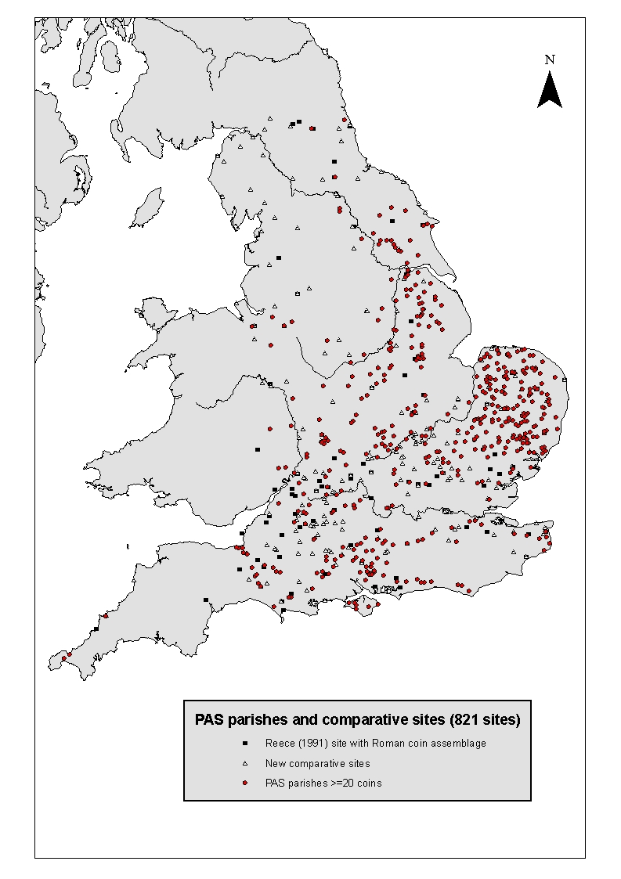
Combining the datasets
Parishes with more than 20 coins plotted against all comparative sites

Slide 6
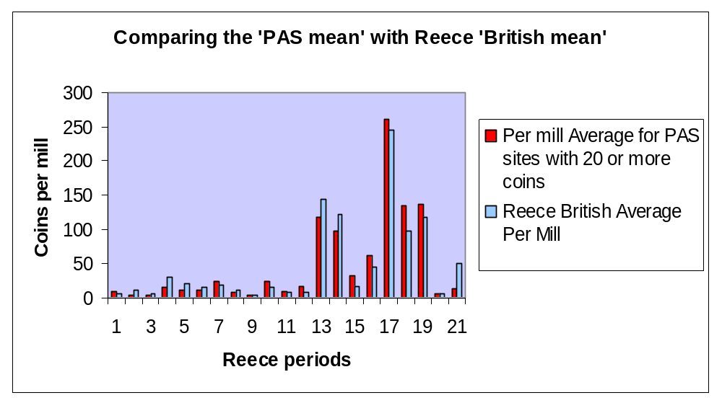
Creating a new British Mean

Slide 7
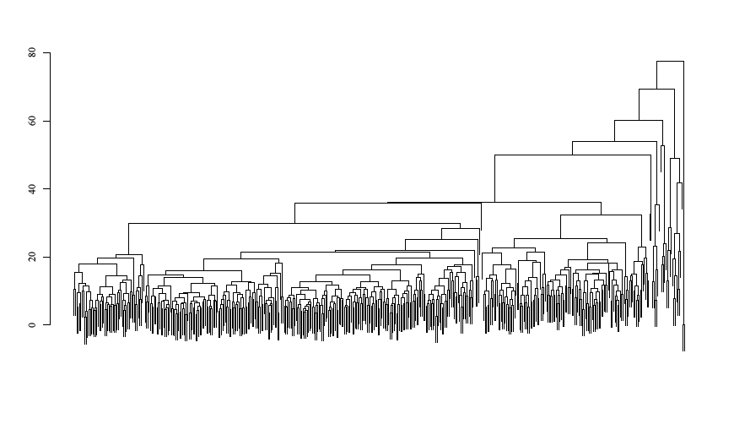
DMAX Cluster Analysis
Dendrogram of cluster analysis on PAS parishes with 20 or more coins

Slide 8
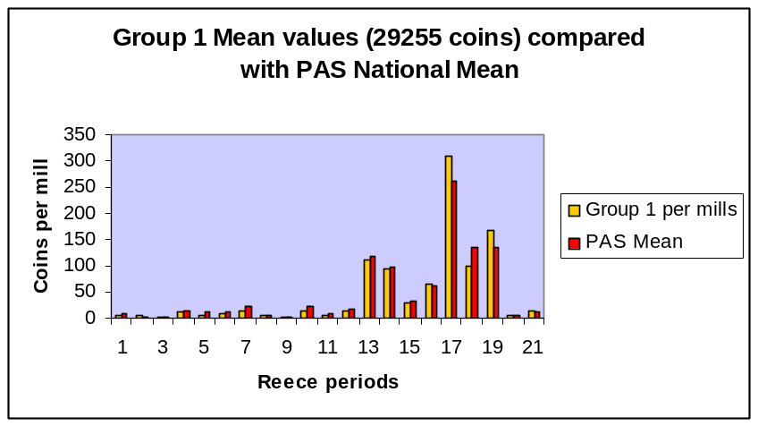
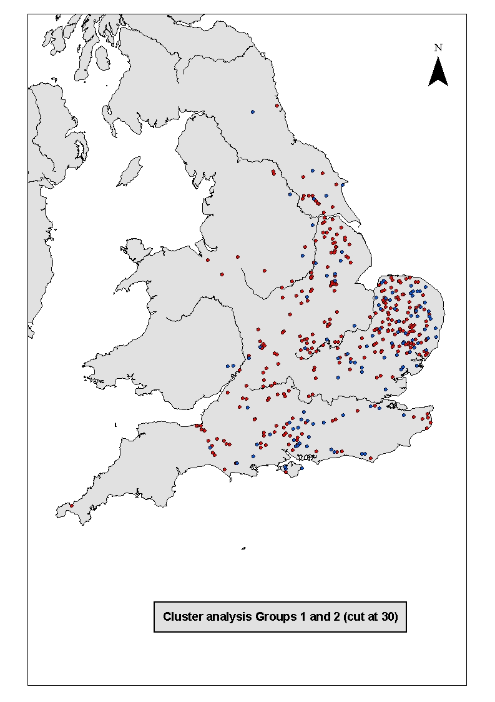
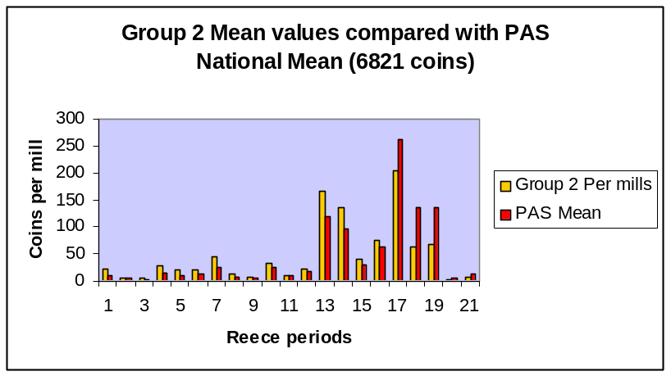
Cluster Analysis – Groups 1 and 2

Slide 9
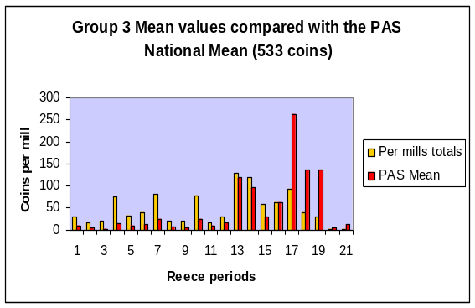
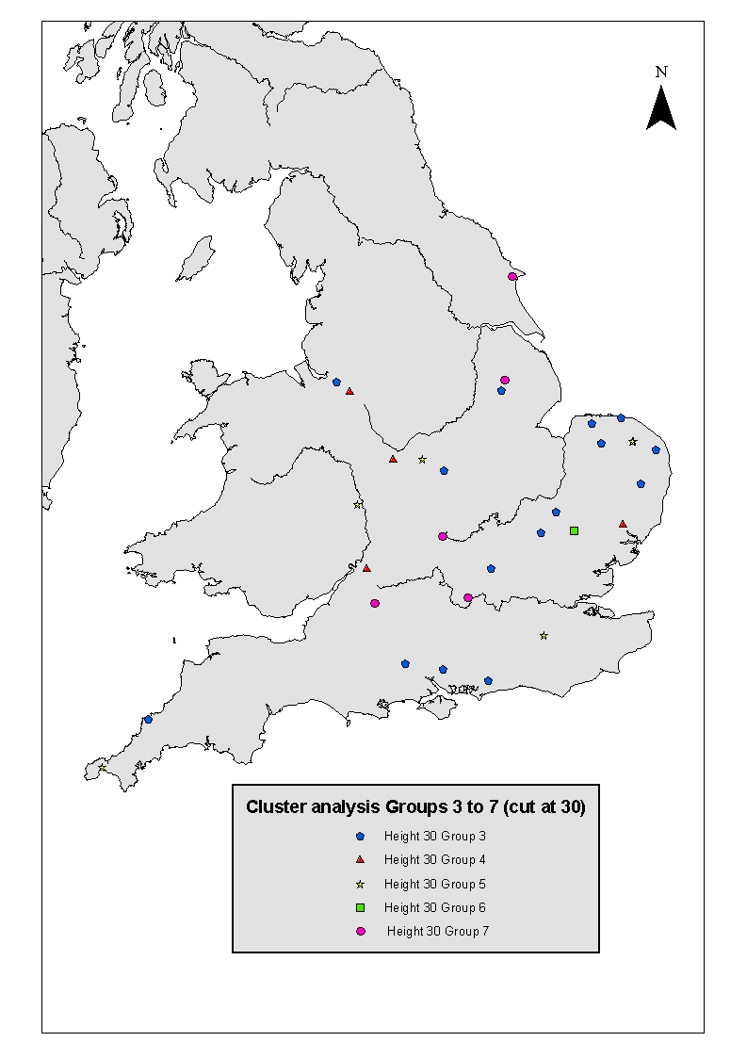
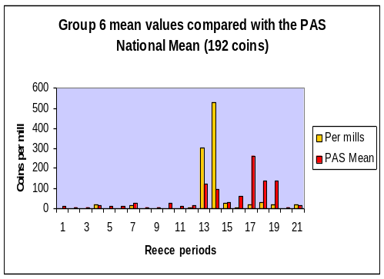
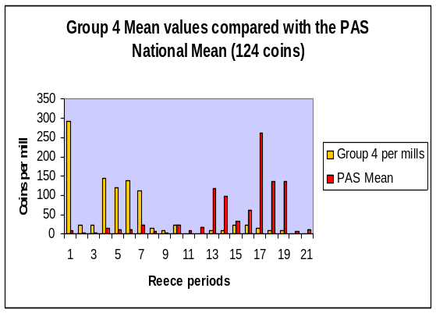
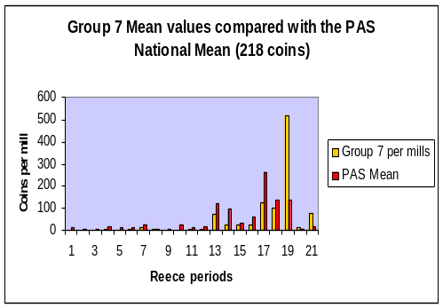
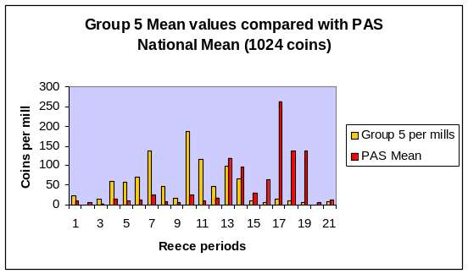
Cluster Analysis - Groups 3 to 7

Slide 10
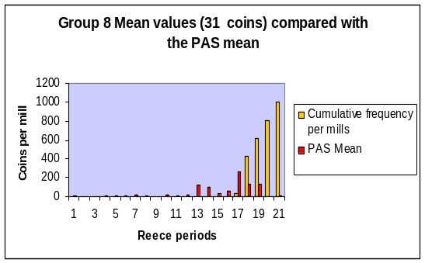
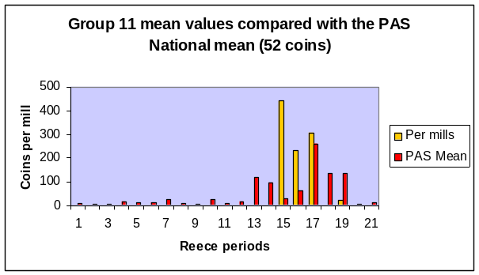
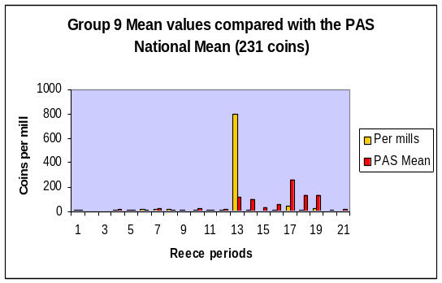

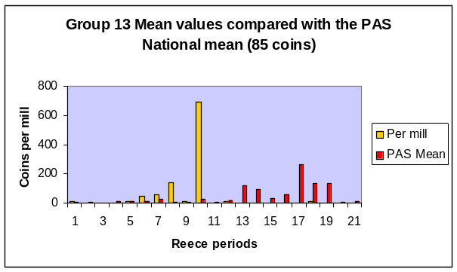
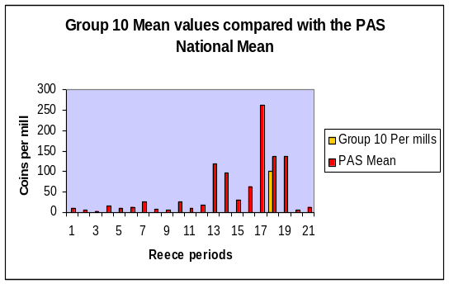
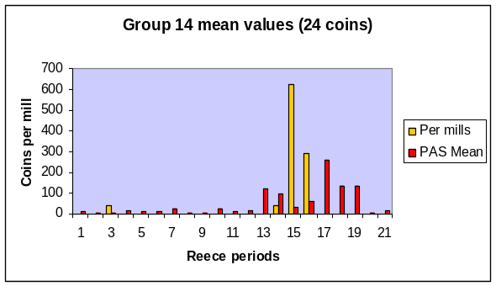
Cluster analysis – Groups 8 to 13

Slide 11
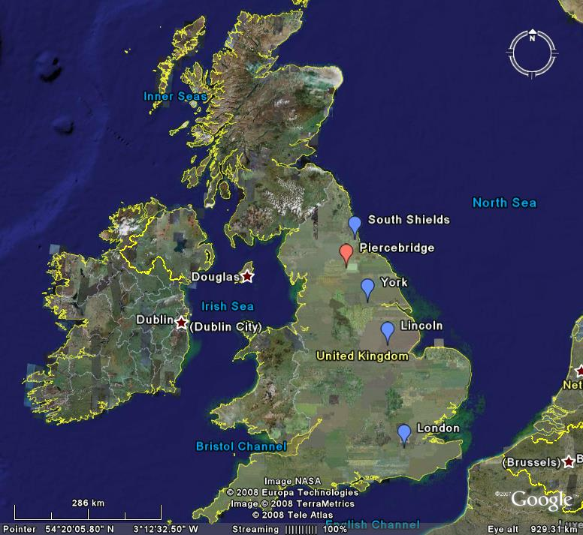
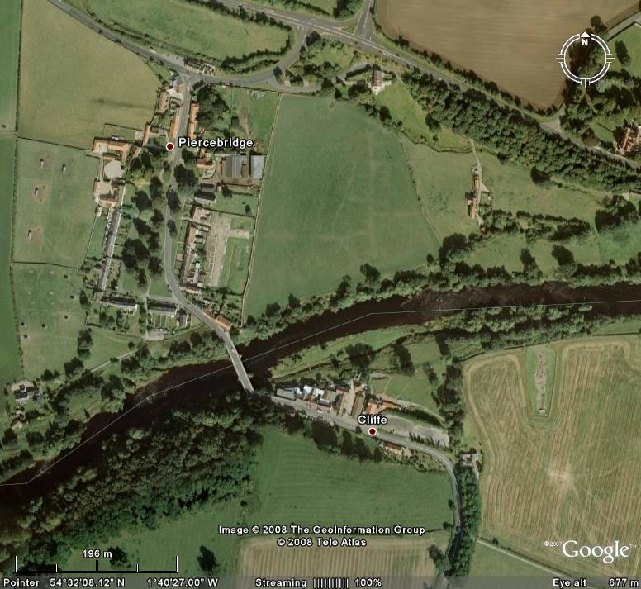
Piercebridge, County Durham
‘Vicus’
fort
Votive deposit

Slide 12
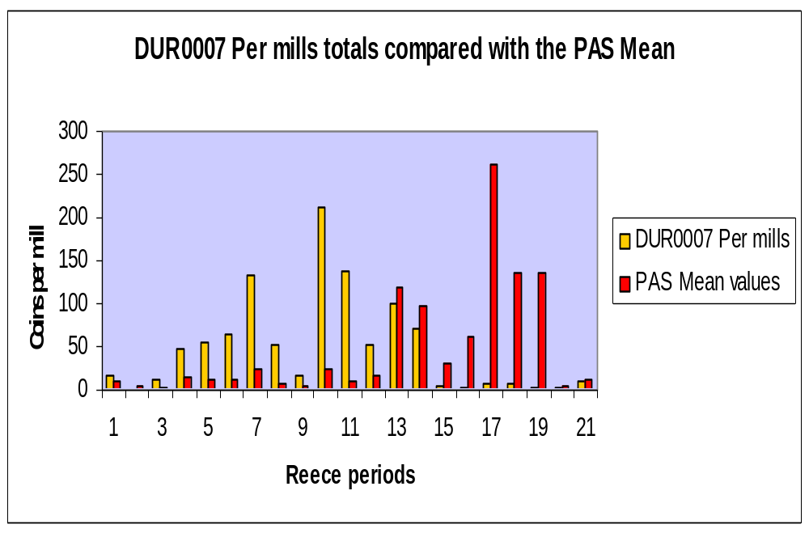
Dating the coin assemblage
Steady levels of activity

Slide 13
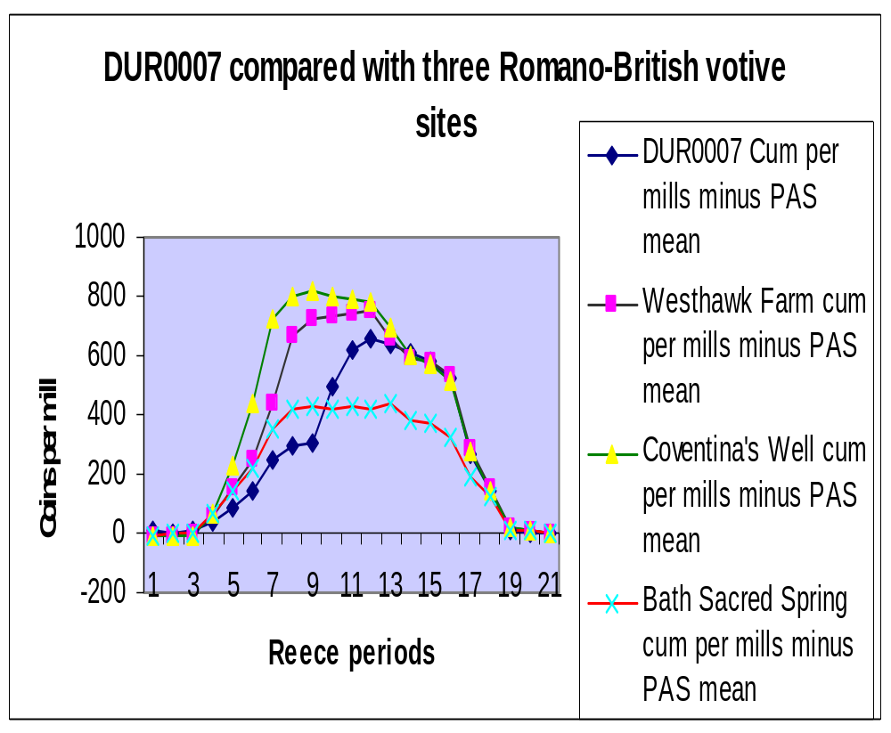
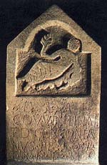
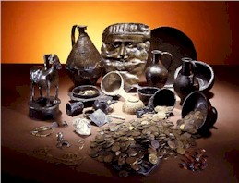
Comparing the river material with the Sacred Spring, Bath and Coventina’s Well, Northumberland
Coventina’s Well
Bath

Slide 14
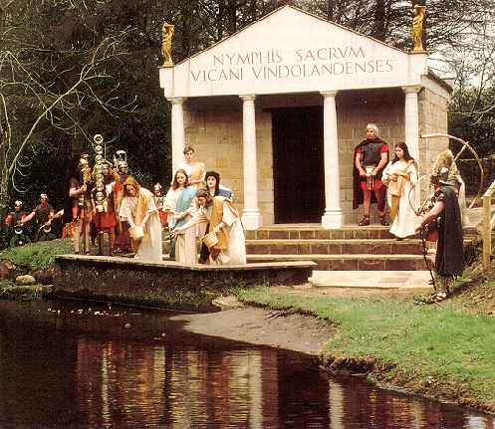
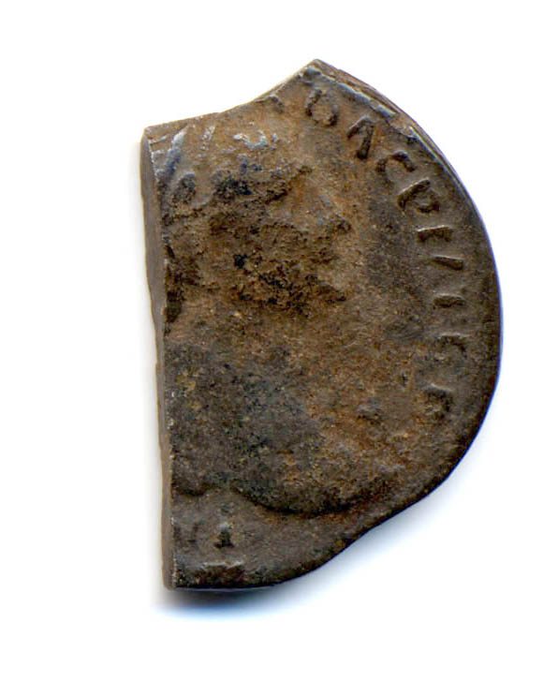

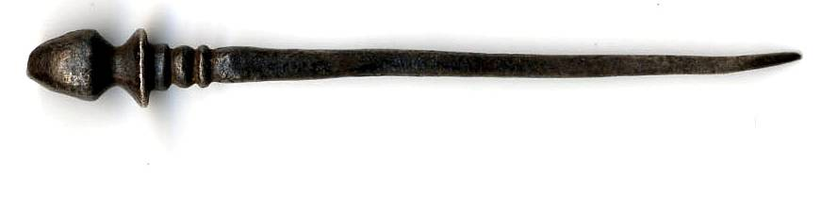
Votive elements in the coin assemblage
Cut denarius of Trajan
Pliny The Younger Epistles 8.8
‘At the foot of a little hill, covered with venerable and shady cypress trees, the river head is sent up out from the ground in several and unequal rills. It bursts forth and forms a broad pool so clear and glassy that you may count the shining pebbles and the little pieces of money which are thrown into it.’
Deliberate selection of female coin and large number of pins

Slide 15
What next?
More detailed analysis of the Cluster Groupings.
Re-running the Cluster analysis with just Groups 1 and 2.
National analysis of coin distributions by Reece period – Claudian copies, coins of British association, Severan copies
Regional and site case studies

