Slide 1
SCHEDULING ALGORITHMS FOR EFFECTIVE MANAGEMENT IN PUBLIC HOSPITALS AND DIAGNOSTIC CENTRES
TEAM MEMEBERS:
S.JAVEED SHAREEF(17071A12G8)
S.RAJESHWAR(17071A12G9)
S.NAVATEJ(17071A12H0)
T.THARUN KUMAR(17071A12H1)
T.SAI HAREESHA(17071A12H2)
)

Slide 2
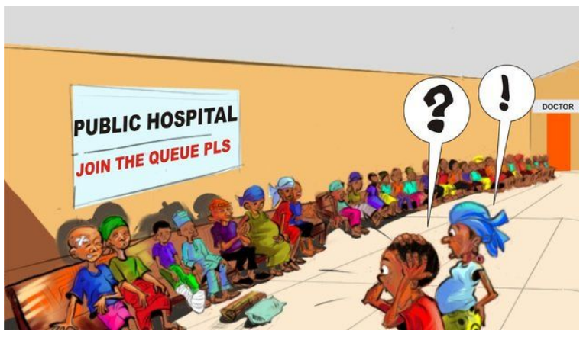
TIRED OF WAITING IN QUEUES? WANT QUICK REPORTS

Slide 3
We are here to provide a solution.
Scheduling algorithms focuses on the applications of analytical method to facilitate better decision making.
If scheduling algorithms are used as part of main stream decision making by diagnostic centre specialist,then it is easy to solve real world problems faced by the common people in diagnostic centres.
We explained basic applications along with suitable simple solutions through scheduling algorithm techniques.
In theory, an appointment system reduces patient waiting time,In practical,the waiting time can still be substantial.Various rules and algorithms are used to solve this.

Slide 4
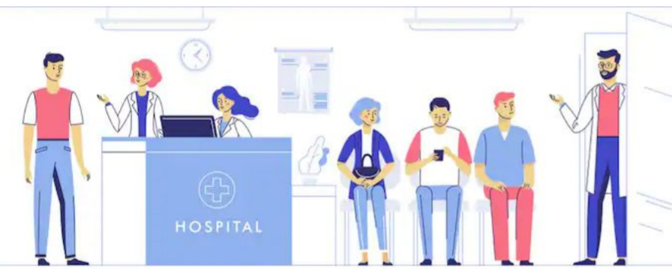
LONG WAITING TIME AT OUTPATIENT CLINICS BEFORE CONSULTATION
The first and simplest outpatient appointment scheduling algorithm is first-come,first-serve(FCFS) scheduling algorithm.
The implementation of the FCFS policy is easily managed with FIFO queue for appointment and the specialist is free,person is allocated to the specialist at the queue.the running person is removed from queue.

Slide 5

LONG TIME FOR SINGLE CONSULTATION
If a patient consulted the doctor,doctor advises MRI scans etc.,which takes longertime.in the mean while doctor can consult another patient which is effective.
This can be resolved by using SJF-PRE EMPTIVE SCHEDULING ALGORITHM.
One patient should consult the doctor and should complete the tests prescribed doctor ,in the meanwhile doctor can treat the patient whose consulting time is less.

Slide 6

EMERGENCY CONSULATIONS ARE NOT ACHIEVED
Needy and emergency conditioned patients are not being served well.
Old age people,children and other emergency cases have to get consultation first.this can be achieved using PRIORITY SCHEDULING.
Old age people,children and other emergency cases have to be ranked with high priority and given medication.

Slide 7
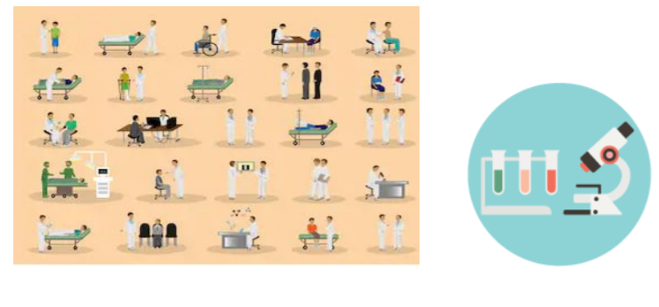
DELAYED REPORTS
In diagnostic centres ,for faster blood reports. eg: Malaria test
The ROUND ROBIN algorithm is designed especially for time sharing system.RR is similar to FCFS but preemption is added to switch between patients,a small unit of time called time quantam is defined.
In the process of parasite checking,there so many steps namely taking blood from the person,preparing blood smear,analytics of smear in microscope and final interpretation etc.,
In comparison to above algorithm ,we can avoid wasting of time between each step.here we can give break to patient between each step namely time quantam so that we can do work with more than one patient at a time.

Slide 8
EXTENSIONS:
1.Dynamic application.
2.Regional support
3.Code optimization

Slide 9
THANK YOU

