Slide 1
Fake News
Timothy Koh Yu Jie May, 2019

Slide 2
Introduction
Rise in Fake News in the recent years
Even addressed by Singapore Law Minister, Mr K Shanmugam on Fighting Fake News
https://www.channelnewsasia.com/news/video-on-demand/fighting-fake-news/an-interview-with-singapore-law-minister-k-shanmugam-11445992
Build a System to Identify Unreliable News Articles

Slide 3
Data Understanding & Exploration
id | title | author | text | label
0 | House Dem Aide: We Didnâ€™t Even See Comeyâ€™s Letter Until Jason Chaffetz Tweeted It | Darrell Lucus | House Dem Aide: We Didnâ€™t Even See Comeyâ€™s Letter Until Jason Chaffetz Tweeted It By Darrell Lucus on October 30, 2016… | 1
6 | Life: Life Of Luxury: Elton Johnâ€™s 6 Favorite Shark Pictures To Stare At During Long, Transcontinental Flights | nan | Ever wonder how Britainâ€™s most iconic pop pianist gets through a long flight? Here are the six pictures of sharks… | 0
Kaggle new articles dataset from 2018
Id, title, author, text, label (1: unreliable, 0:reliable)
Rows: 25,201
Label: label
Features: title, author, text
Column ‘author’ serves no real purpose as their names are not effective in classifying fake news
Column ‘author’ will be changed to True or False, depending on if there is an author – Uses binning technique
No other features removed, as there is already few features

Slide 4
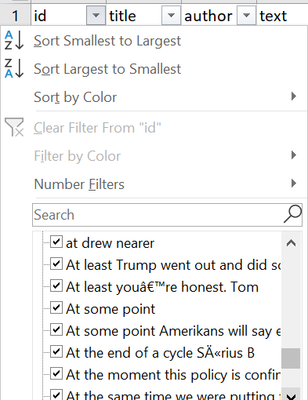
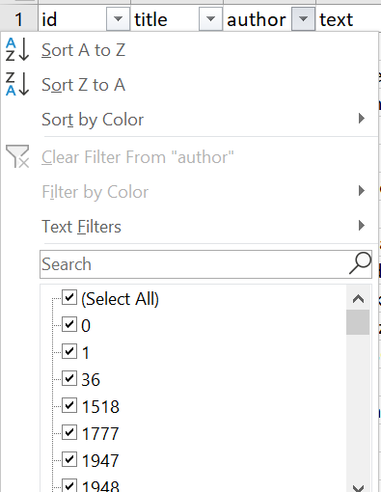
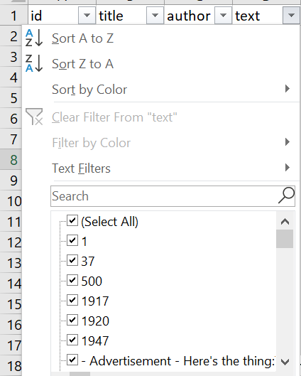
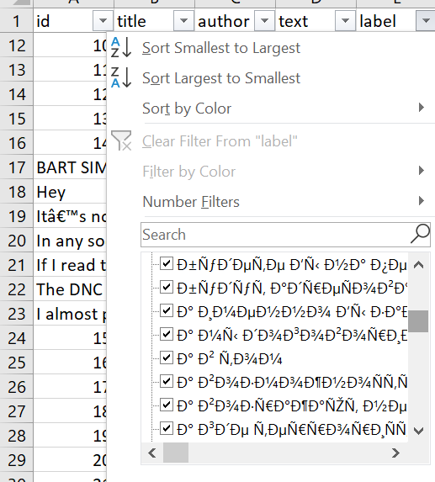
Data Exploration
Every column has nan which is replaced with ‘ ’
Weird texts in all columns
Filtered manually in Excel

Slide 5
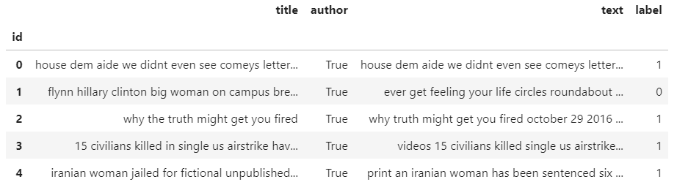
Data Preparation
Re-index data frame with the provided csv index
Binning Author column to True or False
Important to filter noise in text
Change text and title columns to lower case to prevent multiple copies of the same word “And” vs “and”
Remove punctuations in text and title columns as they are useless info
Remove commonly recurring words in df[‘text’] column
Remove rare words in df[‘text’] column
Text and Title are mostly text data which require special preparation, hence Words are encoded as integers for input (Tokenisation)
- CountVectorizer builds a vocabulary of known words and number of times each word appear in the document
- TfidfVectorizer same as CountVectorizer but also accounts for words that have large counts but are not meaningful such as “the”

Slide 6

Extract + TFIDF-Vector Piping
Shuffle,
70% Train
30% Test
Declare 2 Tfidf_Vec
tfid_vec1 = TfidfVectorizer(stop_words='english’)
tfid_vec2 = TfidfVectorizer(stop_words='english’)
text_pipe = make_pipeline(
DataFrameColumnExtracter('text'),
tfid_vectorizer1)
title_pipe = make_pipeline(
DataFrameColumnExtracter('title'),
tfid_vectorizer2)
feature_union = make_union(text_pipe, title_pipe)
new_x_train = feature_union.fit_transform(df_x_train.astype("U"))
new_x_test = feature_union.transform(temp_test.astype("U"))
new_x_train = hstack((new_x_train, np.array(temp_train_author['author'].astype(float))[:,None]))
Extract Text Portion
Fit Vocabulary1 (Train)
Transform Text to Matrix
Extract Title Portion
Fit Vocabulary2 (Train)
Transform Title to Matrix
like | play | games
help | save | people
[0.55 0.33 0.0]
[0.25 0.0 0.20]
Feature Union
+ Author
Sparse Matrix of Text + Sparse Matrix of Title

Slide 7
Edit: Example of Final Input
Trump | Hillary | … | Twitter | Suicide | Author
0.0 | 0.33 |  | 0.12 | 0.042 | TRUE
0.2 | 0.8 |  | 0.0 | 0.1 | FALSE

Slide 8
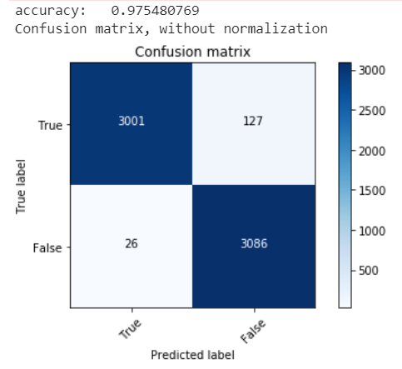
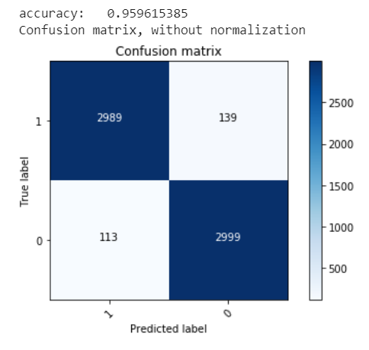
Analysis of Various Algorithms
Logistic Regression: 0.972390 (0.004666)✔ | Multinomial NB: 0.856319 (0.009866)
K Neighbours Classifier: 0.594849 (0.011157) | Decision Tree Classifier: 0.963324 (0.003936)✔
Logistic Regression
Decision Tree Classifier

Slide 9
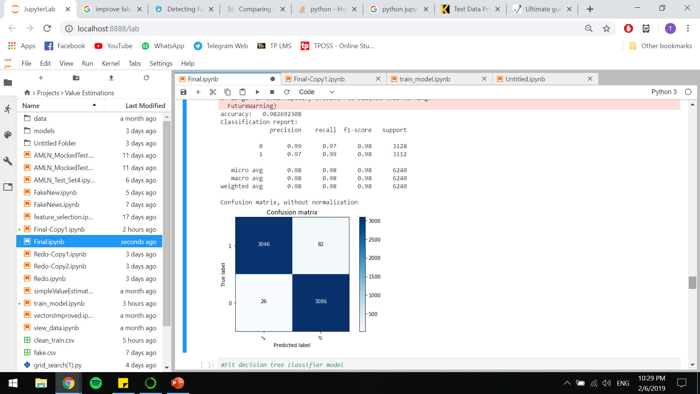
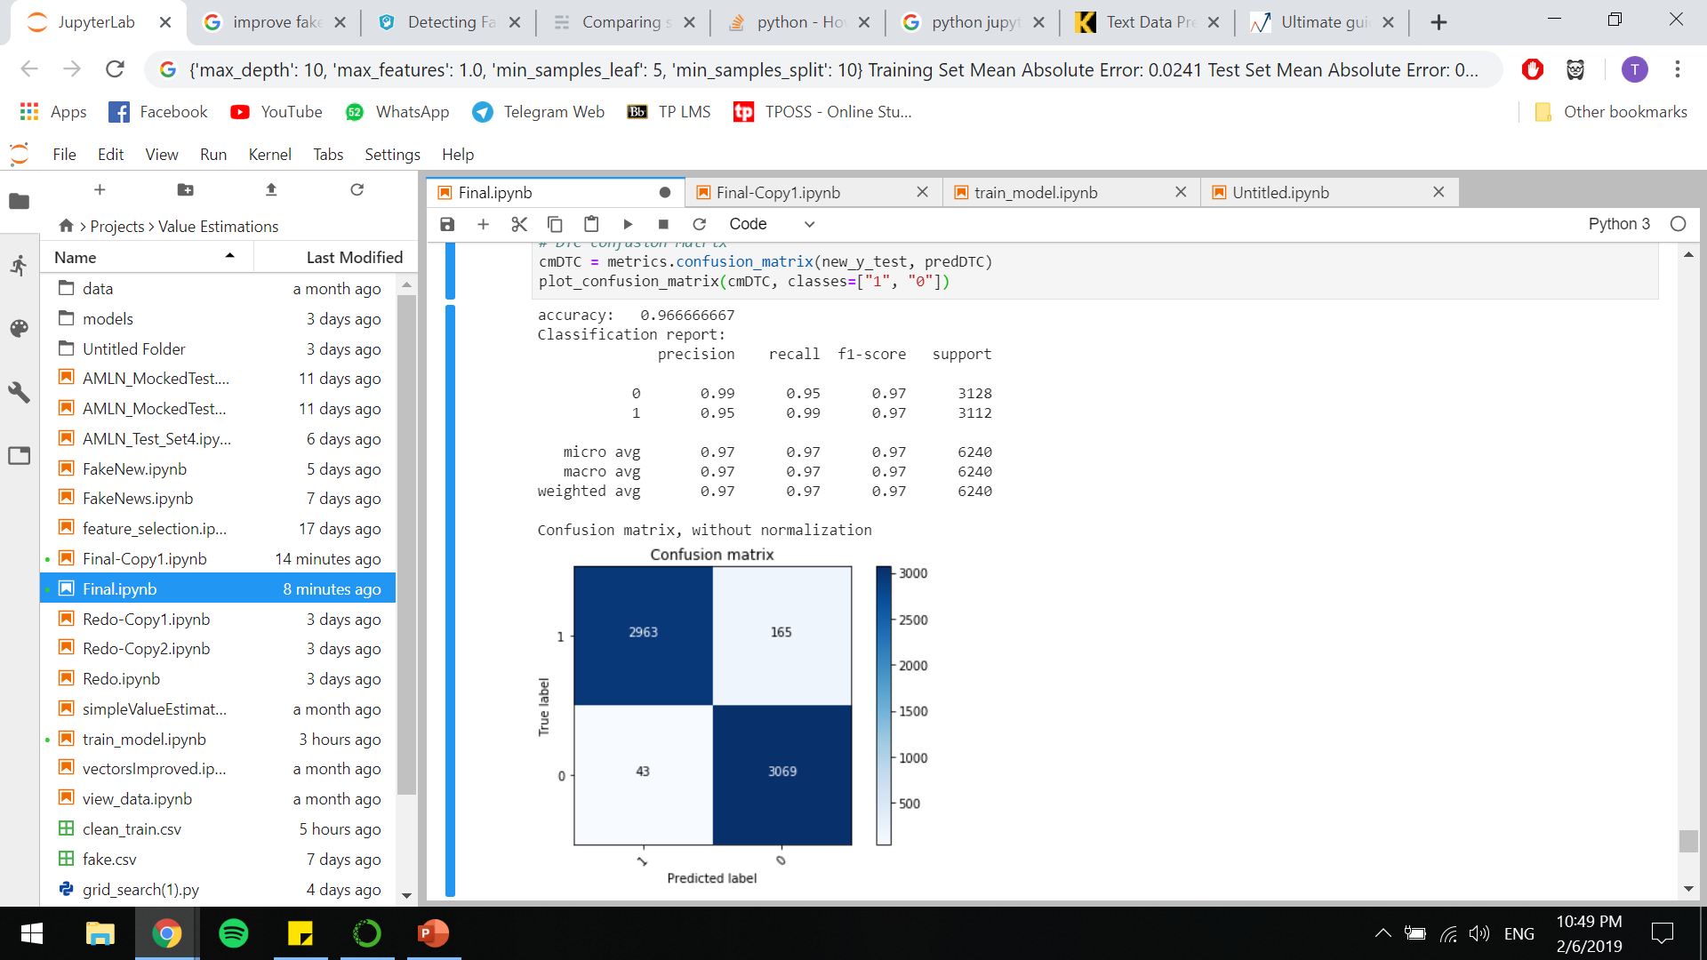
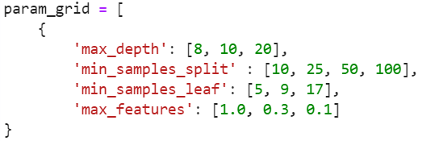
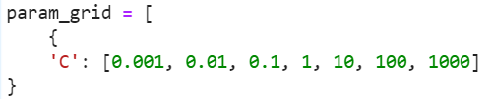
GridSearch Models
Logistic Regression
^ 0.007
Decision Tree Classifier
^ 0.003
C= 1000
Training Set Mean Absolute Error: 0.0000
Test Set Mean Absolute Error: 0.0173
max_depth= 10, max_features= 1.0, min_samples_leaf= 5, min_samples_split= 10
Training Set Mean Absolute Error: 0.0241
Test Set Mean Absolute Error: 0.0333

Slide 10
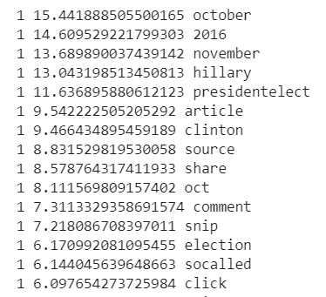
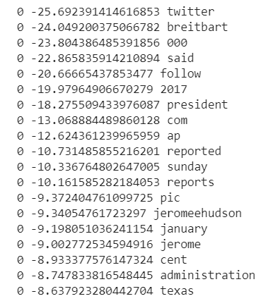
Results and Analysis
Words commonly associated with Unreliable News
14,560 data used to train, 6,240 data used to test
Logistic Regression has 98.3% accuracy
Decision Tree Classifier has 96.7% accuracy
Logistic Regression has better accuracy, precision, recall and f1-score. Also lower error rate
Logistic Regression is the model of choice
Words commonly associated with Reliable News
Logistic Regression
Decision Tree Classifier

Slide 11
Conclusion
Preparing data is important to ensure quality predictions
Difficult to predict with text as much conversion needed
Model has high accuracy, however requires more data set to train
Testing it with it’s own data contributed to the skewed high accuracy
Only useful for US data, and especially for websites that the data set focuses on

Slide 12
References
https://towardsdatascience.com/i-trained-fake-news-detection-ai-with-95-accuracy-and-almost-went-crazy-d10589aa57c
https://www.kaggle.com/mrisdal/fake-news
https://github.com/docketrun/Detecting-Fake-News-with-Scikit-Learn/blob/master/Attempting%20to%20detect%20fake%20news.ipynb
https://scikit-learn.org/stable/tutorial/text_analytics/working_with_text_data.html
https://machinelearningmastery.com/prepare-text-data-machine-learning-scikit-learn/
https://www.analyticsvidhya.com/blog/2018/02/the-different-methods-deal-text-data-predictive-python/
https://www.channelnewsasia.com/news/video-on-demand/fighting-fake-news/an-interview-with-singapore-law-minister-k-shanmugam-11445992
https://blog.kjamistan.com/comparing-scikit-learn-text-classifiers-on-a-fake-news-dataset/

