Slide 1
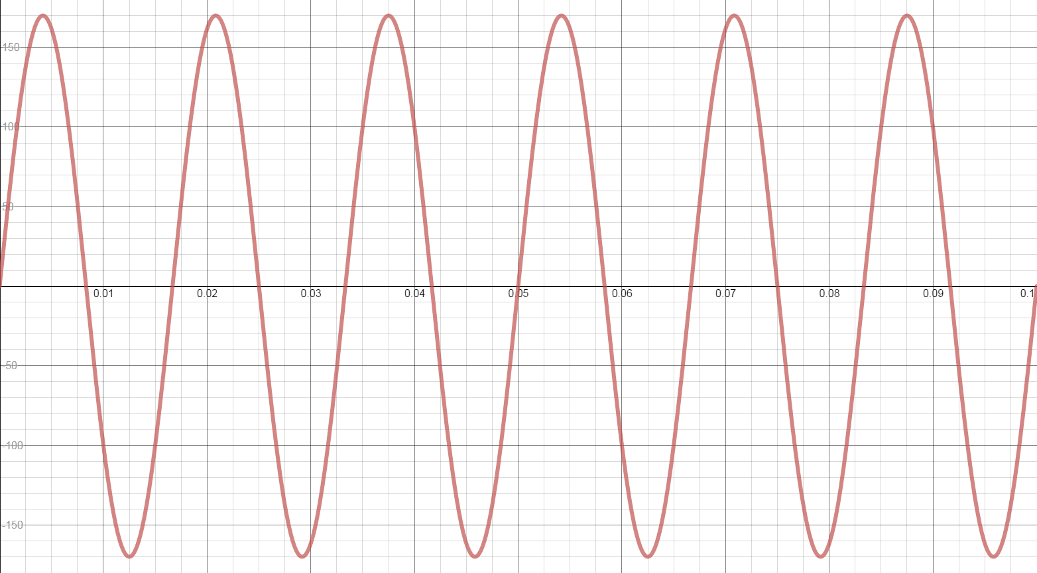
+170V
Voltage
0.1 sec
-170V
Time

