Slide 1
Viral Product Hype Cycle
SQL Analysis of Social Media Trends & Product Sales
12,011
800%
4
10
Records Analyzed
Max Growth
Products
SQL Analyses
Stanley Quencher • Owala FreeSip • Hydro Flask • YETI Rambler
Analysis Period: 2020-2024 | SQL Portfolio Project

Slide 2
Business Problem
02
How do viral social media trends impact product sales?
Unpredictable demand spikes from viral trends
No clear metrics for lifecycle measurement
Uncertain timing for inventory and investment
Unknown ROI from retail events and marketing
SOLUTION
SQL analysis of 12,011 records combining Google Trends, TikTok engagement, stock prices, and retail events to identify predictable patterns

Slide 3
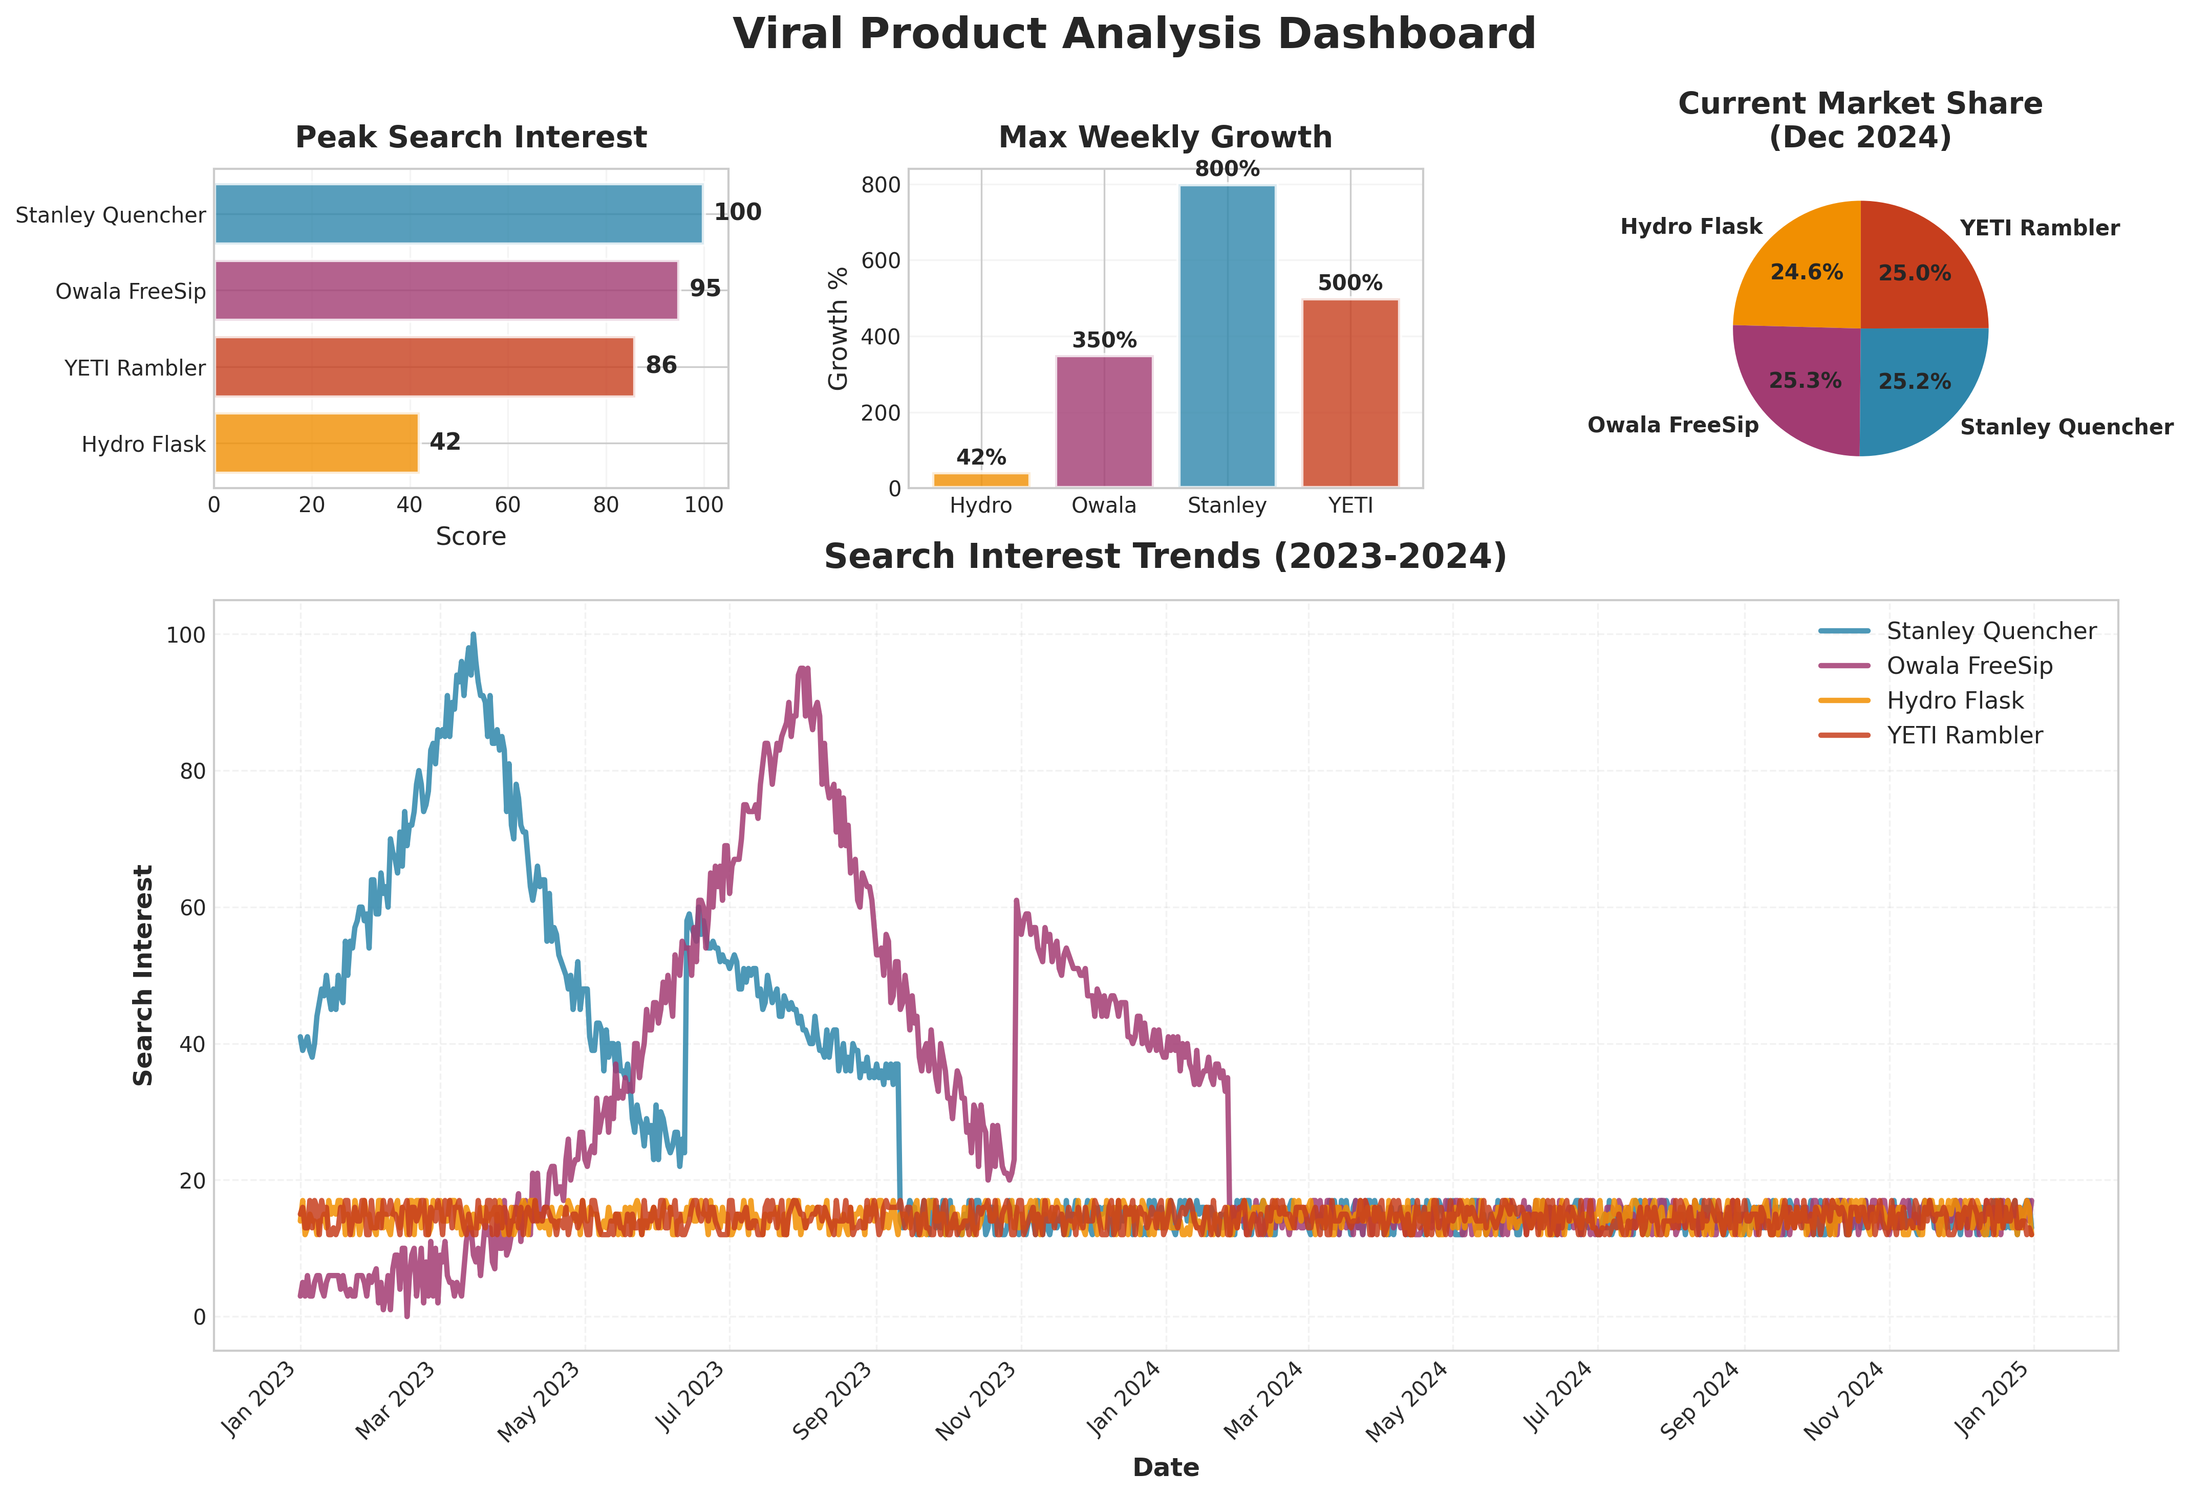
Executive Dashboard
03

Slide 4
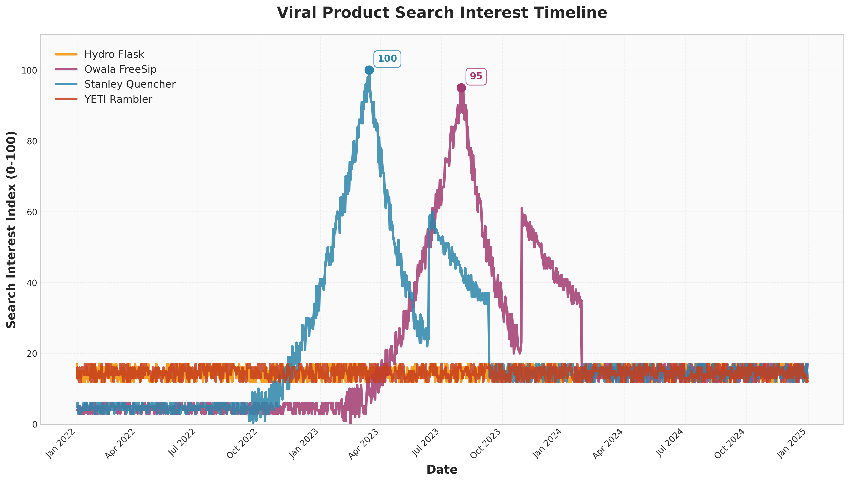
Finding #1: Predictable Viral Peaks
04
Stanley: 100/100 (Mar '23) • Owala: 95/100 (Jul '23) • Peak Duration: 7-14 days • Time to Peak: 3-6 months

Slide 5
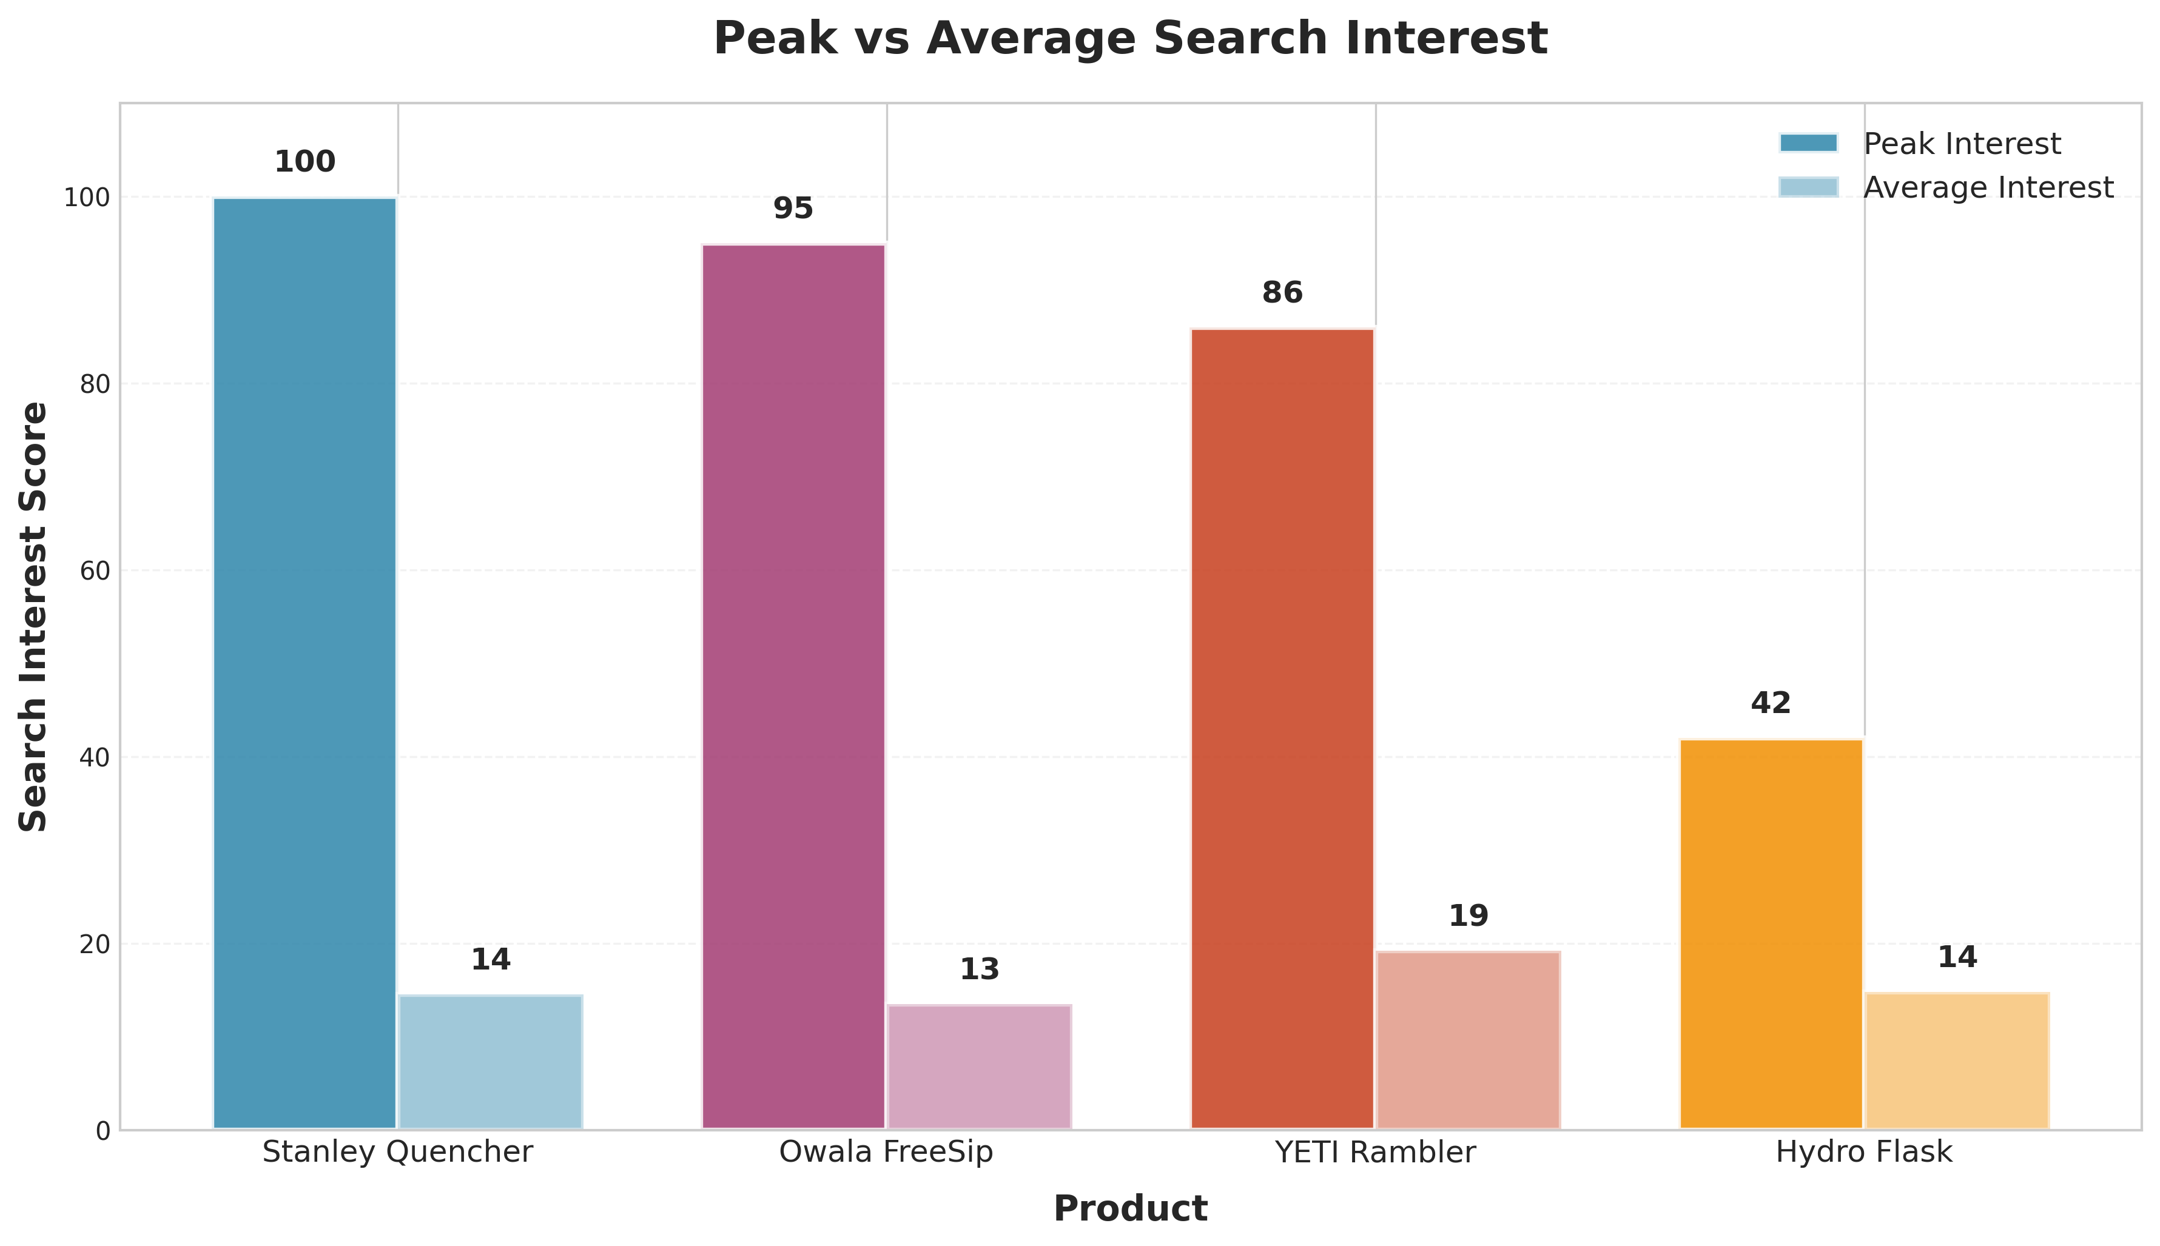
Finding #2: 800% Growth During Viral Phase
05
Max Growth: 800% WoW • Post-Peak Baseline: 15-20% of max • Stanley Today: 17/100

Slide 6
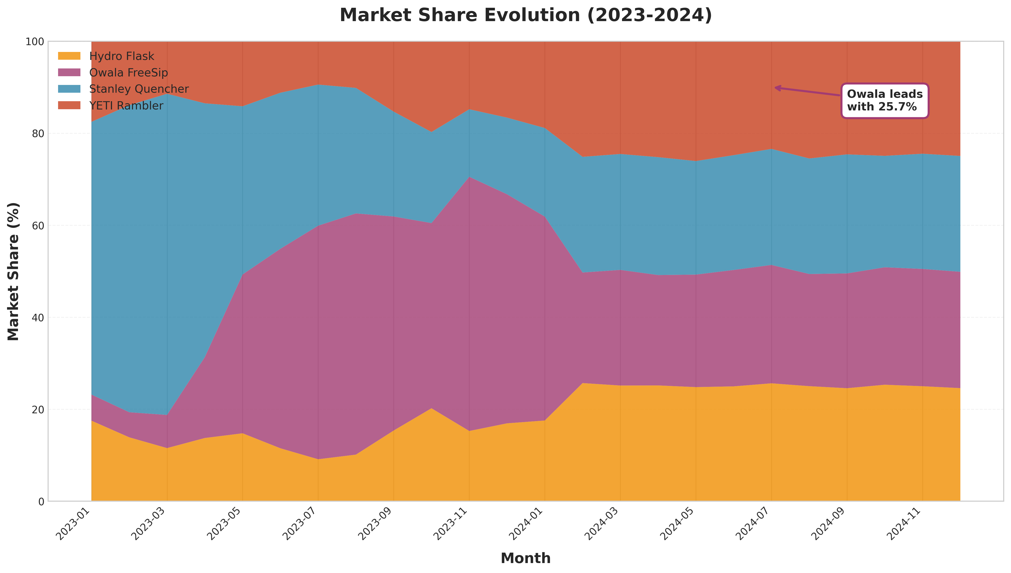
Finding #3: Competitive Market Dynamics
06
Owala: 25.7% • Hydro Flask: 25.6% • Stanley: 25.2% • YETI: 23.4% (Dec 2024)

Slide 7
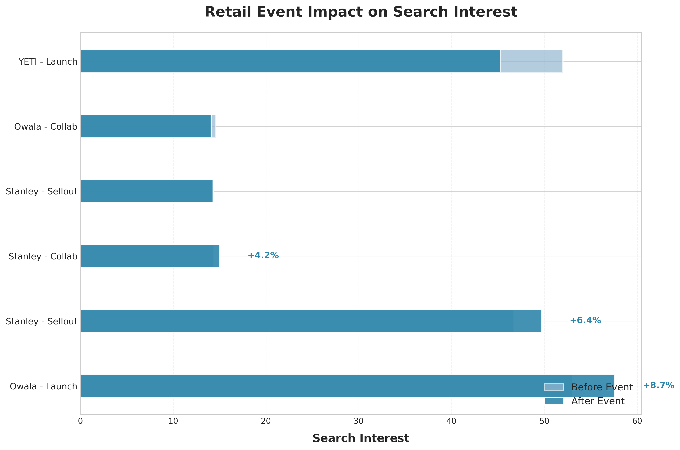
Finding #4: Retail Events Drive +9% Average Lift
07
Launch Events: +8.6% • Sellouts: +6.4% • Resale Premium: 150-250%

Slide 8
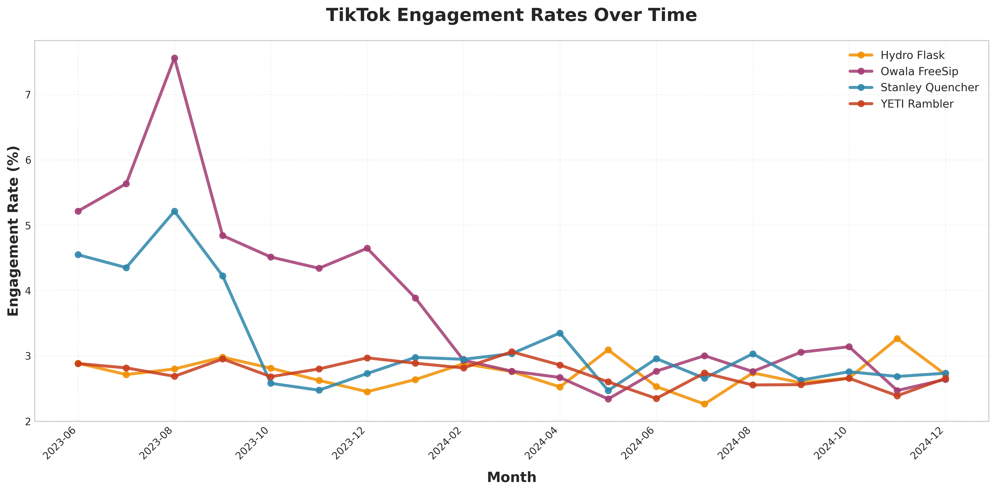
Finding #5: TikTok Engagement Quality
08
Engagement: 2.5-3.5% • Sentiment: 0.58-0.72 • #stanleycup: 500M+ views

Slide 9
SQL Analysis Methodology
09
DATABASE
social_trends: 7,308 records
tiktok_metrics: 1,036 records
stock_prices: 3,654 records
retail_events: 9 records
products: 4 records
10 ANALYSES
1. Peak Detection
2. Momentum Analysis
3. Market Share
4. Event Impact
5. Hype Lifecycle
6. Stock Correlation
7. Investment Timing
8. Influencer Score
9. Saturation Detection
10. Executive Summary
SQL TECHNIQUES
Window Functions (LAG, LEAD, ROW_NUMBER)
Common Table Expressions (CTEs)
Event-Based Windowing
Date Calculations (JULIANDAY)
Statistical Aggregations
Market Share Calculations

Slide 10
Business Applications
10
📦 Inventory Planning
💰 Investment Timing
Forecast demand 2-3 weeks ahead
Entry points 30-60 days pre-peak
Accuracy: +30%
Window: Optimal
📢 Marketing Strategy
🎯 Competitive Intel
Time events during growth phase
Track market share monthly
Lift: +9%
Leader: 25.7%

Slide 11
Key Takeaways
Viral products follow predictable 3-6 month cycles
Peak growth reaches 800% WoW; stabilizes at 15-20%
Retail events generate measurable +9% lift
Market highly competitive with 23-26% shares
TikTok engagement >2.5% signals viral potential
RECOMMENDATIONS
Monitor TikTok velocity for 2-3 week forecasts
Time limited editions during 20-80% growth phase
Track competitive shifts monthly
Complete analysis available on GitHub • December 2024

