Slide 1
CS 1010: Introduction to Programming with Python Lec 06: Control Structures II (Loops)
Dr. Madhavi Vaidya
Instructor
Department of Electrical Engineering & Computer Sciences
Finessefleet Foundation, Bangalore
Ms. Syeda Faaiza Afreen (EE2502102) TA Department of EECS Finessefleet Foundation, Bangalore

Slide 2
Today, we’ll cover
What is a Loop?
Why is it important
Types of Loops
While Loop and example
For Loop and example
Nested Loop and example
Key Differences

Slide 3
What is a Loop and why is it important?
A loop can be used to tell a program to execute statements repeatedly. Or we can say that a loop repeatedly executes the same set of instructions until a termination condition is met.
Loops changes the control flow of program that's why they are also called Control Structure.

Slide 4
Why is it important
Suppose that you need to display a string (e.g., Good Morning!) a hundred times.
print("Good Morning!")
It would be tedious to write this statement a hundred times:
print("Good Morning!")
print("Good Morning!"
.
print("Good Morning!")

Slide 5
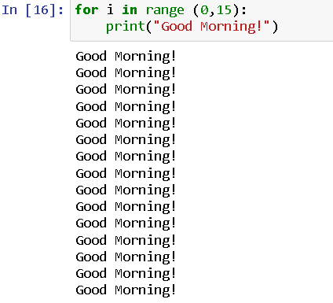
Why is it important
Fortunately, We have loops. Using a loop control statement, you simply tell the computer to display a string a hundred times without having to code the print statement a fifteen times, as follows:

Slide 6
Type of Loops
Python programming language provides following types of loops to handle looping requirements.
They are:
While Loop
For Loop
Nested Loop
Let's understand each of the loops mentioned above.

Slide 7
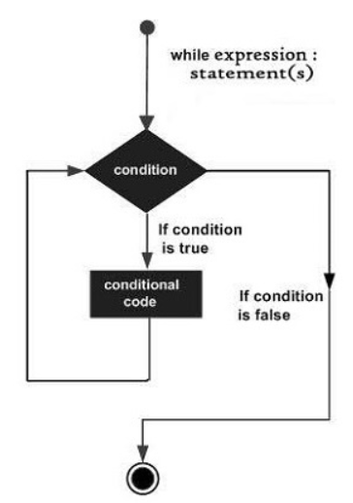
While Loop
A while loop statement in Python programming language repeatedly executes a block of statement as long as a given condition is true.
The syntax of a while loop in Python programming language is: while expression: statement(s)
Here, statement(s) may be a single statement or a block of statements. The expression may be any condition.
The loop iterates while the condition is true. When the condition becomes false, program control passes to the line immediately following the loop.

Slide 8
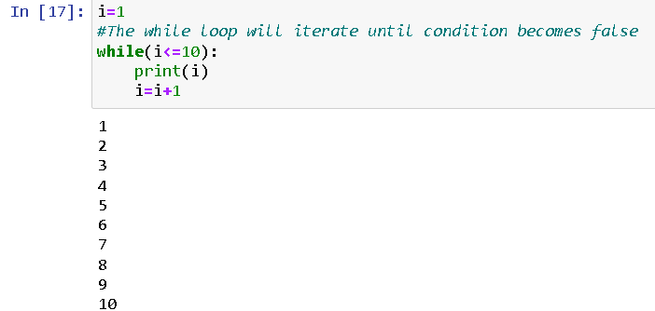
Example of While Loop
Program to print 1 to 10 using while loop

Slide 9
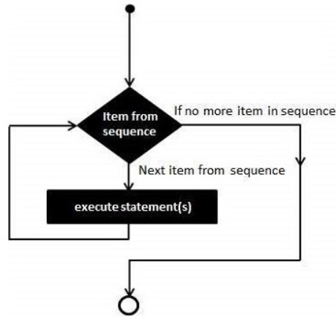
For Loops
A for loop is used for iterating over a sequence (that is either a range, a list, a tuple, a dictionary, a set, or a string)
The syntax of a for loop in Python is: for iterating_var in sequence: statement(s)
Here, the iterating_var can be either an iterable or a sequence item. If it is an index, we use the range() function instead of the sequence. Otherwise, we can mention the sequence.
For each item in sequence, the statements block will be executed until there are no item. After no items left in sequence the control will be transferred to code following the loop.

Slide 10
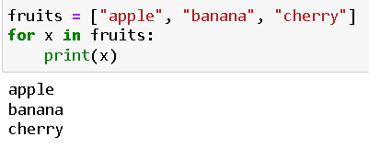
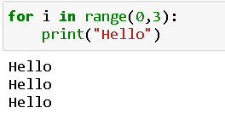
Example of for Loop
LIST: Program to print each fruit in a fruit list:
Range: Program to print “Hello” 3 times:

Slide 11
Nested Loops
A nested loop is a loop inside the body of a loop. It can be for loop inside a for loop or while inside a while loop. It can also be for inside a while loop and vice versa.
The syntax of a nested loop in Python programming language is:
for iterating_var1 in sequence1:
for iterating_var2 in sequence2:
statement(s)
while expression:
while expression:
statement(s)
statement(s)
For each iteration, the outer loop will executes once and the inner loop will executes till completion.
The nested loops can be understood by following examples:
Printing multiplication table of numbers (1 to 3)
Printing a matrix of 3 column and 2 rows

Slide 12
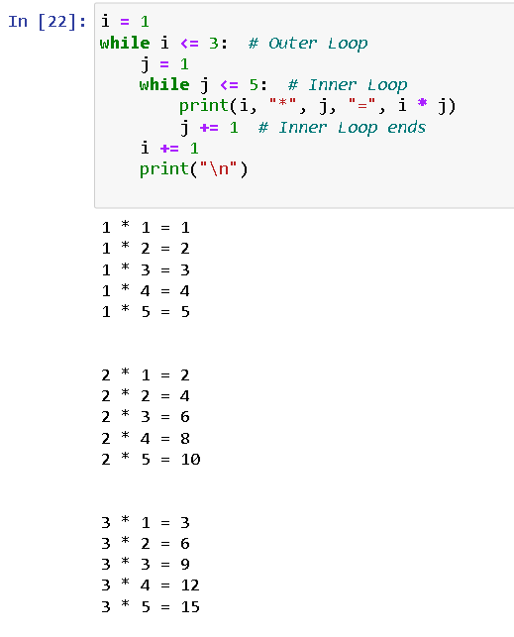
Example of Nested Loop
Printing multiplication table up to 5 of numbers (1 to 3)

Slide 13
Key Differences
Aspect | while Loop | for Loop
Use Case | When the number of iterations is not known | When the number of iterations is known
Condition | Mandatory – error if no condition is given | Can run infinitely if condition is not given
Structure | Initialization, condition check, and iteration written separately | Initialization, condition, and iteration often combined
Control Flexibility | More flexible, can handle complex conditions easily | Best for counters or iterating over sequences

Slide 14
Thank you.

