Slide 1
CS 1010: Introduction to Programming with Python Lec 07: Collections (Lists, Tuples, Dictionary)
Dr. Madhavi Vaidya
Instructor
Department of Electrical Engineering & Computer Sciences
Finessefleet Foundation, Bangalore
Ms. Syeda Faaiza Afreen (EE2502102) TA Department of EECS Finessefleet Foundation, Bangalore

Slide 2
Today, we’ll cover
Python Collection
List
Tuples
Dictionary

Slide 3
Python Collection
There are four collection data types in the Python programming language:
List is a collection which is ordered and changeable. Allows duplicate members.
Tuple is a collection which is ordered and unchangeable. Allows duplicate members.
Dictionary is a collection which is unordered, changeable and indexed. No duplicate members.

Slide 4
List Creation
A list is created by placing all the items (elements) inside a square bracket [], separated by commas.
It can have any number of items and they may be of different types (integer, float, string etc.).
Example:
list = [1, 2, 3] # list with same data-types list = [1, "Hello", 3.4] # list with mixed data-types

Slide 5
Access Items from List
It can be access in several ways
Use the index operator [] to access an item in a list. Index starts from 0. So, a list having 5 elements will have index from 0 to 4.
Example: list = ['p','r','o','b','e’]
print(list[2]) #Positive Indexing
print(list[-2]) #Negative Indexing

Slide 6
Slice List
Accessing a range of items in a list by using the slicing operator [] using (colon :).
Slicing can be best visualized by considering the index to be between the elements.
Example:
list = ['p','r','o','b','e’]
print(list[0:4]) #Positive
print(list[-2:-1]) # Negative

Slide 7
List Method
append() -Add an element to the end of the list.
count() -Returns the count of number of items passed as an argument.
extend() -Add all elements of a list to the another list.
index() -Returns the index of the first matched item.
insert() -Insert an item at the defined index.
pop() -Removes and returns an element at the given index.
copy() -Returns a shallow copy of the list
remove() -Removes an item from the list.
reverse() -Reverse the order of items in the list.
sort() -Sort items in a list in ascending order.

Slide 8
Tuples
It is a collection of object much like a list.
The main different between tuple and list is that tuples are immutable.
It represent as ().
Values of a tuple are syntactically separated by commas.
Tuple elements cannot be changes.

Slide 9
Creation Of Tuples
Tuple1() //empty tuple
Tuple2 = ('zooming', 'For') //tuple with
strings list1=[1, 2, 4, 5, 6]
Tuple = tuple (list1) //tuple with the use of list
3
Tuple = ('zooming',)* 3//tuple with repetition
4
Tuple = (5, 'Welcome’, 7, 'zooming') //tuple with
5 mixed datatypes

Slide 10

Concatenation of Tuples
Concatenation of tuple is the process of joining of two or more Tuples.
Concatenation is done by theuse of '+' operator.
Concatenation of tuples is done always from the end of the original tuple.
Other arithmetic operations do not apply on Tuples.
Concatenaton of tuples Tuple1 =(0, 1, 2, 3)
Tuple2 = ('Zooming', 'For', 'stud')
Tuple3 = Tuple1 + Tuple2
print("\nTuples after Concatenaton: ")
print(Tuple3)

Slide 11
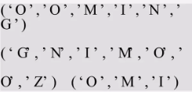
Slicing Of Tuples
#with Numbers
Tuple1 = tuple('ZOOMING')
#From First element
Print (Tuple1 [1:] )
#Reversing the Tuple
print(Tuple1[::-1])
#Printing elements of a Range
print(Tuple1 [2:5])

Slide 12
Deleting
#Deleting a Tuple
Tuple1 = (0, 1, 2, 3, 4)
del Tuple1
print(Tuple1)
NameError: name 'Tuple1' is not defined
Tuples are immutable and hence they do not allow deletion of a part of it.
Entire tuple gets deleted by the use of del() method.
Note- Printing of Tuple after deletion results to an Error.

Slide 13
Built-In-Methods in Tuples
Built-in Function | Description
all() | Returns True if all elements are True or if the tuple is empty
any() | Returns True if any element of the tuple is True; returns False if empty
len() | Returns the length (number of items) of the tuple
enumerate() | Returns an enumerate object of the tuple (index, value pairs)
max() | Returns the maximum element of the tuple
min() | Returns the minimum element of the tuple
sum() | Returns the sum of numeric elements in the tuple
sorted() | Returns a new sorted list from the tuple elements
tuple() | Converts an iterable to a tuple

Slide 14
Python Dictionary
Python dictionary is an unordered collection of items.
While other compound data types have only value as an element, a dictionary has a key: value pair.
Dictionaries are optimized to retrieve values when the key is known

Slide 15
Creation of Dictionary
Creating A Dictionary Is As Simple As Placing Items Inside Curly Braces {} Separated By Comma.
Each element in a dictionary is represented by a key:value pair.
While values can be of any data type and can repeat,
keys must be of immutable type and must be unique.

Slide 16
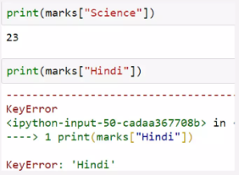
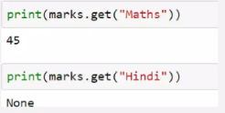
Accessing an elements from a Dictionary
While indexing is used with other container types to access values, dictionary uses keys.
Key can be used either inside square brackets or with the get() method.
The difference while using get() is that it reinstead of KeyError, if the key is not found.

Slide 17
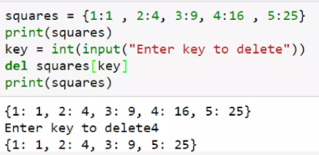
Deletion from a Dictionary
We can remove a particular item in a dictionary by using the method pop(). This method removes as item with the provided key and returns the value.
All the items can be removed at once using the clear() method.
We can also use the del keyword to remove individual items or the entire dictionary itself

Slide 18
Thank you.

