Slide 1
Project Group 23
Sankeerth Alookaran Jivan
Finley Sullivan
Haosong (Stu) Zhang
Zhi Cong Leon (Leon) Zhou

Slide 2
Research
Inspiration and Similar Websites

Slide 3

Used Car Sales
As a group we decided on a website for the sale of used cars.
For inspiration, we found the following sites:
https://www.trademe.co.nz/a/motors
https://www.turners.co.nz/Cars/
https://www.2cheapcars.co.nz/
https://www.needacar.co.nz/

Slide 4
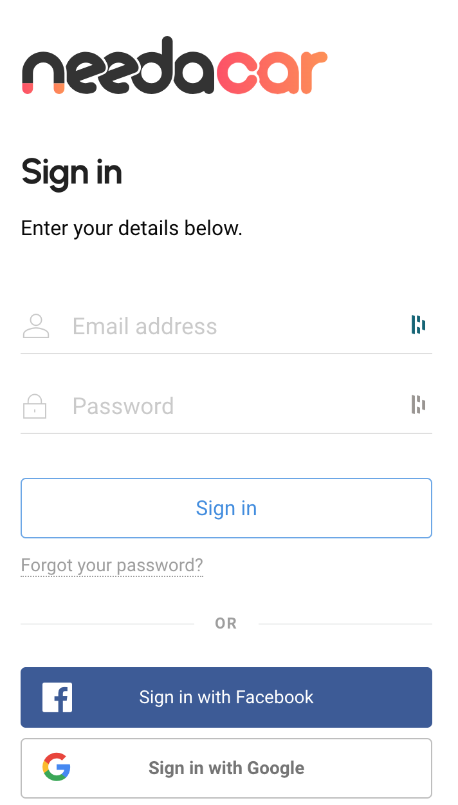
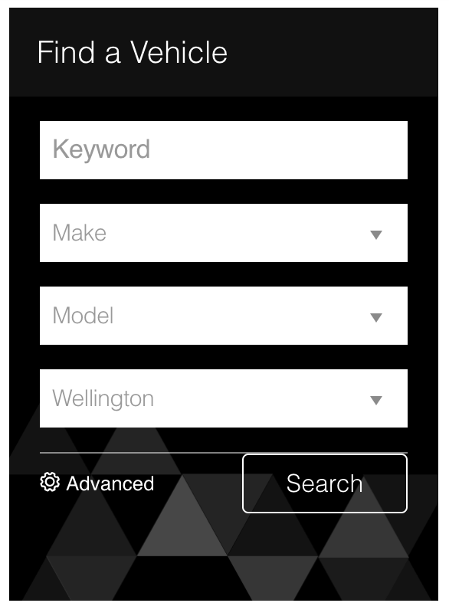
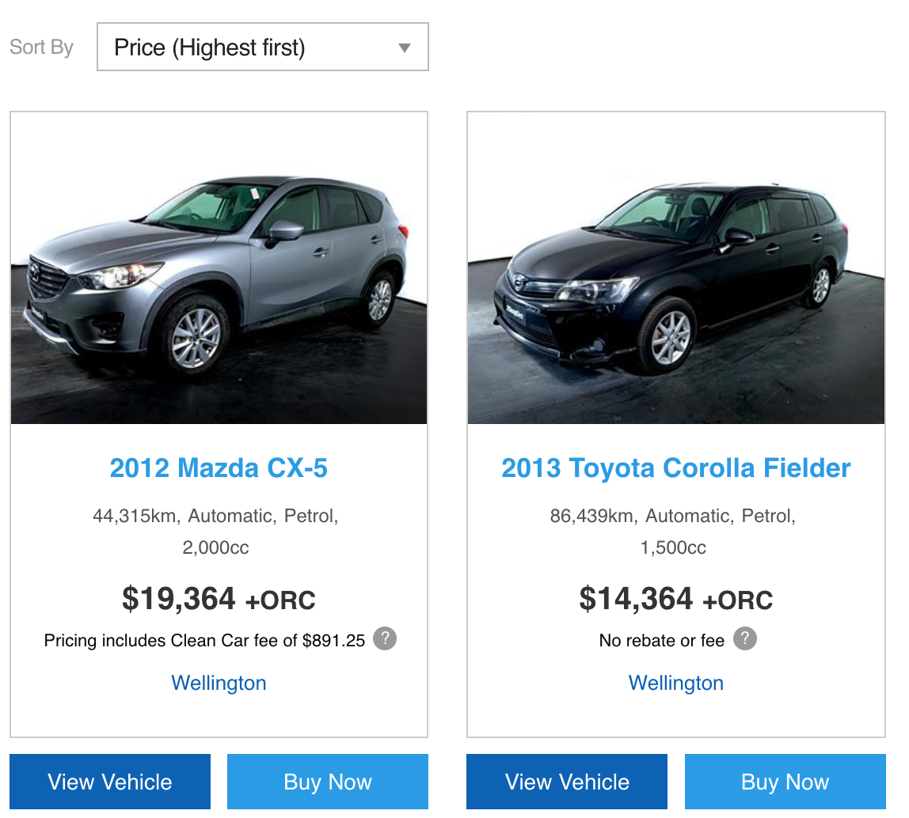
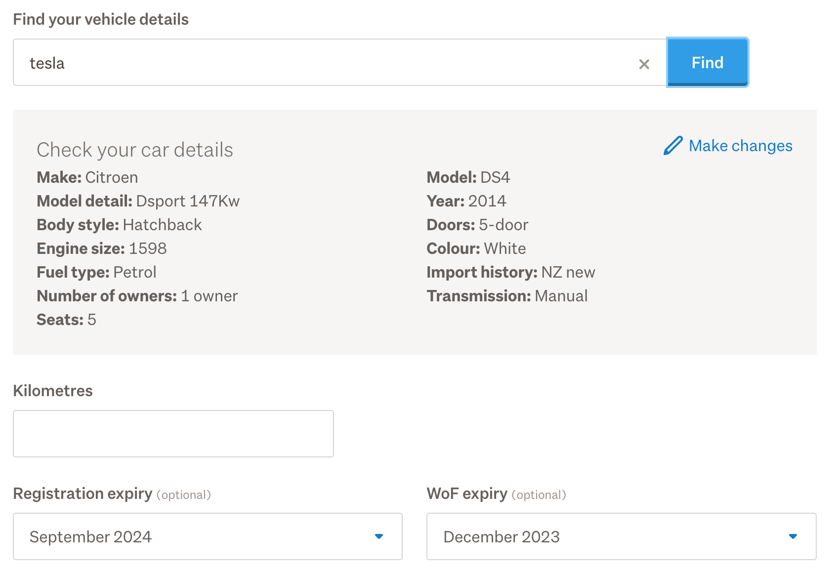
What Does the site need?
Browsing Option
Listing Used Cars
Login Function
Search Function

Slide 5
Our Workload

Slide 6
Group Work Division
Finley:
Sankeerth
Stu
Leon
Presentation and Research
Etc..
…
…
…

Slide 7
Current Progress Demonstration
https://gitlab.ecs.vuw.ac.nz/nwen304_group/trade-cars

